Slide 1
Embedding
Evaluation Methods

Slide 2
Problem
“How can you evaluate whether embeddings are ’good’ representations?”
Many methodologies do this through downstream performance evaluation
- This measures some degree of usefulness on a task, but not much else regarding intrinsic structure

Slide 3
Example -- Swin Transformer V2
Evaluation | What it would reveal | Established?
Recoverability of Features | Whether individual attributes are linearly/nonlinearly/etc. recoverable | No
k-NN Feature Consistency | Whether nearby embeddings share attributes | No
Feature Entropy Across Neighborhoods | How local feature diversity changes | No
Effective Dimensionality | How many dimensions carry substantial variation | No
Downstream Fine-Tuning | Whether the model can adapt to new tasks | Yes
Cross-Task Transfer | Whether representations are useful across applications | Yes

Slide 4
Example of closer to what we want -- DINOv2
Evaluation | What it would reveal | Established?
Recoverability of Features | Whether individual attributes are linearly/nonlinearly/etc. recoverable | Yes
k-NN Feature Consistency | Whether nearby embeddings share attributes | Yes
Feature Entropy Across Neighborhoods | How local feature diversity changes | Yes
Effective Dimensionality | How many dimensions carry substantial variation | No?
Downstream Fine-Tuning | Whether the model can adapt to new tasks | Yes
Cross-Task Transfer | Whether representations are useful across applications | Yes

Slide 5
Coarse Questions
An embedding represents an item as a numeric vector.
A feature is something you know about that item.
---
1. Geometry: “Are items with similar features close together?”
2. Recoverability: “Can a model predict the feature from the vectors on unseen items?”
3. Prediction Distortion: “Do inferred labels preserve the true feature structure, or merely make the map look cleaner?”

Slide 6
Source Statistics & Intrinsic Evaluation
Statistic | Meaning and Interpretation | Scalable?
Coverage | Fraction of items with usable observed values. | Yes.
Label Count & Prevalence | How many categories exist, & how frequently each occurs. These establish the denominator for enrichment. | O(N) work per feature; O(C) counters
Largest-Label Share | Shows if there is dominance of a common category. A large share can hide poor performance. | Yes.
Entropy | Diversity of label occurences. Greater entropy means less concentration. | Yes.
Normalized Entropy | Near 1: evenness among included non-zero labels | Yes.
Numeric Summaries | Mean, variance, quantiles, distributions, skew, extremes, etc... | Mostly yes. Median and quantiles can be expensive memory-wise

Slide 7
Source Statistics & Intrinsic Evaluation
Statistic | Meaning and Interpretation | Scalable?
Feature Cardinality & Cocurrence | Labels per item and counts of items occurring together. Reveals multilabel structure. | Possible. Scales poorly with large amounts of features per item
Spearman Correlation | Measures the strength and direction of a monotonic relationship between two variables. | Possible. Scales poorly with large amounts of features per item
Neighborhood Purity | Fraction of k nearest neighbors carrying the same feature. | ~O(Nk) operations Rough with large k
Lift | Concentration relative to prevalence. ~1: Approximately the concentration expected from prevalence >1: Enrichment: the segment concentrates in its own neighborhoods. <1: Depletion: its members tend to have neighbors from other segments. | After purity, this is cheap. Finding correct pop. prevalence and neighborhoods can be expensive

Slide 8
Source Statistics & Intrinsic Evaluation
Statistic | Meaning and Interpretation | Scalable?
Mean Neighbor Absolute Difference | Smaller differences suggest local smoothness | Yes -- O(NkF)
Local/global Variance Ratio | Smaller ratios indicate locally narrower values | Yes -- O(NkF)
Moran’s I | Positive Values: Neighboring deviations from the global mean tend to align. Negative Values: Indicates opposing deviations | Yes -- O(NkF)
Feature-feature Spearman | Rank associate of observed features Helps identify redundancy / confounding among features. | Meh. O(FNlog(N) + NF^2)
Distance-difference Spearman | When two embeddings are further apart, do observed features tend to differ? | Eh. Feasible O(PFlogP)
Classical distance Correlation | Stronger values suggest association | Expensive :( O(Fm^2)
F = Number of Features
m = Sample size | P = Number of sampled item pairs

Slide 9
“Extrinsic” Evaluation via Probes
An probe trains a model with embedding coordinates as inputs and an observed feature as its target, then evaluates on held-out items.
---
1. Linear/Logistic Regression or Ridge: Tests recoverability through a simple global relationship
Idea: Embeddings that expose source relationships well should expose them cleanly so that even simple models can identify
2. Additional (more expensive yet still basic) Models:
  KNN Prediction: Tests whether nearby training items have informative labels/values
  Random Forest: Tests a richer nonlinear relationship
Idea: It is rather optimistic to assume that all meaningful relationships can be exposed cleanly. So, having these probes permit “worse” or “looser” representations of features in embeddings, but they risk losing any meaningful interpretation if they struggle to re-identify features.
  Reminder: The pipeline to create embeddings should be where core features / relationships should be exposed first. These probes are NOT to train a model. They are to evaluate.

Slide 10
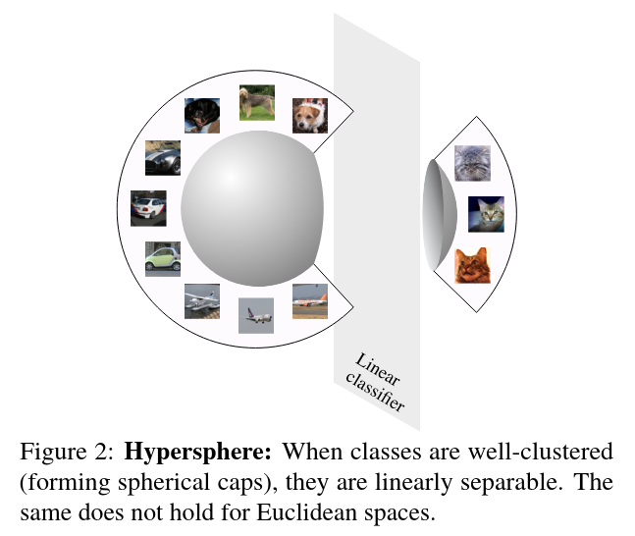
Should Features be Linearly Separable?
Not necessarily, but it is extremely convenient.
This is recognized in ML especially bc it improves training stability where dot products are ubiquitous
This is often achieved by constraining the output to the unit hypersphere
(L2 norm constraint)
Cons:
-- Removes magnitude
-- Mitigated if sufficiently complex
-- d-1 dimensions
-- Constraints ideal to be considering during (contrastive) model learning
Wang, Tongzhou, and Phillip Isola. Understanding Contrastive Representation Learning through Alignment and Uniformity on the Hypersphere. n.d.

Slide 11
Extrinsic Prediction Metrics
Metric | Meaning and Interpretation
Accuracy | Fraction of correct labels; can look good under severe imbalance
Balanced Accuracy | Mean recall across observed classes; exposes classes missed by a majority predictor
Precision / Recall / F1 | Precision measures correctness of positive predictions Recall measures recovery of true positives F1 balances the two
AUROC | Ranking quality across positive / negative examples 0.5 is random ranking.
Average Precision (AP) | Summarizes precision-recall over score thresholds
Multilabel Subset Accuracy | Requires the entire predicted label set to match; stricter than per-label scores
R² | Relative squared-error performance: 1 is perfect, 0 matches the test-set-mean baseline, negative is worse. Constant targets are degenerate.
MAE | Mean absolute prediction error in original units; smaller is better.
Prediction Spearman | Agreement of predicted and true rankings; high rank agreement does not guarantee calibrated magnitudes

