Slide 1

iCellular: Device-Customized Cellular Network Access on Commodity Smartphones
Yuanjie Li¹, Haotian Deng², Chunyi Peng², Zengwen Yuan¹, Guan-Hua Tu¹, Jiayao Li¹, Songwu Lu¹
¹ University of California, Los Angeles
² The Ohio State University

Slide 2







User Demands for High-Quality Cellular Access
“We want high-quality cellular network service anytime, anywhere”
No single carrier network can always satisfy these demands
Home
Campus
2

Slide 3
An Alternative Approach: Multi-Carrier Access
Let the end devices access multiple carriers and choose the best one
Emerging efforts: Google Project Fi, Apple SIM, Samsung e-SIM, etc.
Home
Campus
3

Slide 4

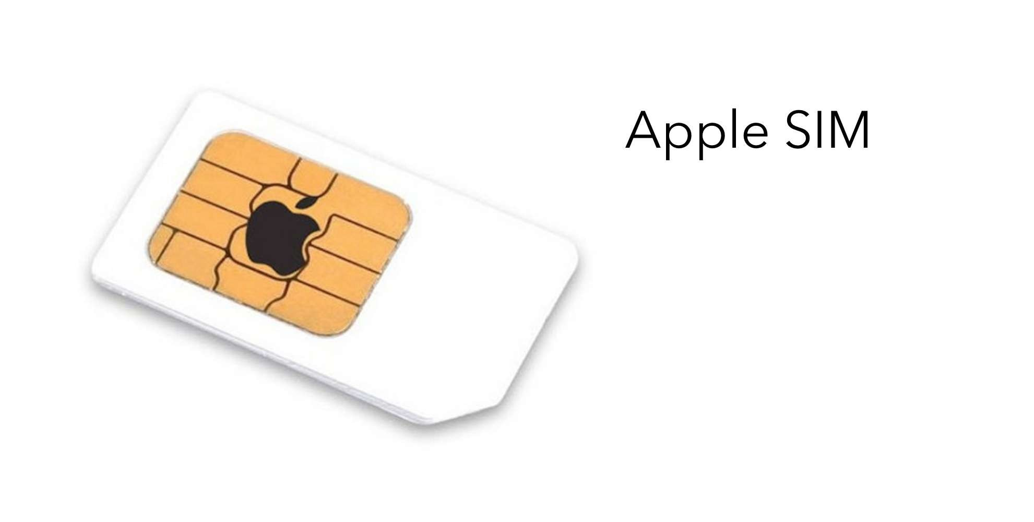

An Alternative Approach: Multi-Carrier Access
Let the end devices access multiple carriers and choose the best one
Emerging efforts: Google Project Fi, Apple SIM, Samsung e-SIM, etc.
Home Campus
4

Slide 5
How PLMN selection works
Network selection is defined by the network itself, not the user!
Passively monitors other carriers after losing home carrier service.
Selects the carrier based on pre-defined roaming preference given by the serving carrier network.
Preference given to it’s own network.
Good for single carrier, not good for multi carrier.
Notes:
PLMN selection process
4.4.1 Introduction
There are two mandatory modes for PLMN selection, automatic and manual. These are described in subclauses 4.4.3 below and illustrated in figures 2a to 2b. Other PLMN (re)selection modes are not prohibited and an optional third PLMN reselection technique is also described in section 4.4.3.2.
4.4.2 Registration on a PLMN
The MS shall perform registration on the PLMN if the MS is capable of services which require registration. In both automatic and manual modes, the concept of registration on a PLMN is used. An MS successfully registers on a PLMN if:
a) The MS has found a suitable cell of the PLMN to camp on; and
b) An LR request from the MS has been accepted in the registration area of the cell on which the MS is camped (see table 1).
It should be noted that if registration is unsuccessful because no suitable cell could be found, the MS will have had to search at least the number, given in subclause 3.2.1, of the strongest RF channels (see subclause 3.2) and therefore all the available PLMNs will potentially have been detected. If registration is unsuccessful because of an LR failure or an LR rejection, the MS need not necessarily have already searched the number, given in subclause 3.2.1, of the strongest RF channels, and would need to do so before being in a position to display to the user all available PLMNs (see below).
4.4.3 PLMN selection
The registration on the selected PLMN and the location registration are only necessary if the MS is capable of services which require registration. Otherwise, the PLMN selection procedures are performed without registration.
4.4.3.1 At switch‑on or recovery from lack of coverage
At switch on, the MS selects and attempts to perform a Location Registration on the registered PLMN, if it exists. On recovery from lack of coverage, the MS selects the registered PLMN (if it exists) and, if necessary (see subclause 4.6.2) attempts to perform a Location Registration.
If successful registration is achieved, the MS indicates the selected PLMN.
If there is no registered PLMN, or if registration is not possible due to the PLMN being unavailable or registration failure, the MS follows one of the following two procedures depending on its operating mode.
A) Automatic Network Selection Mode Procedure
The MS selects and attempts registration on other PLMNs, if available and allowable, in all of its bands of operation in the following order:
i) HPLMN (if not previously selected);
ii) each PLMN in the "PLMN Selector" data field in the SIM (in priority order);
iii) other PLMNs with received signal level above ‑85 dBm in random order;
iv) all other PLMNs in order of decreasing signal strength.
If successful registration is achieved, the MS indicates the selected PLMN.
If registration cannot be achieved because no PLMNs are available and allowable, the MS indicates "no service" to the user, waits until a new PLMN is available and allowable and then repeats the procedure. If there were one or more PLMNs which were available and allowable, but an LR failure made registration on those PLMNs unsuccessful or an entry in a forbidden LAI list prevented a registration attempt, the MS selects the first such PLMN again and enters a limited service state.
B) Manual Network Selection Mode Procedure
The MS indicates whether there are any PLMNs, in all of its bands of operation, which are available. This includes "Forbidden PLMNs". Any PLMN shall only be presented once.
If displayed, PLMNs meeting the criteria above are presented in the following order:
i) HPLMN;
ii) PLMNs contained in the "PLMN Selector" data field in the SIM (in priority order);
iii) other PLMNs with received signal level above ‑85 dBm in random order;
iv) all other PLMNs in order of decreasing signal strength.
The user may select his desired PLMN and the MS then initiates registration on this PLMN. (This may take place at any time during the presentation of PLMNs). For such a registration, the MS shall ignore the contents of the forbidden LAI and PLMN lists.
If the user does not select a PLMN, the selected PLMN shall be the one that was selected before the PLMN selection procedure started. If no such PLMN was selected or that PLMN is no longer available, then the MS shall attempt to camp on any acceptable cell and enter the limited service state.
4.4.3.2 User reselection
At any time the user may request the MS to initiate reselection and registration onto an available PLMN, according to the following procedures, dependent upon the operating mode.
A) Automatic Network Selection Mode
The MS selects and attempts registration on PLMNs, if available and allowable, in all of its bands of operation in accordance with the following order:
i) HPLMN;
ii) PLMNs contained in the "PLMN Selector" data field in the SIM (in priority order) excluding the previously selected PLMN;
iii) Other PLMNs with the received signal level above ‑85 dBm in random order excluding the previously selected PLMN;
iv) Any other PLMNs, excluding the previously selected PLMN in order of decreasing signal strength or, alternatively, the previously selected PLMN may be chosen ignoring its signal strength;
v) The previously selected PLMN.
The previously selected PLMN is the PLMN which the MS has selected prior to the start of the user reselection procedure
B) Manual Network Selection Mode
The Manual Network Selection Mode Procedure of subclause 4.4.3.1 is followed.
C) Service Based Manual Selection of Network with Reversion to Previous Network Selection Mode
The MS indicates whether there are any PLMNs, in all of its bands of operation, which are available. This includes "Forbidden PLMNs". Any PLMN shall only be presented once.
If displayed, PLMNs meeting the criteria above are presented in the following order:
i) HPLMN;
ii) PLMNs contained in the "PLMN Selector" data field in the SIM (in priority order);
iii) other PLMNs with received signal level above ‑85 dBm in random order;
iv) all other PLMNs in order of decreasing signal strength.
Along with the PLMN identification, the MS provides appropriate indications of relevant services, eg GPRS, which have their support broadcast by the cell(s) of that PLMN.
The user may select his desired PLMN and the MS then initiates registration on this PLMN. (This may take place at any time during the presentation of PLMNs). For such a registration, the MS shall ignore the contents of the forbidden LAI and PLMN lists.
Following a successful registration, the mobile station shall revert to the previous network selection mode (either automatic or manual).
If the user does not select a PLMN, the selected PLMN shall be the one that was selected before the PLMN selection procedure started. If no such PLMN was selected or that PLMN is no longer available, then the MS shall attempt to camp on any acceptable cell and enter the limited service state.
4.4.3.3 In VPLMN of home country
The MS shall periodically attempt to obtain service on its HPLMN. For this purpose, a value T minutes may be stored in the SIM, T is either in the range 6 minutes to 8 hours in 6 minute steps or it indicates that no periodic attempts shall be made. If no value is stored in the SIM, a default value of 30 minutes is used.
The attempts to access the HPLMN shall be as specified below:
a) The periodic attempts shall only be performed in automatic mode when the MS is roaming in its home country;
b) After switch on, a period of at least 2 minutes and at most T minutes shall elapse before the first attempt is made;
c) The MS shall make an attempt if the MS is on the VPLMN at time T after the last attempt;
d) Periodic attempts shall only be performed by the MS while in idle mode;
e) If the HPLMN is not found, the MS shall remain on the VPLMN.
4.4.4 Abnormal cases
If there is no SIM in the MS, if there is an authentication failure, or if the MS receives an "IMSI unknown in HLR", "illegal ME" or "illegal MS" response to an LR request, then effectively there is no selected PLMN ("No SIM" state). In these cases, the states of the cell selection process are such that no PLMN selection information is used. No further attempts at registration on any PLMN are made until the MS is switched off and on again, or a SIM is inserted.
When in Automatic Network Selection mode and the MS is in the "not updated" state with one or more suitable cells to camp on; then after 4 unsuccessful LR requests the MS may continue (or start if it is not running) the user reselection procedure of 4.4.3.2 A.
4.4.5 Roaming not allowed in this LA
If in either PLMN selection mode the LR response "Roaming not allowed in this LA" is received:
The PLMN Automatic or Manual Mode Selection Procedure of subclause 4.4.3.1 are followed, depending on whether the MS is in automatic or manual mode. (This requirement applies to all MSs.)

Slide 6
Desired Features for Multi-Carrier Access
#1: Switch when expected
#2: Make a wise decision
#3: Fast and seamless switch
Example:
Will my phone switch to T-Mobile when it is better than Sprint?
Example:
Will my phone select T- Mobile 4G or Sprint 3G?
Example:
Will my phone quickly switch to Sprint 4G with minimal data disruption?
6

Slide 7
Outline
Multi-carrier access today: three issues
Root cause analysis
iCellular design
Evaluation
7

Slide 8
Google Fi Evaluation
Use Nexus 6 with Fi SIM card that connects to T-Mobile and Sprint
Carry other accompanying phones to record the radio signal strength of each access option (T-4G, T-3G, S-4G, S-3G).
8

Slide 9
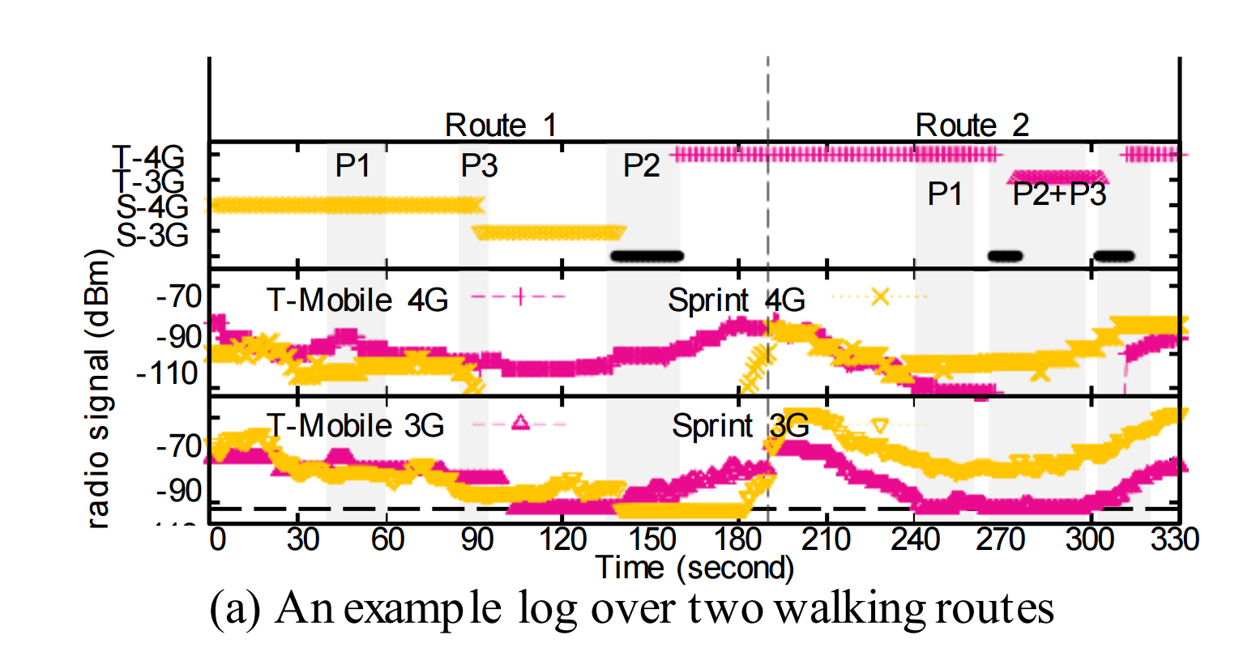
Measurements
9

Slide 10




Multi-Carrier Access Primer
Rich coverage at each location (3G/4G, multi-carriers)
Inter-carrier switch: monitoring à selection à switch
Selection: to Sprint
Monitoring networks…
10

Slide 11
Issue 1: Passive Monitor Misses Better Network
#1: Switch when expected
#2: Make a wise decision
#3: Fast and seamless switch
11

Slide 12
Issue 1: Passive Monitor Misses Better Network
Monitoring is triggered when the serving carrier network fails
Optimized for single-carrier access: roaming to other carriers was not preferred
#1: Switch when expected
#2: Make a wise decision
#3: Fast and seamless switch
No monitoring
12

Slide 13
Issue 2: Unwise Network Selection
#1: Switch when expected
#2: Make a wise decision
#3: Fast and seamless switch
10

Slide 14
Issue 2: Unwise Network Selection
Intra-carrier handoff is still preferred, although other carriers are better
Serving carrier network affects the mobility decision
#1: Switch when expected
#2: Make a wise decision
#3: Fast and seamless switch
to Sprint 3G

Slide 15
Issue 3: Long Switch Time and Service Disruption
#1: Switch when expected
#2: Make a wise decision
#3: Fast and seamless switch

Slide 16
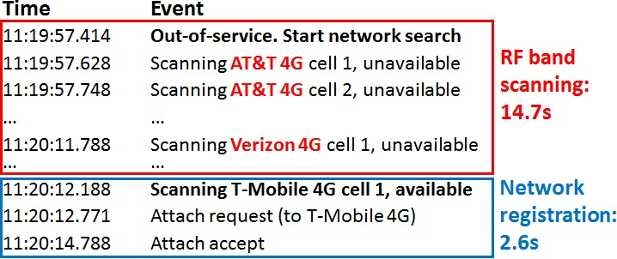
Issue 3: Long Switch Time and Service Disruption
Exhaustive search for all possible carrier networks
#1: Switch when expected
#2: Make a wise decision
#3: Fast and seamless switch
Monitoring networks…

Slide 17
Reality of Multi-Carrier Access
#1: Switch when expected
#2: Make a wise decision
#3: Fast and seamless switch

Slide 18
Reality of Multi-Carrier Access
P1:
Passive monitor
P2:
Unwise selection
P3:
Long switch and disruption
Can we solve these problems
without changing 3G/4G design?
Empower the end device with low-level cellular info!

Slide 19
iCellular Overview
P1:
Passive monitor
P2:
Unwise selection
P3:
Long switch and disruption
Intelligent selection
Active monitor
Direct switch
12

Slide 20
iCellular Architecture
A in-phone software service
Leverage low-level mechanism and info
Runtime cellular info (knowing more for a wiser decision)
Ability for adaptation in existing mechanisms (action ready now)
Intelligent selection
Diagnostic port
Active monitor
SW
Direct switch
HW
Cellular interface

Slide 21
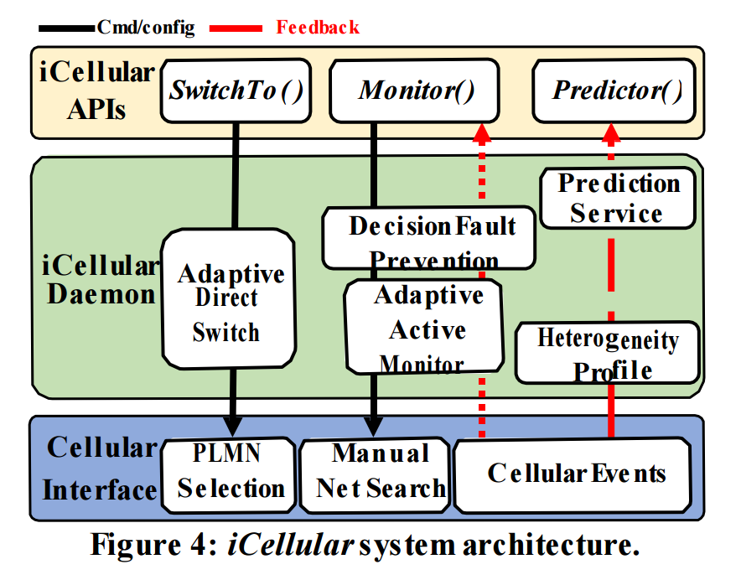
iCellular Architecture

Slide 22
Active Monitor
Goal: proactively detect other available carrier networks
Mechanism: manual network search
Challenge: searching other carriers may disrupt data service!
Monitoring networks…
Downlink data
Active monitor
Intelligent selection
Direct switch
18

Slide 23
Active Monitor
Key insight: data reception is regulated by paging cycle
Schedule the manual network search with low-level cellular feedback
Monitoring networks…
Phone state
On
No data
Active monitor
Intelligent selection
Direct switch
Off
Time
Paging cycle
19

Slide 24
Intelligent Selection
Without registration, data performance cannot be measured …
Better signal strength ≠ Faster speed!
Heterogeneous carrier networks
Is T-Mobile 4G faster?
 | RSS
T-4G | -95dBm
S-4G | -100dBm
Downlink Speed (Mbps)
10
?
5
T-4G
Active
monitor
Intelligent selection
Direct
switch
0
S-4G

Slide 25
Intelligent Selection with Prediction
Collect each carrier network’s profile: QoS + radio parameters
Predict carrier performance with radio measurements + cellular profile
 | RSS | QoS class
T-4G | -95dBm | Background
S-4G | -100dBm | Interactive
Is T-Mobile 4G faster?
Downlink Speed (Mbps)
10
5
Active
monitor
Intelligent selection
Direct
switch
0
T-4G
S-4G

Slide 26
Decision Faults Prevention
Conflicts with network-side mobility rules
Intra-carrier handoff
To T-Mobile 4G
Active
monitor
Intelligent selection
Direct
switch
22

Slide 27
Decision Faults Prevention
Conflicts with network-side mobility rules
Safeguard device selection by predicting decision faults
 | Intra-carrier handoff profile
T-4G | Handoff to 3G if RSS_{T-4G}<- 120dm, and RSS_{T-3G}>-90dBm
T-Mobile 4G unreachable
 | RSS
T-4G | -123dBm
T-3G | -85dBm
T-4GàT-3G handoff
Active
monitor
Intelligent selection
Direct
switch
would be triggered!
23

Slide 28
Adaptive Direct Switch
Goal: minimize switch time and service disruption
Key insight: most switch time is spent on exhaustive search
Solution: cross-layer adaptation for PLMN preference
Monitoring networks…
Active
monitor
Intelligent
selection
Direct
switch
24

Slide 29
Implementation
In-phone daemon service on Nexus 6/6P
Leverage Project Fi SIM card for multi-carrier access
Built-in strategies for better usability
Selection strategies (prediction-based, radio-only, etc.)
Active monitor
SW
Predictor Direct switch
Diagnostic port
HW
Cellular interface

Slide 30
Evaluation Setup
Comparison between iCellular and Project Fi
Pedestrian mobility and static experiments at campus
Four representative applications:
Bulk file transfer: SpeedTest
Web: Firefox
Video streaming: Youtube
VoIP: Skype

Slide 31
Data Performance Improvement
Downlink speed increment: 23.8% on average, 3.74x at maximum
Video suspension reduction: 37% on average, 6.9x at maximum
VoIP latency reduction: 60.4% on average, 1.9x at maximum
Web loading time reduction: 7.3% on average, 46.5% at maximum

Slide 32
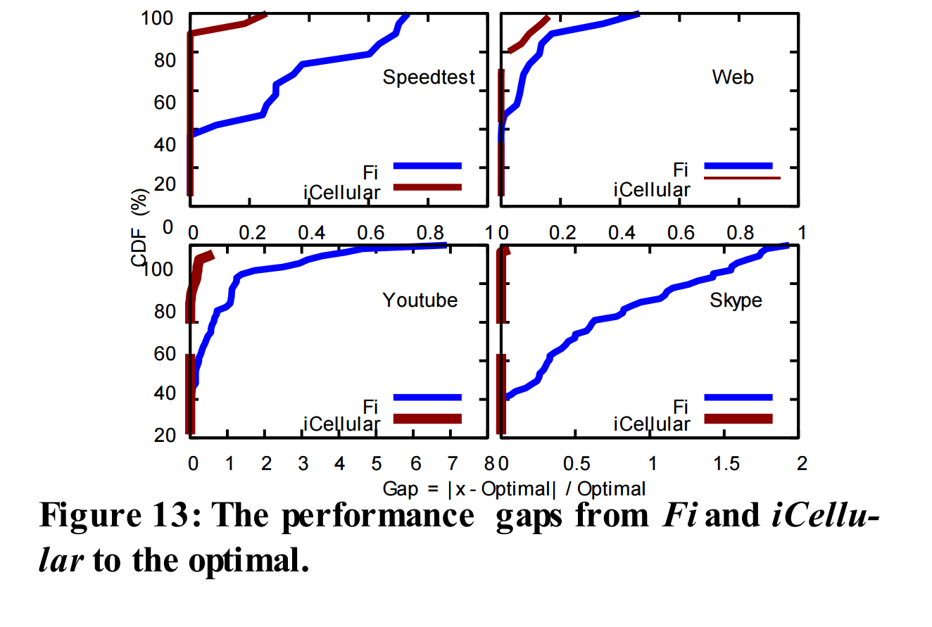
Data Performance Improvement

Slide 33



Inter-carrier Switch Time Reduction
Average saving: 37.7s à 8.8s (76% reduction)
Further improvement is possible with better SIM implementation
Time
Event
16:40:36.756
16:40:36.890
16:40:36.892
…
Deregister from Sprint 4G _{SIM card}
Invalidate SIM data request Reconfiguring SIM card…
…
Reconfig: 6.4s
16:40:43.100
SIM card configuration done
16:40:44.501
16:40:44.709
16:40:45.471
Scanning T-Mobile 4G cell 1, available
Attach request (to T-Mobile 4G)
Attach accept
Network registration: 2.3s

Slide 34


iCellular’s Overhead
Signaling overhead: 32 msg/s at maximum
CPU/Memory: below 2%/16.5MB
Energy consumption: 4.75% battery usage in 24-hr normal usage test
Comparable to normal mobile apps: e.g., 4.54% for Skype in same test
5
4
3
2
1
0
CPU Usage (%
0
300 600 900 120
Time (s)

Slide 35
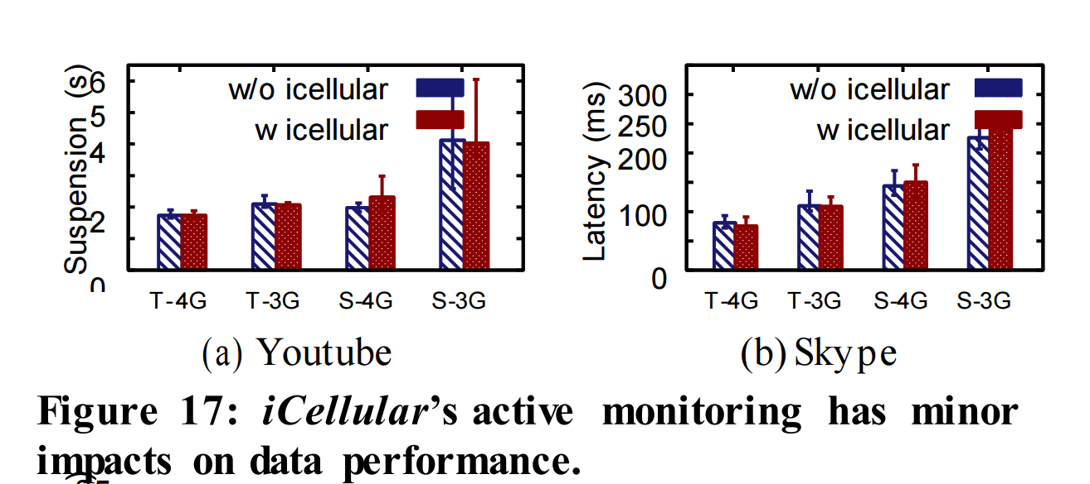
iCellular’s Overhead
Low overhead!

Slide 36
What About a Clean-Slate Design?
What would be nice to have in 5G?
Simultaneous access to multiple carriers
Enhanced cellular access abstractions

Slide 37
Conclusion
Multi-carrier access is promising, but its full benefits are constrained
Legacy 3G/4G was designed for single-carrier access
The end device can take a more active role in multi-carrier access
Leveraging runtime cellular information is an alternative dimension to enhance device-side inter-carrier switch

Slide 38
Thank you!
Source : Most content is heavily sourced from the author’s presentation

