Slide 1

NotRealCorp
Quarterly financial planning meeting, Q3 2023

Slide 2
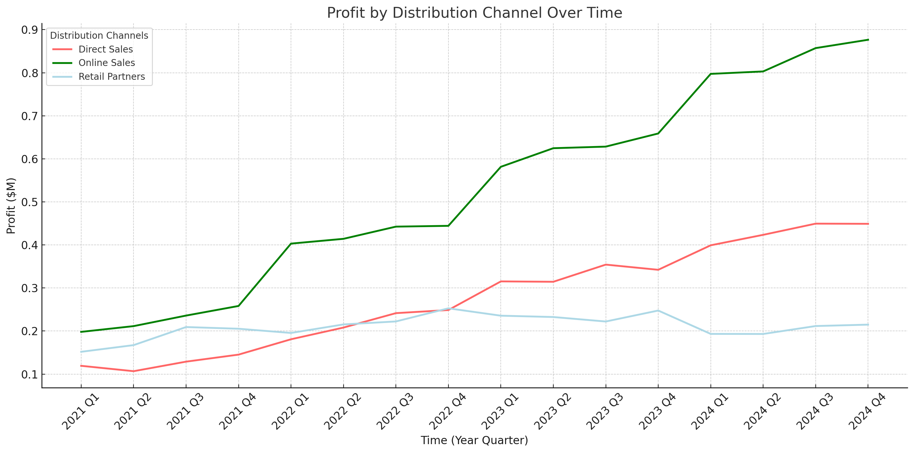
Ascending Profits & Digital Dominance
Key Insights:
• The plot reveals a consistent upward trend in profits for all distribution channels, indicating successful business growth over time. • Particularly, 'Online Sales' shows a notable increase, underscoring the importance of digital presence in revenue generation.

