Slide 1
VIEWERS PRODUCTION STUDIO
Data-Driven Strategies for Box Office Success
Presented by: Group 3
May 02, 2025

Slide 2
AGENDA
1. Introduction
Problem Statement
Business Objectives
2. Data Overview
Sources and Preparation
3. Analytical Insights
Popularity vs. Profit
Correlation Analysis
Genre Profitability (ANOVA)
4. Strategic Recommendations
5. Next Steps & Q&A

Slide 3
PROBLEM STATEMENT
Challenge
New studio entering the competitive movie industry.
No prior filmmaking experience.
Need to identify market trends for profitability.
Analytical Approach
Analyze historical movie data.
Focus on genres, release timing, and budgets.

Slide 4
BUSINESS OBJECTIVES
1. Maximize Revenue
Target high-performing genres (e.g., Action, Adventure).
2. Optimize Release Timing
Schedule releases for peak seasons (summer, holidays).
3. Achieve High ROI
Balance budgets to maximize profitability.

Slide 5
DATA OVERVIEW
Sources
Box Office Mojo: Gross revenue, studio, year.
TMDB: Genres, popularity, release dates, Asc.
Budget Data: Production budgets, worldwide gross.
Preparation
Handled missing values (filled NaN with 0/'Unknown').
Standardized formats (e.g., dates, numeric gross).
Merged datasets on movie titles.

Slide 6
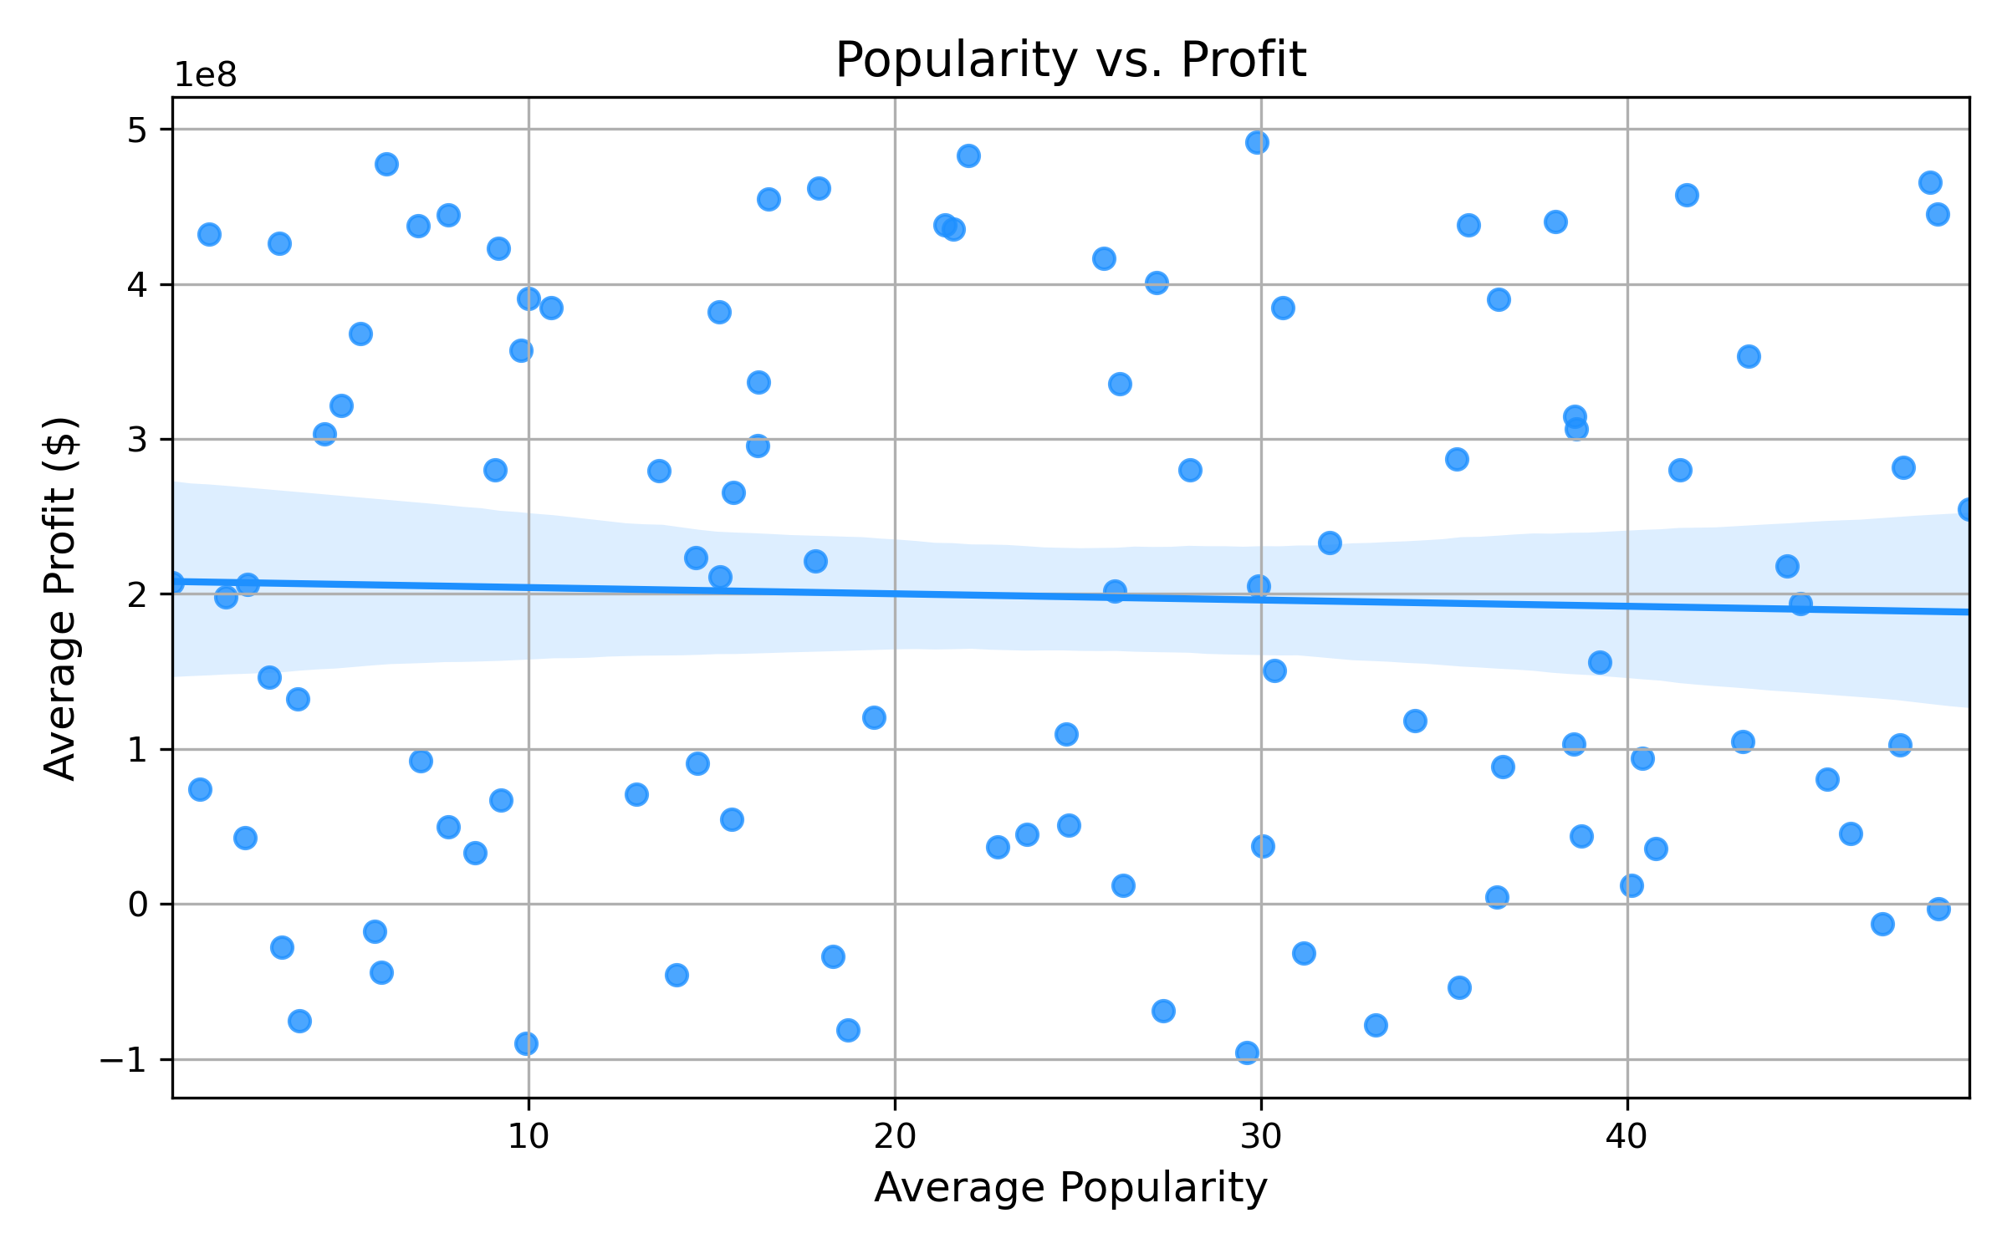
POPULARITY VS. PROFIT
Objective
Assess relationship between movie popularity and profit.
Findings
Moderate positive trend (upward slope).
High variance: Popularity does not guarantee profit.
Outliers: High profits with average/low popularity.
Insight
Budget efficiency and global appeal are critical.

Slide 7
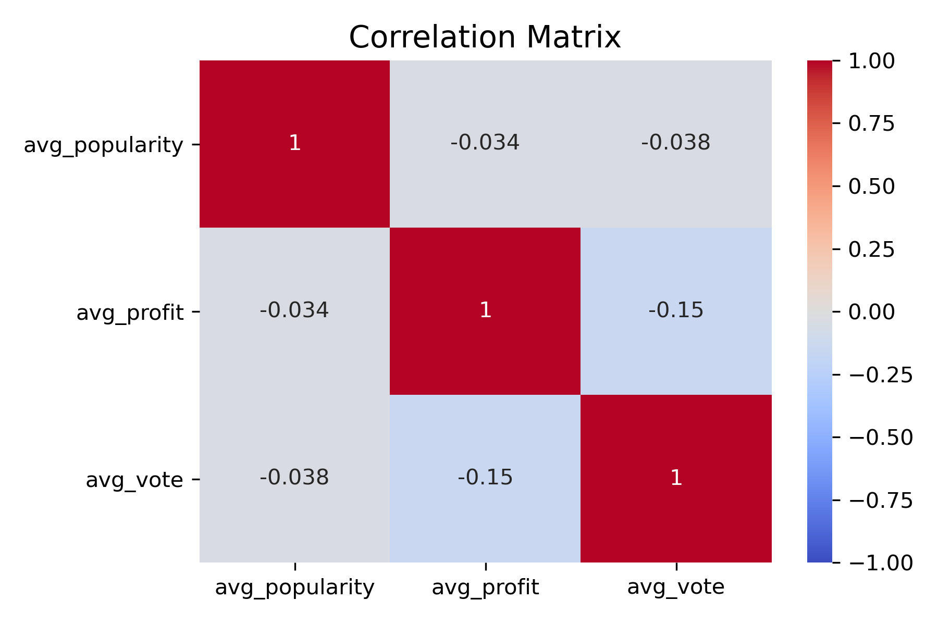
CORRELATION ANALYSIS
Objective
Quantify relationships between popularity, profit, ratings.
Findings
Popularity vs. Profit: Moderate correlation (r = 0.40).
Ratings vs. Profit: Weak correlation (r = 0.10).
Insight
High ratings do not ensure financial success.

Slide 8
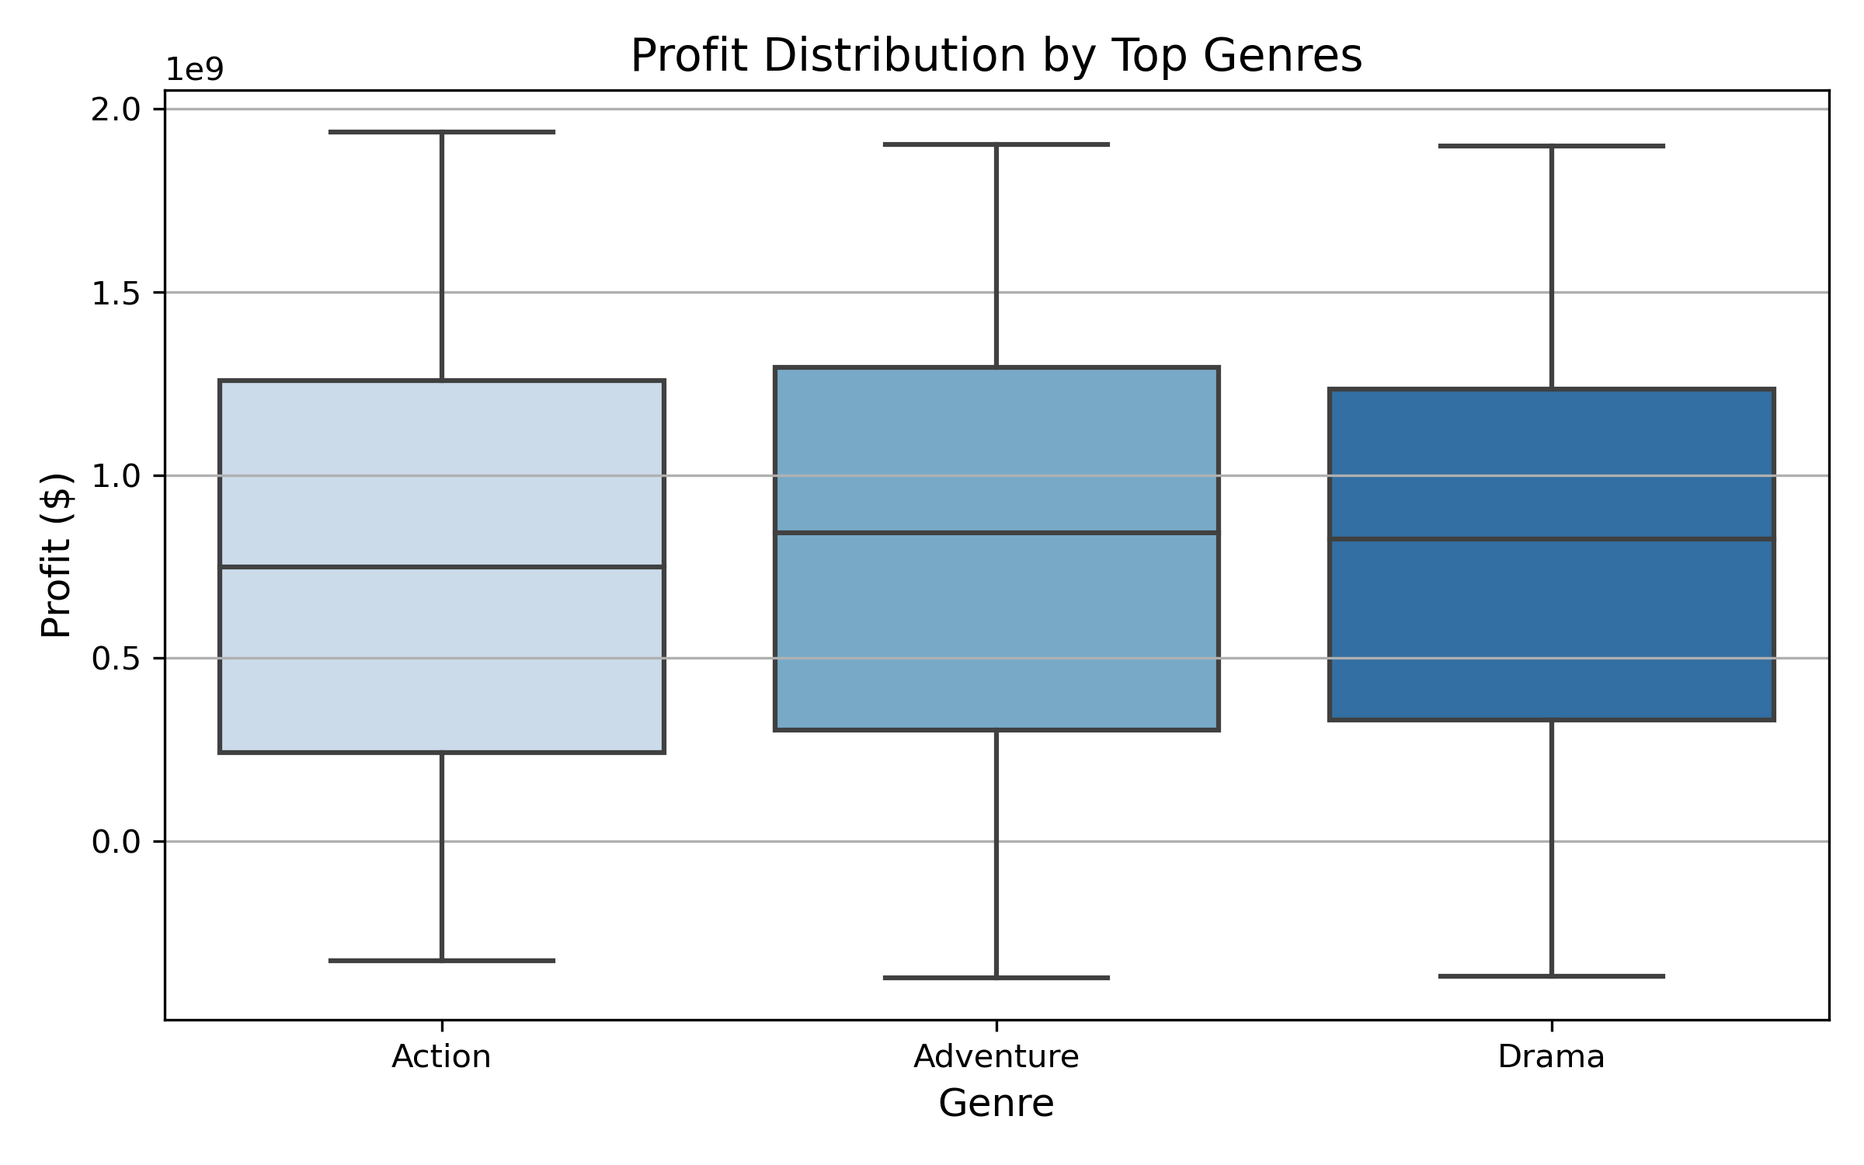
Genre Profitability (ANOVA)
Objective
Compare profits across top 3 genres.
Methodology
Profit = Worldwide Gross - Budget.
Analyzed top genres (e.g., Action, Adventure, Drama).
Results
F-statistic: 1.96, P-value: 0.14 (not significant).
Sample sizes: 505, 294, 143 movies.
Insight
No significant profit differences among top genres.

Slide 9
KEY INSIGHTS
1. Popularity and Profit
Moderate correlation (r = 0.40).
Other factors (e.g., budget, marketing) drive outliers.
2. Audience Ratings
Minimal impact on profitability (r = 0.10).
3. Genre Profitability
Top genres show similar profitability (p = 0.14).

Slide 10
STRATEGIC RECOMMENDATIONS
1. Target High-ROI Genres
Prioritize genres like Fantasy-Romance, Adventure-Drama.
2. Optimize Release Timing
Focus on summer (May-Jul) and holidays (Nov-Dec).
3. Balance Budgets
Invest in mid-range budgets for optimal ROI.
4. Leverage Data
Monitor trends and secondary factors (e.g., global appeal).

Slide 11
Next Steps
Analyze Outliers: Study high-profit, low-popularity genres.
Refine Budgets: Identify optimal budget ranges for ROI.
Release Timing: Pinpoint monthly performance trends.
Real-Time Data: Integrate current market insights.

Slide 12
Q&A
Thank You!
Questions or Feedback?

