Slide 1

DATA SCIENCE CAPSTONE PROJECT
Early Dysgraphia
Screening from
Handwriting
Using deep learning to flag children who may benefit from further dysgraphia assessment.
CRISP-DM • END-TO-END PROJECT
GROUP 8
Samson Sheiunda • Lucy Wainoga • Emmanuel Gunga
Eric Kisu • Dax Kariuki • Ahmed Noor
Early Dysgraphia Screening • CRISP-DM
1

Slide 2
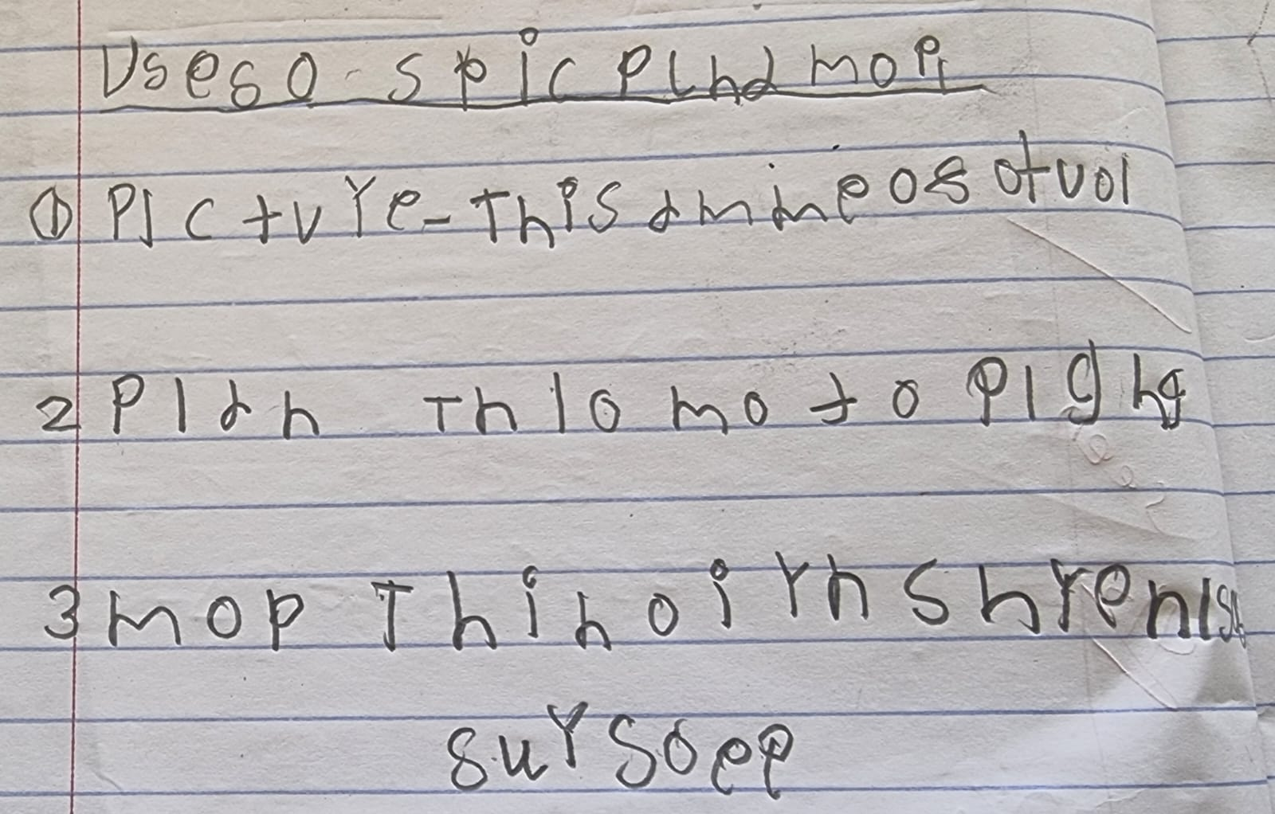
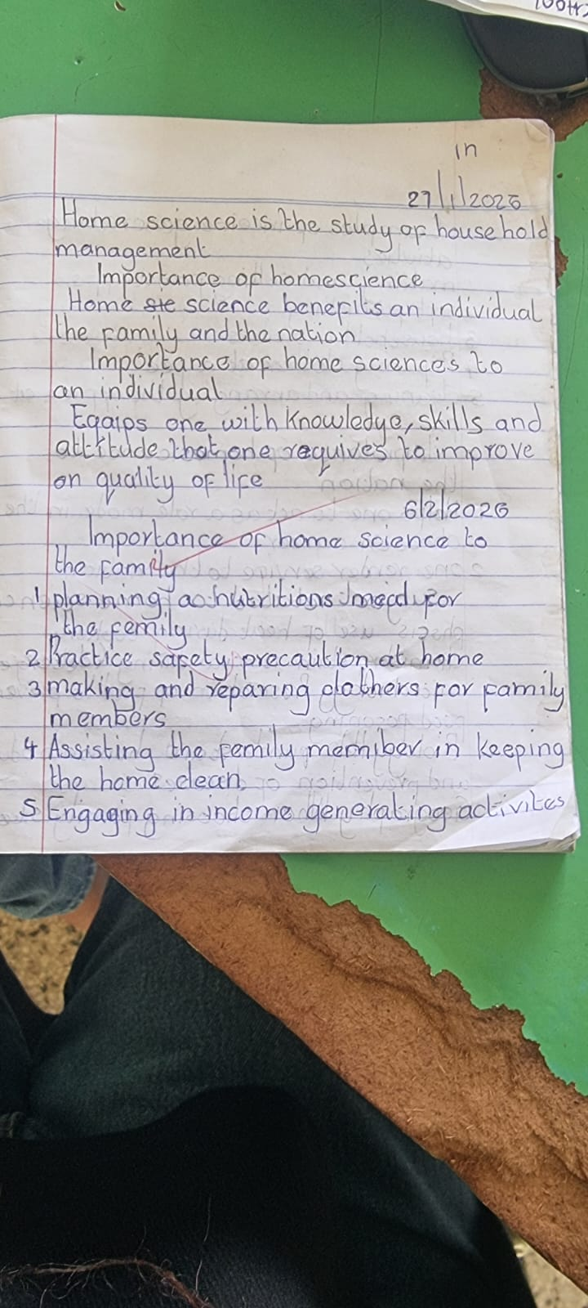
Why this matters
The problem in one view.
5–20%
2–3
estimated share of school-age children showing signs
students in a typical 25–30 pupil classroom
Dysgraphia handwriting
Handwriting sample
Hard to spot early
Screening is limited
The opportunity
Writing difficulties can be misread as carelessness or low effort.
Manual identification depends on trained specialists and time.
Can one everyday scanned sample support an early, low-cost flag?
SCREENING GOAL → FLAG RISK EARLY • NOT DIAGNOSE
Early Dysgraphia Screening • CRISP-DM
2

Slide 3
Solution & objectives
A focused screening pipeline built around the real-world use case.
1
2
3
4
5
Sample
Prepare
Predict
Calibrate
Flag
Scan / photo
Crop • deskew • resize
MobileNetV2
Decision threshold
Specialist review
MODEL-READY
MODEL CHOICE
Can preprocessing standardize handwriting quality?
Can transfer learning beat a small CNN?
THRESHOLD
REUSE
Can calibration balance recall and false positives?
Can the final model be packaged for real-world use?
Early Dysgraphia Screening • CRISP-DM
3

Slide 4
Data understanding
What the model learned from.
1,625
64.5%
35.5%
60 / 20 / 20
total handwriting images
Potential Dysgraphia • 1,049
Low Potential • 576
train / validation / test
PREPROCESSING
Grayscale
Crop ink
Deskew
256×256
Normalize 0–1
Why recall matters
Class imbalance makes raw accuracy misleading; the project prioritised catching Potential Dysgraphia cases.
Early Dysgraphia Screening • CRISP-DM
4

Slide 5
Baseline CNN
First question: can a lightweight model solve the task?
256×256×1
Conv 16
Conv 32
Conv 64
GAP
Dense 32
Sigmoid
25,409
0.502
Result
trainable parameters
validation ROC AUC
Performance was essentially random-chance. A richer visual representation was needed.
PIVOT → TRANSFER LEARNING
EarlyStopping + ReduceLROnPlateau were used to guard against overfitting.
Early Dysgraphia Screening • CRISP-DM
5

Slide 6
Transfer learning: MobileNetV2
Reuse pretrained visual features, then adapt them to handwriting.
0.205 → 0.767
0.502 → 0.800
validation recall
validation ROC AUC
STAGE 1 • FROZEN
STAGE 2 • PARTIAL UNFREEZE
Train the new classification head; base model. trainable = False; up to 20 epochs.
Unfreeze top 30 layers; reduce learning rate ×100; fine-tune up to 40 epochs.
PRETRAINED IMAGE FEATURES
→
HANDWRITING-SPECIFIC ADAPTATION
→
STRONGER SCREENING SIGNAL
Early Dysgraphia Screening • CRISP-DM
6

Slide 7
Tune the model. Then tune the decision.
Validation recall guided model selection; Youden's J set the operating threshold.
HYPERPARAMETER SEARCH
CALIBRATION
Learning rate
1e-3 / 1e-4
Recall-first training over-flagged nearly 99% of samples.
Dropout
0.3 / 0.5
Youden's J
TPR − FPR
Batch size
8 / 16
0.549
Unfreeze depth
20–50 layers
Final threshold
vs. naive 0.5
BEST → CANDIDATE B
Chosen by validation recall, with F1 as tie-break.
Early Dysgraphia Screening • CRISP-DM
7

Slide 8
What changed?
Transfer learning moved the model from chance-level performance to a useful validation signal.
ROC AUC
TAKEAWAY
Baseline CNN
0.502
Pretrained visual features captured patterns the small CNN could not learn from this dataset.
MobileNetV2
0.800
Validation recall
Baseline CNN
0.205
MobileNetV2
0.767
Early Dysgraphia Screening • CRISP-DM
8

Slide 9
Final evaluation
One honest test: the untouched 20% test split (325 images).
0.797
79%
84%
73%
test ROC AUC
at-risk recall
precision
healthy recall
WHAT THAT MEANS
≈ 4 in 5
≈ 3 in 4
Balanced flag
Potential Dysgraphia cases were caught on unseen data.
Low Potential cases were correctly cleared.
Useful as screening support — not an automated diagnosis.
Early Dysgraphia Screening • CRISP-DM
9

Slide 10
Next steps
What would make the screening tool more trustworthy and useful?
01
Interpretability
02
More data
Run Grad-CAM++ to check what visual regions drive predictions.
Grow beyond 1,625 images to improve generalisation.
03
Real-world pilot
04
Severity scoring
Test in classrooms and collect teacher feedback.
Explore multi-class severity instead of one binary flag.
Early Dysgraphia Screening • CRISP-DM
10

Slide 11
Recommendations & conclusion
Responsible deployment matters as much as model performance.
1
Use as a lightweight screening add-on — not a standalone system.
THE BOTTOM LINE
2
Keep a human specialist in the decision loop.
0.502 → 0.797
3
Validate flagged cases with occupational therapists / specialists.
Baseline CNN → calibrated MobileNetV2
(test ROC AUC)
4
Re-calibrate as more labelled data becomes available.
5
Monitor demographic and handwriting-style bias.
A first-pass screening tool can flag risk early — while human judgement remains central.
Early Dysgraphia Screening • CRISP-DM
11

Slide 12
THANK YOU
Questions & discussion
Early Dysgraphia Screening from Handwriting
GROUP 8
Samson Sheiunda • Lucy Wainoga • Emmanuel Gunga
Eric Kisu • Dax Kariuki • Ahmed Noor
Screening support — not diagnosis.
Early Dysgraphia Screening • CRISP-DM
12

