Slide 1

DATA SCIENCE CAPSTONE PROJECT
Early Dysgraphia Screening
from Handwriting
A CRISP-DM capstone journey — from the problem to a deployable screening model.
A child struggling writing in a classroom
GROUP 8
Data Science Capstone Project

Slide 2
Introduction
Setting the stage for the project.
Handwriting is one of the first academic skills every child is expected to master
Dysgraphia — a motor and coordination-based writing difficulty — is common, but frequently overlooked
This project asks a simple question: can a single scanned handwriting sample support early, low-cost screening?
Built end-to-end using the CRISP-DM framework — from business problem to a calibrated, testable model
The result is a first-pass screening tool, not a diagnostic instrument — designed to flag, not to replace, a specialist
Early Dysgraphia Screening • CRISP-DM Walkthrough
2

Slide 3

The Team
The people behind this project.
Samson Sheiunda
Lucy Wainoga
Emmanuel Gunga
Eric Kisu
Dax Kariuki
Ahmed Noor
Data Scientist
Data Scientist
Data Scientist
Data Scientist
Data Scientist
Data Scientist
Early Dysgraphia Screening • CRISP-DM Walkthrough
3

Slide 4
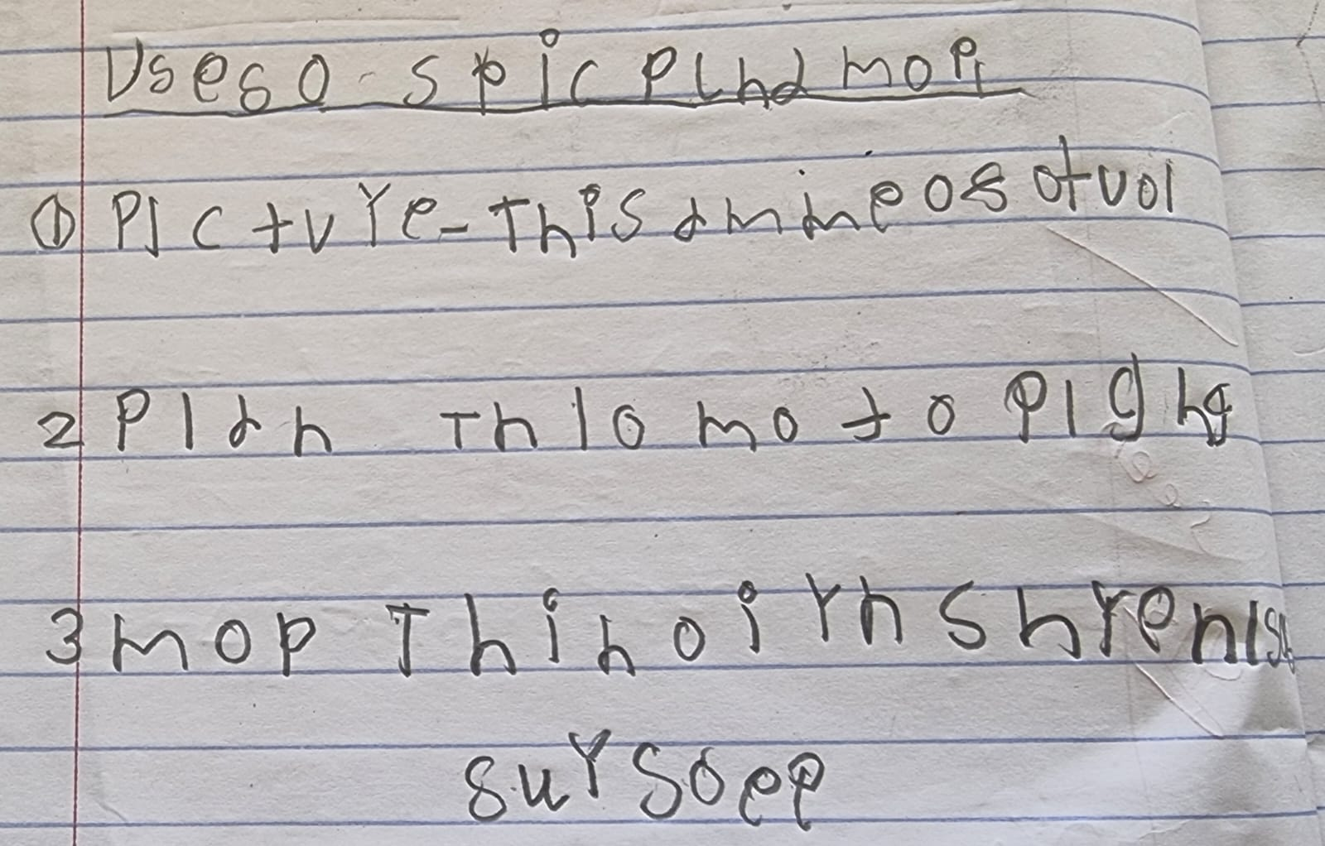
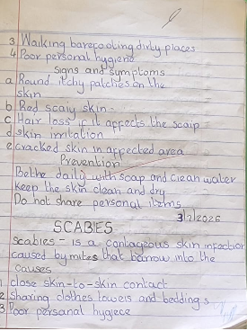
Problem Statement
The gap that motivated this project.
5–20% of school-age children show signs of dysgraphia, according to published estimates
That's roughly 2–3 students in every classroom of 25–30, every year
Formal identification requires a trained specialist evaluating handwriting samples by hand
Dysgraphia handwriting
Manual screening is slow, subjective, and simply unavailable in many schools
Left unaddressed, dysgraphia is easy to misread as carelessness or low effort — and delay isn't neutral
Normal Handwriting
The core question: can an everyday scanned sample flag a child before a specialist referral even begins?
Early Dysgraphia Screening • CRISP-DM Walkthrough
4

Slide 5
Solution
What was built to close that gap.
An image-based screening pipeline, built end-to-end on the CRISP-DM framework
Automated preprocessing standardizes any scanned or photographed handwriting sample
A calibrated deep-learning model returns a risk score — never a diagnosis
Designed to flag, not decide — a human specialist always makes the final call
Deployable with equipment most classrooms already have: a scanner, camera, or tablet
Early Dysgraphia Screening • CRISP-DM Walkthrough
5

Slide 6
Objectives
The questions this project set out to answer.
Can a standardized preprocessing pipeline make handwriting samples model-ready, regardless of scan quality?
Can transfer learning outperform a from-scratch CNN on a small, 1,625-image dataset?
Can threshold calibration produce a screening tool that's balanced — catching at-risk students without over-flagging healthy ones?
Can the final model be packaged for real-world reuse without retraining from scratch?
Early Dysgraphia Screening • CRISP-DM Walkthrough
6

Slide 7
Data Understanding
What the dataset looks like, and how it's made model-ready.
Dataset Snapshot
Getting Scans Model-Ready
1,625 total handwriting images
Grayscale standardization for every image
Dynamic border cropping around the ink content
64.5% Potential Dysgraphia (1,049) / 35.5% Low Potential (576)
Automated deskewing to straighten rotated scans
Stratified 60 / 20 / 20 train / validation / test split
Resize & pad to 256×256, preserving aspect ratio
Class imbalance means raw accuracy would be misleading — recall is the metric that matters
Pixel normalization to a 0–1 range; training-only augmentation for rotation, zoom, and brightness
Early Dysgraphia Screening • CRISP-DM Walkthrough
7

Slide 8
Modeling — The Baseline CNN
A lightweight, from-scratch CNN built to answer one question: can a simple model solve this at all?
Input
256×256×1
Conv2D 16
+ MaxPool
Conv2D 32
+ MaxPool
Conv2D 64
+ MaxPool
GlobalAvgPool
Dense 32
+ Dropout 0.4
Sigmoid
Output
25,409 trainable parameters — GlobalAveragePooling2D avoids a memorization trap on this small dataset
Adam optimizer, binary cross-entropy loss, monitored on validation recall (not accuracy)
EarlyStopping and ReduceLROnPlateau guard against overfitting
0.502
Validation ROC AUC — essentially random-chance performance
Conclusion: a simple CNN cannot extract meaningful stroke geometry from this dataset, justifying the pivot to transfer learning
Early Dysgraphia Screening • CRISP-DM Walkthrough
8

Slide 9
Modeling — Transfer Learning (MobileNetV2)
Reusing a pretrained backbone's visual pattern recognition, adapted to our pipeline.
Backbone: MobileNetV2, pretrained on ImageNet
Two-Stage Fine-Tuning
Grayscale 256×256 images resized to 224×224 and stacked into fake RGB, in-graph
Stage 1 — Frozen
• base_model.trainable = False
• Train only the new head, up to 20 epochs
Custom classification head: Dense(64) with dropout on both sides to resist memorization
Stage 2 — Partial Unfreeze
• Top 30 layers unfrozen
• Learning rate divided by 100
• Fine-tuned for 40 epochs
Result: validation recall rose from 0.205 to 0.767, and ROC AUC from 0.502 to 0.80
Early Dysgraphia Screening • CRISP-DM Walkthrough
9

Slide 10
Modeling — Hyperparameter Search
A small, targeted grid search, guided by validation recall — not accuracy.
Candidate
Learning Rate
Dropout
Batch Size
Unfreeze (N)
Search Space
A
1e-3
0.3
8
20
Learning rate: 1e-3, 1e-4
B
1e-3
0.5
16
30
Dropout: 0.3, 0.5
C
1e-4
0.3
16
30
Batch size: 8, 16
D
1e-4
0.5
8
50
Unfreeze depth: 20–50
★ Candidate B: best by validation recall (F1 tie-break)
Each candidate trained for a short, fixed number of epochs to rank configurations before committing full training time to the winner
Early Dysgraphia Screening • CRISP-DM Walkthrough
10

Slide 11
Evaluation — Calibration
Why the decision threshold couldn't stay at a naive 0.5.
Optimizing purely for recall caused the model to over-flag — nearly 99% of samples marked dysgraphic
Youden's J = TPR − FPR
Youden's J statistic (TPR − FPR) was used to calibrate the decision threshold instead
Final calibrated threshold: 0.549
This balances the true positive rate against the false positive rate — respecting healthy cases, not just chasing recall
(vs. the naive default of 0.5)
Early Dysgraphia Screening • CRISP-DM Walkthrough
11

Slide 12
Evaluation — Baseline vs. Transfer Model
How calibration and transfer learning moved the needle on validation data.
Early Dysgraphia Screening • CRISP-DM Walkthrough
12

Slide 13
Evaluation — The Final, Honest Judgment
The calibrated MobileNetV2 model, tested once against the untouched 20% test split (325 images).
0.797
79%
84%
73%
ROC AUC
At-Risk Recall
Precision
Healthy Recall
Curve arches strongly toward top-left
of Potential Dysgraphia cases caught
of flagged cases were truly at-risk
of Low Potential cases correctly cleared
Reading the Result
Catches roughly 4 in 5 at-risk students on completely unseen data
Still correctly clears about 3 in 4 healthy students
Functions as a balanced screening tool, not an automated panic button that flags everyone
Early Dysgraphia Screening • CRISP-DM Walkthrough
13

Slide 14



Next Steps
Where the project goes from here.
Interpretability Check
Expand The Dataset
Run Grad-CAM++ to visually confirm the model focuses on letter shape and baseline deviation, not scanner artifacts
Grow beyond 1,625 images to improve generalization across handwriting styles
Real-World Pilot
Severity Scoring
Trial the tool in an actual classroom setting and gather teacher feedback
Explore multi-class severity output instead of a single binary flag
Early Dysgraphia Screening • CRISP-DM Walkthrough
14

Slide 15
Recommendations
How to responsibly put this tool to use.
Deploy as a lightweight add-on to existing classroom or clinic workflows — not a standalone system
Always pair model output with human review — never let the model auto-diagnose
Partner with occupational therapists and specialists to validate flagged cases before wider rollout
Re-calibrate the decision threshold periodically as more labeled data becomes available
Monitor for demographic or handwriting-style bias before expanding beyond the pilot group
Early Dysgraphia Screening • CRISP-DM Walkthrough
15

Slide 16
Conclusions
A simple baseline CNN (0.502 AUC) proved the task needed richer features than a from-scratch model could learn
Transfer learning and threshold calibration together delivered a balanced, deployable screening tool (0.797 test AUC)
Recall-first evaluation reflects the real cost of a missed at-risk student — the metric was chosen to match the mission
The model is built to flag, not diagnose — human judgment remains central to every decision it supports
A CRISP-DM structure kept the project grounded in the original business goal from start to finish
Early Dysgraphia Screening • CRISP-DM Walkthrough
16

Slide 17
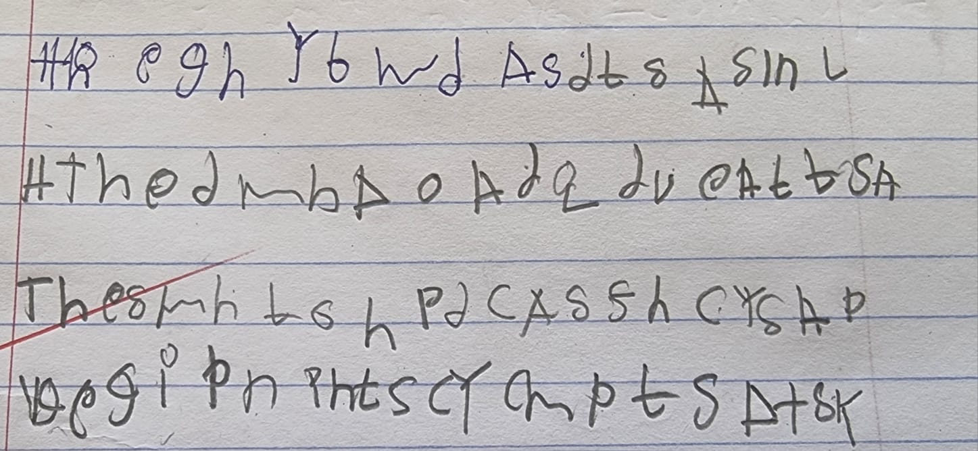
THANK YOU
Questions welcome.
[Your Name / Team Name]
[email@example.com]

