Slide 1
BIA 678 Final Presentation: Football Player evaluation using FIFA23 Dataset
Samrudh Nagesh, Saadeldin Mostafa, Aiwu Song, & Braedon Brenna (Team 8)

Slide 2
Introduction - Purpose
The purpose of this project is to create a model using Spark to use the EA Sports FIFA 23 dataset to predict the value of football players.
We use 4 different regression models such as Linear Regression, Random Forest Regression, Generalized Linear Regression and Gradient Boosting.
We evaluate the performance of these models using RMSE metric and time for different fractions of the dataset.
We also evaluate the performance on local, 3 nodes, 4 nodes and 6 nodes by using Google Dataproc Clusters.
We compare the results to find the best algorithm in terms of accuracy and time to predict the value of football players.

Slide 3
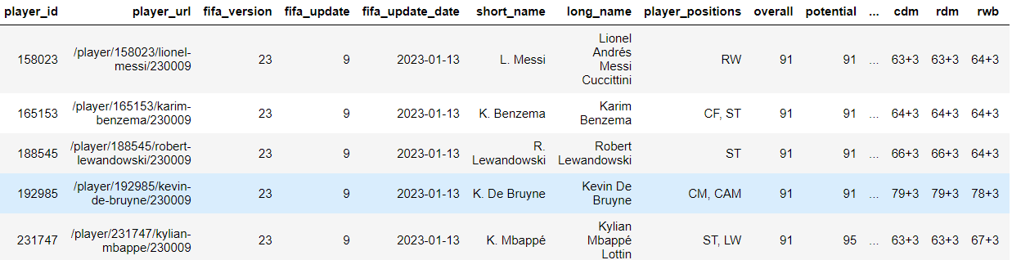
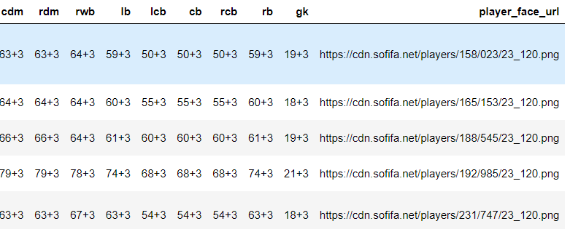
The Dataset

Slide 4
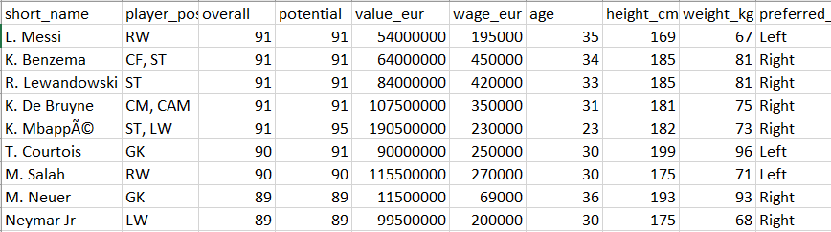
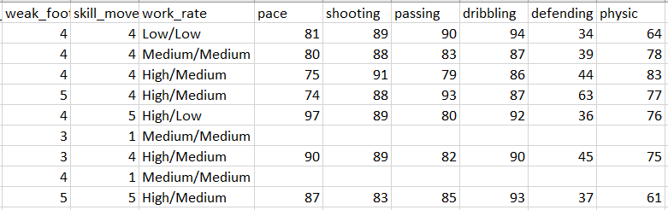
The Dataset (continued)

Slide 5
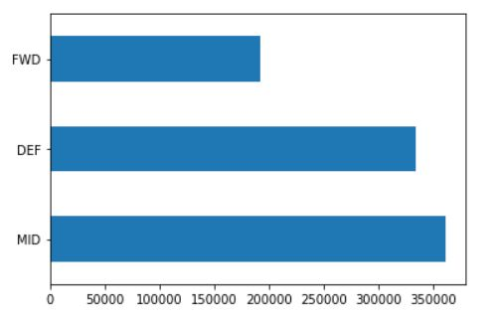
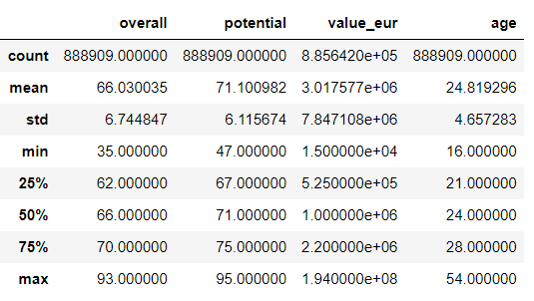
Preliminary Data Analysis
Count of Forwards, Defenders and Midfielders
Summary of overall, potential, value and age

Slide 6
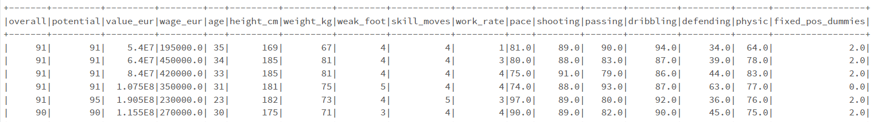
Data Preprocessing
The dataset had many playing positions such as GK, CM, CB, LW, ST, RM…etc. Some players played in multiple positions as well. We remove GK and assign 3 positions (FWD, MID, DEF) based on their original positions.
We convert the categorical column “work_rate” to numerical values, where higher work rate is valued more.
We use StringIndexer to convert the categorical column “fixed_pos” to numeric.
We use the “value_eur” column as our target variable as we are predicting the value of players.

Slide 7
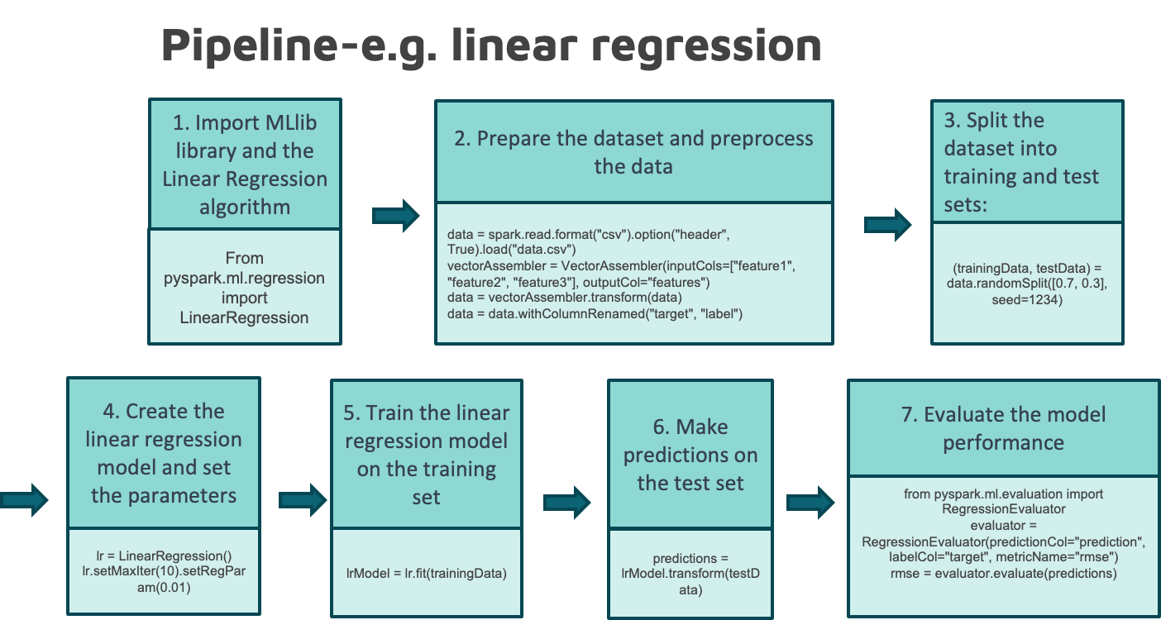

Slide 8
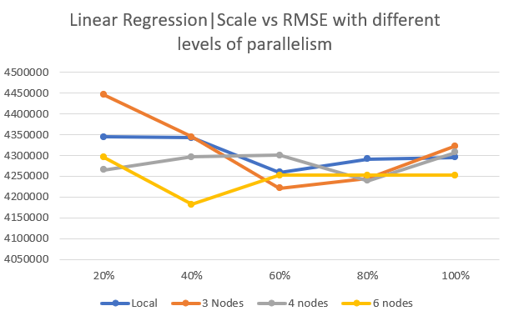
Linear Regression
RMSE for Linear regression is very high.
RMSE difference is low while using 100% of the data.
6 nodes show consistent results.

Slide 9
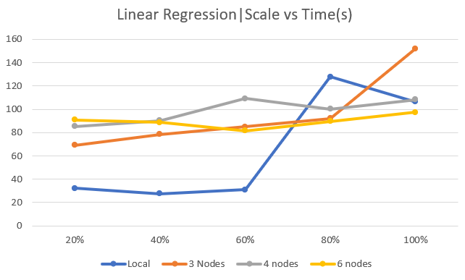
Linear Regression
Algorithm is faster on local only for a fraction of the data, larger data takes more time.
Similar times for 3, 4 & 6 nodes except for the one outlier.

Slide 10
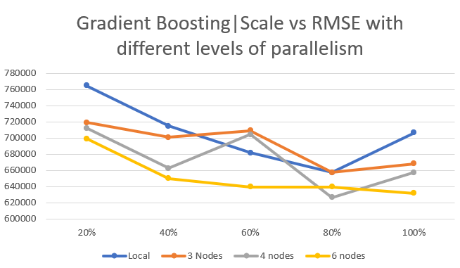
Gradient Boosting

Slide 11
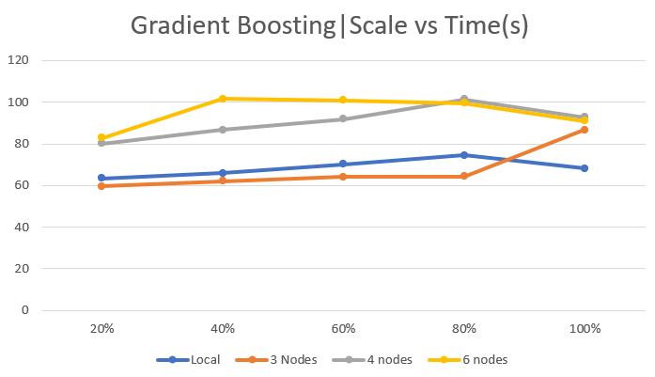
Gradient Boosting

Slide 12
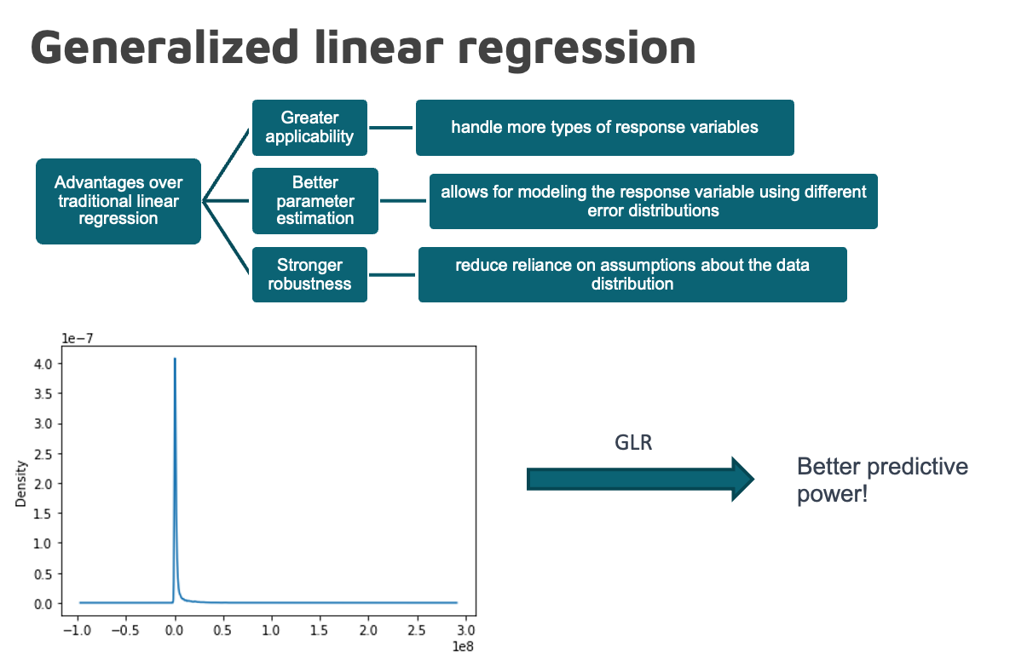

Slide 13
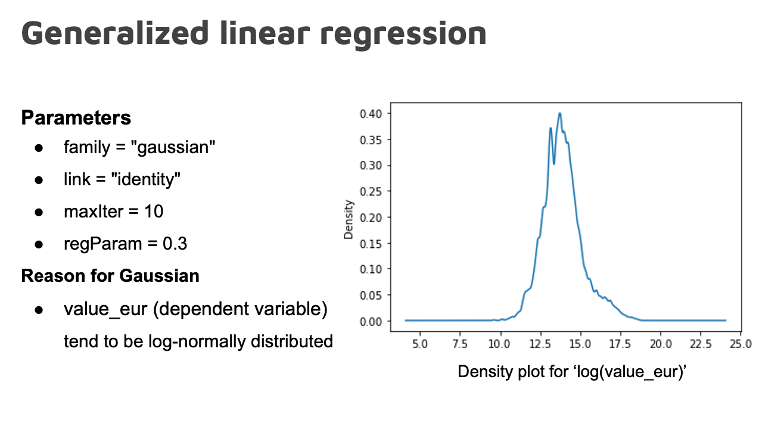

Slide 14
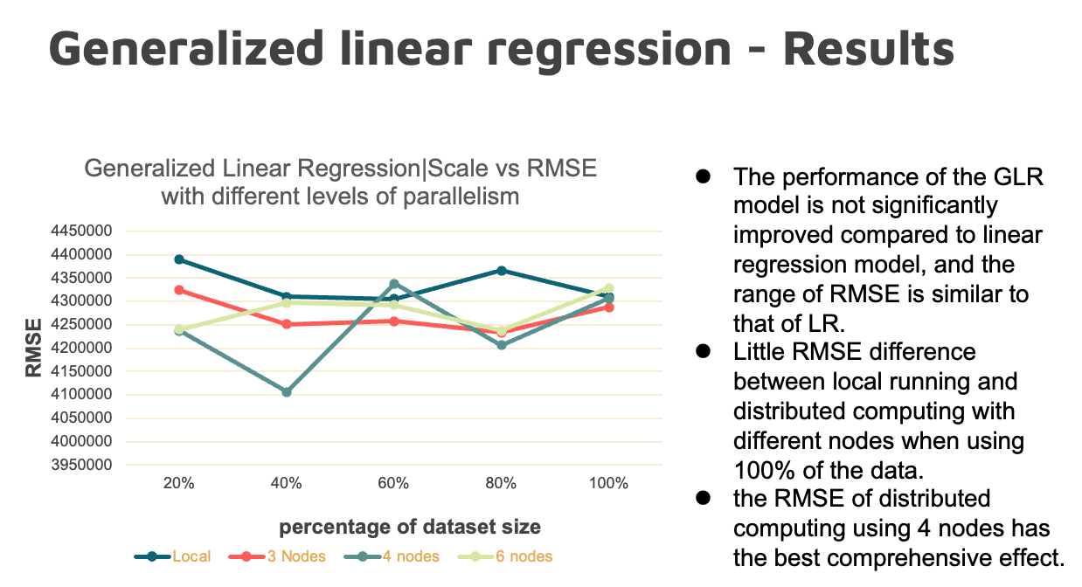

Slide 15
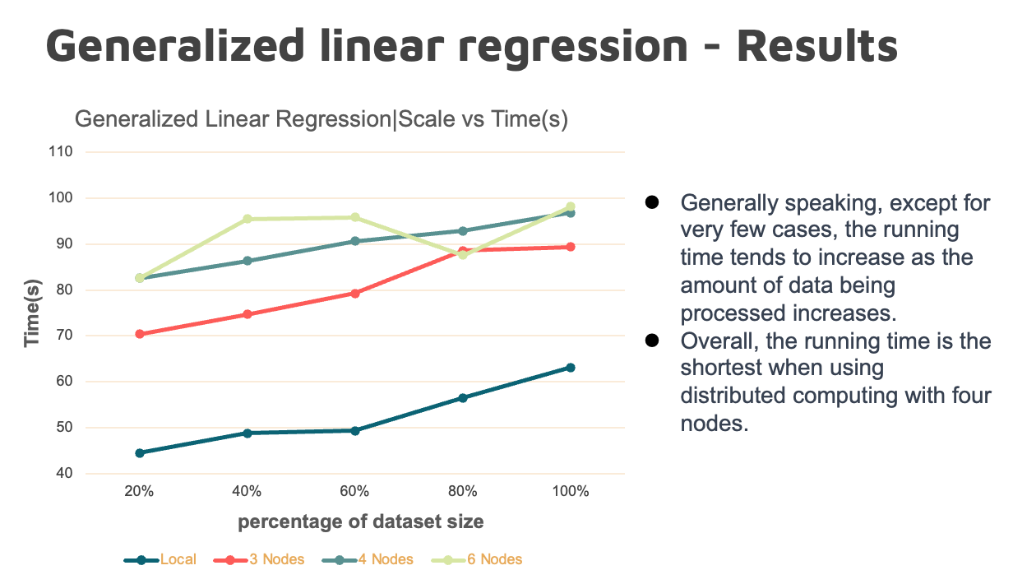

Slide 16
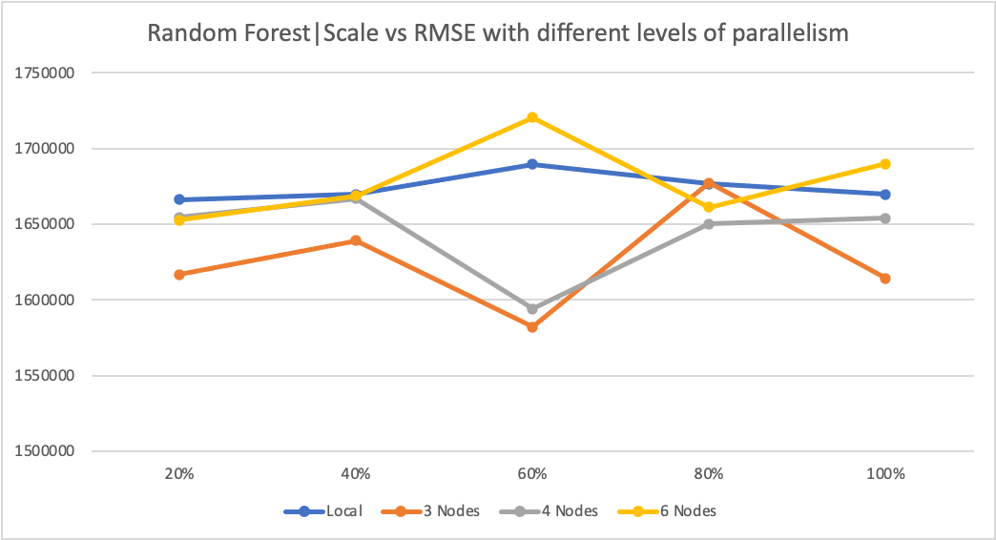
Random Forest
RMSE for Random Forest is quite low compared to other models (linear regression models)
Widest RMSE range at 60% data
Narrowest RMSE range at 80% data

Slide 17
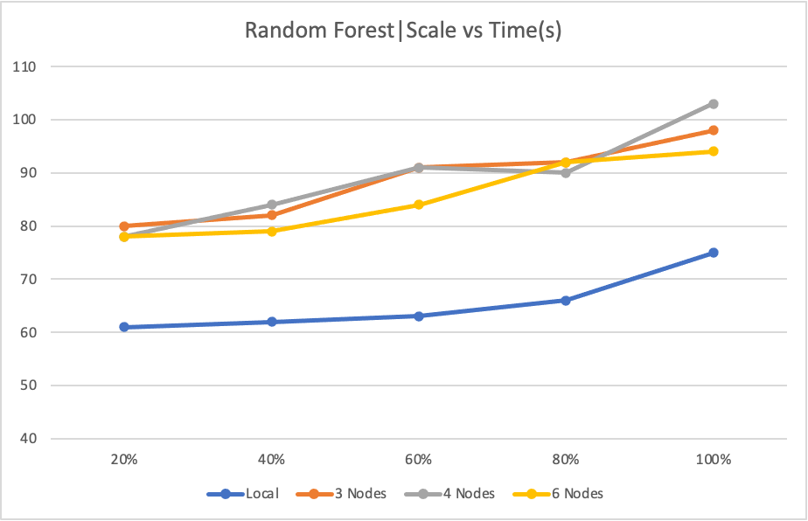
Random Forest
Algorithm is faster on local no matter the data size.
Similar times for 3, 4 & 6 nodes at all data sizes
As with the RMSE statistic, 60% of the data produces the widest range of times amongst the worker nodes

Slide 18
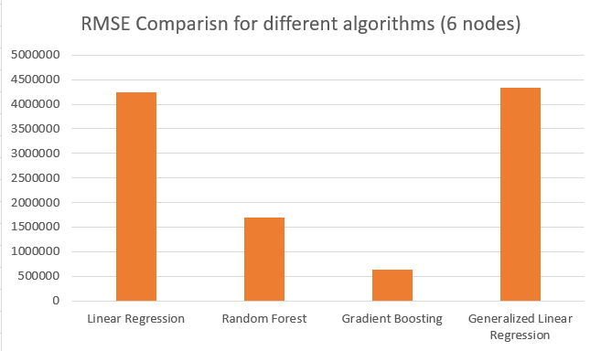
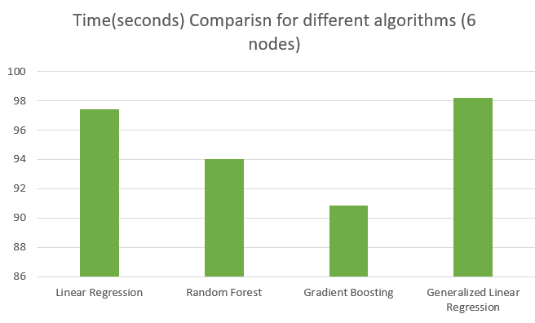
Comparison

Slide 19
Conclusion
By comparing the RMSE and Time for 4 different machine learning algorithms, we found that Gradient Boosting is the most accurate and fastest.
Reasons:
Gradient Boosting provides high accuracy in prediction as it minimizes the loss function during training.
It also provides the ability to identify important features in the dataset that are important for prediction.
Gradient Boosting also provides high efficiency in training large datasets as observed, this can also be because it can be parallelised easily.

Slide 20
Thank you!

