Slide 1
GROUP B
Afolabi James
Ajeyomi Adedoyin
Alli Fesomade
Michael Ajiboye
Ifeanyichukwu Onyechere

Slide 2

OUR TASK
Project 2: Stock Market Data Streaming & Analysis
Stock prices for companies like TESLA (TSLA) and NVIDIA (NVDA) fluctuate rapidly. Your task is to build a real-time data pipeline that streams stock market data for these two companies using the Alpha Vantage API, processes the data to compute metrics like price changes, moving averages, and volume spikes, and stores the results in a queryable and structured format.
Select and justify a preferred tech stack.
Design and submit a high-level architecture diagram.
Break project into components and assign team members.
Share tools/resources to be used to execute the project.
Stores the results in an efficient format (partitioned by symbol/date/hour).

Slide 3
Task Breakdown
Research and Architecture Development (Cloud deployment)
Ajeyomi Adedoyin
Etl pipeline and Data Exploration
Ifeanyichukwu Onyechere
Been Part of the process and following through on everything, we have also had two virtual meetings, they said they are ready to learn along and also contribute to the idea process
Alli Fesomade – Work on Analytics
Michael Ajiboye – Work on Documentation
Afolabi James – slides and also on Etl pipeline with Ifeanyi

Slide 4
Proposed Tools and Why
API Endpoint: The data source provides updates at 1-minute and 5-minute intervals; we opted for the 1-minute frequency to ensure near real-time data freshness and more granular insights.
S3: Stores raw and processed data; low cost, charged based on storage used and access requests.
Firehose: Streams data every minute to S3 or Redshift; billed by data volume and frequency, making 1-min intervals more costly but necessary for real-time precision.
Python with Boto3: Pulls data every minute from the API and sends it to Firehose; no direct cost, but downstream AWS usage incurs charges.
Lambda: Transforms the 1-min interval data in Firehose before storage in S3; cost-efficient for small, frequent payloads due to per-invocation pricing.

Slide 5
Proposed Tools and Why
Optional tools (to explore data)
Redshift: Performs analytics on streamed data; higher cost, best suited for heavy aggregations and dashboards—optimize usage or batch loads to control spend.
Athena: Runs SQL queries directly on S3 data; pay-per-query—ideal for on-demand exploration and historical comparisons without moving data.

Slide 6
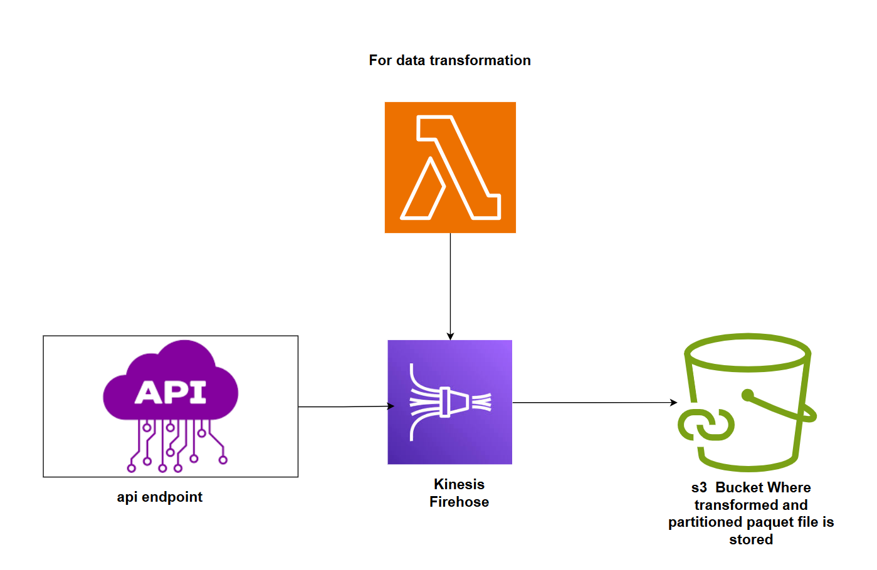
Proposed Architecture 1

Slide 7
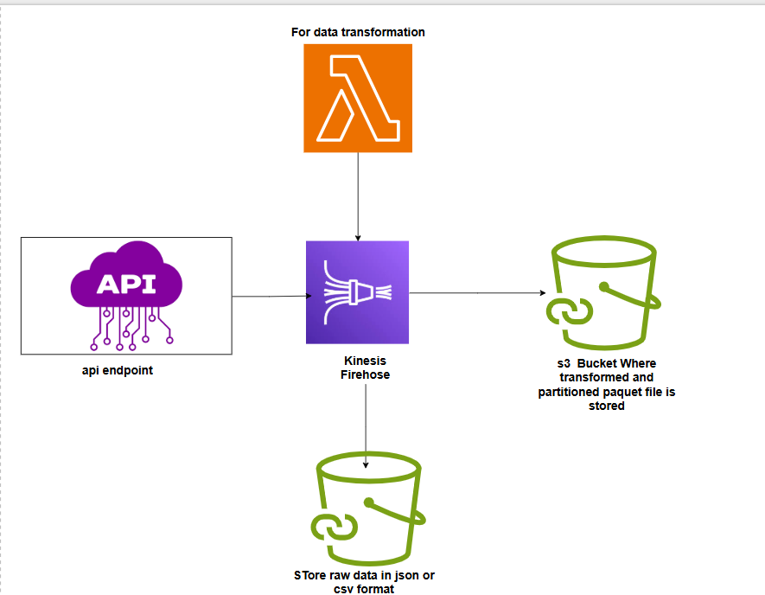
Proposed Architecture 2

Slide 8
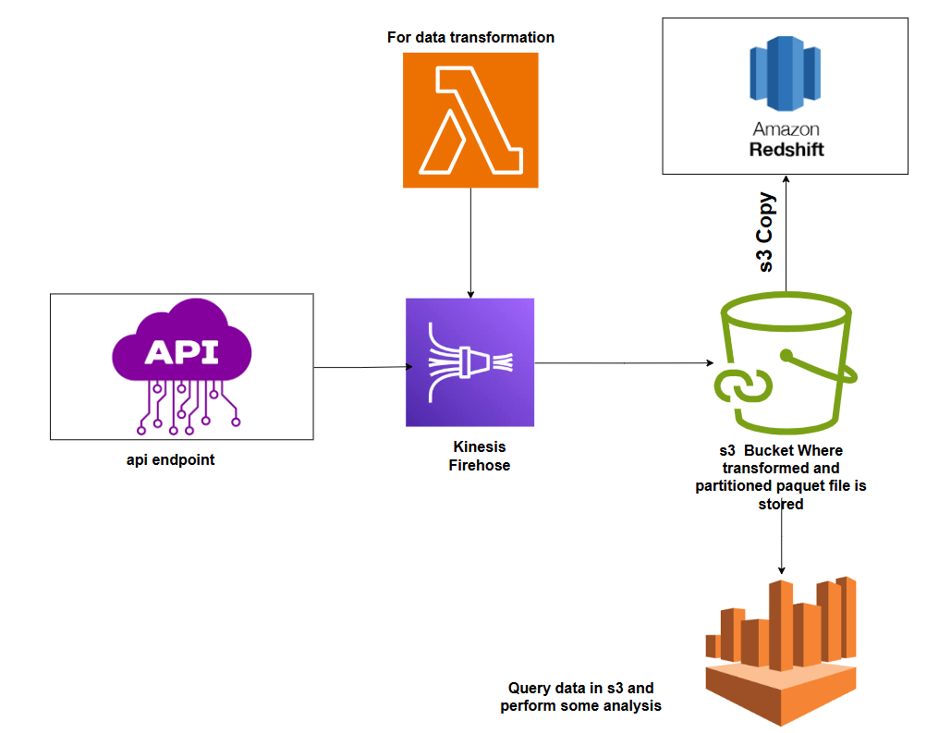
Proposed Architecture 3

Slide 9
Thank you Suggestion from Mentor

