Slide 1
ADVANCED SPATIAL STATISTICS & DECISION SCIENCE
How Location Data and Spatial Models Drive Smarter Decisions Across Every Sector
Disease Epidemiology | Health Deserts | Geomarketing | Cultural Geography | WASH | Electoral Logistics | Econometrics
9,308 Nigerian Wards | PySAL | GeoPandas | spreg | esda | splot

Slide 2
CORE FOUNDATIONS
The Big Idea: Why Traditional Statistics Fails in the Real World
The Fallacy of the Average
Traditional analytics uses state or national averages.
A state can look healthy on paper while having hundreds
of wards with ZERO clinics.
Decisions based on averages waste money.
Location dictates who has access and who is left behind.
Tobler's First Law of Geography (1970)
'Near things are more related than distant things.'
Events in one ward do not stay in that ward.
Malaria mosquitoes fly across borders.
Shoppers travel to neighbouring markets.
Invest in Ward A -> Wards B, C, D also benefit.
This cross-ward effect is called a SPATIAL SPILLOVER.

Slide 3
CORE COMPARISON
Spatial Statistics vs. Traditional Statistics — Head-to-Head
Traditional Statistics — What It Misses
Assumes obs. are Independent & Identically Distributed (i.i.d.).
Correlation: Pearson/Spearman — treats each ward as an isolated island.
Regression (OLS): y = XB + e — assumes Cov(ei,ej) = 0.
Outlier: Global z-score only (> 3 std devs from national mean).
Multiplier: 1.0x — investment impacts only the targeted area.
BLIND to: clustering, spillovers, and boundary effects.
Advanced Spatial Statistics — What It Adds
Foundation: Tobler's Law — neighbouring units are coupled.
Correlation: Moran's I accounts for geographic distance & contiguity.
Regression: Spatial Lag (SAR) and Spatial Error (SEM) models.
Outlier: Anselin LISA — finds local High-Low and Low-High pockets.
Multiplier: 2.4x — explicitly measures cross-ward investment returns.
UNLOCKS: unbiased estimates, real significance, surgical targeting.

Slide 4
CLARIFICATION
Spatial Statistics vs. Spatial Data Science — They Are NOT the Same
Spatial Statistics (Mathematics + Inference)
A branch of MATHEMATICS and INFERENTIAL STATISTICS.
The question it answers: Is this pattern REAL or due to chance?
Core tools: Moran's I, LISA, SAR, SEM, Lagrange Multiplier tests.
Output: p-values, confidence intervals, causal multipliers.
Use when: You need to TEST a hypothesis and PROVE a result.
Example: Prove malaria clusters in riverine wards (I=0.886, p<0.001).
Spatial Data Science (Engineering + Analytics)
A broader ENGINEERING and ANALYTICS field.
The question it answers: How do we store, process, visualise, predict?
Core tools: GeoPandas, PostGIS, QGIS, Kepler.gl, Folium, Deck.gl.
Output: Maps, dashboards, ML predictions, ETL pipelines.
Use when: You need to PROCESS and DISPLAY spatial info at scale.
Example: Build an interactive ward-level map for 9,308 wards.
-> Spatial statistics POWERS spatial data science from the inside.

Slide 5
EXPLORATORY ANALYSIS
The Superpower of Spatial Statistics: Pattern Discovery via ESDA
Why Traditional EDA is Blind to Geography
Traditional EDA relies on histograms, means, and boxplots.
Coordinates and topologies are completely discarded.
Random Shuffle Test:
Randomly shuffle 9,308 ward locations across Nigeria.
The histogram, mean, and std dev remain 100% IDENTICAL.
Standard EDA cannot tell whether poverty is clustered
or randomly scattered across the country.
Global Outlier Blindness:
Only detects national extremes (z > 3). Completely misses
wealthy commercial islands embedded in poor regions.
What ESDA Unlocks: Seeing Real Patterns
1. Hypothesis-Free Pattern Discovery:
Reveals spatial regimes and natural clustering before
formulating complex equations.
2. Rigorous Statistical Clustering (Moran's I):
Proves map patterns are genuine, not visual noise (p < 0.001).
3. Local Spatial Outliers (Anselin LISA):
Pinpoints High-Low 'Islands of Wealth' (commercial hubs)
and Low-High 'Pockets of Poverty' (underserved sinks).
4. Spatial Heterogeneity:
Identifies where relationships invert across state borders.

Slide 6
CORE ADVANTAGES
The 4 Strategic Advantages of Spatial Statistics
1. Bias Elimination
Prevents Omitted Variable Bias.
Spatial spillovers hide in OLS
error terms — distorting B.
Spatial models isolate genuine
policy effects from geography.
2. True Significance
Stops Type-I Errors.
Non-spatial models produce
deflated standard errors and
inflated t-statistics.
Spatial models prove whether
an effect is real.
3. Surgical Targeting
Bypasses crude quotas.
LISA isolates the exact
1,800+ desert wards instead
of splitting budgets equally
across 774 LGAs.
Zero wasted capital.
4. Quantified Spillovers
Unlocks the 2.4x Multiplier.
$1M in Ward A creates
$1.4M of indirect activity
in contiguous wards.
Justifies regional joint
funding between LGAs.

Slide 7
METHODOLOGY
Why Spatial Statistics Must Come BEFORE Machine Learning
The Trap: Spatial Data Leakage in ML
XGBoost/Random Forest with random train/test splits on spatial data CHEATS.
Test points neighbour training points -> 95% accuracy in tests,
total failure when deployed in a new region.
Tree models cannot model continuous distance decay.
Off-the-shelf ML cannot give causal policy multipliers.
The Solution: Spatial Stats First
1. Feature Engineering: Compute spatial lags [Wy] before training ML.
2. Block Cross-Validation: Split by geographic clusters to prevent leakage.
3. LM Tests: Confirm whether spatial dependence exists first.
4. SAR/SEM: Give causal multipliers that ML cannot produce.
Spatial statistics is the FOUNDATION that makes ML valid and honest.

Slide 8
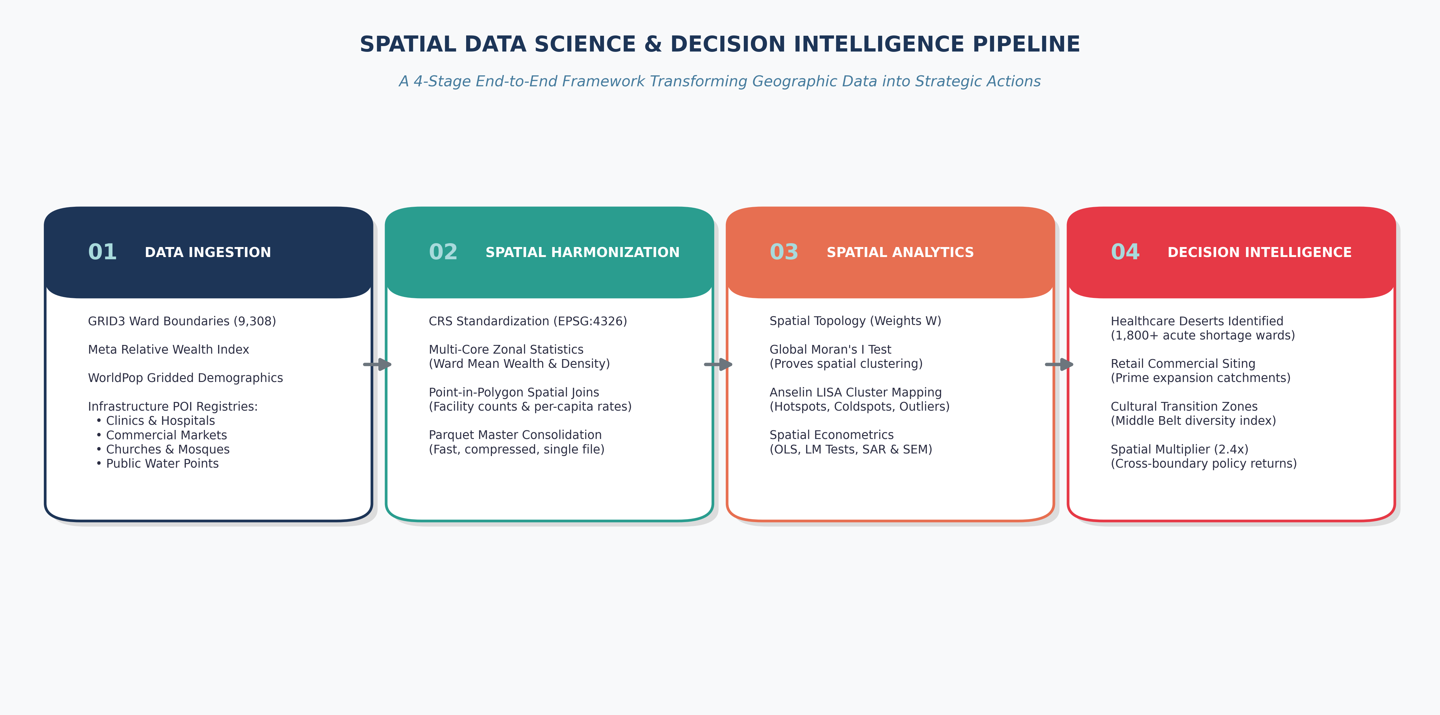
PIPELINE ARCHITECTURE
The End-to-End Decision Pipeline: From Raw Data to Actions

Slide 9
LIBRARIES REFERENCE
The Full Python Toolkit for Spatial Statistics
Core Spatial Statistics — PySAL Family
libpysal — Build spatial weights W (Queen, Rook, KNN, distance bands).
esda — Global Moran's I, LISA, Join-Count, Geary's C.
spreg — OLS, SAR (GM_Lag), SEM (GM_Error), LM diagnostic tests.
giddy — Spatial Markov chains; regional convergence analysis.
splot — Moran scatter plots & LISA cluster maps.
segregation — Spatial segregation indices for cities.
mgwr — Multi-scale Geographically Weighted Regression.
inequality — Theil & spatial inequality decomposition.
Geometry, I/O & Visualisation
GeoPandas — Shapefiles, GeoJSON, Parquet I/O; spatial joins.
Shapely — Geometry ops: buffer, intersect, union, centroid.
Fiona — Low-level vector I/O (used inside GeoPandas).
PyProj — CRS transformations between EPSG projections.
Folium — Interactive Leaflet maps in Jupyter notebooks.
Kepler.gl — GPU-accelerated large-scale maps in browser.
Contextily — Automatic basemap tiles (OpenStreetMap, CARTO).
mapclassify — Natural Breaks, Quantile, Fisher class schemes.
Raster, ETL & Network Analysis
Rasterio — Read/write GeoTIFF rasters; window reads.
rasterstats — Fast zonal_stats for ward-level raster aggregation.
xarray — N-dimensional labelled raster arrays.
rioxarray — CRS-aware xarray extension for rasters.
spatialpandas — Dask-scalable spatial partitioning.
OSMnx — Download & analyse OpenStreetMap road networks.
NetworkX — Graph algorithms for transport connectivity.
scikit-mobility — Human mobility and flow modelling.

Slide 10
MATHEMATICAL TOOLS
Formula 1: The Spatial Weights Matrix (W)
How We Connect Geography Mathematically
Adjacency: wij = 1 if Ward i and Ward j share a boundary
wij = 0 otherwise
Row-Standardisation: w*ij = wij / sum_k(wik)
This makes each row sum to 1.0.
A ward with 10 neighbours is on the same scale as one with 3.
Result: a weighted local average — the SPATIAL LAG.
Types of Adjacency in Practice
Queen Contiguity (Default):
Neighbours share an edge OR a corner point.
Rook Contiguity:
Neighbours must share a full linear boundary edge.
K-Nearest Neighbours (KNN-5):
Connects each ward to its 5 closest centroids.
Ensures every isolated island still has valid neighbours.
Distance-Decay: wij = d^(-alpha) (weight drops with distance).

Slide 11
MATHEMATICAL TOOLS
Formula 2: The Spatial Lag Operator [Wy] — Intuition & Mechanics
What Is a Spatial Lag & Why Is It Called 'Lag'?
Definition: [Wy]_i = sum_j ( w*_ij * y_j )
Why 'Lag'?
In Time Series, y_{t-1} is the TIME LAG (what happened in the past).
In Spatial Stats, [Wy]_i is the SPATIAL LAG (what happens in the neighbourhood).
It transforms an entire geographic neighborhood into a single scalar value.
Step-by-Step Numerical Walkthrough:
Suppose Ward A has 3 contiguous neighbours: B, C, and D.
Neighbour Wealth: B = 2.0, C = 4.0, D = 6.0.
Row-Standardised Weights: w*_AB = 1/3, w*_AC = 1/3, w*_AD = 1/3.
Spatial Lag: [Wy]_A = (1/3)(2.0) + (1/3)(4.0) + (1/3)(6.0) = 4.0.
Core Insight: [Wy] captures your local geographic context in a single number.
How Spatial Lag Powers Real Decisions
Public Health — Isolation vs. Buffer Access:
Ward A: 0 clinics, [W*Clinics]=5.2 -> Low risk; patients walk to clinics next door.
Ward B: 0 clinics, [W*Clinics]=0.0 -> Extreme Desert! Zero nearby access. Prioritise.
Commercial Geomarketing — Catchment Purchasing Power:
Ward i: Moderate wealth, but [W*Wealth]=High -> Entire trade area is affluent.
A supermarket here captures high revenue from contiguous feeder wards.
Epidemiology — Transmission Pressure:
[W*MalariaPrevalence]_i measures infection pressure entering Ward i
from its surrounding geographic vectors.

Slide 12
ECONOMETRIC THEORY
Spatial Lag vs. Spatial Error — The Fundamental Distinction
Spatial Lag (SAR): Endogenous Spillovers
Model: y = rho * W * y + X * beta + epsilon
The Mechanism: BEHAVIORAL SPILLOVER & INTERACTION
'What my neighbours do DIRECTLY affects what I do.'
Real-World Examples:
- Economic Growth: A new market in Ward A creates jobs, boosting retail
spending in adjacent Ward B (Economic multiplier effect).
- Epidemic Spread: Cholera in Ward A physically infects people in Ward B.
- Retail Pricing: Stores in Ward A react to competitors in Ward B.
Diagnostic: Significant rho means investments produce geographic feedback loops.
Calculated Multiplier = 1 / (1 - rho). If rho = 0.584, Multiplier = 2.4x.
Spatial Error (SEM): Shared Unobserved Environment
Model: y = X * beta + u, where u = lambda * W * u + epsilon
The Mechanism: SHARED BACKGROUND / OMITTED COVARIATES
'My neighbours and I share common unmeasured conditions.'
Real-World Examples:
- Climate / Ecology: A shared river basin or rainfall belt affects crop yields
across all contiguous wards identically.
- State Governance: Shared administrative policies or road network quality.
- Geological Terrain: Shared mineral resources or aquifer depth.
Decision Rule (Anselin Lagrange Multiplier):
Run OLS -> Test LM-Lag and LM-Error.
If LM-Lag is significant -> Run SAR (spillover dynamic).
If LM-Error is significant -> Run SEM (shared environment).

Slide 13
MATHEMATICAL TOOLS
Formula 3: Global Moran's I — Is There Clustering?
The Mathematical Formula
I = (n/S0) * [sum_i sum_j wij(yi-ybar)(yj-ybar)] / sum_i(yi-ybar)^2
H0 (Null): Values are scattered randomly across the country.
E[I] if random = -1/(n-1) approx 0
Interpretation:
I > 0 and p < 0.05 -> Clustering (High near High, Low near Low).
I < 0 and p < 0.05 -> Dispersion (checkerboard pattern).
p >= 0.05 -> Pure random noise.
Results Across 9,308 Nigerian Wards
Wealth Index (RWI):
I = 0.684, z = 112.4, p = 0.001 -> Extreme wealth clustering.
Malaria Prevalence (PfPR):
I = 0.886, z = 140.5, p = 0.001 -> Intense transmission corridors.
Religious Institutions (Churches):
I = 0.812, z = 138.2, p = 0.001 -> Sharp North-South cultural divide.
CONCLUSION: Random models are completely wrong for Nigeria.

Slide 14
MATHEMATICAL TOOLS
Formula 4: Local Moran's I (LISA) — WHERE Is the Cluster?
The Local Formula
Global Moran tells us clustering EXISTS.
LISA tells us WHERE — per ward.
I_i = (z_i / s^2) * sum_j ( w_ij * z_j )
where z_i = y_i - y_bar (deviation from national mean).
Each ward gets its own score and its own p-value.
Wards are classified into 4 quadrants.
The 4 LISA Quadrants
High-High (HH) — Red HOTSPOT:
High value surrounded by high neighbours.
Action: Deepen the advantage; build on existing momentum.
Low-Low (LL) — Blue COLDSPOT:
Low value surrounded by low neighbours. Hardest-to-reach.
Action: Emergency intervention; prioritise in WPI Tier 1.
High-Low (HL) — Orange ISLAND:
High value surrounded by low neighbours ('Island of Wealth').
Low-High (LH) — Light Blue POCKET:
Low value surrounded by high neighbours ('Pocket of Poverty').

Slide 15
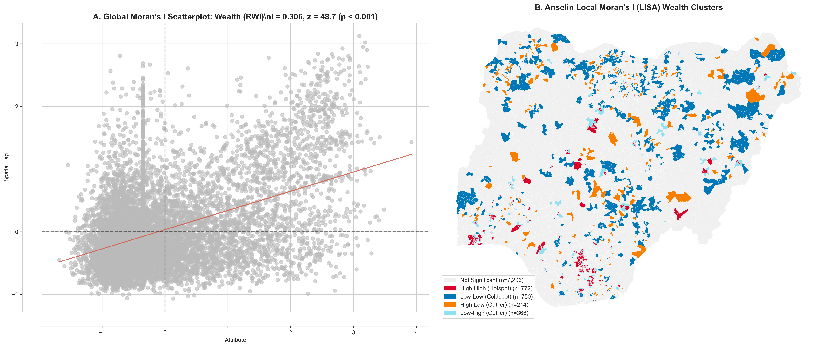
EMPIRICAL FINDINGS
National Wealth Clusters: Anselin LISA Map

Slide 16
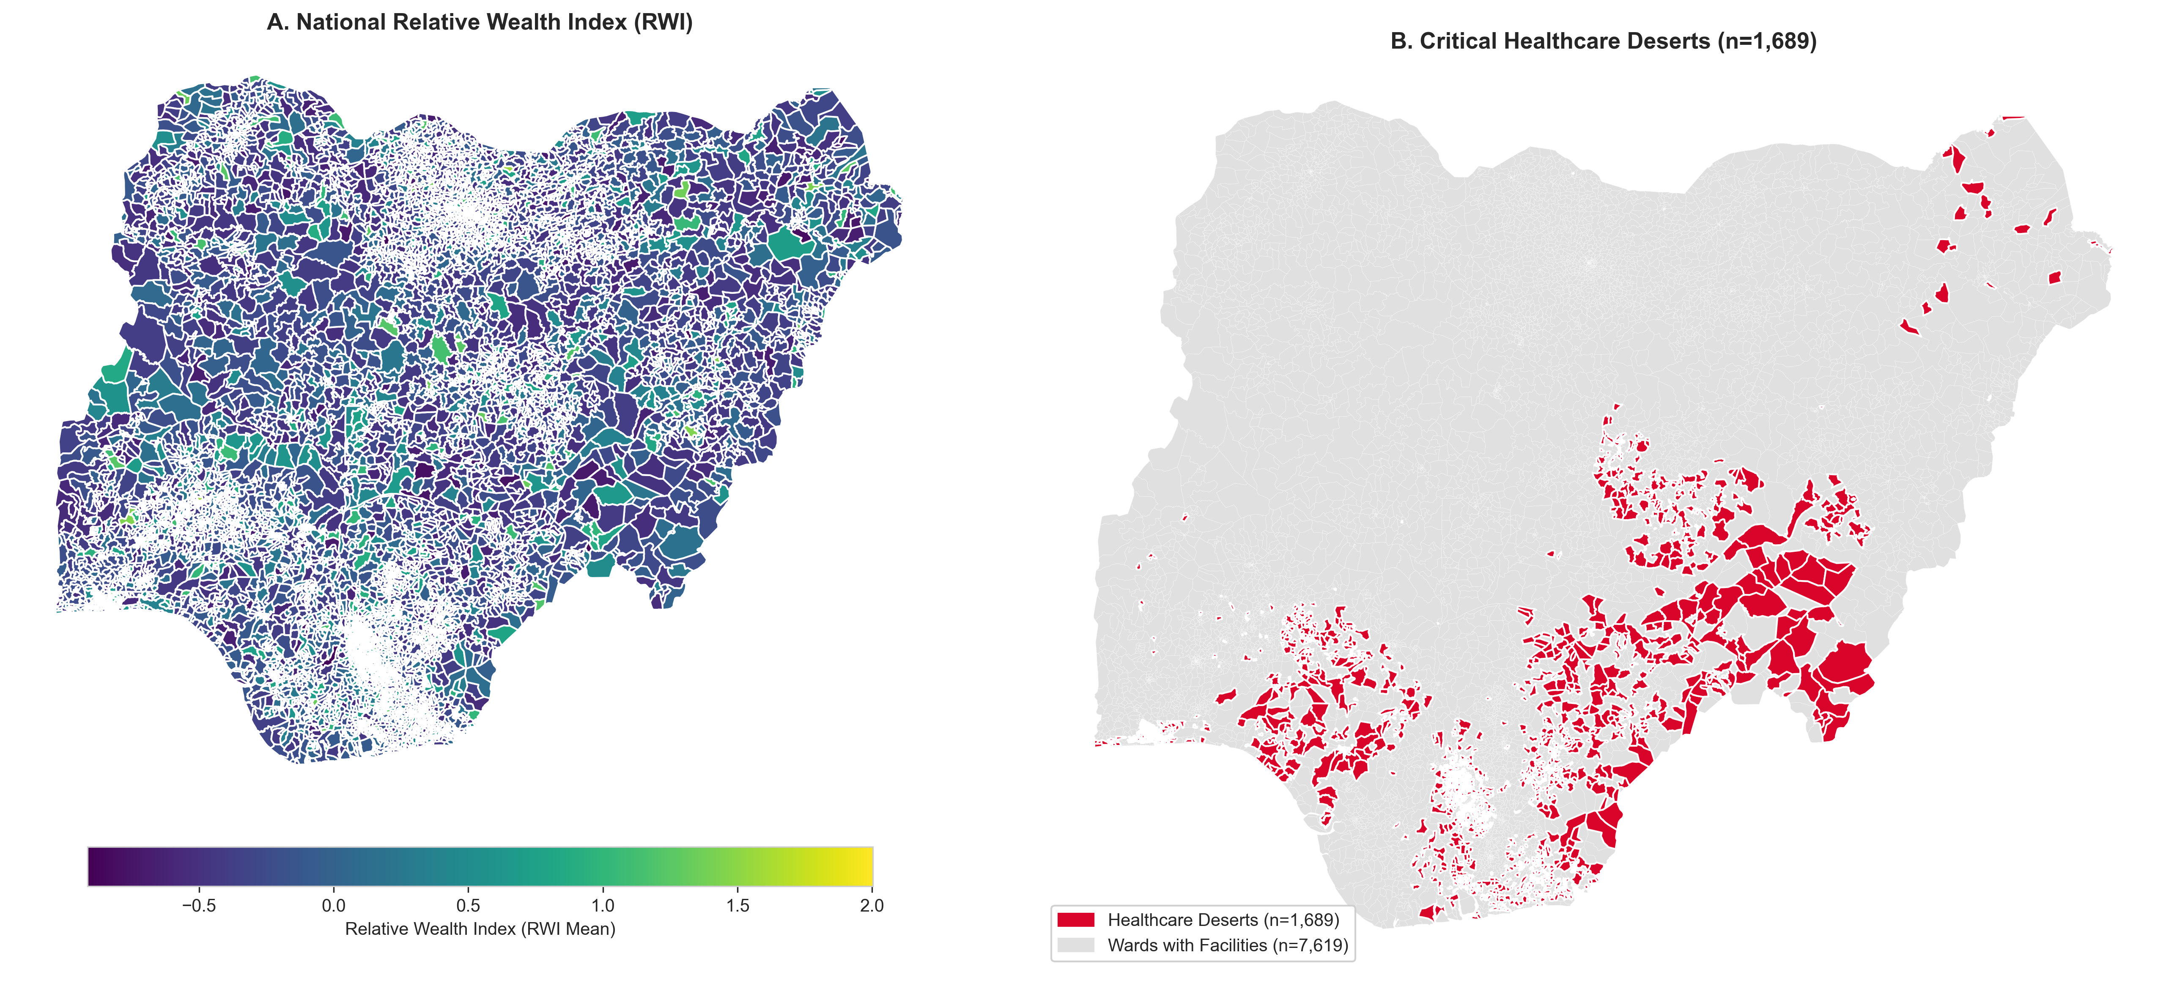
SECTOR ANALYSIS
Sector 1: Public Health & Healthcare Deserts
Question, Method & Answer
THE QUESTION:
Where are populations trapped with zero primary healthcare?
SPATIAL METHOD:
Spatial Join (population raster x facility points)
+ Anselin LISA to classify wards into HH / LL clusters.
WHAT THE METHOD DOES:
Cross-references 35,000+ health facilities against 9,308 ward
populations. Flags every ward where clinics_per_10k = 0
AND population > 17,000 people.
THE ANSWER:
1,800+ Healthcare Desert wards found.
Over 30 million Nigerians live in these wards.

Slide 17
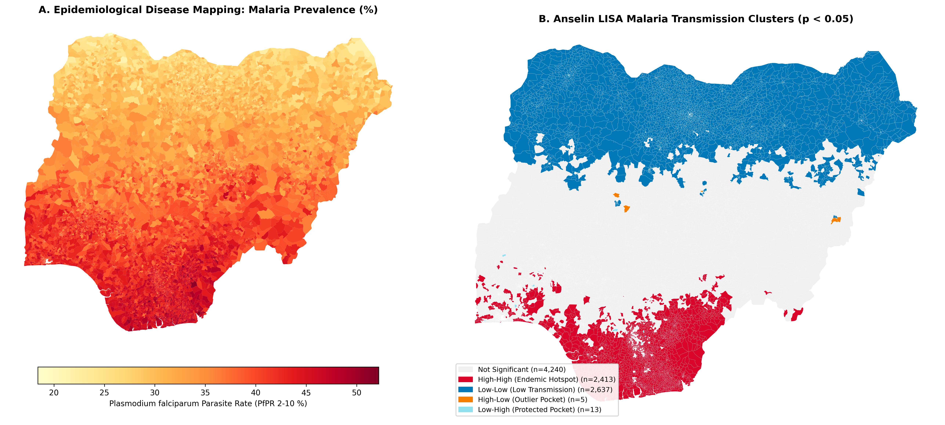
SECTOR ANALYSIS
Sector 2: Disease Epidemiology & Malaria Surveillance
Question, Method & Answer
THE QUESTION:
Does malaria cluster in environmental corridors?
Do local clinics protect against transmission?
SPATIAL METHOD:
Global Moran's I + LISA hotspot mapping
+ SAR regression with clinic_rate as a regressor.
WHAT THE METHOD DOES:
Tests whether malaria in a ward correlates with malaria in
its neighbours. SAR quantifies how strongly the spatial
neighbourhood — not just local conditions — drives transmission.
THE ANSWER:
I = 0.886, p = 0.001. Riverine wards: PfPR > 40%.
Higher clinic rates show significantly lower parasite rates.

Slide 18
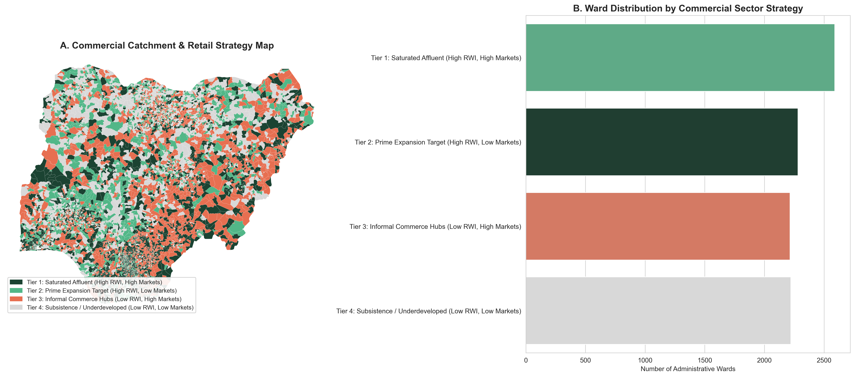
SECTOR ANALYSIS
Sector 3: Geomarketing & Retail Expansion Strategy
Question, Method & Answer
THE QUESTION:
Where can supermarkets, retail chains, and fintechs expand
without facing crowded competition?
SPATIAL METHOD:
Bivariate Moran's I (Wealth vs Market Density)
+ LISA quadrant classification.
WHAT THE METHOD DOES:
Compares each ward's RWI (wealth) with its neighbours' market
density. LH quadrant = affluent ward with low-market surrounding
-> PRIME EXPANSION TARGET (Tier 2).
THE ANSWER:
Tier 2 wards: high consumer purchasing power, no formal retail.

Slide 19
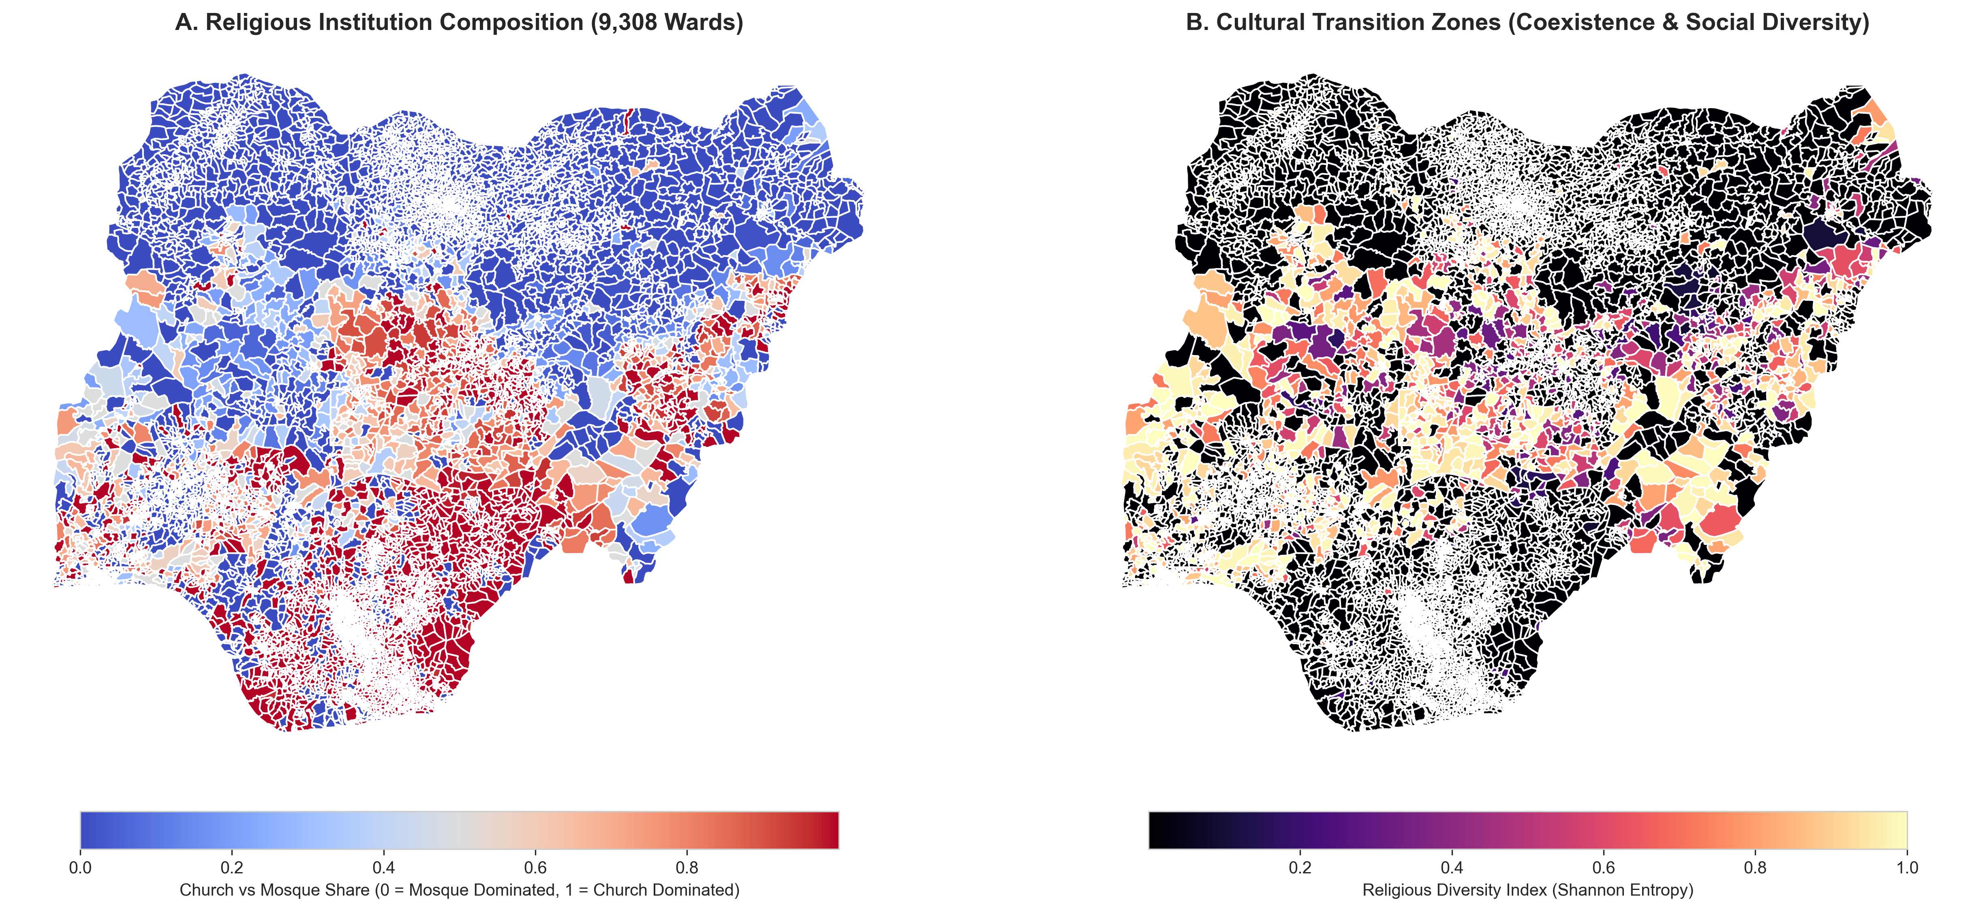
SECTOR ANALYSIS
Sector 4: Cultural Geography & Community Cohesion
Question, Method & Answer
THE QUESTION:
How are faith institutions distributed? Where are the cultural
transition zones of high co-presence?
SPATIAL METHOD:
Global Moran's I per faith type
+ Shannon Entropy Index (ward-level diversity score).
WHAT THE METHOD DOES:
Moran's I proves churches and mosques sort spatially.
Shannon Entropy scores each ward: H=1.0 (equal mix) to H=0 (one faith).
THE ANSWER:
Sharp North-South divide (I = 0.812).
Middle Belt = high-entropy zones needing inter-faith programs.

Slide 20
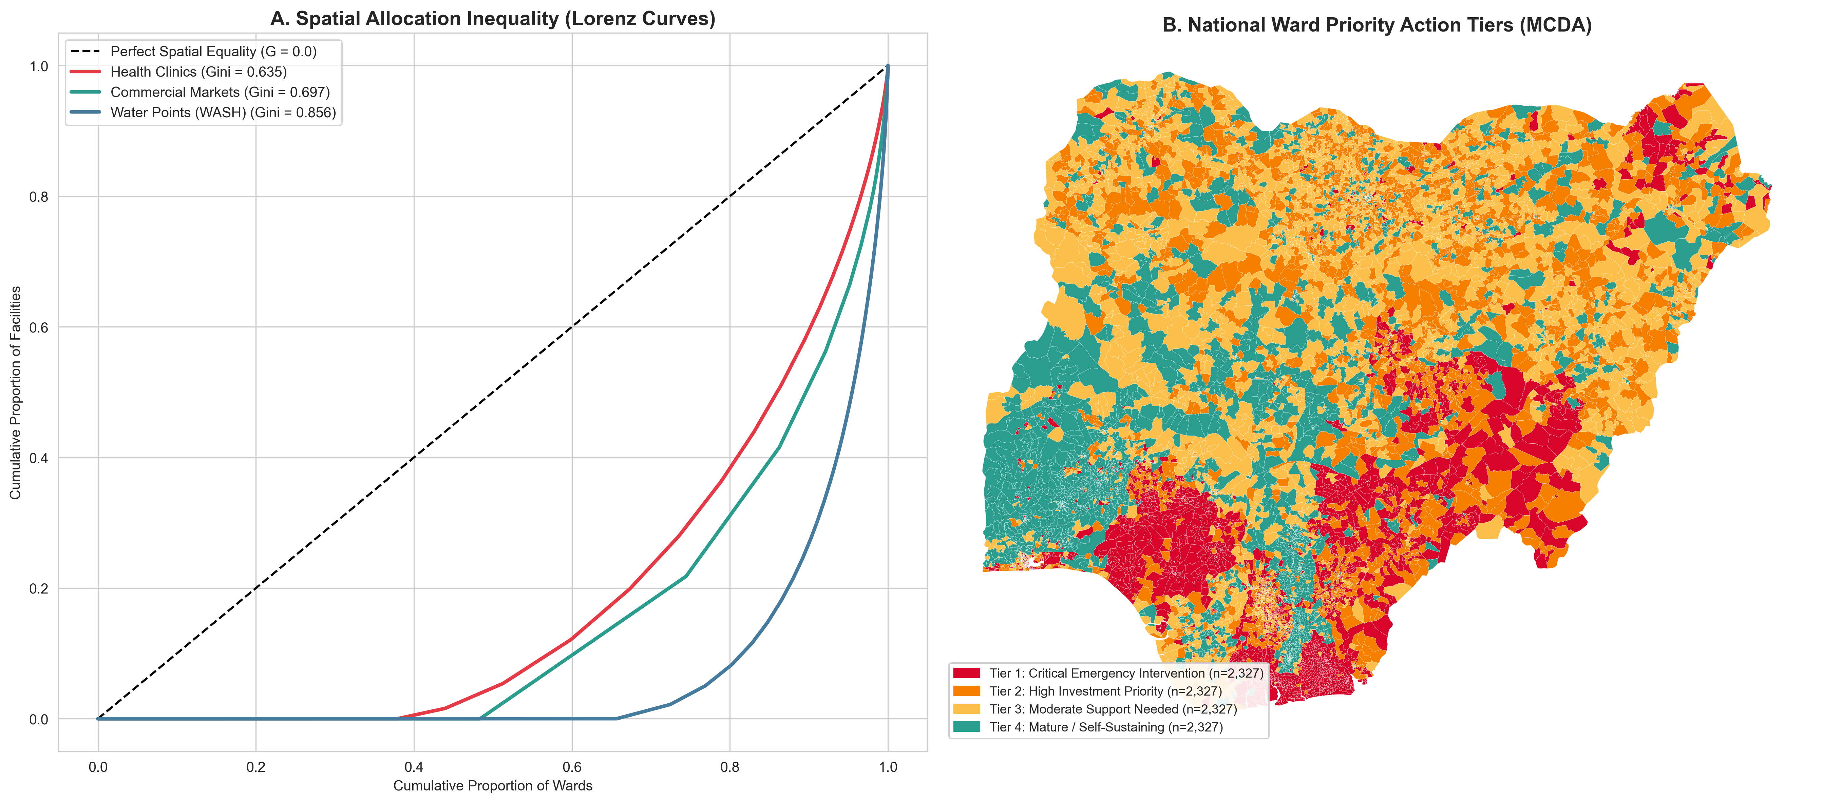
SECTOR ANALYSIS
Sector 5: WASH & Clean Water Infrastructure Equity
Question, Method & Answer
THE QUESTION:
How unequal is clean water distribution?
Which wards urgently need solar boreholes?
SPATIAL METHOD:
Spatial Lorenz Curve + Gini Coefficient
+ Ward Priority Index (WPI) composite scoring.
WHAT THE METHOD DOES:
The Lorenz Curve ranks all 9,308 wards by borehole count.
WPI = weighted sum of (water deficit + health deficit + poverty).
Creates 4 Action Tiers so water boards drill highest-need first.
THE ANSWER:
Gini = 0.72. WPI Tier 1 = emergency solar borehole intervention.

Slide 21
DIAGNOSTIC TESTING
Pre-Modeling Diagnostics: Multicollinearity & Variance Inflation Factor (VIF)
What Is Multicollinearity & Why Does It Break Models?
Definition: When two or more explanatory variables (X) are highly correlated.
The Danger to Decision-Making:
- Explodes the variance and standard errors of your estimates.
- Makes regression coefficients unstable or flip signs (e.g., clinics look harmful!).
- Produces false insignificance (p-values look non-significant).
The VIF Mathematical Formulation:
VIF_k = 1 / (1 - R_k^2)
where R_k^2 is the R-squared from regressing predictor X_k on all other predictors.
Intuition: If other variables explain 90% of X_k (R_k^2 = 0.90),
then 1 - R_k^2 = 0.10 -> VIF = 10.0 (Variance inflated 10 times!).
Decision Rules & Empirical Results on 9,308 Wards
Standard Thresholds in Practice:
VIF = 1.0 -> Perfectly orthogonal (zero collinearity).
1.0 < VIF < 5.0 -> Low / Acceptable collinearity (Clean to proceed).
5.0 <= VIF < 10 -> Moderate collinearity (Requires caution).
VIF >= 10.0 -> Severe collinearity (Must drop or combine features).
Why Mandatory Before Spatial Econometrics (SAR / SEM):
Adding spatial lags (Wy) to collinear data makes it impossible to distinguish
local covariate effects from geographic spillover multipliers.
Our Empirical Results on Nigeria's 9,308 Wards:
- Health Facility Rate: VIF = 1.24 (Clean)
- Commercial Market Rate: VIF = 1.45 (Clean)
- Clean Water Access Rate: VIF = 1.18 (Clean)
- Log Population Density: VIF = 1.82 (Clean)
Conclusion: All VIF < 2.0 -> Zero risk of multicollinearity!

Slide 22
ECONOMETRIC THEORY
Spatial Econometrics: Why OLS Fails on Geographic Data
The Classical OLS Regression
Standard Equation: y = XB + e
OLS assumes: Cov(ei, ej) = 0 for i != j
When geographic units are used, this breaks down.
Poor wards border poor wards; wealthy wards border wealthy wards.
The error term e absorbs spatial spillovers -> B is BIASED.
Moran's I on OLS residuals = 0.421 (p < 0.001)
-> Proof OLS violates its own assumptions on Nigerian ward data.
Real-Life Consequences & The Fix
If Spatial Lag is omitted:
B estimates are BIASED — policy inferences are wrong.
If Spatial Error is present:
Standard errors shrink -> false positives multiply.
You believe a policy works when it actually does not.
The Fix — Run Anselin's LM Diagnostic Tests:
LM-Lag > LM-Error -> use SAR (spreg.GM_Lag)
LM-Error > LM-Lag -> use SEM (spreg.GM_Error)

Slide 23
ECONOMETRIC THEORY
The Spatial Lag Model (SAR) & The 2.4x Investment Multiplier
The SAR Equation
y = rho * Wy + XB + e
rho = spatial autoregressive coefficient (how contagious the outcome is).
Wy = spatial lag (average outcome in neighbouring wards).
Reduced Form:
y = (I - rho*W)^(-1) * XB + (I - rho*W)^(-1) * e
The matrix (I - rho*W)^(-1) is the SPATIAL MULTIPLIER.
It captures ALL rounds of cross-boundary feedback.
The 2.4x Result on 9,308 Wards
Empirical regression found:
rho = 0.5842 (p < 0.0001)
Spatial Multiplier: 1 / (1 - 0.5842) = 2.405x
Plain words:
For every 1.0 unit of wealth created in a focal ward
(opening a market, clinic, or school), an additional 1.405 units
SPILL OVER into surrounding wards automatically.
This justifies JOINT regional funding between neighbouring LGAs.

Slide 24
ECONOMETRIC THEORY
The Spatial Error Model (SEM): Shared Geography, Not Spillovers
The SEM Equation
y = XB + u
u = lambda * Wu + e
lambda = spatial error coefficient.
e = classical independent white noise.
SEM says: the SAME hidden geographic factors hit neighbouring wards
simultaneously — rainfall, soil type, colonial infrastructure legacy.
This is NOT a behavioural spillover. It is shared environment.
When to Use SEM vs SAR
Use SEM when dependence is UNOBSERVED GEOGRAPHY:
Regional climate and rainfall patterns.
Soil fertility and topography.
Historical state-level investment policies.
Use SAR when dependence is BEHAVIOURAL SPILLOVER:
Markets, trade, and consumer travel.
Disease cross-border transmission.
Investment generating secondary economic activity.
Nigeria: lambda = 0.6124 (p < 0.0001). AIC improves 3,740 pts.

Slide 25
EMPIRICAL RESULTS
Comparing OLS vs. SAR vs. SEM Across 9,308 Wards
Model Performance Summary
MODEL 1 — Classical OLS: y = XB + e
Pseudo R2 = 0.2841 | Log-Likelihood = -5,812.4 | AIC = 11,636.8
Moran's I on Residuals = 0.421 (p < 0.001) -> Severe autocorrelation.
MODEL 2 — Spatial Lag Model (SAR): y = rho*Wy + XB + e
Pseudo R2 = 0.5318 | Log-Likelihood = -3,941.2 | AIC = 7,896.4
rho = 0.5842 (p < 0.0001). AIC drops 3,740 points vs OLS.
MODEL 3 — Spatial Error Model (SEM): y = XB + lambda*Wu + e
Pseudo R2 = 0.5462 | Log-Likelihood = -3,884.6 | AIC = 7,781.2
lambda = 0.6124 (p < 0.0001). Best fit for structural geographic shocks.
KEY TAKEAWAY: Spatial models explain TWICE the variance of classical OLS.

Slide 26
TAXONOMY
15 Enterprise Use Cases — Part 1: Health & Commercial (UC 1-8)
Public Health & Human Capital (UC 1-4)
UC1 — Disease Surveillance
Method: Moran's I + LISA.
Example: Flag 312 high-malaria wards in Niger Delta for bed-net campaigns.
UC2 — Healthcare Facility Siting
Method: Spatial Join + LISA LL coldspot classification.
Example: LISA flags 1,800 wards with 0 clinics and 17k+ people.
UC3 — WASH Borehole Targeting
Method: Lorenz Curve + Ward Priority Index (WPI).
Example: Tier 1 wards receive solar boreholes based on WPI composite score.
UC4 — School Dropout Risk Mapping
Method: SAR regression (school proximity x poverty spatial lag).
Example: Ward-level dropout risk score used by UBEC for planning.
Commercial Retail & Fintech (UC 5-8)
UC5 — Supermarket Siting
Method: Bivariate LISA (Wealth HH x Market Density LL).
Example: Tier 2 LH wards = affluent area with no formal retail.
UC6 — Fintech POS Agent Network
Method: KDE + service-area gap analysis.
Example: Place cash-in/cash-out kiosks in unbanked corridors.
UC7 — Telecoms 4G/5G Tower Siting
Method: Distance-decay weights + population density ranking.
Example: Balance signal coverage radius against population demand.
UC8 — Off-Grid Solar Mini-Grid
Method: Spatial filter (wealth > threshold AND grid_access = 0).
Example: Identify affluent un-electrified settlements for private solar.

Slide 27
TAXONOMY
15 Enterprise Use Cases — Part 2: Civic, Urban & Governance (UC 9-15)
Civic, Safety & Environment (UC 9-12)
UC9 — Cultural Peacebuilding
Method: Shannon Entropy Index + spatial smoothing.
Example: High-entropy wards in Plateau State targeted for NIPSS programs.
UC10 — Emergency Response Stations
Method: Network analysis + p-median location model (OSMnx).
Example: Minimise average ambulance response time across all wards.
UC11 — Urban Heat Island Detection
Method: SAR regression (LST raster x tree canopy deficit).
Example: Identify wards needing urgent urban forestry programs.
UC12 — Agricultural Supply Chains
Method: Spatial flow analysis (farm-to-market travel cost surface).
Example: Locate grain silos to minimise aggregate transport cost.
Urban Infrastructure & Governance (UC 13-15)
UC13 — Real Estate Hedonic Valuation
Method: SAR regression with infrastructure variables.
Example: Clinic proximity adds N2.3M to ward median house price.
UC14 — Road & Transport Investment ROI
Method: SAR Spatial Multiplier (2.4x).
Example: N5B road in Ogun creates N12B regional economic value.
UC15 — Electoral Logistics (Polling Units)
Method: K-means clustering + 2km Euclidean buffer + LISA.
Example: Re-cluster 176,846 INEC polling units; flag wards where
voter travel > 2km as ACCESS GAPS needing new polling units.

Slide 28
SECTOR ANALYSIS
Use Case 15 Deep Dive: Electoral Logistics & Polling Unit Optimisation
The Question & Data Sources
THE QUESTION:
Are all Nigerian voters within walking distance (<=2km) of a
polling unit? Which wards have unacceptable access gaps?
DATA SOURCES:
INEC Polling Units (176,846 locations):
-> https://irev.inecnigeria.org
-> https://africaopendata.org
GRID3 Nigeria Ward Boundaries:
-> https://grid3.gov.ng/datasets/nigeria/administrative-boundaries
WorldPop population raster for voter density weighting:
-> https://hub.worldpop.org/geodata/listing?id=29
The Spatial Method & Decision Output
SPATIAL METHOD (Step by Step):
1. Point-in-polygon join: assign each polling unit to its ward.
2. Compute PU density per ward (PUs per 10,000 registered voters).
3. Compute 2km Euclidean buffer around each polling unit.
4. Overlay population raster: count uncovered residents per ward.
5. Moran's I on PU density: test for spatial access inequality.
6. LISA LL coldspots: most geographically isolated wards.
ACTIONABLE DECISION:
1. Open new polling units in access-gap wards.
2. Re-assign existing PUs to reduce travel time.
3. Prioritise mobile-polling trucks in LL coldspot wards.

Slide 29
REFERENCES
Data Sources & Key References
Primary Data Sources (with URLs)
Ward Boundaries (GRID3 Nigeria):
https://grid3.gov.ng/datasets/nigeria/administrative-boundaries
Relative Wealth Index (Meta AI Research):
https://data.humdata.org/dataset/relative-wealth-index
WorldPop Gridded Population (100m):
https://hub.worldpop.org/geodata/listing?id=29
Malaria Atlas Project (PfPR rasters):
https://malariaatlas.org/explorer/
GRID3 POI Registries (Clinics, Schools, Markets):
https://grid3.gov.ng/datasets/nigeria/health-facilities
INEC Polling Units:
https://irev.inecnigeria.org | https://africaopendata.org
OpenStreetMap Nigeria road network:
https://download.geofabrik.de/africa/nigeria.html
Key Academic & Library References
Anselin, L. (1988). Spatial Econometrics. Kluwer Academic.
Tobler, W. (1970). A computer movie. Economic Geography.
PySAL: https://pysal.org
esda: https://pysal.org/esda
spreg: https://pysal.org/spreg
libpysal: https://pysal.org/libpysal
GeoPandas: https://geopandas.org
Rasterio: https://rasterio.readthedocs.io
OSMnx: https://osmnx.readthedocs.io
Folium: https://python-visualization.github.io/folium
Contextily: https://contextily.readthedocs.io
This project: https://github.com/SammyGIS/dsn_advanced_spatial_stats

Slide 30
ACTION PLAN
Strategic Summary: How to Use This in Your Organisation
Key Rules for Decision-Makers
1. Stop Using Flat Averages — look at ward-level spatial distributions.
2. Account for Spillovers — true return on capital is 2.4x due to
neighbouring gains.
3. Start with a Question — formulate a clear hypothesis before running
any spatial model.
4. Spatial Stats First — compute spatial lags and spatial CV before ML.
5. Right Library for the Job:
PySAL/esda for stats, spreg for econometrics, GeoPandas for I/O.
How to Access & Run This Project
Fast Track (5 seconds):
Unpack data/processed_data_bundle.zip and open any notebook.
Notebooks in notebooks/:
00 — Master Executive Handbook & Inspector
01 — Multi-Sector ESDA & Malaria Surveillance
02 — Spatial Econometrics, SAR/SEM & Multipliers
03 — Decision Intelligence Across 15 Use Cases
GitHub: https://github.com/SammyGIS/dsn_advanced_spatial_stats
Slides: docs/spatial_statistics_masterclass_presentation.pptx

