Slide 1
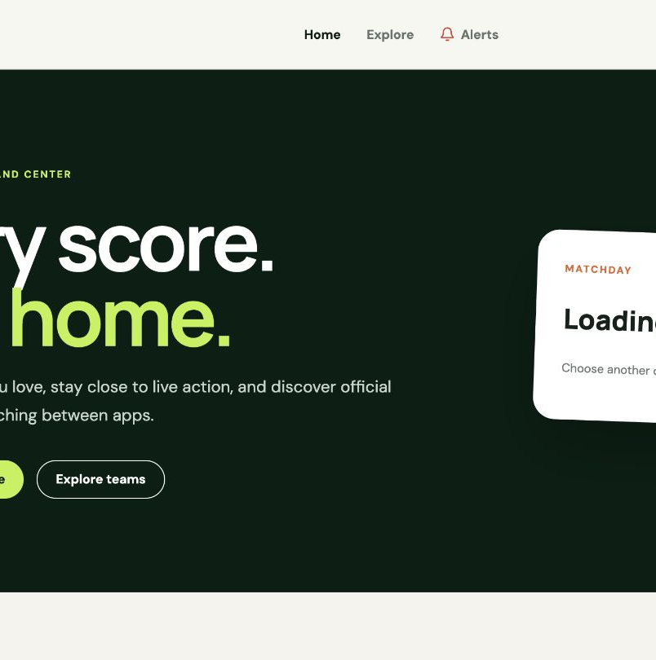
SPORTSHUB
A focused football
matchday experience
CS425 project demonstration
Samson Kitigo · Student ID 618666
REACT
FASTAPI
POSTGRESQL
A working web release backed by a documented path to live updates, alerts, ticket discovery, and administration.
Notes:
Introduce SportsHub as a football-first fan platform and immediately distinguish the working course release from its documented evolution.
The presentation moves from the problem and technology choices to requirements, implementation, UML evidence, testing, demonstration, and roadmap.
[Sources]
- /Users/samsonkitigo/Documents/Codex/sportshub/README.md
- /Users/samsonkitigo/Documents/Codex/sportshub/.tmp/submission-review/screenshots/home-desktop.png
[/Sources]

Slide 2
SPORTSHUB · CS425 PROJECT
SportsHub connects the pieces of a fan’s matchday
Problem and purpose
01
Fans
02
Administrators
Scores and fan tools often live in separate places.
Browse matchdays, inspect fixtures, follow teams, and manage alert preferences.
A planned portal manages featured tournaments, integrations, configuration, and operations.
SportsHub brings the essential football journey into one responsive experience while keeping the architecture open to richer live and administrative capabilities.
03
External providers
04
Course objective
Sports data, ticket inventory, and delivery networks remain outside the SportsHub system boundary.
Demonstrate requirements traceability, layered design, persistence, testing, and a working application.
FOOTBALL FIRST
02
Notes:
Explain the product in stakeholder terms before discussing features.
SportsHub owns accounts, preferences, internal associations, alert records, and normalized application behavior; external systems remain authoritative for sports and ticket data.
[Sources]
- /Users/samsonkitigo/Documents/Codex/sportshub/docs/sportshub_usecase.pdf
- /Users/samsonkitigo/Documents/Codex/sportshub/docs/sportshub_architecture.pdf
- /Users/samsonkitigo/Documents/Codex/sportshub/README.md
[/Sources]

Slide 3
SPORTSHUB · CS425 PROJECT
The core stack favors speed, clarity, and strong boundaries
React + TypeScript
FastAPI + Pydantic
Docker Compose
Responsive client and explicit contracts
Small API surface with built-in validation
One repeatable environment for the full stack
• Reusable page and form components
• Client-side routing for clear fan journeys
• Type checking catches API-shape mistakes early
• Vite keeps local development and builds fast
• Versioned REST endpoints and OpenAPI documentation
• Typed request and response schemas
• Dependency-based authentication and authorization
• Straightforward unit and API testing
• Starts PostgreSQL, migrations, API, and web client
• Reduces machine-specific setup differences
• Preserves service boundaries without microservices
• Supports a separate PostgreSQL test profile
Selection principle: use mature tools that make the architecture visible without adding unnecessary operational complexity.
03
Notes:
Describe why each technology was selected, not only what it is.
React and FastAPI create a clean browser-to-API boundary; TypeScript and Pydantic validate both sides; Docker makes the demonstration reproducible.
[Sources]
- /Users/samsonkitigo/Documents/Codex/sportshub/sportshub-frontend/package.json
- /Users/samsonkitigo/Documents/Codex/sportshub/sportshub-backend/requirements.txt
- /Users/samsonkitigo/Documents/Codex/sportshub/compose.yaml
[/Sources]

Slide 4
SPORTSHUB · CS425 PROJECT
Persistence and integrations can evolve independently
PostgreSQL
Relational integrity for users, teams, preferences, and alerts
Transactions and constraints fit account-to-team associations and user-scoped records.
SQLAlchemy + Alembic
Explicit repositories plus repeatable schema evolution
ORM mappings keep queries isolated while migrations make database changes reviewable.
iSportsAPI adapter
Provider data normalized behind a stable SportsHub contract
The adapter isolates vendor fields, applies caching, and can be replaced without rewriting endpoints.
Pytest + Vitest + Playwright
Evidence from business rules through browser journeys
Layered tests cover normal, boundary, error, persistence, desktop, and mobile behavior.
The current release uses a persistent file cache for provider responses; Redis and background workers are planned target-architecture components.
04
Notes:
Use this slide to connect technology selection to requirements: relational persistence, provider replaceability, quota-conscious caching, and test evidence.
Redis and workers belong to the documented next architecture, not the current Docker stack.
[Sources]
- /Users/samsonkitigo/Documents/Codex/sportshub/sportshub-backend/app/repositories
- /Users/samsonkitigo/Documents/Codex/sportshub/sportshub-backend/app/integrations/isports.py
- /Users/samsonkitigo/Documents/Codex/sportshub/sportshub-backend/alembic
- /Users/samsonkitigo/Documents/Codex/sportshub/docs/TEST_PLAN.md
[/Sources]

Slide 5
SPORTSHUB · CS425 PROJECT
Six use cases define the product and its next iterations
01
User account management
PARTIAL
02
Manage favorite teams
IMPLEMENTED
Registration and sign-in work now; full profile update and account deletion remain planned.
Search, follow, list, and remove teams through authenticated user-scoped operations.
03
View live matches
PARTIAL
04
View match details
IMPLEMENTED
Date and status browsing work now; independent polling and SSE updates are planned.
Overview, statistics, lineups, and timeline are available when provider data exists.
05
Search official tickets
PLANNED
06
Feature tournaments
PLANNED
Resolve fixture context, search an official provider, and redirect purchase externally.
Administrators select, order, and remove featured competitions without deleting fixtures.
The use-case descriptions record actors, preconditions, normal flows, postconditions, and business rules—not just feature names.
05
Notes:
Walk through status deliberately. The documents define the whole intended product; the labels show what the current executable release supports.
Ticket purchasing remains outside SportsHub, and removing a featured tournament never deletes the competition or its fixtures.
[Sources]
- /Users/samsonkitigo/Documents/Codex/sportshub/docs/sportshub_usecase.pdf
- /Users/samsonkitigo/Documents/Codex/sportshub/README.md
[/Sources]

Slide 6
SPORTSHUB · CS425 PROJECT
Persistence and integrations can evolve independently
PostgreSQL
Relational integrity for users, teams, preferences, and alerts
Transactions and constraints fit account-to-team associations and user-scoped records.
SQLAlchemy + Alembic
Explicit repositories plus repeatable schema evolution
ORM mappings keep queries isolated while migrations make database changes reviewable.
iSportsAPI adapter
Provider data normalized behind a stable SportsHub contract
The adapter isolates vendor fields, applies caching, and can be replaced without rewriting endpoints.
Pytest + Vitest + Playwright
Evidence from business rules through browser journeys
Layered tests cover normal, boundary, error, persistence, desktop, and mobile behavior.
The current release uses a persistent file cache for provider responses; Redis and background workers are planned target-architecture components.
04
Notes:
Use this slide to connect technology selection to requirements: relational persistence, provider replaceability, quota-conscious caching, and test evidence.
Redis and workers belong to the documented next architecture, not the current Docker stack.
[Sources]
- /Users/samsonkitigo/Documents/Codex/sportshub/sportshub-backend/app/repositories
- /Users/samsonkitigo/Documents/Codex/sportshub/sportshub-backend/app/integrations/isports.py
- /Users/samsonkitigo/Documents/Codex/sportshub/sportshub-backend/alembic
- /Users/samsonkitigo/Documents/Codex/sportshub/docs/TEST_PLAN.md
[/Sources]

Slide 7
SPORTSHUB · CS425 PROJECT
Persistence and integrations can evolve independently
PostgreSQL
Relational integrity for users, teams, preferences, and alerts
Transactions and constraints fit account-to-team associations and user-scoped records.
SQLAlchemy + Alembic
Explicit repositories plus repeatable schema evolution
ORM mappings keep queries isolated while migrations make database changes reviewable.
iSportsAPI adapter
Provider data normalized behind a stable SportsHub contract
The adapter isolates vendor fields, applies caching, and can be replaced without rewriting endpoints.
Pytest + Vitest + Playwright
Evidence from business rules through browser journeys
Layered tests cover normal, boundary, error, persistence, desktop, and mobile behavior.
The current release uses a persistent file cache for provider responses; Redis and background workers are planned target-architecture components.
04
Notes:
Use this slide to connect technology selection to requirements: relational persistence, provider replaceability, quota-conscious caching, and test evidence.
Redis and workers belong to the documented next architecture, not the current Docker stack.
[Sources]
- /Users/samsonkitigo/Documents/Codex/sportshub/sportshub-backend/app/repositories
- /Users/samsonkitigo/Documents/Codex/sportshub/sportshub-backend/app/integrations/isports.py
- /Users/samsonkitigo/Documents/Codex/sportshub/sportshub-backend/alembic
- /Users/samsonkitigo/Documents/Codex/sportshub/docs/TEST_PLAN.md
[/Sources]

Slide 8
SPORTSHUB · CS425 PROJECT
Persistence and integrations can evolve independently
PostgreSQL
Relational integrity for users, teams, preferences, and alerts
Transactions and constraints fit account-to-team associations and user-scoped records.
SQLAlchemy + Alembic
Explicit repositories plus repeatable schema evolution
ORM mappings keep queries isolated while migrations make database changes reviewable.
iSportsAPI adapter
Provider data normalized behind a stable SportsHub contract
The adapter isolates vendor fields, applies caching, and can be replaced without rewriting endpoints.
Pytest + Vitest + Playwright
Evidence from business rules through browser journeys
Layered tests cover normal, boundary, error, persistence, desktop, and mobile behavior.
The current release uses a persistent file cache for provider responses; Redis and background workers are planned target-architecture components.
04
Notes:
Use this slide to connect technology selection to requirements: relational persistence, provider replaceability, quota-conscious caching, and test evidence.
Redis and workers belong to the documented next architecture, not the current Docker stack.
[Sources]
- /Users/samsonkitigo/Documents/Codex/sportshub/sportshub-backend/app/repositories
- /Users/samsonkitigo/Documents/Codex/sportshub/sportshub-backend/app/integrations/isports.py
- /Users/samsonkitigo/Documents/Codex/sportshub/sportshub-backend/alembic
- /Users/samsonkitigo/Documents/Codex/sportshub/docs/TEST_PLAN.md
[/Sources]

Slide 9
SPORTSHUB · CS425 PROJECT
Persistence and integrations can evolve independently
PostgreSQL
Relational integrity for users, teams, preferences, and alerts
Transactions and constraints fit account-to-team associations and user-scoped records.
SQLAlchemy + Alembic
Explicit repositories plus repeatable schema evolution
ORM mappings keep queries isolated while migrations make database changes reviewable.
iSportsAPI adapter
Provider data normalized behind a stable SportsHub contract
The adapter isolates vendor fields, applies caching, and can be replaced without rewriting endpoints.
Pytest + Vitest + Playwright
Evidence from business rules through browser journeys
Layered tests cover normal, boundary, error, persistence, desktop, and mobile behavior.
The current release uses a persistent file cache for provider responses; Redis and background workers are planned target-architecture components.
04
Notes:
Use this slide to connect technology selection to requirements: relational persistence, provider replaceability, quota-conscious caching, and test evidence.
Redis and workers belong to the documented next architecture, not the current Docker stack.
[Sources]
- /Users/samsonkitigo/Documents/Codex/sportshub/sportshub-backend/app/repositories
- /Users/samsonkitigo/Documents/Codex/sportshub/sportshub-backend/app/integrations/isports.py
- /Users/samsonkitigo/Documents/Codex/sportshub/sportshub-backend/alembic
- /Users/samsonkitigo/Documents/Codex/sportshub/docs/TEST_PLAN.md
[/Sources]

Slide 10
SPORTSHUB · CS425 PROJECT
Persistence and integrations can evolve independently
PostgreSQL
Relational integrity for users, teams, preferences, and alerts
Transactions and constraints fit account-to-team associations and user-scoped records.
SQLAlchemy + Alembic
Explicit repositories plus repeatable schema evolution
ORM mappings keep queries isolated while migrations make database changes reviewable.
iSportsAPI adapter
Provider data normalized behind a stable SportsHub contract
The adapter isolates vendor fields, applies caching, and can be replaced without rewriting endpoints.
Pytest + Vitest + Playwright
Evidence from business rules through browser journeys
Layered tests cover normal, boundary, error, persistence, desktop, and mobile behavior.
The current release uses a persistent file cache for provider responses; Redis and background workers are planned target-architecture components.
04
Notes:
Use this slide to connect technology selection to requirements: relational persistence, provider replaceability, quota-conscious caching, and test evidence.
Redis and workers belong to the documented next architecture, not the current Docker stack.
[Sources]
- /Users/samsonkitigo/Documents/Codex/sportshub/sportshub-backend/app/repositories
- /Users/samsonkitigo/Documents/Codex/sportshub/sportshub-backend/app/integrations/isports.py
- /Users/samsonkitigo/Documents/Codex/sportshub/sportshub-backend/alembic
- /Users/samsonkitigo/Documents/Codex/sportshub/docs/TEST_PLAN.md
[/Sources]

Slide 11
SPORTSHUB · CS425 PROJECT
Persistence and integrations can evolve independently
PostgreSQL
Relational integrity for users, teams, preferences, and alerts
Transactions and constraints fit account-to-team associations and user-scoped records.
SQLAlchemy + Alembic
Explicit repositories plus repeatable schema evolution
ORM mappings keep queries isolated while migrations make database changes reviewable.
iSportsAPI adapter
Provider data normalized behind a stable SportsHub contract
The adapter isolates vendor fields, applies caching, and can be replaced without rewriting endpoints.
Pytest + Vitest + Playwright
Evidence from business rules through browser journeys
Layered tests cover normal, boundary, error, persistence, desktop, and mobile behavior.
The current release uses a persistent file cache for provider responses; Redis and background workers are planned target-architecture components.
04
Notes:
Use this slide to connect technology selection to requirements: relational persistence, provider replaceability, quota-conscious caching, and test evidence.
Redis and workers belong to the documented next architecture, not the current Docker stack.
[Sources]
- /Users/samsonkitigo/Documents/Codex/sportshub/sportshub-backend/app/repositories
- /Users/samsonkitigo/Documents/Codex/sportshub/sportshub-backend/app/integrations/isports.py
- /Users/samsonkitigo/Documents/Codex/sportshub/sportshub-backend/alembic
- /Users/samsonkitigo/Documents/Codex/sportshub/docs/TEST_PLAN.md
[/Sources]

Slide 12
SPORTSHUB · CS425 PROJECT
Persistence and integrations can evolve independently
PostgreSQL
Relational integrity for users, teams, preferences, and alerts
Transactions and constraints fit account-to-team associations and user-scoped records.
SQLAlchemy + Alembic
Explicit repositories plus repeatable schema evolution
ORM mappings keep queries isolated while migrations make database changes reviewable.
iSportsAPI adapter
Provider data normalized behind a stable SportsHub contract
The adapter isolates vendor fields, applies caching, and can be replaced without rewriting endpoints.
Pytest + Vitest + Playwright
Evidence from business rules through browser journeys
Layered tests cover normal, boundary, error, persistence, desktop, and mobile behavior.
The current release uses a persistent file cache for provider responses; Redis and background workers are planned target-architecture components.
04
Notes:
Use this slide to connect technology selection to requirements: relational persistence, provider replaceability, quota-conscious caching, and test evidence.
Redis and workers belong to the documented next architecture, not the current Docker stack.
[Sources]
- /Users/samsonkitigo/Documents/Codex/sportshub/sportshub-backend/app/repositories
- /Users/samsonkitigo/Documents/Codex/sportshub/sportshub-backend/app/integrations/isports.py
- /Users/samsonkitigo/Documents/Codex/sportshub/sportshub-backend/alembic
- /Users/samsonkitigo/Documents/Codex/sportshub/docs/TEST_PLAN.md
[/Sources]

Slide 13
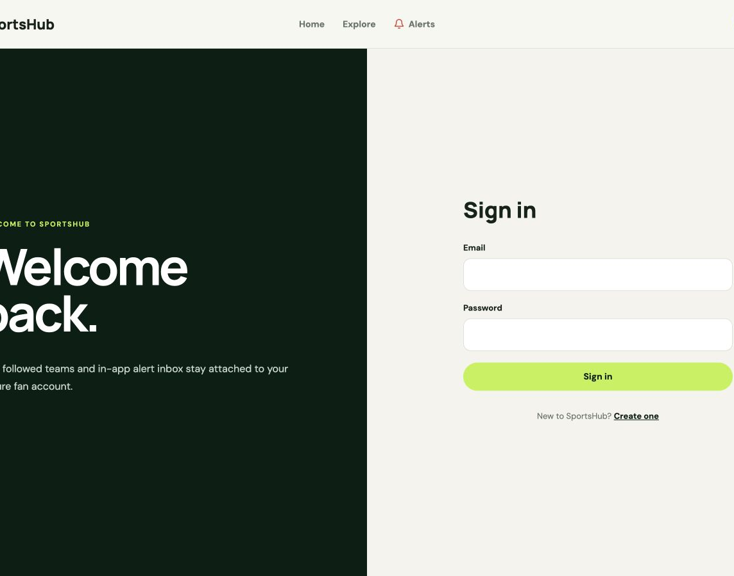
SPORTSHUB · CS425 PROJECT
Security and persistence are enforced behind the UI
SECURITY + DATA DESIGN
Passwords
BCrypt hashes are stored instead of plaintext credentials.
Bearer tokens
Signed, expiring JWTs are validated for protected requests.
Current user
The API derives identity from the token; the browser never supplies userId.
Repositories
SQLAlchemy persistence operations stay outside endpoint and service code.
Migrations
Alembic creates repeatable, reviewable PostgreSQL schema changes.
Secrets
Provider keys and signing secrets remain in ignored runtime configuration.
Security is enforced by the API—not by hiding links.
10
Notes:
Connect the UI to backend enforcement: route protection improves experience, but authentication, authorization, validation, and user scoping are verified by the API.
Point out the controller-service-repository separation in the real package structure.
[Sources]
- /Users/samsonkitigo/Documents/Codex/sportshub/sportshub-backend/app/services/auth.py
- /Users/samsonkitigo/Documents/Codex/sportshub/sportshub-backend/app/api/dependencies.py
- /Users/samsonkitigo/Documents/Codex/sportshub/sportshub-backend/app/repositories
- /Users/samsonkitigo/Documents/Codex/sportshub/sportshub-backend/alembic
- /Users/samsonkitigo/Documents/Codex/sportshub/.tmp/submission-review/screenshots/sign-in-desktop.png
[/Sources]

Slide 14
SPORTSHUB · CS425 PROJECT
Automated evidence covers behavior at every layer
46
8
2
46
backend tests
frontend tests
browser projects
PostgreSQL tests
pytest
Vitest
Playwright
Docker profile
Controller and API
Authentication, validation, status codes, matchday filtering, and fixture details
Service and repository
Preference rules, alert state, database queries, transactions, and error cases
Provider boundary
iSportsAPI normalization, caching, fallback host, optional detail data, and failures
Browser
Desktop and mobile journeys through matchday, fixture tabs, and team exploration
Last verified locally · August 25, 2026
11
Notes:
Testing is not a single count. Explain what each layer proves and show terminal output if time allows.
The PostgreSQL profile confirms migrations and repository behavior against the production database type.
[Sources]
- /Users/samsonkitigo/Documents/Codex/sportshub/docs/TEST_PLAN.md
- /Users/samsonkitigo/Documents/Codex/sportshub/Makefile
- /Users/samsonkitigo/Documents/Codex/sportshub/sportshub-backend/tests
- /Users/samsonkitigo/Documents/Codex/sportshub/sportshub-frontend/src/test/App.test.tsx
- /Users/samsonkitigo/Documents/Codex/sportshub/sportshub-frontend/e2e/smoke.spec.ts
[/Sources]

Slide 15
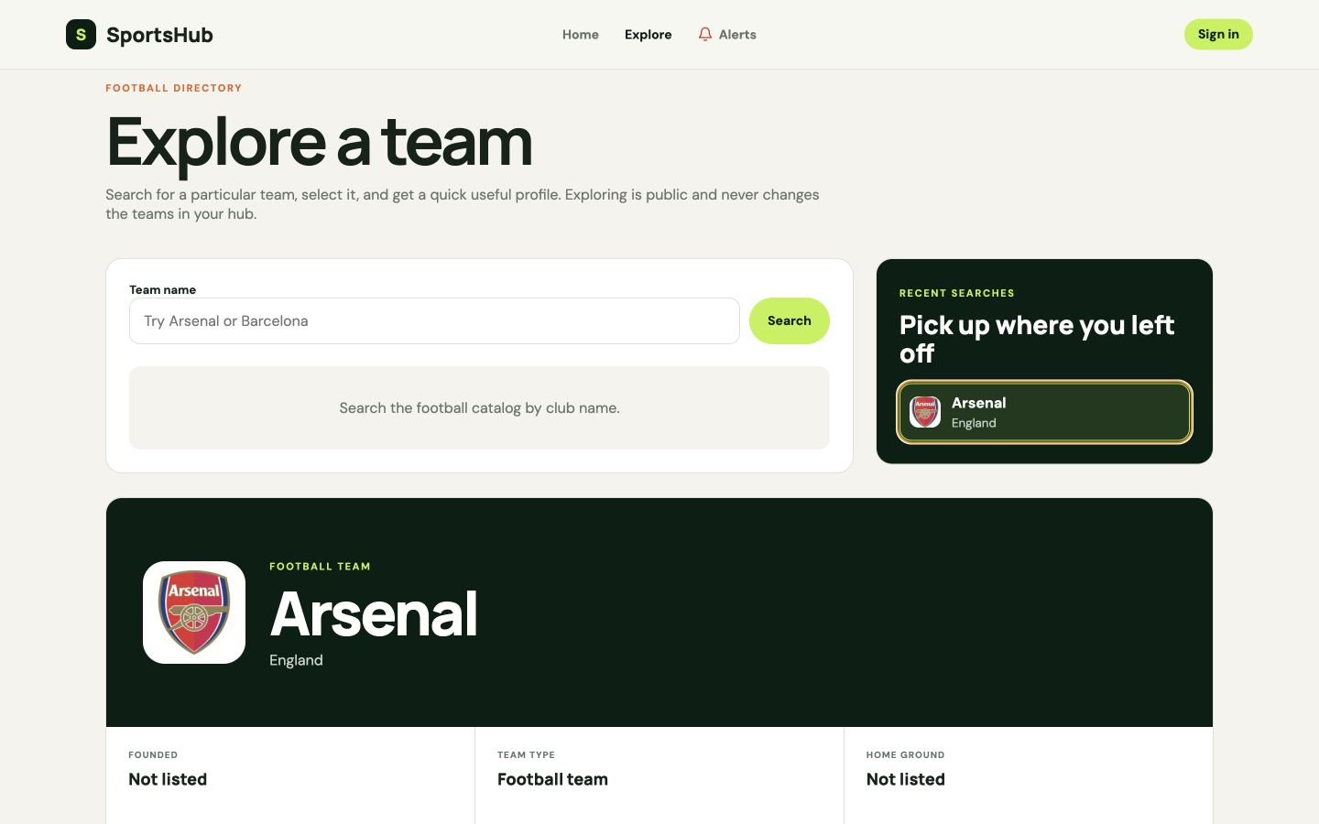
SPORTSHUB · CS425 PROJECT
The demo follows one fan from discovery to personalization
1
Browse the matchday
Choose a date and open a fixture.
2
Inspect the fixture
Show statistics, lineups, timeline, and the chat boundary.
3
Explore a team
Search, open a profile, and revisit a recent search.
4
Build My Hub
Register, follow the team, then remove it.
5
Clear the alerts
Read one item and mark the rest as read.
If live provider data is unavailable, continue with the sample provider and local account, hub, and alert flows.
12
Notes:
Use this as the live browser checklist. The route proves the major current-release use cases in one coherent story.
Keep the provider contingency ready so an external outage cannot stop the presentation.
[Sources]
- /Users/samsonkitigo/Documents/Codex/sportshub/README.md
- /Users/samsonkitigo/Documents/Codex/sportshub/sportshub-frontend/README.md
- /Users/samsonkitigo/Documents/Codex/sportshub/.tmp/submission-review/screenshots/team-explorer-desktop.png
[/Sources]

Slide 16
SPORTSHUB · CS425 PROJECT
The working release completes four connected fan journeys
01
Matchday
02
Fixture detail
Browse a selected local date, filter live/half-time/full-time/scheduled games, and paginate results.
Open overview, statistics, lineups, timeline, and a clearly labeled chat placeholder.
03
Team hub
04
Alert inbox
Search teams, view useful profiles and recent searches, then follow or remove a team.
Review persisted summaries, unread counts, preferences, individual read state, and mark-all-read.
Release boundary
Live SSE, automated match alerts, ticketing, Redis, admin workflows, and cloud hosting are planned.
06
Notes:
This is the executable scope checkpoint. Everything in the four cards is demonstrable in the current application.
The release-boundary strip prevents later design diagrams from being mistaken for completed behavior.
[Sources]
- /Users/samsonkitigo/Documents/Codex/sportshub/README.md
- /Users/samsonkitigo/Documents/Codex/sportshub/sportshub-frontend/src/pages/HomePage.tsx
- /Users/samsonkitigo/Documents/Codex/sportshub/sportshub-frontend/src/pages/FixtureDetailPage.tsx
- /Users/samsonkitigo/Documents/Codex/sportshub/sportshub-frontend/src/pages/TeamsPage.tsx
- /Users/samsonkitigo/Documents/Codex/sportshub/sportshub-backend/app/api/notifications.py
[/Sources]

Slide 17
SPORTSHUB · CS425 PROJECT
The working release completes four connected fan journeys
01
Matchday
02
Fixture detail
Browse a selected local date, filter live/half-time/full-time/scheduled games, and paginate results.
Open overview, statistics, lineups, timeline, and a clearly labeled chat placeholder.
03
Team hub
04
Alert inbox
Search teams, view useful profiles and recent searches, then follow or remove a team.
Review persisted summaries, unread counts, preferences, individual read state, and mark-all-read.
Release boundary
Live SSE, automated match alerts, ticketing, Redis, admin workflows, and cloud hosting are planned.
06
Notes:
This is the executable scope checkpoint. Everything in the four cards is demonstrable in the current application.
The release-boundary strip prevents later design diagrams from being mistaken for completed behavior.
[Sources]
- /Users/samsonkitigo/Documents/Codex/sportshub/README.md
- /Users/samsonkitigo/Documents/Codex/sportshub/sportshub-frontend/src/pages/HomePage.tsx
- /Users/samsonkitigo/Documents/Codex/sportshub/sportshub-frontend/src/pages/FixtureDetailPage.tsx
- /Users/samsonkitigo/Documents/Codex/sportshub/sportshub-frontend/src/pages/TeamsPage.tsx
- /Users/samsonkitigo/Documents/Codex/sportshub/sportshub-backend/app/api/notifications.py
[/Sources]

Slide 18
SPORTSHUB · CS425 PROJECT
The core stack favors speed, clarity, and strong boundaries
React + TypeScript
FastAPI + Pydantic
Docker Compose
Responsive client and explicit contracts
Small API surface with built-in validation
One repeatable environment for the full stack
• Reusable page and form components
• Client-side routing for clear fan journeys
• Type checking catches API-shape mistakes early
• Vite keeps local development and builds fast
• Versioned REST endpoints and OpenAPI documentation
• Typed request and response schemas
• Dependency-based authentication and authorization
• Straightforward unit and API testing
• Starts PostgreSQL, migrations, API, and web client
• Reduces machine-specific setup differences
• Preserves service boundaries without microservices
• Supports a separate PostgreSQL test profile
Selection principle: use mature tools that make the architecture visible without adding unnecessary operational complexity.
03
Notes:
Describe why each technology was selected, not only what it is.
React and FastAPI create a clean browser-to-API boundary; TypeScript and Pydantic validate both sides; Docker makes the demonstration reproducible.
[Sources]
- /Users/samsonkitigo/Documents/Codex/sportshub/sportshub-frontend/package.json
- /Users/samsonkitigo/Documents/Codex/sportshub/sportshub-backend/requirements.txt
- /Users/samsonkitigo/Documents/Codex/sportshub/compose.yaml
[/Sources]

Slide 19
SPORTSHUB · CS425 PROJECT
The core stack favors speed, clarity, and strong boundaries
React + TypeScript
FastAPI + Pydantic
Docker Compose
Responsive client and explicit contracts
Small API surface with built-in validation
One repeatable environment for the full stack
• Reusable page and form components
• Client-side routing for clear fan journeys
• Type checking catches API-shape mistakes early
• Vite keeps local development and builds fast
• Versioned REST endpoints and OpenAPI documentation
• Typed request and response schemas
• Dependency-based authentication and authorization
• Straightforward unit and API testing
• Starts PostgreSQL, migrations, API, and web client
• Reduces machine-specific setup differences
• Preserves service boundaries without microservices
• Supports a separate PostgreSQL test profile
Selection principle: use mature tools that make the architecture visible without adding unnecessary operational complexity.
03
Notes:
Describe why each technology was selected, not only what it is.
React and FastAPI create a clean browser-to-API boundary; TypeScript and Pydantic validate both sides; Docker makes the demonstration reproducible.
[Sources]
- /Users/samsonkitigo/Documents/Codex/sportshub/sportshub-frontend/package.json
- /Users/samsonkitigo/Documents/Codex/sportshub/sportshub-backend/requirements.txt
- /Users/samsonkitigo/Documents/Codex/sportshub/compose.yaml
[/Sources]

Slide 20

SPORTSHUB · CS425 PROJECT
A working foundation for a broader sports platform
Working now
A tested football workflow for matchdays, fixture detail, team personalization, authentication, and alerts.
Designed next
Realtime updates, automated notifications, official tickets, featured tournaments, and scalable infrastructure.
The constant
Stable boundaries keep the product understandable as it grows.
Questions
Notes:
Close by returning to the opening promise: SportsHub already demonstrates a coherent matchday experience and the design work shows how it grows responsibly.
Invite technical questions about architecture, authentication, persistence, provider normalization, caching, migrations, or the test strategy.
[Sources]
- /Users/samsonkitigo/Documents/Codex/sportshub/README.md
- /Users/samsonkitigo/Documents/Codex/sportshub/docs/sportshub_usecase.pdf
- /Users/samsonkitigo/Documents/Codex/sportshub/docs/sportshub_architecture.pdf
- /Users/samsonkitigo/Documents/Codex/sportshub/.tmp/submission-review/screenshots/home-hero.png
[/Sources]

