Slide 1
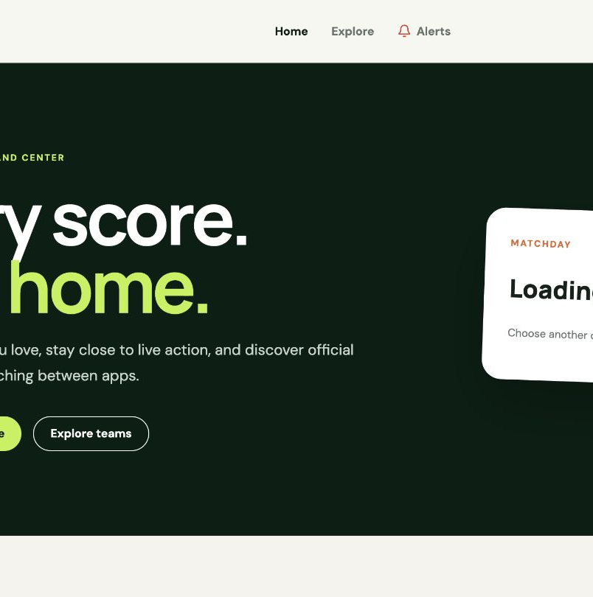
SPORTSHUB
A focused football
matchday experience
CS425 project demonstration
Samson Kitigo · Student ID 618666
REACT
FASTAPI
POSTGRESQL
A working, tested web release—followed by a clearly separated plan for realtime updates, official tickets, administration, and broader sports coverage.
Notes:
Introduce SportsHub as a football-first product with a working browser release.
Set the expectation that the presentation will clearly separate what is executable today from what the documents place in the next release or later horizon.
[Sources]
- /Users/samsonkitigo/Documents/Codex/sportshub/README.md
- /Users/samsonkitigo/Documents/Codex/sportshub/docs/WEB_PLAN.md
[/Sources]

Slide 2
SPORTSHUB · CS425 PROJECT
SportsHub connects the pieces of a fan’s matchday
Problem and purpose
01
Fans
02
Administrators
Scores, team context, and fan tools often live in separate places.
Browse matchdays, inspect fixtures, explore teams, personalize My Hub, and review alerts.
Planned role-protected workflows manage competitions, integrations, and operational configuration.
SportsHub brings the essential football journey into one responsive web experience: browse the day, understand a fixture, explore a club, personalize a hub, and review alerts.
03
External providers
04
Course objective
iSportsAPI remains authoritative for sports data; future ticket and delivery providers stay outside the system boundary.
Demonstrate requirements traceability, layered design, persistence, security, testing, and a working application.
FOOTBALL FIRST
02
Notes:
Explain the product problem in fan terms before discussing implementation.
The current course release is football-first and browser-based; provider-owned data and ticket fulfillment remain outside SportsHub.
[Sources]
- /Users/samsonkitigo/Documents/Codex/sportshub/docs/sportshub_usecase.pdf
- /Users/samsonkitigo/Documents/cs425/CS425.pdf
[/Sources]

Slide 3
SPORTSHUB · CS425 PROJECT
The core stack makes responsibilities visible and testable
React + TypeScript
FastAPI + Pydantic
PostgreSQL
Responsive fan journeys with explicit client contracts
A small modular API with built-in validation
Durable relational storage for user-scoped records
• Route-level pages keep public and protected journeys clear
• Typed API models catch response-shape mistakes early
• Reusable components support desktop and mobile layouts
• Vite keeps development, tests, and production builds fast
• Versioned REST endpoints and generated OpenAPI documentation
• Pydantic schemas validate requests and normalize responses
• Dependency injection provides auth and repository boundaries
• A modular monolith fits the course scope without microservice overhead
• Constraints protect users, teams, preferences, and alerts
• Transactions fit follow operations and inbox creation
• Indexes support predictable user and team lookups
• Alembic provides repeatable, reviewable schema changes
Selection principle: choose mature tools that strengthen correctness, clarity, and demonstration value.
03
Notes:
Explain why each technology was chosen, not only its name.
Docker is intentionally omitted here because it is a local development and integration-test convenience, not a product architecture decision.
[Sources]
- /Users/samsonkitigo/Documents/Codex/sportshub/sportshub-frontend/package.json
- /Users/samsonkitigo/Documents/Codex/sportshub/sportshub-backend/requirements.txt
- /Users/samsonkitigo/Documents/Codex/sportshub/sportshub-backend/app/db/models.py
[/Sources]

Slide 4
SPORTSHUB · CS425 PROJECT
The implementation follows explicit application-layer boundaries
Endpoint layer
Own HTTP validation, status codes, and authentication dependencies
Controllers translate requests and responses without embedding database queries or provider rules.
Service layer
Coordinate business rules and transaction boundaries
Following teams, creating alerts, and updating global preferences remain deliberate, testable operations.
Repository layer
Isolate SQLAlchemy queries and persistence operations
Repositories keep database code out of endpoints and make PostgreSQL behavior independently testable.
Provider adapter
Normalize iSportsAPI behind SportsHub contracts
Caching, host fallback, and vendor-field mapping can change without rewriting client-facing endpoints.
These boundaries keep persistence details, provider formats, and privileged diagnostics out of the fan interface.
04
Notes:
Walk the instructor through controller, service, repository, model, and database responsibilities.
Call out that the explicit repository layer was added to match the implementation rubric and improve testability.
[Sources]
- /Users/samsonkitigo/Documents/Codex/sportshub/sportshub-backend/app/api
- /Users/samsonkitigo/Documents/Codex/sportshub/sportshub-backend/app/services
- /Users/samsonkitigo/Documents/Codex/sportshub/sportshub-backend/app/repositories
- /Users/samsonkitigo/Documents/Codex/sportshub/sportshub-backend/app/integrations/isports.py
[/Sources]

Slide 5
SPORTSHUB · CS425 PROJECT
Six implemented capabilities form one connected fan experience
01
Account access
IMPLEMENTED
02
Matchday center
IMPLEMENTED
Register, sign in, restore the current user, and reach protected routes with a bearer token.
Browse one selected local date with status groups, local kickoff times, ordering, and pagination.
03
Fixture details
IMPLEMENTED
04
Explore Teams
IMPLEMENTED
Review overview, statistics, lineups, timeline, and an explicit Chat coming-soon boundary.
Search publicly, open a useful team profile, view match outlook, and return through recent searches.
05
My Hub
IMPLEMENTED
06
Alert inbox
IMPLEMENTED
Follow, list, and remove teams through authenticated user-scoped operations.
Review persisted summaries, unread counts, read state, mark-all-read, and stored global preferences.
Every capability on this page is executable in the current release; later features begin in the dedicated roadmap section.
05
Notes:
Use this as the scope checkpoint: every card can be demonstrated in the current application.
The following slides explain the behavior and implementation value of each capability in more detail.
[Sources]
- /Users/samsonkitigo/Documents/Codex/sportshub/README.md
- /Users/samsonkitigo/Documents/Codex/sportshub/sportshub-frontend/README.md
- /Users/samsonkitigo/Documents/Codex/sportshub/sportshub-backend/README.md
[/Sources]

Slide 6
SPORTSHUB · CS425 PROJECT
Accounts create a secure, user-scoped experience
Create account
Registration validates required fields and unique email
A successful registration persists the fan and immediately issues an authenticated session.
Sign in & restore
Login verifies credentials; /auth/me restores the current user
AuthContext owns token lifecycle so route pages do not duplicate session logic.
Authenticated identity
Protected endpoints derive the user from the validated token
Self-service preference operations never trust a browser-supplied userId.
Protected journeys
My Hub and Alerts require authentication
Anonymous visitors are redirected to sign in while matchday and team exploration remain public.
Documented next step: add full profile editing and account deletion with the same user-scoped security rules.
06
Notes:
Demonstrate registration or login, then explain that route guards improve UX while the API provides the actual security boundary.
[Sources]
- /Users/samsonkitigo/Documents/Codex/sportshub/sportshub-backend/app/api/auth.py
- /Users/samsonkitigo/Documents/Codex/sportshub/sportshub-backend/app/services/auth.py
- /Users/samsonkitigo/Documents/Codex/sportshub/sportshub-frontend/src/auth/AuthContext.tsx
[/Sources]

Slide 7
SPORTSHUB · CS425 PROJECT
The matchday center keeps every fixture on the right day
Selected date
Users can move through past, current, and upcoming matchdays
The API returns only fixtures whose kickoff belongs to the selected local calendar date.
Local kickoff
Browser timezone is sent to the API and rendered with locale rules
Fans see the match at the time and date that apply where they are, including UTC day-boundary cases.
Status & ordering
Live, half-time, full-time, and scheduled fixtures stay distinct
Live and in-progress matches appear first, with the latest active fixtures ordered ahead of older results.
Pagination & states
Large matchdays are paginated and filterable
Loading, no-results, unavailable-provider, and retry states keep the page usable without exposing provider telemetry.
Next release adds independent polling and SSE; the current page refreshes from date-scoped provider snapshots.
07
Notes:
Show a date change, local kickoff time, status tab, and pagination control.
Explain the prior bug that mixed other-day completed fixtures and how local-date filtering now prevents it.
[Sources]
- /Users/samsonkitigo/Documents/Codex/sportshub/sportshub-backend/app/api/fixtures.py
- /Users/samsonkitigo/Documents/Codex/sportshub/sportshub-frontend/src/pages/HomePage.tsx
[/Sources]

Slide 8
SPORTSHUB · CS425 PROJECT
Fixture details turn a score into match context
Overview
Score, status, venue, referee, kickoff, and period totals
A fan can understand the match state without leaving the selected fixture.
Statistics
Provider-backed team metrics are normalized into a stable response
Available possession, shots, and other measures render by team while missing data degrades cleanly.
Lineups
Formation, coach, starting XI, and substitutes appear by team
The detail contract keeps provider-specific fields out of the React page.
Timeline & tabs
Goals, cards, substitutions, and match events share an accessible tab set
Tabs keep dense information readable and retain one clear route back to the matchday center.
Chat is intentionally labeled “Coming soon”; no messaging or community behavior is claimed in this release.
08
Notes:
Open each detail tab during the demo and emphasize graceful handling when a provider omits optional data.
[Sources]
- /Users/samsonkitigo/Documents/Codex/sportshub/sportshub-backend/app/api/fixtures.py
- /Users/samsonkitigo/Documents/Codex/sportshub/sportshub-frontend/src/pages/FixtureDetailPage.tsx
[/Sources]

Slide 9
SPORTSHUB · CS425 PROJECT
Explore Teams answers who a club is—and what comes next
Public search
Search provider-backed teams without signing in
Discovery is deliberately separate from the authenticated action of following a team.
Useful profile
Crest, country, type, founded year, venue, capacity, and location
The selected search result expands into a stable SportsHub team record rather than stalling on a button state.
Match outlook
Show a live/current fixture, next match, and latest result when available
Each match card links directly to the fixture detail route in the fan’s local time.
Recent searches
The browser keeps the five most recently opened team profiles
Fans can resume exploration quickly without changing account data or the teams in My Hub.
Exploring a team is public and read-only; it never adds or removes a followed-team association.
09
Notes:
Demonstrate a team search, the profile facts, the match outlook, and a recent-search revisit.
[Sources]
- /Users/samsonkitigo/Documents/Codex/sportshub/sportshub-backend/app/api/teams.py
- /Users/samsonkitigo/Documents/Codex/sportshub/sportshub-backend/app/services/teams.py
- /Users/samsonkitigo/Documents/Codex/sportshub/sportshub-frontend/src/pages/TeamsPage.tsx
[/Sources]

Slide 10
SPORTSHUB · CS425 PROJECT
My Hub makes personalization reversible and user-scoped
Follow a team
Authenticated fans add a resolved team to their personal hub
The current user comes from the bearer token, so one fan cannot write another fan’s preferences.
Stable resolution
Repository logic resolves internal UUIDs and provider identifiers
Shared team records remain reusable even when a provider uses a different external ID format.
Duplicate safe
The service appends only missing user-team associations
Repeated follow requests report duplicates instead of creating a second association.
Confirmed removal
Fans confirm before removing a followed team
Only that user-team association is deleted; the shared team and other users’ follows remain intact.
Team following and global notification preferences are separate transactions with separate API requests.
10
Notes:
Follow a team, show it in My Hub, then remove it to prove that personalization is reversible.
[Sources]
- /Users/samsonkitigo/Documents/Codex/sportshub/sportshub-backend/app/api/users.py
- /Users/samsonkitigo/Documents/Codex/sportshub/sportshub-backend/app/repositories/team_preferences.py
- /Users/samsonkitigo/Documents/Codex/sportshub/sportshub-frontend/src/pages/TeamsPage.tsx
[/Sources]

Slide 11
SPORTSHUB · CS425 PROJECT
The alert inbox makes account activity visible
Persistent inbox
Alerts are stored per user and ordered newest first
Refreshing the page preserves summaries, links, timestamps, and read state in PostgreSQL.
Current sources
Registration creates a welcome alert; a new follow creates a team alert
These concrete account events prove the inbox flow without pretending scheduled match alerts already run.
Unread workflow
Navigation badge, unread dot, single-read, and mark-all-read stay synchronized
Every read operation is scoped to the authenticated user and updates the visible unread count.
Preference foundation
Global pre-match, kickoff, end, chat, and promotion toggles are stored
The API can also store a device token, but the web release does not expose push setup or delivery.
Next release generates pre-match, match-start, score, and full-time alerts from fixture events; today’s delivery is in-app only.
11
Notes:
Explain the difference between the implemented inbox/preferences foundation and the not-yet-implemented match-event scheduler.
[Sources]
- /Users/samsonkitigo/Documents/Codex/sportshub/sportshub-backend/app/services/notifications.py
- /Users/samsonkitigo/Documents/Codex/sportshub/sportshub-backend/app/services/auth.py
- /Users/samsonkitigo/Documents/Codex/sportshub/sportshub-backend/app/services/teams.py
- /Users/samsonkitigo/Documents/Codex/sportshub/sportshub-frontend/src/pages/AlertsPage.tsx
[/Sources]

Slide 12
SPORTSHUB · CS425 PROJECT
Provider integration stays quota-conscious and replaceable
Adapter boundary
iSportsAPI calls stay behind one SportsHub provider contract
Endpoints and React pages consume normalized fixtures, teams, statistics, lineups, and schedules.
Normalization
Vendor fields map into stable internal response models
A provider replacement changes the adapter and contract tests—not every controller and component.
Cache discipline
Matchdays, fixture details, teams, searches, and schedules are cached
Persistent snapshots reduce repeat requests, support local pagination, and protect a limited API allowance.
Graceful fallback
Secondary-host retry, sample data, and clear unavailable states protect the demo
The UI never exposes API keys, quota counters, cache-hit telemetry, or raw provider diagnostics to fans.
Provider diagnostics remain administrator-only; credentials and signing secrets stay in ignored runtime configuration.
12
Notes:
Connect caching to the provider suspension and free-tier constraint: the goal is resilient product behavior, not a quota dashboard for users.
[Sources]
- /Users/samsonkitigo/Documents/Codex/sportshub/sportshub-backend/app/integrations/isports.py
- /Users/samsonkitigo/Documents/Codex/sportshub/sportshub-backend/app/api/admin.py
- /Users/samsonkitigo/Documents/Codex/sportshub/docs/WEB_PLAN.md
[/Sources]

Slide 13
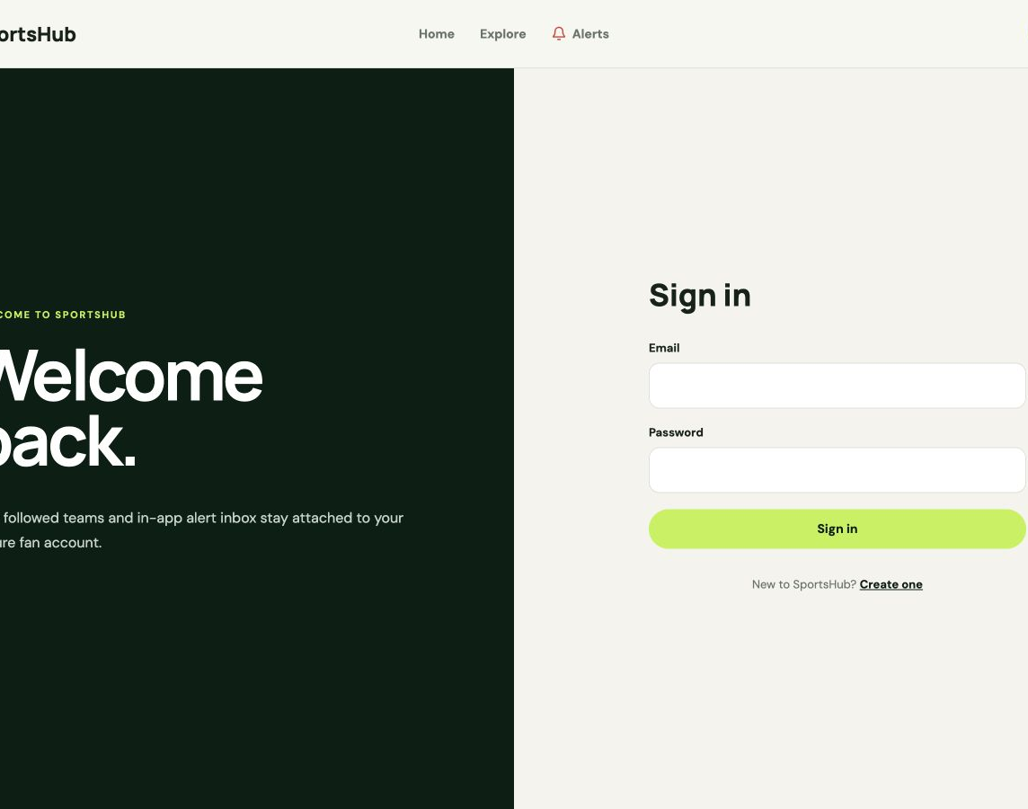
SPORTSHUB · CS425 PROJECT
Security and persistence are enforced behind the UI
SECURITY + DATA DESIGN
Passwords
BCrypt hashes are stored instead of plaintext credentials.
Bearer tokens
Signed, expiring JWTs are validated for protected requests.
Current user
The API derives identity from the token; the browser never supplies userId.
Repositories
Repository classes keep SQLAlchemy queries outside endpoint and service code.
Migrations
Alembic creates repeatable, reviewable PostgreSQL schema changes.
Secrets
Provider keys and signing secrets remain in ignored runtime configuration.
Security is enforced by the API—not by hiding links.
13
Notes:
Tie the user interface to backend enforcement: protected routes improve navigation, but authorization, validation, and record scoping happen in the API.
[Sources]
- /Users/samsonkitigo/Documents/Codex/sportshub/sportshub-backend/app/core/security.py
- /Users/samsonkitigo/Documents/Codex/sportshub/sportshub-backend/app/api/dependencies.py
- /Users/samsonkitigo/Documents/Codex/sportshub/sportshub-backend/alembic
[/Sources]

Slide 14
SPORTSHUB · CS425 PROJECT
Automated evidence covers behavior at every layer
48
8
2
48
backend tests
frontend tests
browser projects
PostgreSQL tests
pytest
Vitest
Playwright
Integration profile
Controller and API
Authentication, validation, status codes, local-date filtering, pagination, and fixture details
Service and repository
Preference rules, user scoping, alert state, repository queries, transactions, and error cases
Provider boundary
iSportsAPI normalization, caching, secondary-host fallback, optional detail data, and failures
Browser
Desktop and mobile matchday, fixture-tab, and team-detail browser journeys
Current suite · 48 backend tests · 8 frontend tests · 2 browser projects
14
Notes:
Explain what each layer proves rather than treating the counts as the entire testing story.
The integration profile reruns the backend suite against PostgreSQL so repository behavior matches the production database type.
[Sources]
- /Users/samsonkitigo/Documents/Codex/sportshub/docs/TEST_PLAN.md
- /Users/samsonkitigo/Documents/Codex/sportshub/sportshub-backend/tests
- /Users/samsonkitigo/Documents/Codex/sportshub/sportshub-frontend/src/test/App.test.tsx
- /Users/samsonkitigo/Documents/Codex/sportshub/sportshub-frontend/e2e/smoke.spec.ts
[/Sources]

Slide 15
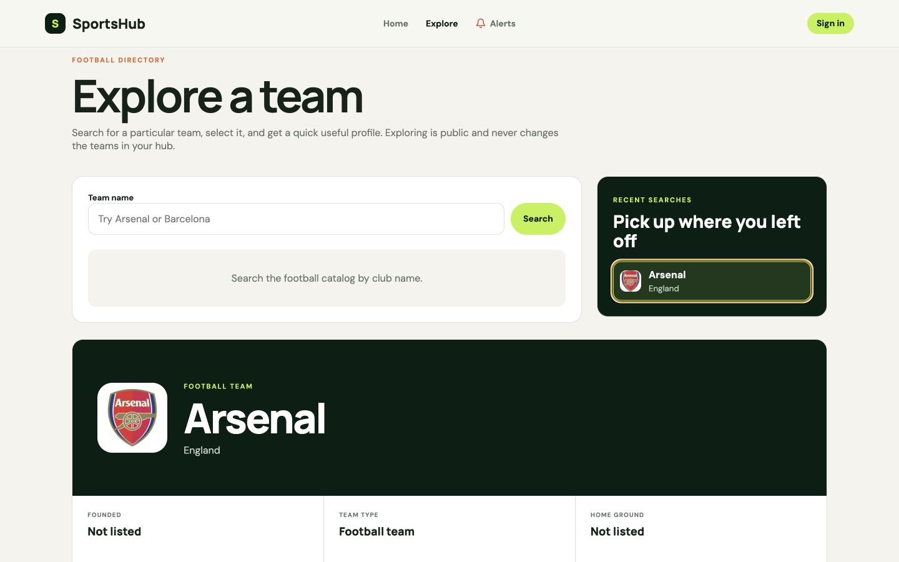
SPORTSHUB · CS425 PROJECT
The demo follows one fan from discovery to personalization
1
Browse the matchday
Change the date, show local time, select a status, and open a fixture.
2
Inspect the fixture
Move through overview, statistics, lineups, timeline, and the Chat boundary.
3
Explore a team
Search, open a profile, inspect the match outlook, and revisit a recent search.
4
Build My Hub
Register or sign in, follow the team, then remove it with confirmation.
5
Review the inbox
Open Alerts, read one item, and clear the remaining unread count.
If live provider data is unavailable, continue with the sample provider and the local account, hub, and alert flows.
15
Notes:
Use this as the browser demonstration checklist so the presentation proves the major current-release use cases in one story.
[Sources]
- /Users/samsonkitigo/Documents/Codex/sportshub/README.md
- /Users/samsonkitigo/Documents/Codex/sportshub/sportshub-frontend/README.md
[/Sources]

Slide 16
SPORTSHUB · CS425 PROJECT
Next release: realtime updates and match-event alerts
01
Independent poller
02
Browser SSE
Poll live fixtures in background work, compare snapshots, and broadcast only when a match is live or its state changes.
Subscribe before the initial detail lookup, then deliver connected, fixture_detail, fixture_update, and heartbeat events.
03
Fresh reconnect
04
Generated alerts
A reconnect opens a new subscription and restores current state from a fresh snapshot—without Last-Event-ID or replay.
Evaluate followed teams and global toggles to create pre-match, kickoff, score, and full-time inbox events.
Built now
Stored global toggles and inbox records exist now; next release adds event generation and scheduling.
16
Notes:
Present realtime behavior and automated alerts as one coherent next-release slice built on the current fixture and inbox foundations.
[Sources]
- /Users/samsonkitigo/Documents/Codex/sportshub/docs/WEB_PLAN.md
- /Users/samsonkitigo/Documents/Codex/sportshub/docs/lab4_sequence_diagram.pdf
- /Users/samsonkitigo/Documents/Codex/sportshub/docs/SportsHub_Lab5.pdf
[/Sources]

Slide 17
SPORTSHUB · CS425 PROJECT
Next release: tickets, standings, and administration
01
Standings & competitions
02
Official ticket discovery
Add normalized competition and standings views so fans can move from a fixture to broader league context.
Resolve fixture teams, competition, date, and attraction mappings into Ticketmaster search parameters.
03
Safe buy redirect
04
Admin workflows
Route /api/v1/tickets/events/{eventId}/buy through eligible Impact links with direct Ticketmaster fallback.
Add role-protected featured-tournament ordering, integration status, and limited user/content operations with audit evidence.
Boundary
SportsHub does not own inventory or process payment, fulfillment, refunds, or ticket-provider support.
17
Notes:
Keep ticketing precise: SportsHub supports discovery and safe handoff only.
Featured-tournament administration comes from the documented use case and does not delete the underlying tournament or fixtures.
[Sources]
- /Users/samsonkitigo/Documents/Codex/sportshub/docs/sportshub_usecase.pdf
- /Users/samsonkitigo/Documents/Codex/sportshub/docs/WEB_PLAN.md
- /Users/samsonkitigo/Documents/Codex/sportshub/docs/lab4_sequence_diagram.pdf
[/Sources]

Slide 18
SPORTSHUB · CS425 PROJECT
Next-release engineering makes the product production-ready
Shared realtime state
Background work
Cloud-ready operations
Introduce infrastructure only when the live path requires it
Separate scheduled work from browser requests
Harden delivery, recovery, and observability
• Add Redis when multiple API processes must share cache or subscription state
• Define ownership, TTLs, versioned keys, and invalidation rules
• Keep process-local cache disposable and provider snapshots recoverable
• Prove concurrency and fixture-isolation behavior with automated tests
• Run fixture polling and alert generation outside request handlers
• Make jobs idempotent and retry provider failures with bounds
• Record alert outcomes without inventing user-visible queue semantics
• Measure worker health and live-update delay
• Add secure edge routing, TLS, scaling, and environment configuration
• Centralize logs, metrics, health checks, and secret redaction
• Rehearse migrations, backup, restore, rollback, and provider outage paths
• Complete accessibility, performance, and responsive regression gates
This work turns the same modular boundaries into a dependable release without prematurely splitting the application into microservices.
18
Notes:
Describe these as release-enabling engineering tasks rather than end-user features.
[Sources]
- /Users/samsonkitigo/Documents/Codex/sportshub/docs/WEB_PLAN.md
- /Users/samsonkitigo/Documents/Codex/sportshub/docs/TEST_PLAN.md
- /Users/samsonkitigo/Documents/Codex/sportshub/docs/SportsHub Lab 3 Architecture - Scope Aligned.pdf
[/Sources]

Slide 19
SPORTSHUB · CS425 PROJECT
Later expansion stays separate from the next release
More sports
Native mobile
Optional engagement
Extend the football-first product through stable contracts
Deliver a dedicated Android and iOS experience
Ideas documented beyond the initial platform
• Add sports only after provider coverage and response models are defined
• Reuse authentication, preferences, alerts, and navigation foundations
• Keep sport-specific rules behind adapters and services
• Preserve the current “more sports coming soon” expectation
• Push notifications tied to the same global preference model
• Offline access to selected content and home-screen widgets
• Biometric authentication and improved mobile performance
• Share API contracts without duplicating backend business rules
• AI predictions and personalized recommendations
• Social communities, match discussion, and in-app messaging
• Official merchandise discovery or marketplace features
• Premium subscriptions and advanced statistics
These are long-term possibilities—not commitments for the next release and not completed functionality in the current submission.
19
Notes:
Use this slide to protect scope: the documents name these ideas, but the next release remains focused on finishing the web platform.
[Sources]
- /Users/samsonkitigo/Documents/cs425/CS425.pdf
- /Users/samsonkitigo/Documents/Codex/sportshub/docs/SportsHub Lab 3 Architecture - Scope Aligned.pdf
- /Users/samsonkitigo/Documents/Codex/sportshub/docs/WEB_PLAN.md
[/Sources]

Slide 20

SPORTSHUB · CS425 PROJECT
A working foundation for a broader sports platform
Working now
A tested football workflow for local-time matchdays, fixture detail, team exploration, My Hub, authentication, and an in-app alert inbox.
Next release
Realtime updates, generated match alerts, standings, official ticket discovery, administration, and release hardening.
The constant
Stable application boundaries keep the product understandable as it grows.
Questions
Notes:
Close by returning to the opening promise: a coherent current experience and a disciplined, evidence-backed next release.
Invite technical questions about layering, authentication, user scoping, provider normalization, caching, migrations, or tests.
[Sources]
- /Users/samsonkitigo/Documents/Codex/sportshub/README.md
- /Users/samsonkitigo/Documents/Codex/sportshub/docs/WEB_PLAN.md
[/Sources]

