Slide 1
Students Score

Slide 2
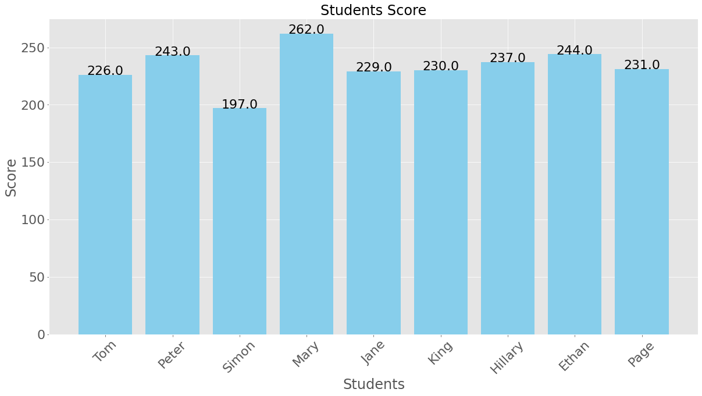
Students Score Bar Graph

