Slide 1
Team Graph_Algos
Sean Garvey
Minh Truong
Sammy Tbeile

Slide 2
Acknowledgements
Bjarne Stroustrup
David King
Developers of Matplotlib
Jeff Whitaker, Developer of Basemap
stat-computing.org, US Airline Flight Path Data
openflights.org, World Airline Flight Path Data

Slide 3
Overview
Library
Set of Algorithm functions
Container class
Represents adjacency lists and matrices
Helper class
Constructs adjacency lists and matrices
Example Code
Application: Airline Flight Path Data

Slide 4
Motivation
Boost Algorithms Library has a complex interface
void dijkstra_shortest_paths_no_init(const Graph& g, typename graph_traits<Graph>::vertex_descriptor s, PredecessorMap predecessor, DistanceMap distance, WeightMap weight, IndexMap index_map, Compare compare, Combine combine, DistZero zero, DijkstraVisitor vis, ColorMap color = default);
Wanted to create a simple interface

Slide 5
Implemented Algorithms
Dijkstra’s
Shortest Path
Bellman Ford
Shortest Path, with negative edges
Johnson’s
All Pairs Shortest Path
Prim’s
Minimum Spanning Tree
Tarjan’s
Articulation Points

Slide 6
Dijkstra’s - Shortest Path
Finds the shortest path between two vertices in a graph
This is asymptotically the fastest single source shortest-path finding algorithm
Time complexity
O(|V|log|V|)
Applications
Networking
Navigation

Slide 7
Bellman Ford - Shortest Path
Finds the shortest path between two vertices in a graph
Slower than Dijkstra’s but this algorithm works for graphs with negative weights
Time complexity
O(|E|*|V|)
Applications
Computer Networks/routing protocols

Slide 8
Johnson’s - All Pairs Shortest Path
Finds the shortest path between all pairs of vertices in a graph
Time complexity
O(|V|^2 * log|V||)
Slower than running Dijkstra’s for every pair of vertices but it accounts for negative edge weights, and it is faster than running Bellman-Ford for every pair of vertices
Applications
Navigation
Networking

Slide 9
Prim’s - Minimum Spanning Tree
Computes a minimum spanning tree of a graph
Time complexity
O(|E| log |V|)
Applications
Mechanical / Electrical Networks
Dependency Trees
Circuits

Slide 10
Tarjan’s Algorithm - Articulation Points
Finds the articulation points of a graph
Time complexity
O(|V| + |E|)
Applications
Social Network Theory
Marketing
Computer Networks
Graph Analysis

Slide 11
Algorithm Interface
vector<pair<unsigned long, double>> BellFord(Graph graph, unsigned long origin_index, unsigned long destin_index); vector<pair<unsigned long, double>> Dijkstras(Graph graph, unsigned long origin_index, unsigned long destin_index); vector<vector<vector<pair<unsigned long, double>>>> Johnsons(Graph graph); vector<unsigned long> Tarjans(Graph graph); vector<vector<pair<unsigned long, double>>> Prims(Graph graph);

Slide 12
Graph Container
Purpose
Simplifies Algorithm interface
Validation structure of representation
Internal representation as adjacency list and adjacency matrix
Re-usable
Inner graph data structure is immutable
Internal representation is compact -- keep the cache hot and run faster
Vertices in the internal graph representation are implemented using doubles
Vertices cannot be represented using user defined classes or types

Slide 13
Graph Container Interface
template<typename Container> Graph(Container container);
Container can be either an
Adjacency Matrix: Container<Container<double>>
Adjacency List: Container<Container<pair<unsigned long, double>>>
Can be vector<array< >>, array<list< >>, list<vector< >>, etc..
Container need only implement
begin()
end()
size()

Slide 14
Graph Helper
Purpose
To aid the user in construction of a graph representation
Returns either
Adjacency List or Matrix as a vector<vector<double>>
Also returns
Vertex → Index Map
Index → Vertex Associative Vector
Interface is minimal
Specify Vertex as template parameter
Specify graph representation as constructor parameter

Slide 15
Graph Helper Interface
enum graph_t { LIST, MATRIX }; template<typename Vertex> Graph_Helper(graph_t g); void add_edge(Vertex origin, Vertex destin, double dist); // tuple<matrix, map, associative vector> tuple<vector<vector<double>>, unordered_map<Vertex, unsigned long>, vector<Vertex>> get_matrix_tuple(); // tuple<list, map, associative vector> tuple<vector<vector<pair<unsigned long, double>>>, vector<Vertex>, unordered_map<Vertex, unsigned long>> get_list_tuple();

Slide 16
Application of Library:
Airline Flight Path Data
Used Airline Flight Path Data to test our library
Plotted resulting output using Matplotlib in conjunction with Basemap
Data Schemas:
Airports (AirportCode varchar(3), Latitude double, Longitude double)
Paths (OriginCode varchar(3), DestinCode varchar(3), Distance int(32))
Data Sources
stat-computing.org (US Data)
openflights.org (World Data)

Slide 17
Example Use Case
Use the Graph_Helper class to
add edges to an adjacency matrix
construct a vertex → index unordered_map
construct an index → vertex vector
Use the vertex → index map to
find the indexes of the starting/ending vertices
Use Dijkstra’s
Algorithm::Dijkstras(Graph graph, unsigned long start_index, unsigned long end_index)
Print to stdout

Slide 18
Example Use Case: Add Edges
auto graph_helper = Graph_Helper<string>(MATRIX); auto result_set = statement->executeQuery("SELECT * FROM Paths"); while(result_set->next()) { auto origin = result_set->getString("Origin"); // 3-Letter Airport Code auto destin = result_set->getString("Destin"); // 3-Letter Airport Code double dist = result_set->getInt("Distance"); graph_helper.add_edge(origin, destin, dist); }

Slide 19
Example Use Case: Get Tuple
auto graph_helper = Graph_Helper<string>(MATRIX); auto result_set = statement->executeQuery("SELECT * FROM WorldPaths"); while(result_set->next()) { auto origin = result_set->getString("Origin"); // 3-Letter Airport Code auto destin = result_set->getString("Destin"); // 3-Letter Airport Code double dist = result_set->getInt("Distance"); graph_helper.add_edge(origin, destin, dist); } auto matrix_tuple = graph_helper.get_matrix_tuple(); auto matrix = get<0>(matrix_tuple); auto code_index_map = get<1>(matrix_tuple); // vertex --> index auto index_code_vector = get<2>(matrix_tuple); // index --> vertex auto graph = Graph(matrix);

Slide 20
Example Use Case: Find Indexes
auto graph_helper = Graph_Helper<string>(MATRIX); auto result_set = statement->executeQuery("SELECT * FROM WorldPaths"); while(result_set->next()) { auto origin = result_set->getString("Origin"); // 3-Letter Airport Code auto destin = result_set->getString("Destin"); // 3-Letter Airport Code double dist = result_set->getInt("Distance"); graph_helper.add_edge(origin, destin, dist); } auto matrix_tuple = graph_helper.get_matrix_tuple(); auto matrix = get<0>(matrix_tuple); auto code_index_map = get<1>(matrix_tuple); // vertex --> index auto index_code_vector = get<2>(matrix_tuple); // index --> vertex auto graph = Graph(matrix); string origin = argv[1]; string destin = argv[2]; unsigned long origin_index = code_index_map[origin]; // vertex --> index unsigned long destin_index = code_index_map[destin]; // vertex --> index

Slide 21
Example Use Case: Run Dijkstra’s
auto graph_helper = Graph_Helper<string>(MATRIX); auto result_set = statement->executeQuery("SELECT * FROM WorldPaths"); while(result_set->next()) { auto origin = result_set->getString("Origin"); // 3-Letter Airport Code auto destin = result_set->getString("Destin"); // 3-Letter Airport Code double dist = result_set->getInt("Distance"); graph_helper.add_edge(origin, destin, dist); } auto matrix_tuple = graph_helper.get_matrix_tuple(); auto matrix = get<0>(matrix_tuple); auto code_index_map = get<1>(matrix_tuple); // vertex --> index auto index_code_vector = get<2>(matrix_tuple); // index --> vertex auto graph = Graph(matrix); string origin = argv[1]; string destin = argv[2]; unsigned long origin_index = code_index_map[origin]; // vertex --> index unsigned long destin_index = code_index_map[destin]; // vertex --> index auto res = Algorithms::Dijkstras(graph, origin_index, destin_index);

Slide 22
Example Use Case: Print Output
auto graph_helper = Graph_Helper<string>(MATRIX); auto result_set = statement->executeQuery("SELECT * FROM WorldPaths"); while(result_set->next()) { auto origin = result_set->getString("Origin"); // 3-Letter Airport Code auto destin = result_set->getString("Destin"); // 3-Letter Airport Code double dist = result_set->getInt("Distance"); graph_helper.add_edge(origin, destin, dist); } auto matrix_tuple = graph_helper.get_matrix_tuple(); auto matrix = get<0>(matrix_tuple); auto code_index_map = get<1>(matrix_tuple); // vertex --> index auto index_code_vector = get<2>(matrix_tuple); // index --> vertex auto graph = Graph(matrix); string origin = argv[1]; string destin = argv[2]; unsigned long origin_index = code_index_map[origin]; // vertex --> index unsigned long destin_index = code_index_map[destin]; // vertex --> index auto res = Algorithms::Dijkstras(graph, origin_index, destin_index); for(auto& e : res) { auto code = index_code_vector[e.first]; // index --> vertex auto gps_pair = code_gps_map[code]; // supplemental map for our dataset auto lat = gps_pair.first; auto lng = gps_pair.second; auto weight = e.second; cout << lat << ", " << lng << ", " << weight << ", " << code << '\n'; }

Slide 23
Application of Library:
Airline Flight Path Data Plots

Slide 24
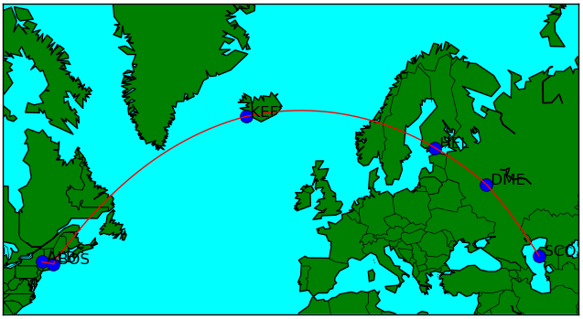
Dijkstra’s
Albany, New York - Aktau, Kazakhstan

Slide 25
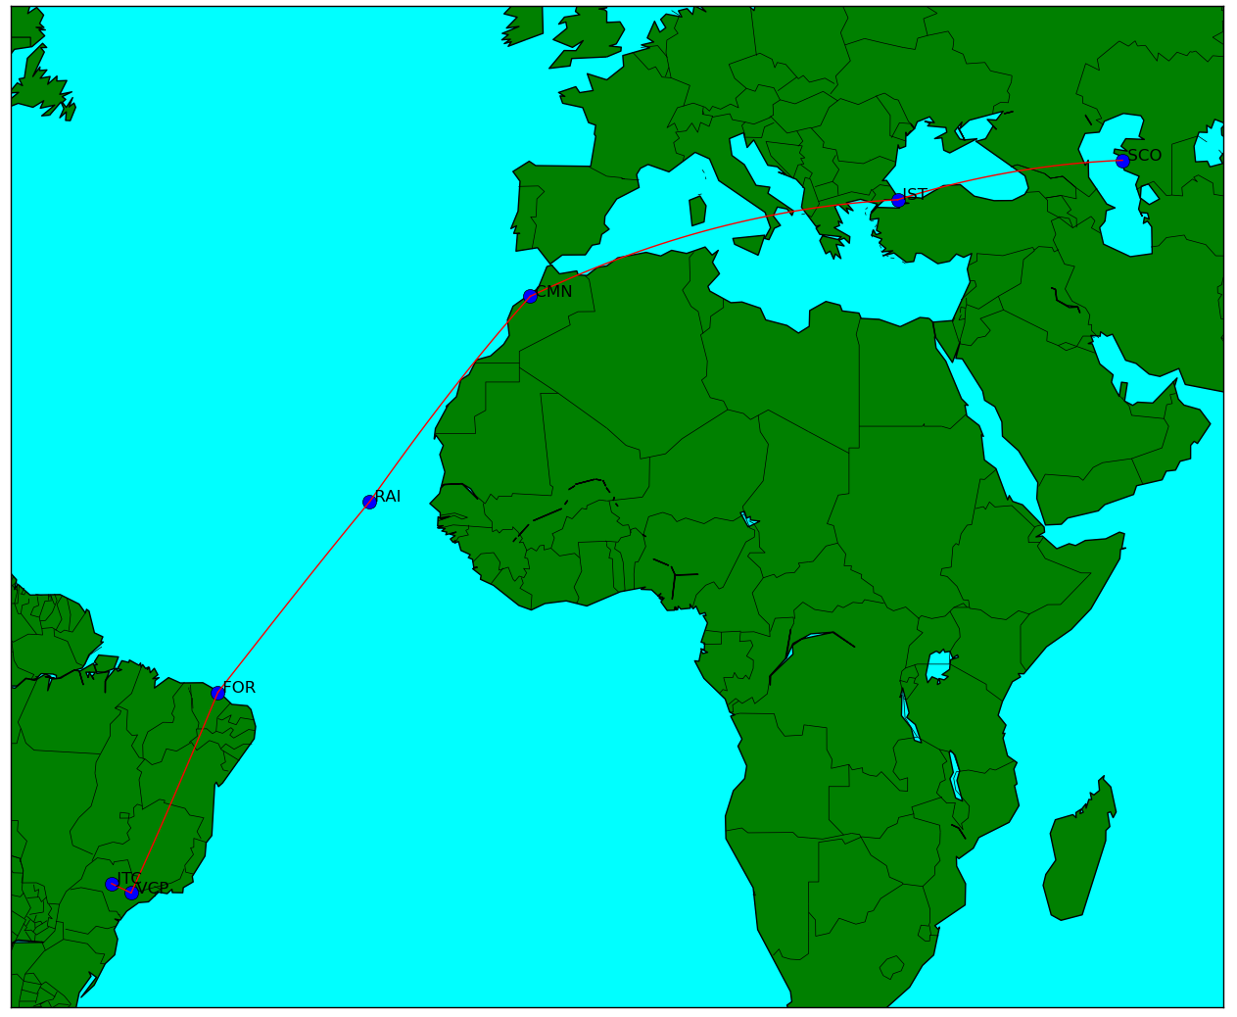
BellmanFord Bauru, Brazil - Aktau, Kazakhstan

Slide 26
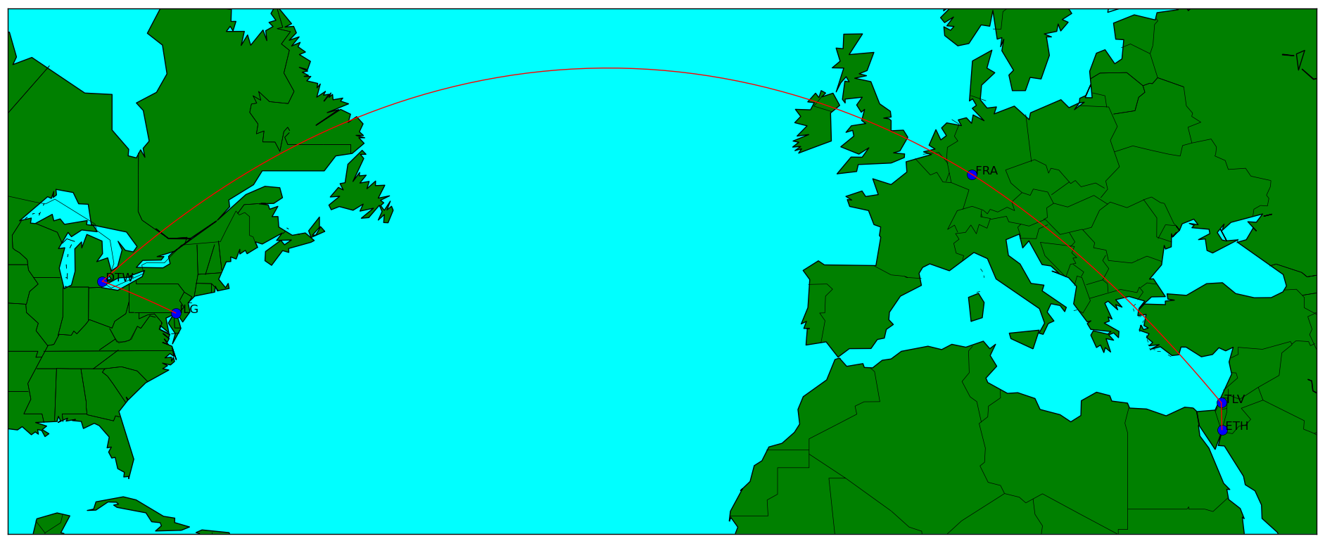
Dijkstra’s
Wilmington, Delaware - Eilat, Israel

Slide 27
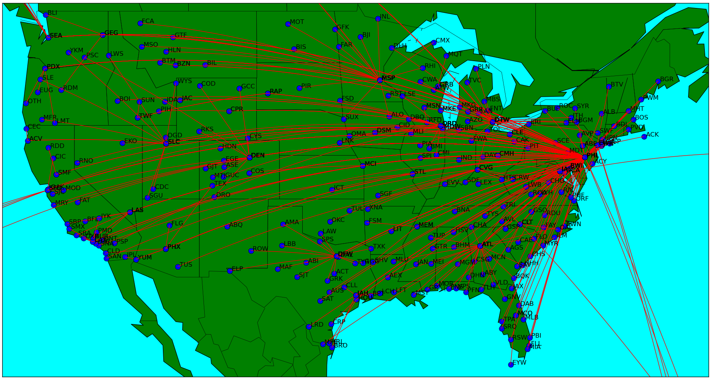
Johnson’s
Philadelphia, Pennsylvania - All US Cities

Slide 28
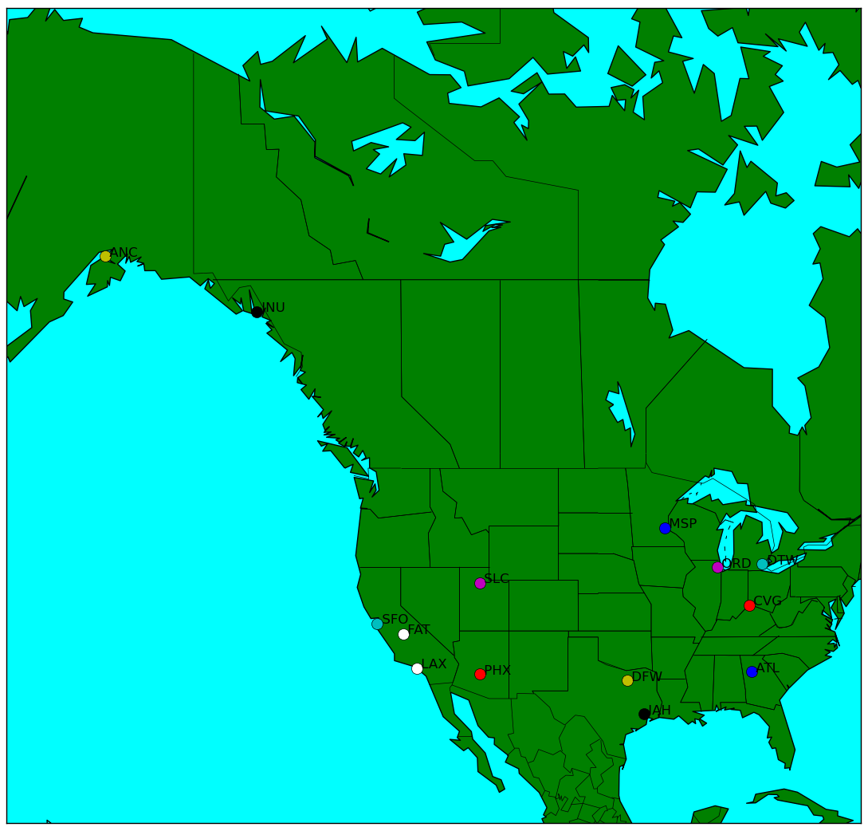
Tarjan’s - US

Slide 29
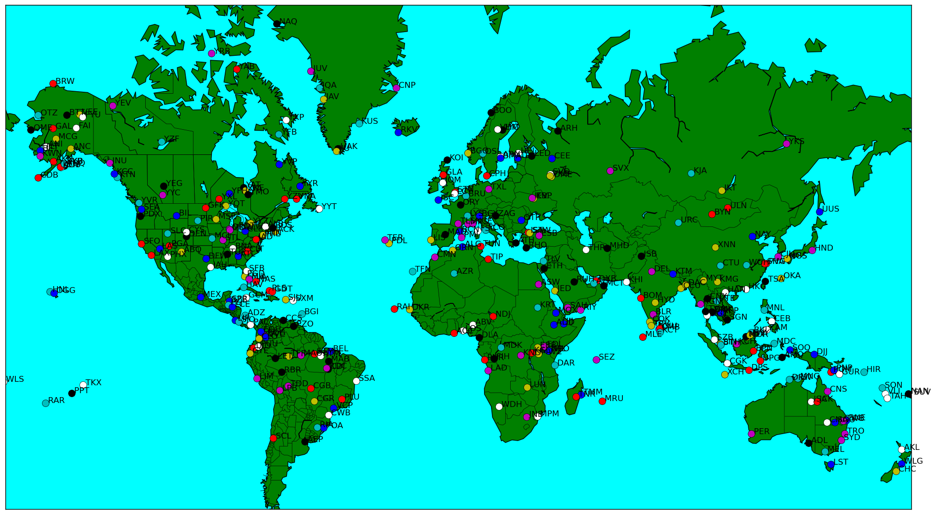
Tarjan’s - World

Slide 30
Thank you!

