Slide 1
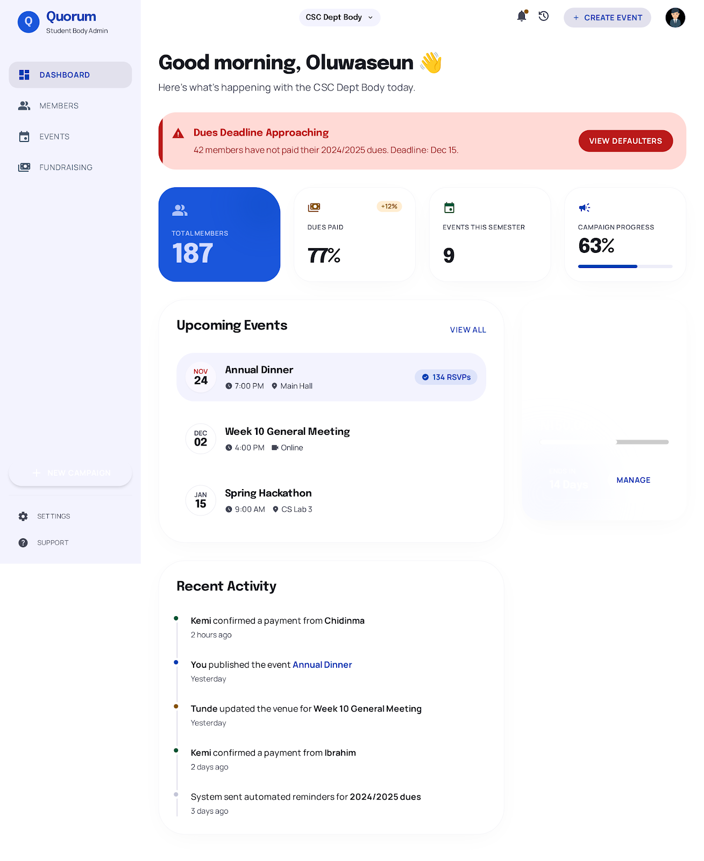
Q
Quorum
Where student bodies
get things done.
The operating system for student bodies,
communities and small organisations — built for Africa.
Thinkathon 2025
🟢 Live at quorum-taupe.vercel.app

Slide 2
THE PROBLEM
Q
Student bodies run on
WhatsApp and spreadsheets.
No accountability
Dues collection is manual chaos
Treasurer overhead
Tasks assigned verbally in group chats. Action items get buried. Nothing is tracked or followed up.
Broadcast messages, individual DMs, and bank transfer screenshots shared back and forth every semester.
Manually cross-checking 40–60 payment screenshots per cycle — a full afternoon of unpaid admin work.
Institutional amnesia
No affordable alternative
Meeting minutes in personal Notes apps. Leadership changes annually. Decisions and history disappear.
Google Workspace costs $6–18/user/month. Notion has no dues or fundraising. Nothing fits a 10-person exco.

Slide 3
THE SOLUTION
Q
One platform. Seven modules.
Built for how student bodies actually operate.
👥
💳
📅
📋
Member Registry
Dues Tracker
Events & Programs
Meetings
Role-based profiles, level filters, invite links, bulk CSV export
Payment submission, AI-verified receipts, live defaulter list
Event creation, RSVP, WhatsApp OG preview links, attendance analytics
Agenda builder, quorum check, live minutes, action items, PDF export
💰
📊
🔗
Fundraising
Budget Planner
Smart Links & Portal
Multi-stream campaigns, public donation page, contributor ledger
Budget line items, planned vs actual spend, variance flags
Branded short links, custom slugs, QR codes, public body portal page

Slide 4
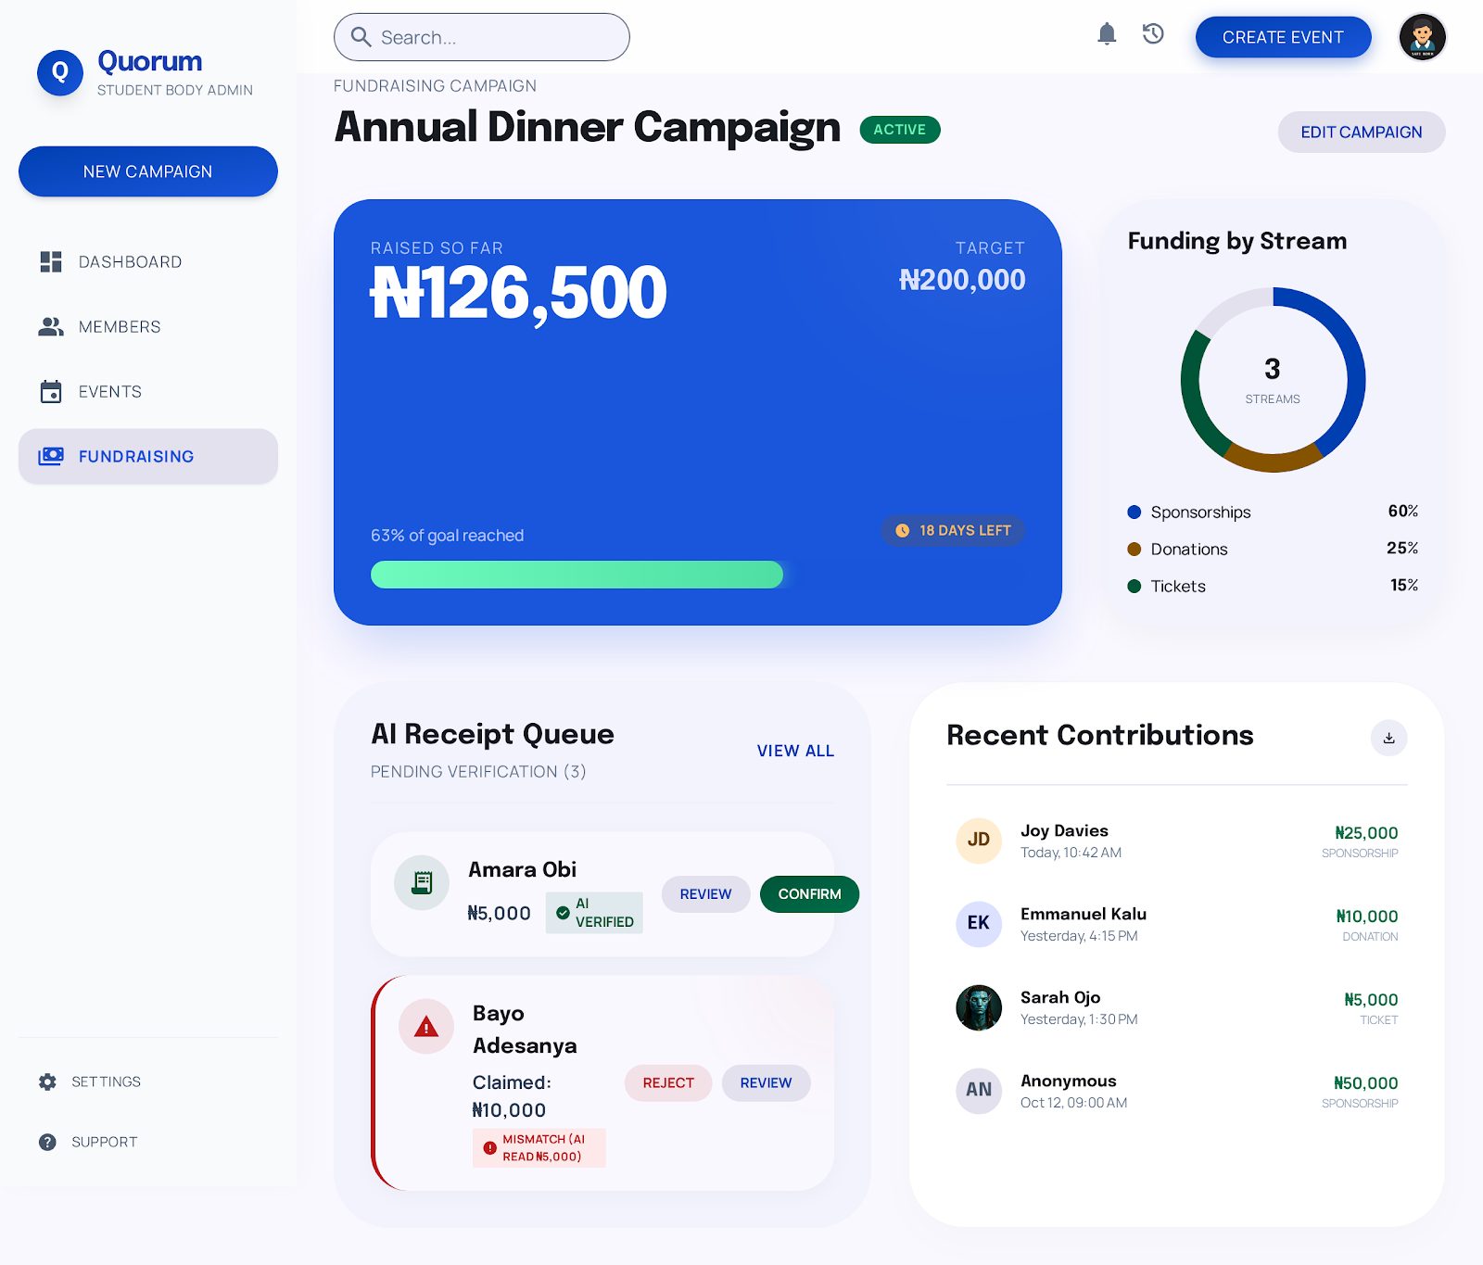
PRODUCT
Q
Live. Deployed. Open source.
Next.js frontend
FastAPI (Python)
Claude AI
GitHub public
Frontend:
Live at quorum-taupe.vercel.app
Backend:
Live at quorum-9djb.onrender.com/docs
AI Layer:
Claude — meeting minutes + task assignment
Codebase:
github.com/Sammybams/Quorum — public repo
Fundraising dashboard — live on Vercel · full 7-module platform deployed

Slide 5
AI FEATURES
Q
We use AI where it adds
real value — not for show.
Dues collection — two-path flow
Meeting intelligence
PRIMARY
The primary Claude feature — turns meetings into structured records automatically.
01
02
03
Member clicks Pay
Paystack checkout
Webhook confirms
01
Transcript arrives
Inside Quorum dashboard
→
Card, transfer, USSD, virtual account
→
Dues status auto-updates. Zero manual work.
Auto-synced from Google Meet, Fireflies, or Zoom — or pasted manually.
02
Claude processes it
Structures minutes, extracts every action item and decision.
FALLBACK
For cash payments or transfers made outside Quorum:
03
Tasks auto-assigned
01
02
03
Each action item becomes a task assigned to the named exco member.
Upload receipt
Claude reads it
Treasurer confirms
Bank alert screenshot
→
Extracts amount, sender, date, ref
→
One tap — or rejects if mismatch.
04
Email notifications sent
Assigned members receive task details and meeting context.
Payment gateway eliminates manual verification. Claude handles what gateways can't — unstructured text, meeting transcripts, and narrative intelligence.

Slide 6
MARKET OPPORTUNITY
Q
A large, underserved market
across African universities.
TAM
₦360M+
All university student bodies across Africa — Nigeria plus Ghana, Kenya, South Africa — that need structured operations tools but cannot afford enterprise software like Google Workspace or Notion.
Basis: ~1,000 African universities × 30 bodies × ₦12,000/year = ₦360M (Nigeria alone: 200 × 30 × ₦12k = ₦72M)
Total Addressable Market
SAM
₦72M
Nigerian university student bodies specifically — where the pain is most acute, digital adoption is rising fastest, and Quorum's local-first design (Nigerian bank receipts, ₦ pricing, WhatsApp-native links) gives it a structural advantage.
Basis: 200 universities × 30 bodies × ₦12,000/year = ₦72M addressable annual revenue
Serviceable Addressable Market
SOM
₦15M
Year 1 (validation): 200 workspaces, 30 paid → ₦2.4M. Year 2 (scale): 500 workspaces across 20 campuses, 125 paid at ₦11,600 blended ARPU → ₦15M. Conversion improves as product matures and referral loops activate.
Basis: 125 paid × ₦11,600 blended ARPU × 10 active months = ₦14.5M ≈ ₦15M
Serviceable Obtainable Market
Year 2 target
Sources: NUC 2024 — 200 accredited universities; Statista Africa SaaS Market 2024; World Bank Nigeria Education Data 2023

Slide 7
BUSINESS MODEL
Q
Role-based tiered pricing.
Designed for student budgets.
Every workspace has a Super Admin (exco president), Subteam Leads, and Core Members. Pricing scales with team size — not with the wider membership.
Starter
Growth
Pro
Free
₦8,000
₦20,000
forever
/month · ₦86,400/year
/month · ₦216,000/year
Up to 3 admin seats
Up to 10 admin seats
Up to 25 admin seats
20 AI receipt verifications/month
100 AI verifications/month + minutes assistant
500 AI verifications/month + analytics reports
Member registry
Everything in Starter
Everything in Growth
Dues tracker with receipt upload
Meetings module (agenda, quorum, minutes)
Custom domain for portal page
Event creator with shareable links
Budget planner
White-label branding
Announcements board
Events analytics dashboard
AI-generated analytics reports
1 active fundraising campaign
Short link click analytics
Custom role builder
Additional AI credits available: ₦1,500 / 50 credits · ₦4,500 / 200 credits · ₦9,000 / 500 credits

Slide 8
AI AUDIT REPORT
Q
Every student body deserves
to know how well they performed.
At the end of each semester, Claude reads all platform data and generates a full organisational performance report — the kind of document a president can present to the general assembly, the faculty, or the incoming exco at handover.
01
Executive summary
Sample performance scorecard
3-paragraph narrative verdict — honest about wins and failures.
6.8
Good
/ 10
02
Category scorecards
7 modules scored against targets: dues, events, meetings, fundraising, membership, comms, AI usage.
Dues collection
68%
Events & programs
86%
03
Recommendations
Meetings & governance
72%
5–8 specific actions for the next leadership cycle, each tied to a data finding.
Fundraising
63%
04
Handover note
Membership growth
91%
Addressed directly to incoming exco — what they are inheriting, good and bad.
How it works: Claude reads all platform data → scores 7 categories → writes narrative → exports branded PDF · Customisable: toggle categories, set targets, add custom sections

Slide 9
DEVELOPMENT STATUS & NEXT STEPS
Q
The product is live.
Here is what comes next.
LIVE
Frontend
Backend API
AI integration
GitHub
Next.js — deployed on Vercel
quorum-taupe.vercel.app
→
FastAPI on Render — Swagger docs live
quorum-9djb.onrender.com/docs
→
Claude meeting minutes, task
extraction + email notifications
→
Public repo · all modules
github.com/Sammybams/Quorum
▼
IN PROGRESS
Payment integration
OAuth integrations
→
Paystack + Flutterwave webhooks
for automatic dues & donation confirmation
Google Meet transcript sync
Microsoft Teams + Outlook email invite
NEXT
1. Beta — 3 campus bodies
2. AI analytics report feature
→
▼
→
3. Public launch + onboarding

Slide 10
Q
Quorum
Where student bodies get things done.
Free to start · Built for Nigeria · Expanding across Africa
quorum.ng
hello@quorum.ng
@quorumng

