Slide 1

Introduction to Data Science/Machine Learning
University of Wisconsin Milwaukee
Fall 2025
Sammie Omranian

Slide 2

Girls Who Code – Week 2
- More Python Basics
- Real-World Data in Python

Slide 3
Agenda
Today’s Plan:
Quick Python Basics Review
Practice: if/else, for loops, while loops
Intro to Real-World Data
Hands-on with Titanic dataset

Slide 4
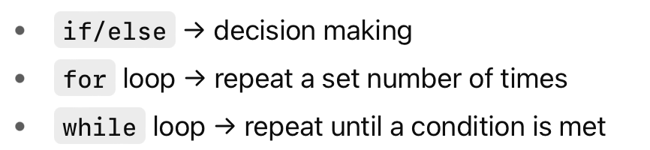
Python Basics Review

Slide 5
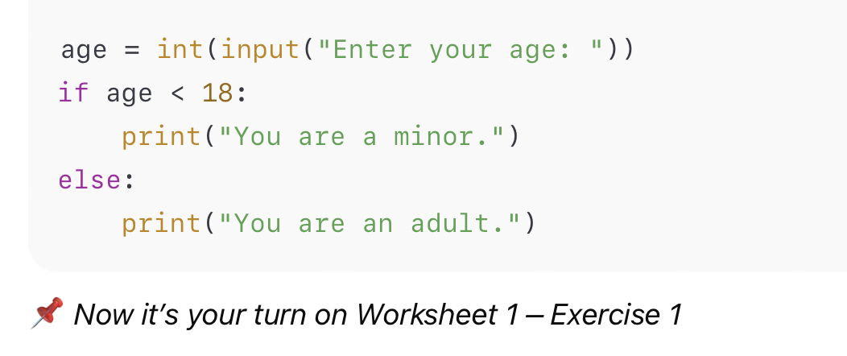

Slide 6
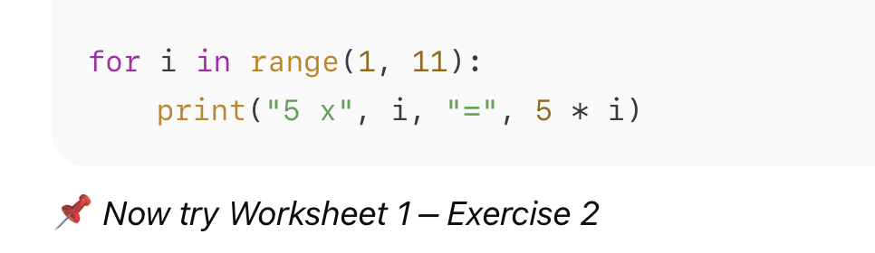
for loop

Slide 7
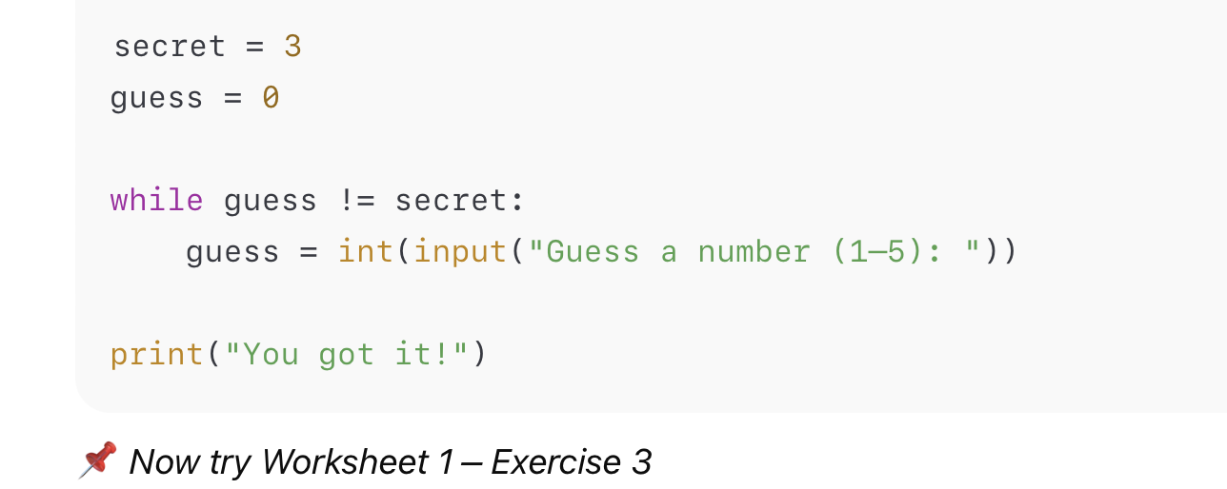
while loop

Slide 8
Intro to Real-World Data
Data is everywhere (music, sports, social media, weather)
Python helps us organize and explore data
We’ll use a library called pandas

Slide 9
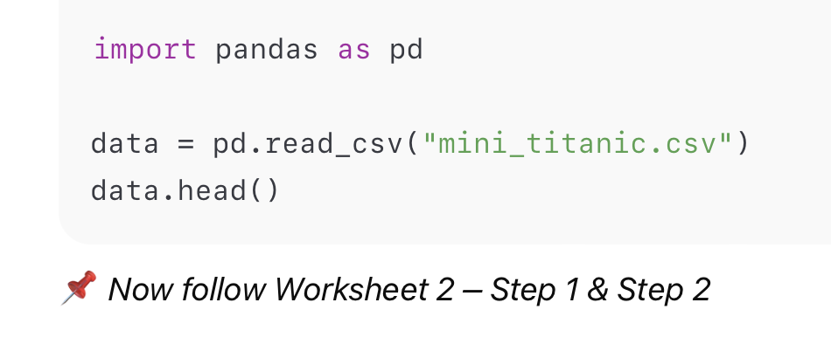
First Look at a Dataset

Slide 10
Exploring Titanic Data
Who survived and who didn’t?
Do survival rates differ by gender?
Which class had more survivors?
📌 Worksheet 2 – Exercises 1–3

Slide 11

Google Colab – Our Coding Hub Where we’ll write, run, and share all our Python code

Slide 12
Wrap up
✅ Reviewed Python basics (if/else, for, while)
✅ Practiced with small programs
✅ Learned how to load and explore a dataset in Colab
📌 Next week: Cleaning & preparing data

