Slide 1

Introduction to Data Science/Machine Learning
University of Wisconsin Milwaukee
Fall 2025
Sammie Omranian

Slide 2

Girls Who Code – Week 3
- Data cleaning and preparation

Slide 3
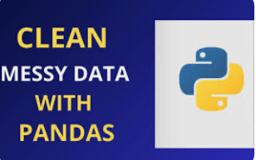
Agenda
Today’s Plan:
Recap – Titanic dataset & Python basics
Why Clean Data? – real-world examples
Tools in Pandas – handling missing values, duplicates, renaming
Hands-On Activity – clean a weather dataset
Reflection & Wrap-Up – why clean data matters

Slide 4

Why Clean Data?
Real-world data is messy!
Problems we often see:
Missing values (blanks or NaN)
Duplicates
Wrong formats (e.g., age stored as text)
Cleaning data makes analysis accurate and trustworthy
Image source

Slide 5
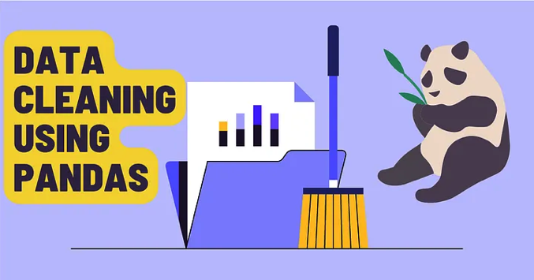
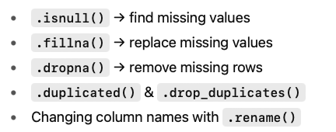
Pandas Tools for Cleaning

Slide 6
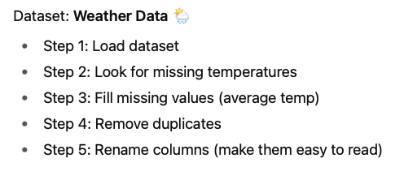
Hands-On Activity

Slide 7

Python Lists (Quick Review)
What is a list?
A list is a collection of items.
Items are inside square brackets []
Items are separated by commas
Use lists when you want to keep multiple things in order.

Slide 8

Google Colab – Our Coding Hub Where we’ll write, run, and share all our Python code

