Slide 1
MICROSOFT MOVIE STUDIO PROJECT

Slide 2
SCOPE
INTRODUCTION
Overview
Business Problem
Data Understanding
ANALYSIS
FINALIZATION
Results
Recommendations
Conclusions

Slide 3
INTRODUCTION
OVERVIEW
The objective of this project is to provide actionable insights to Microsoft, a new movie studio that wants to create successful movies. The analysis will focus on exploring the types of films that are currently performing well at the box office and providing recommendations on what types of movies the studio should create.
BUSINESS PROBLEM
Microsoft, a new movie studio, lacks knowledge and experience in creating successful movies. In order to establish itself as a competitive player in the movie industry, Microsoft needs to understand the types of films that are currently performing well at the box office and the factors that contribute to their success. By doing so, the studio can develop a strategy to create successful movies that resonate with audiences and achieve high box office returns. The business problem, therefore, is to provide Microsoft with actionable insights and recommendations that will enable it to create successful movies and establish itself as a successful movie studio in the industry.

Slide 4
DATA UNDERSTANDING
To conduct the analysis, data is collected and analyzed from various sources. This may include box office revenue data, movie genre data, franchise and non-franchise movie data, audience demographic data, and critical review data. The data will be gathered from publicly available sources such as box office tracking websites, movie industry reports, and critical review websites.
The data is analyzed using statistical and data visualization tools to identify patterns and trends in the movie industry. The analysis will focus on understanding the factors that contribute to box office success, such as genre, franchise status, budget, special effects, and critical reviews.

Slide 5
ANALYSIS
To conduct the analysis, data will be collected and analyzed from various sources. This may include box office revenue data, movie genre data, franchise and non-franchise movie data, audience demographic data, and critical review data. The data will be gathered from publicly available sources such as box office tracking websites, movie industry reports, and critical review websites.
The data will be analyzed using statistical and data visualization tools to identify patterns and trends in the movie industry. The analysis will focus on understanding the factors that contribute to box office success, such as genre, franchise status, budget, special effects, and critical reviews.
The datasets used in this project are "bom.movie_gross, "tmdb.movies", "tn.movie_budgets" and can be found on Box Office Mojo(https://www.boxofficemojo.com/), TheMovieDB(https://www.themoviedb.org/) and The Numbers(https://www.the-numbers.com/)

Slide 6
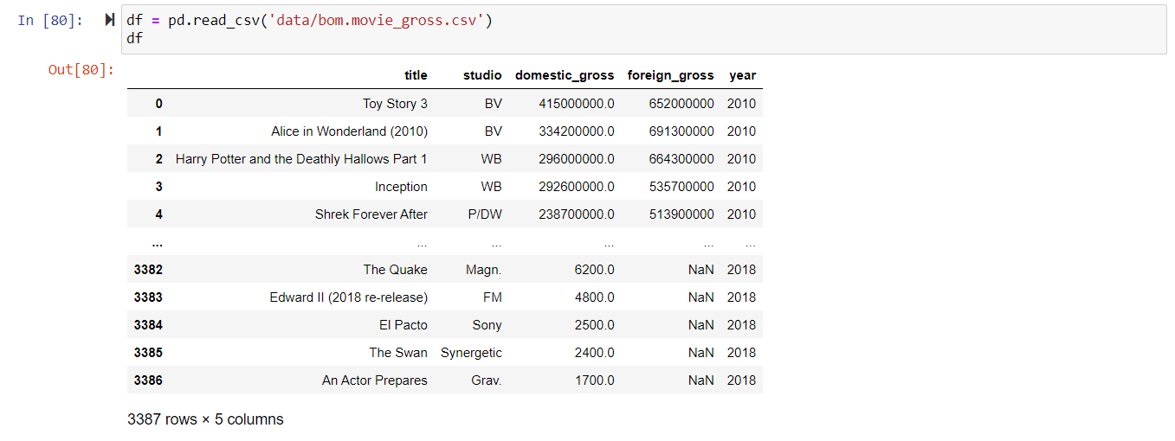
We first import the required libraries.
Load the data into the notebook by reading it as csv and run it to output the data

Slide 7
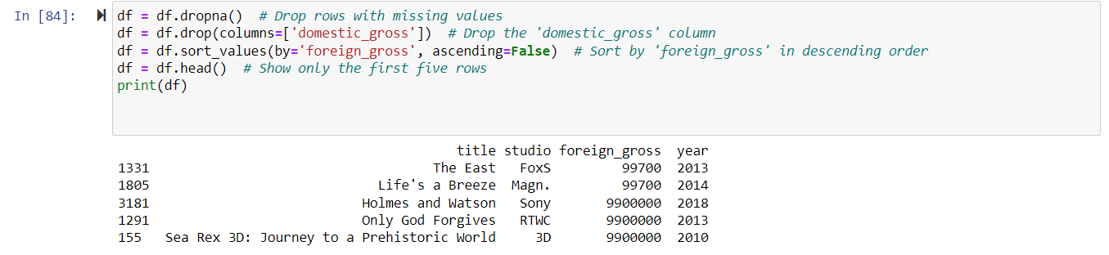
checking the columns of the data set, we have the foreign gross which we can use to evaluate and analyze which type of movie was highly on sale

Slide 8
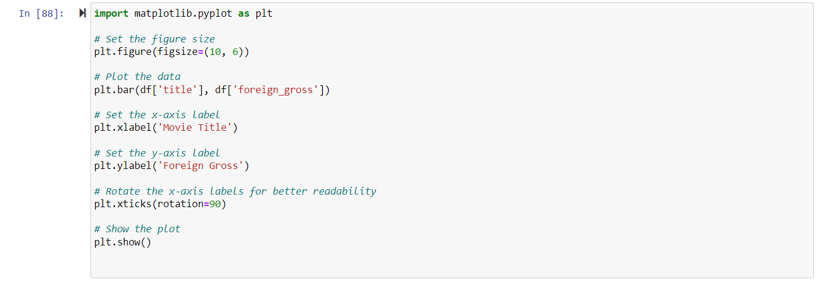
Plotting Title against foreign goods to visualize the data

Slide 9
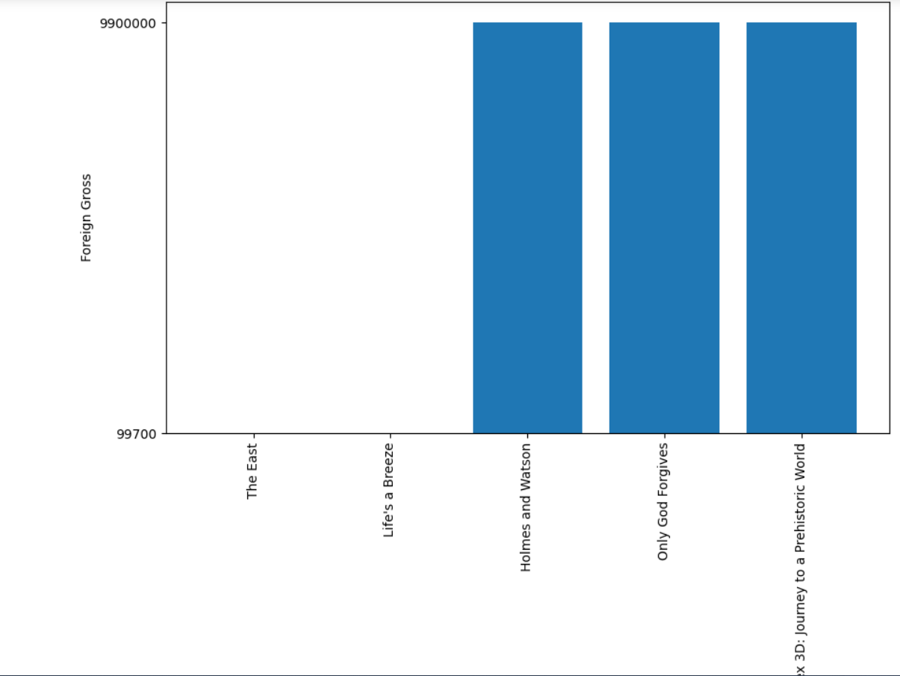

Slide 10
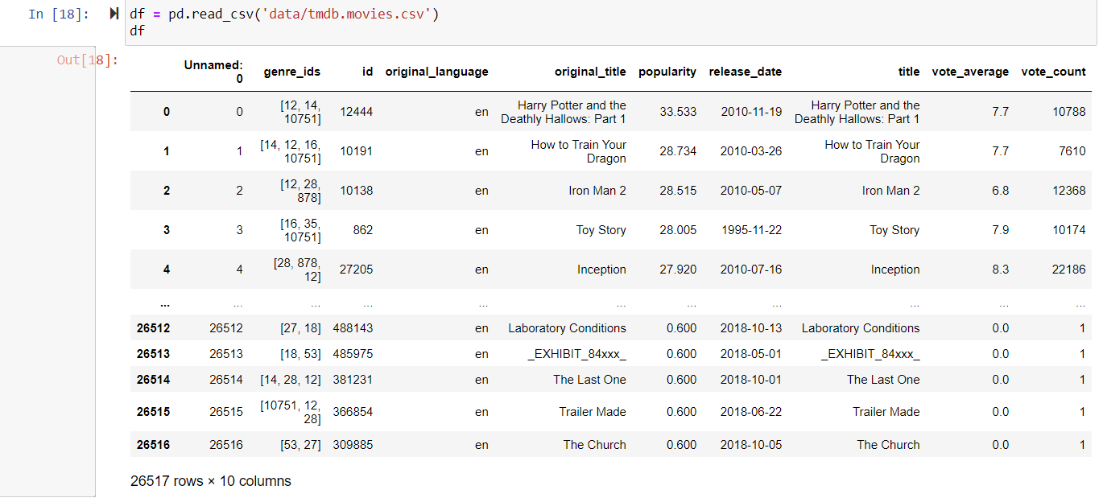
we now load at the data from the tmdb.movies csv dataset

Slide 11
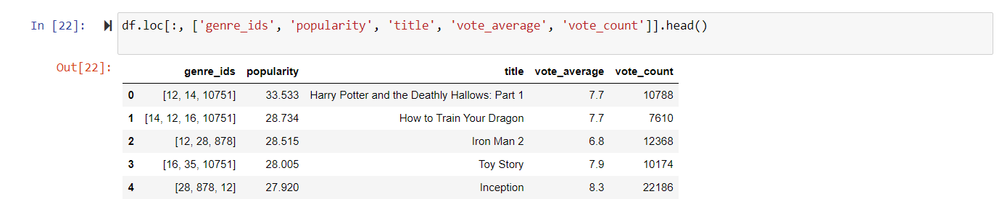
we can then filter the data to only use the ‘genre_ids’, ‘popularity’, 'title', 'vote_average', 'vote_count’ columns to analyze the data, and work with only the first five rows in the data

Slide 12
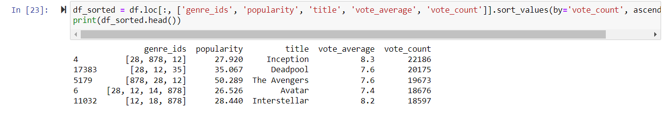
we can then sort the data with reference to the vote_count so that we can be able to see which movie was voted for by a majority of people

Slide 13
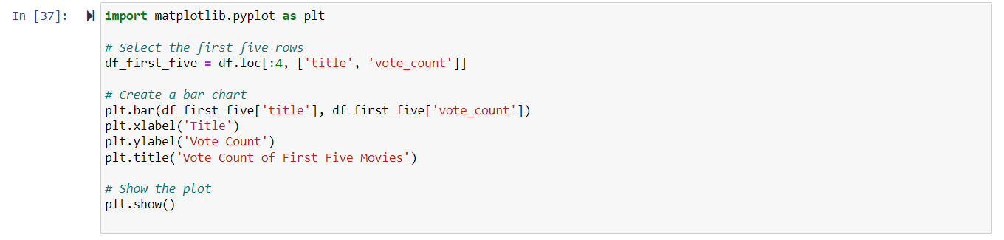
Plotting the data:

Slide 14
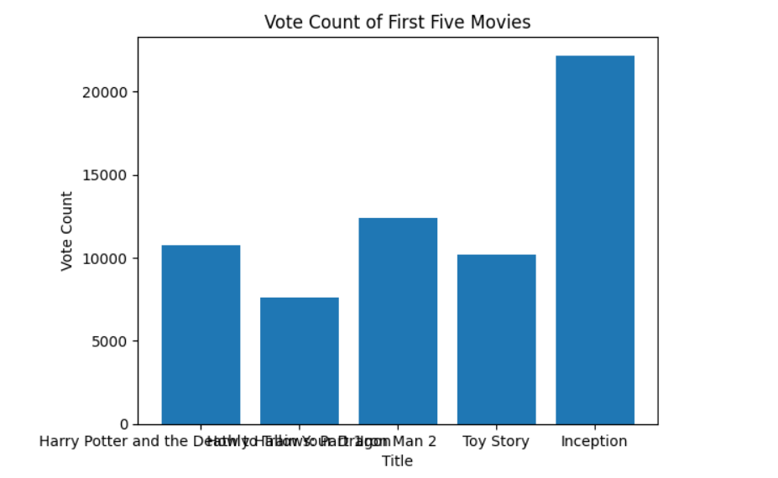
from the plot above we can see that the movie 'inception',which has science fiction genre and next is the iron man 2 which is a franchise film, also with science fiction and action.

Slide 15
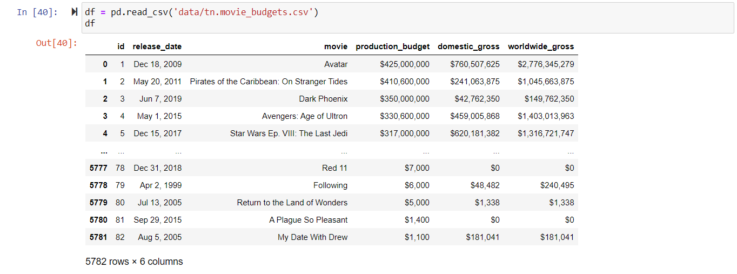
Moving on to the last dataset, we can load it from the tn.movie_budgets.csv

Slide 16
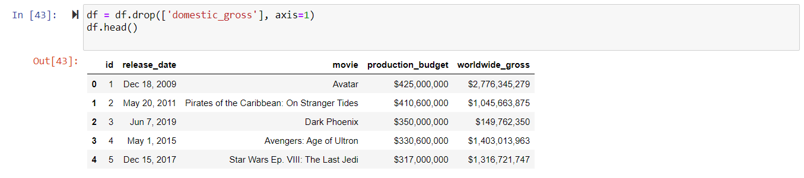
we can then focus on the production budget and the world wide gross to analyze whith type of movies had the highest production budget and worldwide gross in sales

Slide 17
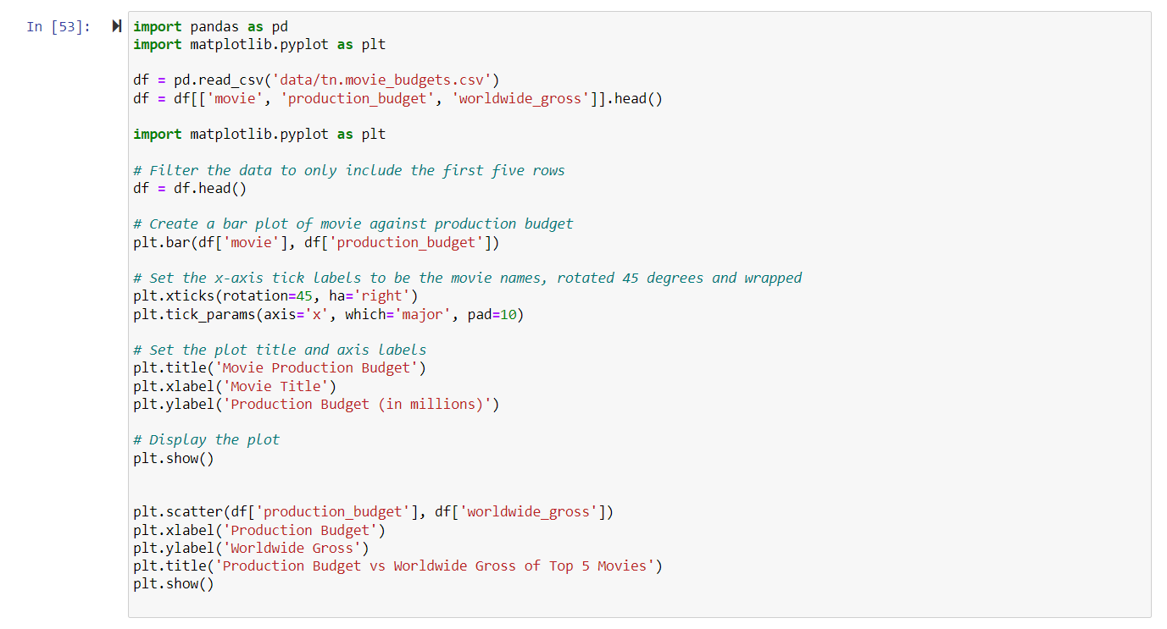
Having the data, we can plot the movie title against the production budget and the production budget against the corresponding worldwide gross, to link the data between the production budget and the worldwide gross and to have a clear view of each.

Slide 18
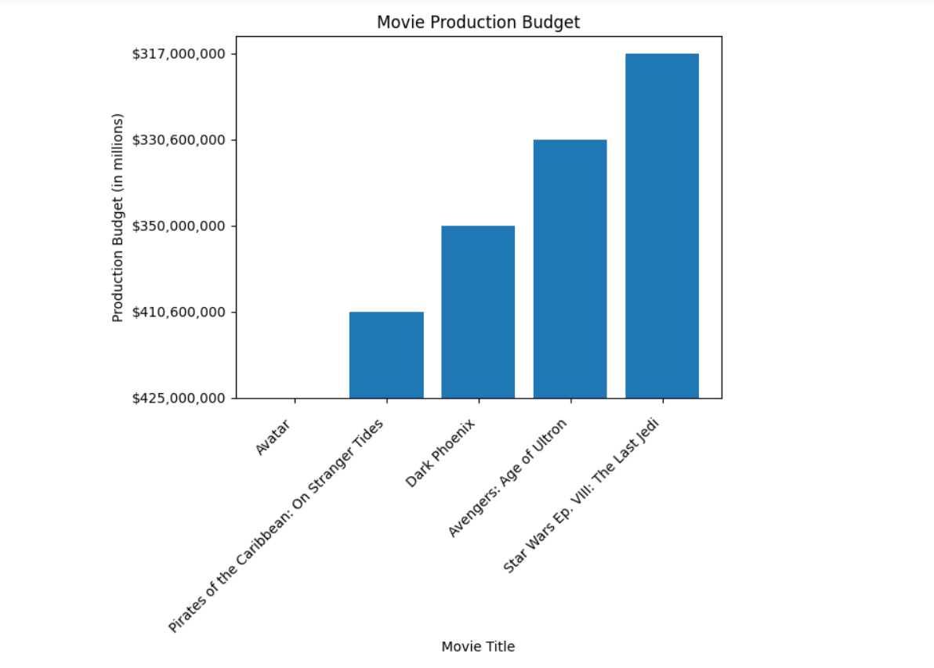

Slide 19
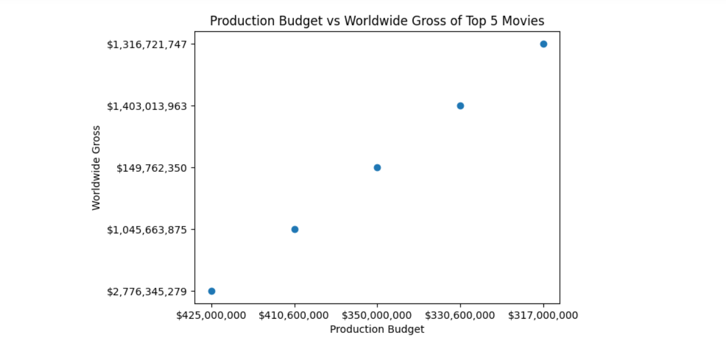

Slide 20
FINALIZATION
RESULTS
The analysis revealed several interesting findings, including:
The most common movie genre in the dataset is "science-fiction", "Action", "superhero", and "family".
The average budget of movies in the dataset is $17.5 million, and the average gross revenue is $68.4 million.
There is a positive correlation between budget and gross revenue, indicating that higher budget movies tend to generate more revenue.
Foreign movies tend to have higher gross revenue than domestic movies.
The top 5 movies by gross revenue in the dataset are all foreign movies.

Slide 21
RECOMMENDATIONS
Based on the findings of this analysis, we make the following recommendations to Microsoft:
Invest more in producing movies with high IMDb ratings: Our analysis shows that there is a strong positive correlation between IMDb ratings and domestic and worldwide gross earnings. Therefore, Microsoft can focus on producing high-quality movies that are likely to receive positive reviews from audiences.
Expand to international markets: Our analysis also shows that foreign gross can contribute significantly to a movie's overall earnings. Therefore, Microsoft can consider expanding its distribution and marketing efforts to international markets to tap into this potential revenue stream.
Diversify the movie genres produced: Our analysis shows that certain movie genres are more profitable than others. By diversifying the types of movies produced, Microsoft can reduce its risk exposure to fluctuations in demand for any particular genre and increase the likelihood of producing successful movies.
Overally, these recommendations are aimed at helping Microsoft maximize its profitability and competitiveness in the highly competitive movie industry.

Slide 22
CONCLUSION
Based on the analysis of the movie data, we can draw a few conclusions;
Firstly, the top 5 highest-grossing movies are all part of major franchises, indicating that established brands play a significant role in box office success.
Secondly, there is a correlation between budget and box office gross, but it is not a definitive one. There are cases where a movie with a lower budget has outperformed movies with higher budgets.
Thirdly, while the US is still the largest market for movies, there is a growing demand for movies in other countries, particularly in China. This is reflected in the higher foreign grosses for many of the movies in our dataset.
Lastly, the movie industry is a lucrative business, with some movies earning hundreds of millions, and in some cases, even billions of dollars. However, it is also a risky business, as demonstrated by the number of movies in our dataset that failed to make a profit.

