Slide 1
IBM University Engagement Project Submission
“Exploring the Power of Agentic AI with IBM watsonx.ai for Personalized Nutrition Assistance”

Slide 2
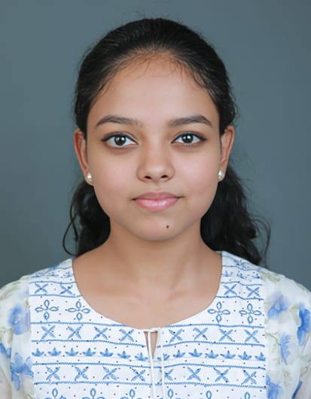
Project Tile – Nutrition Agent
Domain of Project – Healthcare
Student Name | Recent Passport Photo | Email ID | Mobile number [WhatsApp]
SAMNAYA K S |  | tl23btai0052@vidyaacademy.ac.in | 9947162499
Recommended font style and size: Font Style: Arial Font Size (Heading): 28
Font Size (Content): 20

Slide 3
Problem Statement -
Problem Statement : Nutrition Agent
The Challenge
Maintaining a healthy diet requires proper meal planning, calorie management, and nutritional awareness. However, many individuals struggle to identify reliable dietary information and create personalized meal plans that suit their health conditions, lifestyle, and fitness goals. Most available nutrition resources provide generic recommendations rather than individualized guidance, making it difficult for users to adopt healthy eating habits.
The Objective
Develop an AI-Powered Nutrition Agent using IBM watsonx.ai that provides intelligent, personalized nutrition guidance through an interactive conversational interface. The system aims to:
Personalized Diet Plans – Generate customized meal plans based on age, weight, height, gender, and health goals.
BMI & Calorie Calculator – Calculate Body Mass Index (BMI) and estimate daily calorie requirements (TDEE/BMR).
Nutrition Analysis – Analyze foods and provide nutritional information and dietary recommendations.
Family Profile Management – Maintain multiple user profiles for personalized recommendations.
AI Chat Assistant – Answer nutrition-related questions using IBM watsonx.ai foundation models.
Healthy Lifestyle Support – Encourage balanced diets and informed food choices through AI-powered recommendations.

Slide 4
Proposed Solution -
Proposed Solution: AI-Powered Nutrition Agent
The proposed solution is an AI-powered Nutrition Agent developed using Python Flask and IBM watsonx.ai Foundation Models. The system provides personalized nutrition guidance through an interactive web application that combines conversational AI with health-related utilities. By leveraging IBM watsonx.ai, the application delivers intelligent responses and customized dietary recommendations based on user inputs.
The solution consists of the following key modules:
AI Nutrition Chatbot – Provides real-time answers to nutrition and diet-related queries using IBM watsonx.ai foundation models.
Personalized Meal Planner – Generates customized meal plans according to age, weight, height, gender, dietary preferences, and health goals.
BMI & Calorie Calculator – Calculates Body Mass Index (BMI), Basal Metabolic Rate (BMR), and Total Daily Energy Expenditure (TDEE) to estimate daily calorie requirements.
Food Nutrition Analyzer – Analyzes foods and provides nutritional insights to help users make healthier food choices.
Family Profile Management – Maintains multiple user profiles so recommendations can be personalized for each family member.
User-Friendly Dashboard – Offers an intuitive and responsive interface for accessing all nutrition-related services from a single platform.
Overall, the proposed system provides an intelligent, interactive, and personalized nutrition assistant that helps users adopt healthier eating habits and make informed dietary decisions using AI-powered recommendations.

Slide 5
Technology Used
Python Flask – Backend development and API management.
IBM watsonx.ai – AI model integration for personalized nutrition assistance.
Meta Llama 3.3-70B Instruct – Generates intelligent nutrition recommendations and responses.
IBM Cloud – Secure cloud platform for authentication and AI services.
HTML, CSS & JavaScript – Responsive and interactive user interface.
Git & GitHub – Version control and project management.

Slide 6
System Components Used-
User Input – Accepts nutrition-related queries and user health information.
2) IBM watsonx.ai – Processes user requests using IBM Foundation Models to generate AI responses.
3) Foundation Model – Meta Llama 3.3-70B Instruct for nutrition guidance and meal recommendations.
4) Flask Backend – Handles API requests, application logic, and communication with IBM watsonx.ai.
5) Frontend (HTML, CSS & JavaScript) – Provides an interactive chatbot, dashboard, and meal planner interface.
6) Family Profile Storage – Stores and manages multiple user profiles for personalized recommendations.

Slide 7
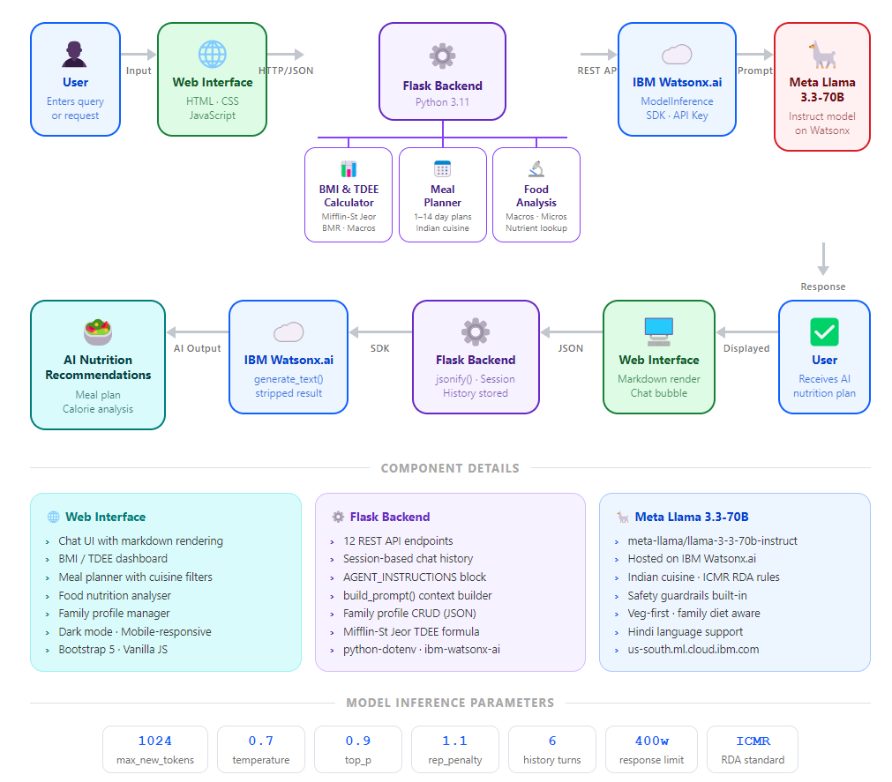
System Workflow

Slide 8
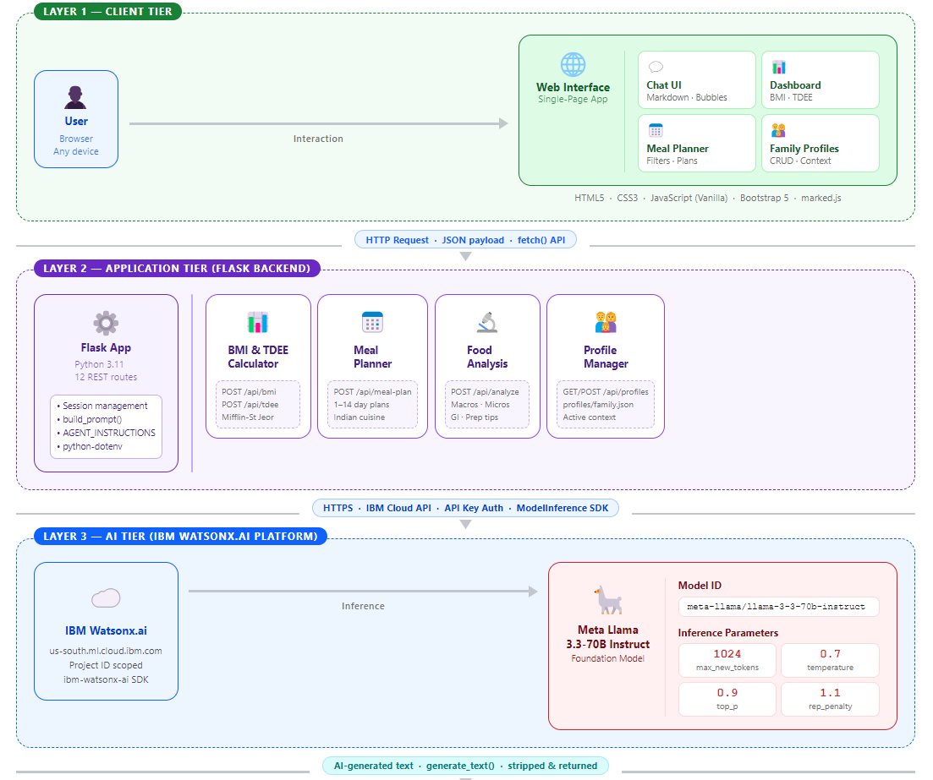
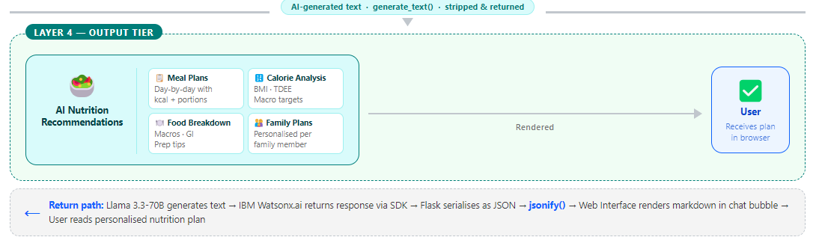
Architecture blueprint

Slide 9

Role of Agentic AI in the solution
Role of Agentic AI in Nutrition Agent
The Nutrition Agent uses IBM watsonx.ai Foundation Models to function as an intelligent AI assistant that provides personalized nutrition guidance. Instead of giving predefined responses, the agent understands user queries, analyzes health-related information, and generates context-aware recommendations.
The Agentic AI in the system performs the following tasks:
Understands User Intent – Interprets nutrition-related questions and user preferences.
Generates Personalized Recommendations – Suggests meal plans and dietary advice based on user inputs.
Supports Health Analysis – Assists with BMI, calorie estimation, and food nutrition analysis.
Maintains Context – Uses active family profiles to provide personalized responses.
Provides Interactive Assistance – Enables real-time conversational support for healthy lifestyle decisions.
Overall, Agentic AI enhances the system by delivering intelligent, personalized, and context-aware nutrition assistance, helping users make informed dietary choices through an interactive AI-powered experience.

Slide 10
Novelty and Uniqueness
The proposed AI-Powered Nutrition Agent combines IBM watsonx.ai, Flask, and a modern web interface to provide intelligent, personalized nutrition guidance.
Key Features
AI-Powered Recommendations – Generates personalized meal plans and nutrition advice using IBM watsonx.ai Foundation Models.
Personalized Experience – Considers user details such as age, gender, weight, height, and health goals.
Integrated Health Tools – Includes BMI Calculator, Meal Planner, Food Analysis, and Family Profile management in one application.
Interactive Chat Interface – Provides real-time conversational assistance through a simple and user-friendly interface.
Modern Web Application – Responsive design with dashboard, dark mode, and intuitive navigation.
Secure IBM Cloud Integration – Uses IBM watsonx.ai APIs for reliable and scalable AI-powered recommendations.
The solution combines AI-powered nutrition guidance, health analysis tools, and personalized recommendations into a single easy-to-use web application, enabling users to make healthier dietary decisions through an interactive AI assistant.

Slide 11
Git Hub Link
Please create public github repository (Enable Add README button while creating repository) with format –
Please test and Paste the working Github URL –https://github.com/Samnaya/Nutrition-Agent-IBM
Make sure you have Uploaded following three files into your github repository 1) app.json file , 2) yourproblemstatement.pdf file 3) your projectpresntation.pptx file 4)any other files
·
·
·

Slide 12
Future Scope
1. Integration with Wearables & Health Devices –
The system can be integrated with smartwatches and fitness trackers to collect real-time health data such as heart rate, calories burned, step count, and sleep patterns. This will enable the Nutrition Agent to provide more personalized and dynamic dietary recommendations based on the user's daily activities and health status.
2. AI-Powered Voice Assistant & Food Image Recognition –
Future versions can support voice interaction and food image analysis, allowing users to communicate naturally and upload meal images for automatic calorie estimation and nutritional analysis. This will improve accessibility and enhance the overall user experience.
3. Advanced Personalization & Disease-Specific Diet Planning –
The application can be enhanced to maintain long-term user health records and provide personalized diet plans for medical conditions such as diabetes, hypertension, obesity, and heart disease. This will improve the accuracy and effectiveness of AI-generated nutrition recommendations.
·
·
·

Slide 13
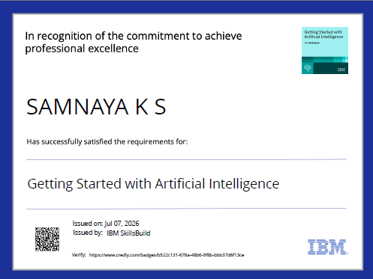
Certificates Earned:
Please add your credly certificate

Slide 14
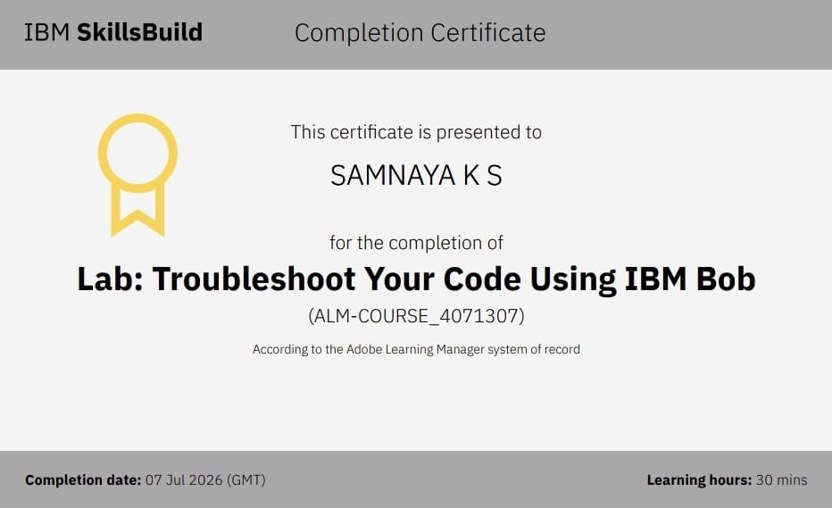
Certificates Earned:​
Add your IBM BOB Certificate

Slide 15


