Slide 1

FEDERAL UNIVERSITY OTUOKE
A PROJECT PRESENTATION
ON
PURCHASE PRICE PREDICTOIN FOR USED CARS USING MACHINE LEARNING
BY
KIRIKAREYE OYINKURO PRINCE
FUO|19|CSI|11781
COMPUTER SCIENCE AND INFORMATICS
FACULTY OF SCIENCE

Slide 2
OUTLINE
COVER PAGE
ABSTRACT
INTRODUCTION
LITERATURE REVIEW
METHODOLOGY
RESULTS
CONCLUSION AND RECOMMENDATION
REFERENCE
END NOTE.

Slide 3
ABSTRACT
This study investigates the performance of Convolutional Neural Networks (CNN) and Long Short-Term Memory (LSTM) models for cyberbullying detection using text data. The CNN classifier demonstrated strong performance with an accuracy of 87.35%, achieving a confusion matrix of [[2111, 313], [193, 1384]], indicating effective identification of both bullying and non-bullying comments. In contrast, the LSTM model, despite achieving an accuracy of 60.58%, showed poor performance in classifying non-bullying comments, with a confusion matrix of [[2424, 0], [1577, 0]]. The lack of true negatives suggests issues with data imbalance and model sensitivity. For deployment, the models were integrated into a web application using Flask, where the CNN model was selected for its superior accuracy. This application allows users to submit text comments and receive predictions about their likelihood of being bullied. The study highlights the need for further refinement in model architecture and data handling to improve the LSTM’s performance and address data imbalance issues for better classification outcomes.

Slide 4
INTRODUCTION
BACKGROUND OF THE STUDY
Social media platforms serve as dynamic mediums for exchanging vital facts, opportunities, and stories, and encouraging ideas. However, one of the significant challenges associated with social media is the prevalence of threatening and abusive language, commonly known as cyberbullying, Chakraborty and Siddiqui, (2019). Among these platforms, Facebook stands out as the most popular platform for human connection, boasting approximately 2.27 billion active users
AIM AND OBJECTIVES
This study aims to develop a hybrid machine-learning model for effective cyberbullying detection on social media platforms. The specific objectives include to:

Slide 5
Collect social media data relevant to cyberbullying for model development and evaluation.
Design an N-gram-based feature extraction process to identify cyberbullying language patterns within the social media data.
Develop a Long Short-Term Memory (LSTM) model specifically designed to identify sentiment associated with cyberbullying in the social media data.
Extract sentiment scores from the LSTM and combine them with N-gram frequencies to create a comprehensive feature set for cyberbullying detection.
Train a Logistic Regression model for the final classification task using the combined feature set and implement the Logistic Regression model for cyberbullying detection on social media data.

Slide 6
SCOPE
The scope includes training a logistic regression model to classify text data as bullying or non-bullying based on the combined feature set derived from LSTM and N-gram analysis. An evaluation of the model’s performance will be conducted to assess its effectiveness in accurately distinguishing between bullying and non-bullying content.
STATEMENT OF THE PROBLEM
Many features influence the price of a used car (e.g., model, year, mileage), and traditional prediction methods struggle to account for these variables efficiently. Thus, machine learning offers a solution through advanced regression techniques such as bagging regression, random forest, decision tree, extra tree, etc. to predict the purchase price of a used car efficiently.

Slide 7
LITERATURE REVIEW
The Author's Name | Year of Publication | Author's Contribution | Author's limitation
Chahat et al | (2021) | Chahat et al. (2021) proposed a system that aimed to improve cyberbullying detection accuracy by comparing traditional machine learning and shallow neural network approaches on real-world datasets, alongside examining feature extraction techniques like TF-IDF and GloVe. | The study encountered limitations as the paper did not deeply explore the generalizability of the models across different social media platforms. Also, class imbalance in the datasets was not extensively addressed.
Kwok and Wang | (2013) | worked on a study that focused on the problem of detecting racism in Twitter posts using text classification algorithms, particularly focusing on racist and non-racist content. | The unigram Bag-of-Words model used for feature extraction was somewhat limited in capturing contextual nuances in text, leading to moderate performance.

Slide 8
Nobata et al. . | (2016) | proposed a study that addressed the problem of hate speech detection by designing an approach that utilized linguistics, n-grams, and distributed syntactic features. N-gram features combined with a classifier for hate speech detection algorithms were employed. | The study was limited as the use of n-grams, while effective for certain tasks, could not sometimes capture long-range dependencies in the text, limiting its effectiveness in complex language situations.
Themeli | (2021) | carried out a study that aimed to compare the performance of traditional machine learning and deep neural network models for hate speech detection. The Logistic Regression and Three-layer Neural Network algorithms were employed for this study. | Although the Bag-of-Words (BoW) performed well, but was limited as it did not capture contextual meaning as effectively as more advanced word embeddings like GloVe.
Bu and Cho | (2018) | authored a work aimed to improve knowledge transfer in cyberbullying detection by using deep learning models to capture both character-level syntactic features and semantic features. | The framework faced challenges as it was limited in handling large-scale datasets efficiently, as deep learning models typically require extensive computational resources.

Slide 9
Agrawal and Awekar | (2018) . | proposed a system which aimed to transfer knowledge from one domain to another to enhance the performance of deep learning models in detecting cyberbullying across different datasets. | The use of domain-specific embeddings like SSWE made the model dependent on sentiment features, which might not generalize across all datasets, this was a major limitation Encountered by the authors while carrying out this study.
Listiani | (2009) | Listiani used Support Vector Machines (SVM) to predict leased car prices and found that SVM was more accurate for large datasets with high-dimensional data than Multiple Linear Regression. | SVM took significantly longer to compute, up to a day, compared to the simpler Multiple Linear Regression model, making SVM less practical for very large datasets unless computational resources are abundant.
Kuiper | (2008) | Collected data from General Motors and used a Multivariate Regression model after applying variable selection techniques to reduce the complexity of the dataset. | The study only included data from a single car manufacturer (General Motors), which might limit the generalizability of the model to other brands and broader datasets
Nabarun Pal | (2018) | Used Random Forest with 500 decision trees to predict used car prices, achieving 95.82% training accuracy and 83.63% testing accuracy with the Kaggle dataset after selecting the most correlated features. | While the model performed well, it relied heavily on feature selection, and the performance may drop if the dataset contains less informative features or requires more advanced hyperparameter tuning.

Slide 10
Jian Da Wu | (2017) | Developed a system consisting of a data acquisition component, price forecasting algorithm, and performance analysis using ANFIS (Adaptive Neuro-Fuzzy Inference System), which combined fuzzy logic and neural networks for price prediction. The system provided more accurate results than traditional ANN models. | he study focused heavily on ANFIS, leaving the performance of other ensemble methods or newer machine learning techniques unexplored, despite their potential to further improve accuracy.

Slide 11
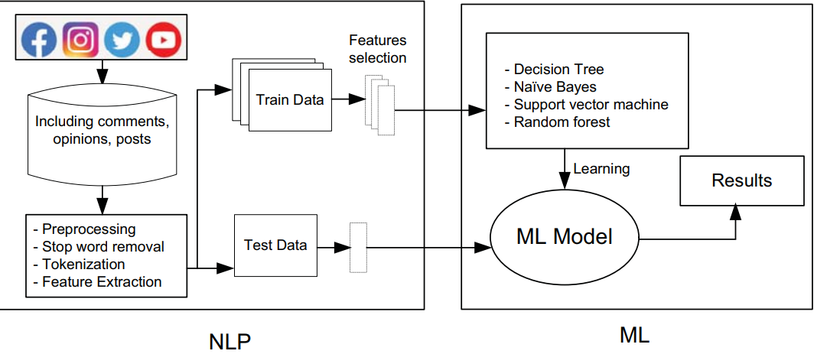
METHODOLOGY
THE EXISTING SYSTEM ARCHITECTURE

Slide 12
The Advantages of the Existing System
High accuracy on labeled data: Existing systems perform well on large labeled data sets, achieving high accuracy rates using supervised learning models.
Easy feature extraction: Systems using feature extraction methods such as TF-IDF and Bag of Words have demonstrated easy implementation and effective results in capturing keyword frequencies.
Disadvantages of the Existing System
Limited to labeled data: Supervised learning systems rely heavily on labeled datasets.
High false positive rate: These systems often struggle with sarcasm, coded language, and indirect forms of harassment, leading to a high rate of false positives.

Slide 13
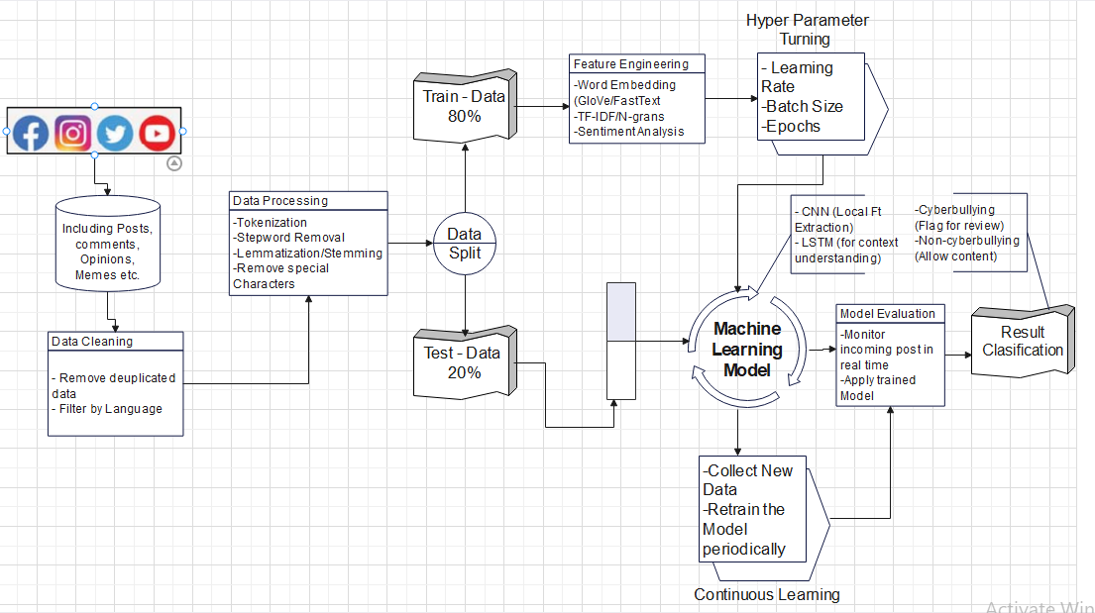
MODEL ARCHITECTURE
Fig. 2. System Design. Source (self generated)

Slide 14
ADVANTAGES OF THE PROPOSED MODEL OVER EXISTING MODELS
Complexity and robustness,
User Prompt,
The proposed model has a robust database both from the sourced data to the implemented dataset.
User friendly web interface
THE LIMITATIONS OF THE PROPOSED SYSTEM
The proposed system's limitations include its reliance on a single dataset, which may not capture all market variations, and its computationally intensive training process, which could affect scalability and efficiency in real-time applications.

Slide 15
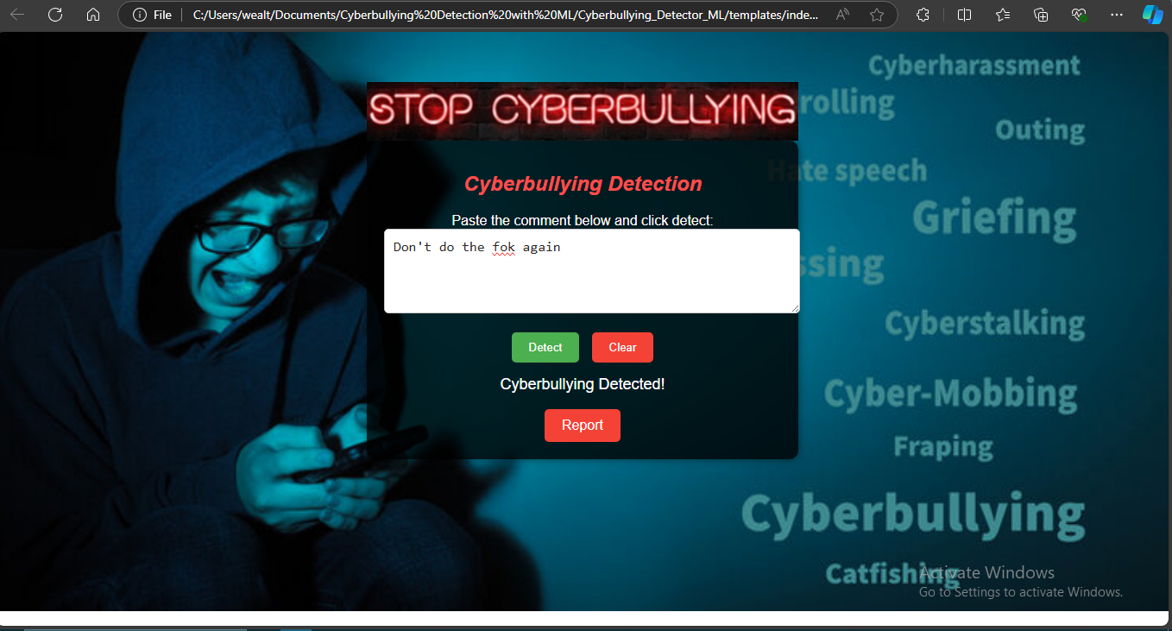
RESULTS
USER WEB INTERFACE SCREENSHOT
Fig. 3 Used car Price prediction web interface over view

Slide 16
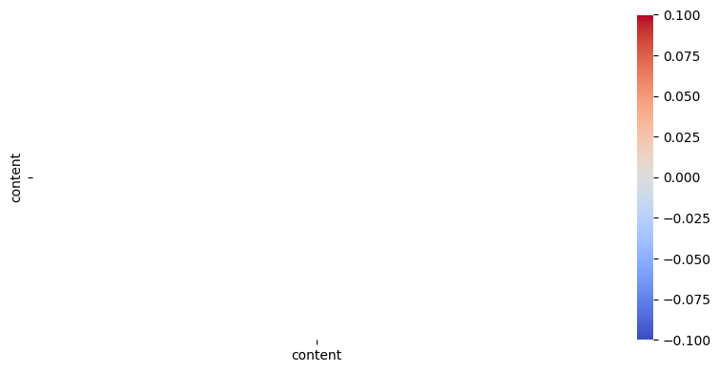
CNN
The Confusion Matrix was generated to be [[2111 313], [ 193 1384]] with an Accuracy: of 87.35316395759583
LSTM
The Confusion Matrix was [[2424 0], [1577 0]] with an Accuracy of 60.58485507965088.

Slide 17
THANK YOU FOR LISTENING

