Slide 1
Pet Adoption Center Adopt a Friend

Slide 2
Introduction
The Pet Adoption Center web application facilitates the connection between animal shelters and potential pet adopters. It streamlines the entire process from listing pets to completing payments and finalizing adoptions. The system comprises two main interfaces: one for adopters and one for shelters.

Slide 3
Core Purpose
To create a digital marketplace that simplifies pet adoption and better experience for adopters.

Slide 4
Added value
Our platform is the first of its kind in the country—offering open, accessible pet adoption for all types of animals.
Unlike an existing alternative, Lajka (which supports only dog adoptions through its own shelter), our solution empowers any verified shelter or individual to list pets for adoption—creating a nationwide, inclusive adoption network.
This democratized approach ensures greater visibility for all pets, faster adoptions, and more lives saved.

Slide 5
Who is mainly affected by it?
Pets
Shelters
Potentially increases the number of adopted pets
Designed profiles lead to better impression for customers
Fast and well structured application and payment process
Universal platform for managing pet adoption
Easier process for adoption
Efficient communication with customers
Insight to applications and payments

Slide 6
Business Plan - Freemium Model
🐾 Shelters (Service Providers)
- Users who represent animal shelters or rescue organizations that list animals for adoption.
Free Tier:
Create and manage pet listings
Review adoption applications
Approve or reject applicants
View payment confirmations
All pet adoptions listed are completely free of charge for adopters
Premium Tier (Paid):
Access advanced analytics & statistics (e.g., adoption success rate, profile visits, time to adoption)
Feature their own pets first in search results for better visibility
Get priority support and marketing exposure through the app
🐶 Adopters (End Users)
- Individuals seeking to adopt a best friend—free of cost.
Browse all pets available for adoption
Filter and search by species, age, size, etc.
Submit adoption applications with optional questionnaires
Track application status in real-time
No fees – adoptions are 100% free

Slide 7
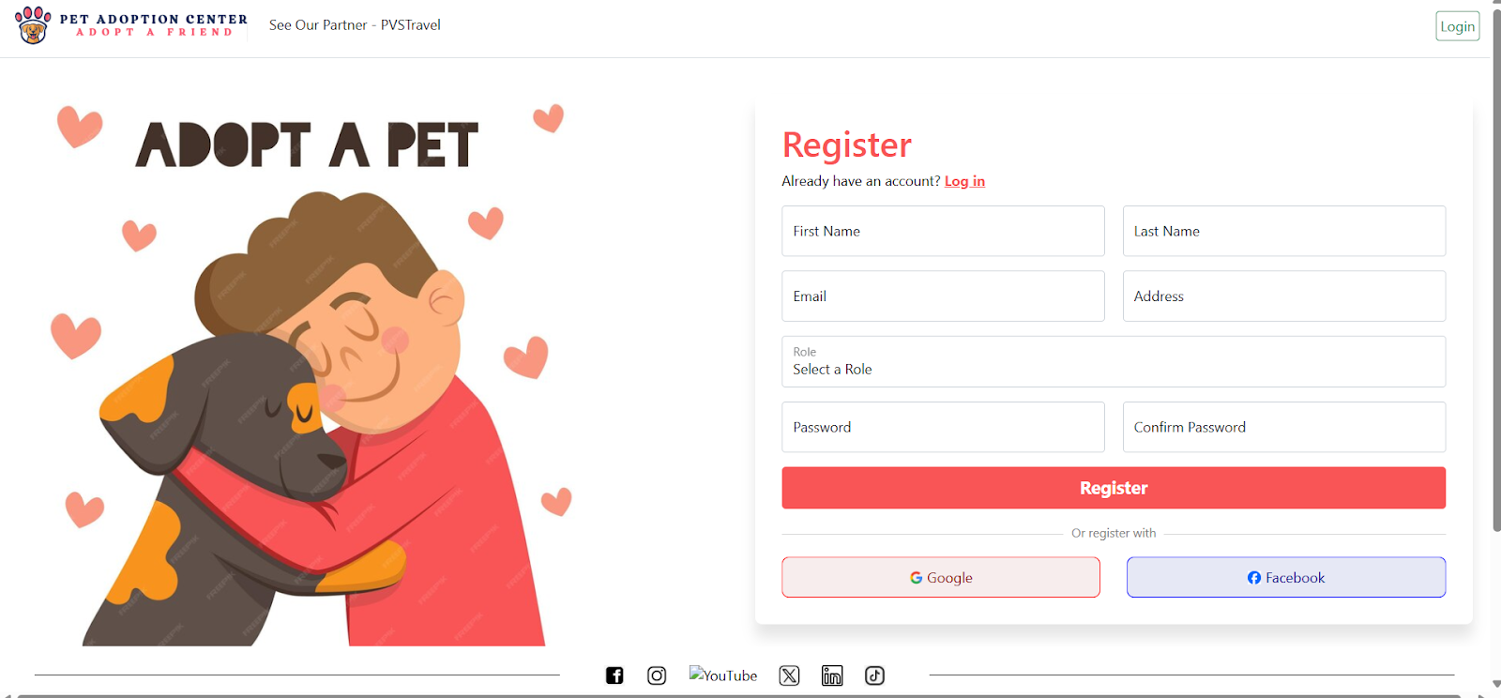
User Roles
Shelters: Users who represent animal shelters or rescue orgs that have animals available for adoption.
- Can create and manage pet listings
- Review adoption applications
- Approve or reject applicants
- View payment confirmations
Adopters: Individuals seeking to adopt a best friend.
- Browse available pets
- Filter and search for specific pets
- Submit adoption applications with follow-up questions and view application status
- Make adoption fee payments

Slide 8
Key features for Shelters
Pet Listing Management
Application Review
Creation, update and deletion of pet listing with detailed information
Evaluate adoption applications through a structured interface
Applicant Selection
Status Tracking
Dashboard
Choose the best-suited adopter for each pet
Monitor the adoption process from listing to payment completion
Visualize shelter performance metrics and adoption statistics

Slide 9
Key features for Adopters
Pet Discovery
Application Submission
Browse through available pets with filtering options
Complete and submit adoption questionnaires
Status Tracking
Secure Payments
Favorite Pets
Monitor application progress
Secure payment process
Save pets of interest for later review

Slide 10
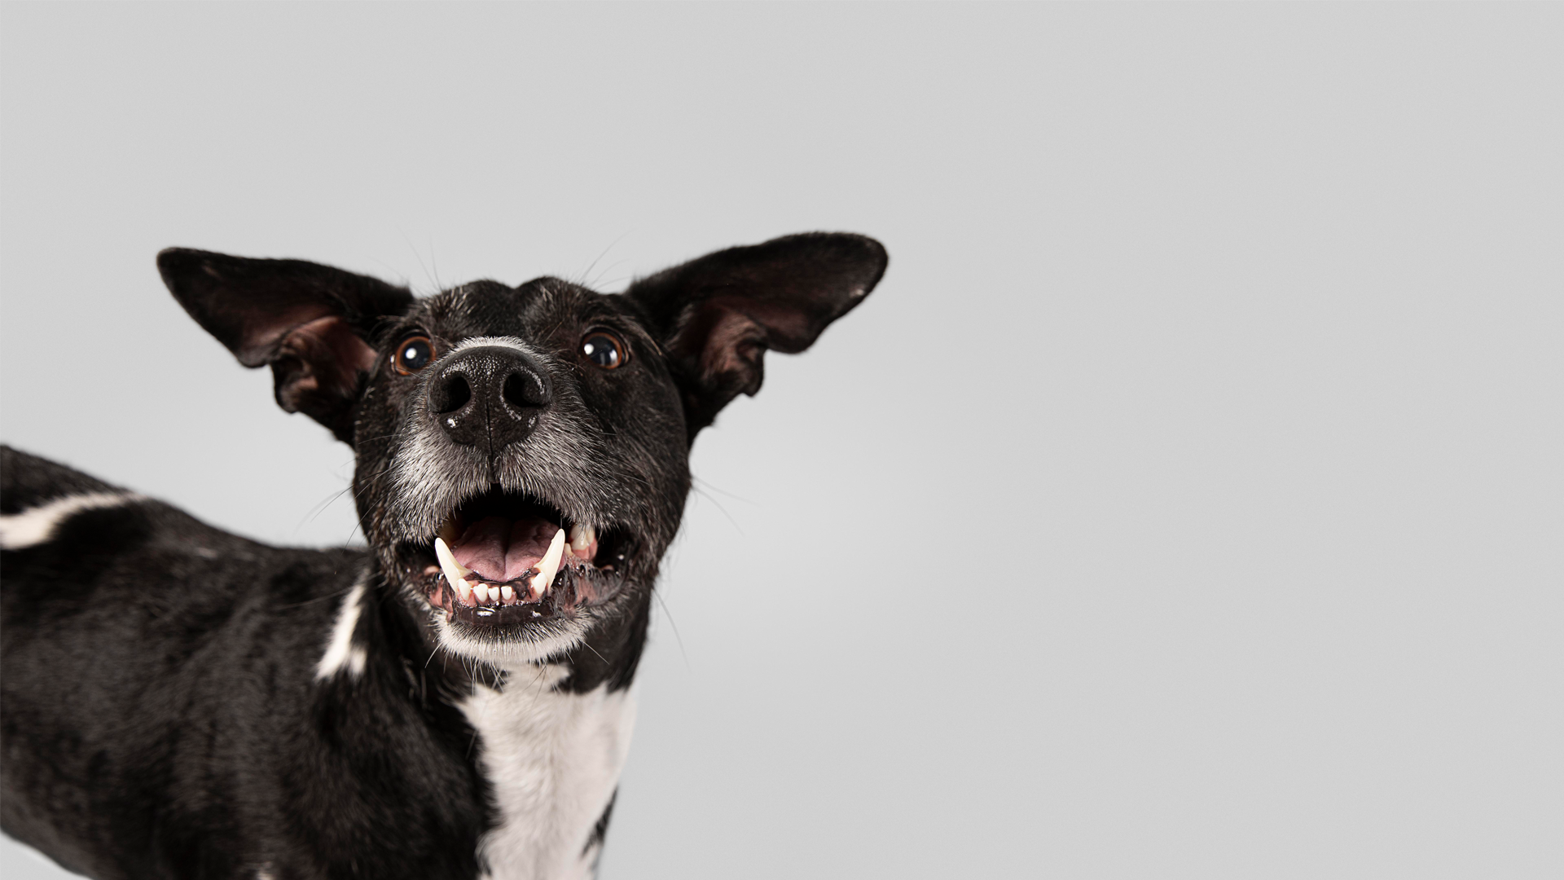
A picture of a happy pet is worth a thousand words

Slide 11
Pet Listing Process
Step 1
Step 2
Step 3
Authentication
Pet Details
Publishing
Shelter creates a new account (if new) or logs in
Species, breed, age, gender, health information, background, photos, adoption fee…)
Shelter published listing, making it visible to adopters

Slide 12
Adoption Process
Adopter browses available pets Adopter completes questionnaire for adoption application | Selected adopter receives notification Application status changes to “Waiting for Payment”
Adopter submits application for desired pet | Adopter completes payment
Application status changes to “Pending” preview | Application status changes to “Adopted”
Shelter reviews applications for the pet and selects preferred adopter | Pet listing is marked as “Adopted” and removes from available pets

Slide 13
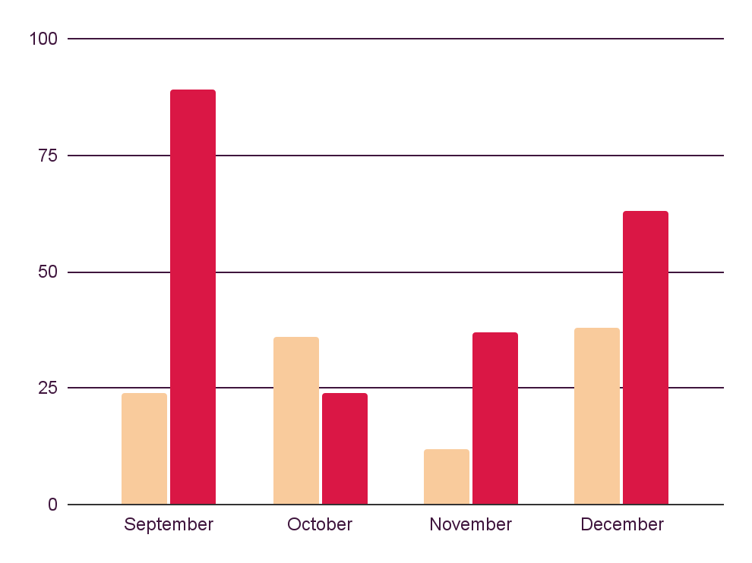
Risks factors
Cats
Dogs
No-show
55%
Many scheduled appointments are missed, fear , reconsideration etc.
Returned pets
70%
Returns happen due to mismatched pet-owner lifestyles.
“Help us reduce drop-offs by sending reminders and improving matchmaking.

Slide 14
Key numbers
35-50
1-3
12
Potential users
Local shelters open for colaborations
Friends, acquaintances, pet owners
People who want to apply their pet to adoption

Slide 15
Our conclusions
Adopting a pet is more than a decision—it’s a lifelong commitment. Cats and dogs each bring joy, companionship, and love, but they also require care and responsibility.
🐶 Many users prefer dogs for their loyalty and energy, 🐱 while cats are loved for their independence and calm nature.

Slide 16
Thank you
Visit us:
http://petadoptioncenterwebwindows-dev.eba-en3re3mn.us-east-1.elasticbeanstalk.com/
Do you have any questions?

