Slide 1
NFL Play predictor
By Mohammed Ansari & Samy Metadjer
Machine Learning course
Paris Diderot University

Slide 2
DATASET
Source: https://www.kaggle.com/maxhorowitz/nflplaybyplay2009to2016
408 000 lines of data with more than 100 parameters describing each play
CSV file

Slide 3
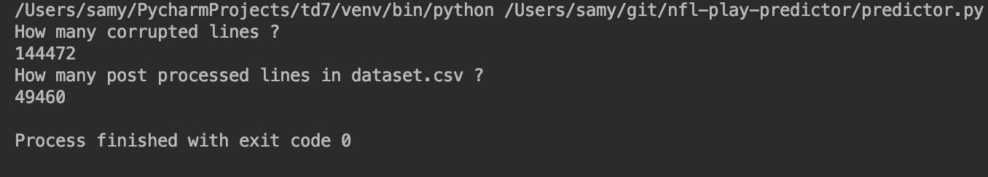
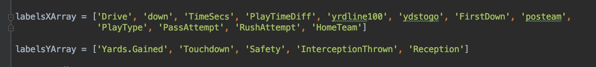
Cleaning
Parsing:
Each line contains all the data we need to know (Xs and Ys) about a play.
We extracted the data and stored it into the appropriate data structures

Slide 4
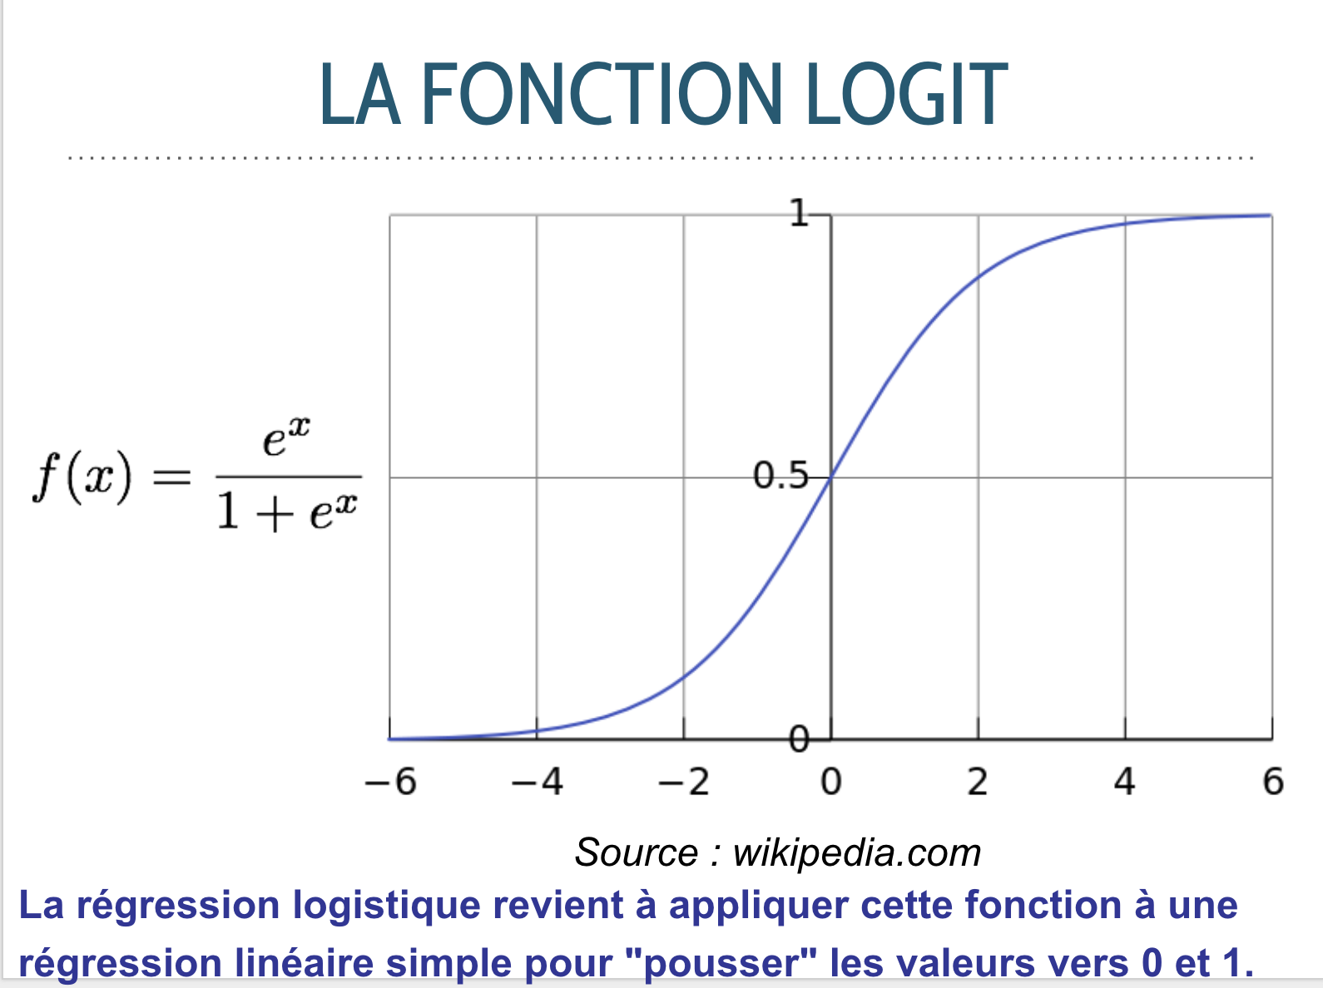
Algorithmic model
What kind of problem do we have ?
What are the models solving the problem ?
Which one did we choose ? Why ?

Slide 5
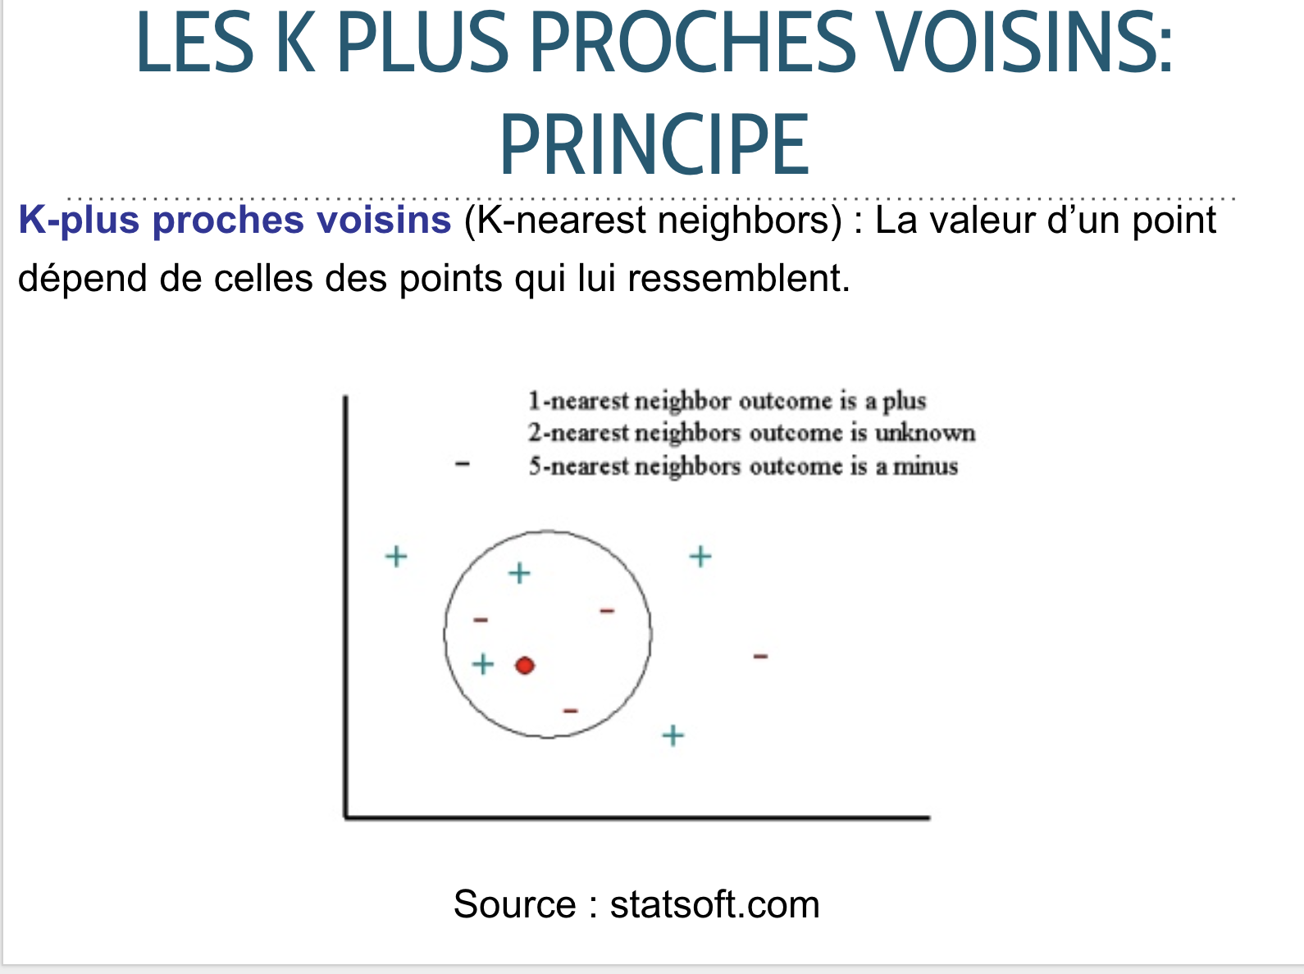
Algorithmic model
What kind of problem do we have ?
What are the models solving the problem ?
Which one did we choose ? Why ?

Slide 6
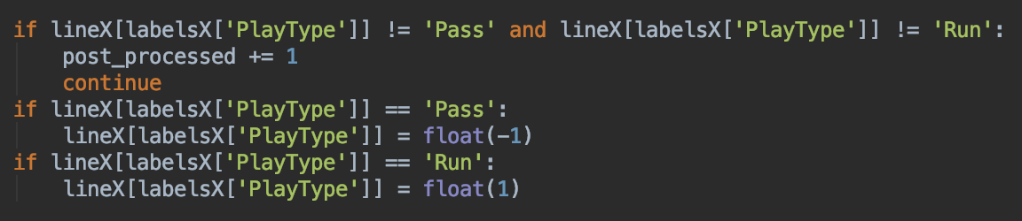
encoding
No need to encode with a specific method
We mostly took the raw data, and encoded some specific parameters

Slide 7
Tuning
102 parameters in the original dataset, it was way too much !
We used crossed-validation for one model : K nearest neighbors
We also used the weight provided by the LogisticRegression

Slide 8
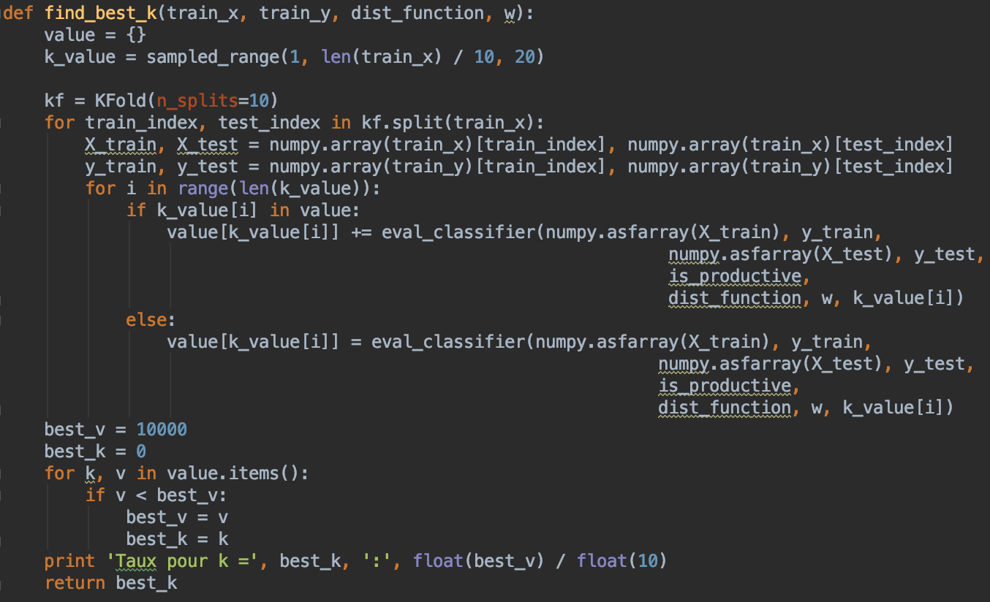
tuning

Slide 9
Train / validation
We split the dataset.csv into 2 files ‘test’ and ‘train’

Slide 10
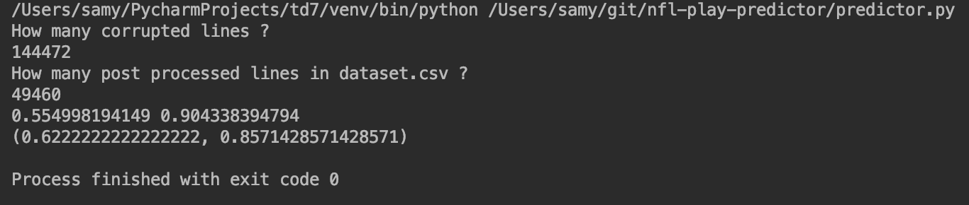
results
With a simple euclidien distance : (0.45614035087719296, 0.38461538461538464)
Best K found with a 1000 values set : 100

Slide 11
Discussion
Nothing.

