Slide 1
Introduction to Tensorflow
Bartosz Świderski

Slide 2

in logistic regression
In logistic regression, we maximized the expression
$$ln\left(L\left(w\right)\right)=\sum_{i=1}^{m}{\left[y_{i}∙ln\left(p\left(x_{i}, w\right)\right)+\left(1−y_{i}\right)∙ln\left(1−p\left(x_{i}, w\right)\right)\right]}$$
$$\text{With} \text{the} \text{probability} \text{model}\text{:}$$
$$p\left(x_{i},w\right)=\frac{exp\left(w^{T}x_{i}\right)}{1+exp\left(w^{T}x_{i}\right)}$$
By looking for the zero of the first derivative.
$$\frac{∂ln\left(L\left(w\right)\right)}{∂w}=X^{T}\left(y−p\right)$$
$$\frac{∂^{2}ln\left(L\left(w\right)\right)}{∂w∂w^{T}}=−\sum_{i=1}^{m}{x_{i}x_{i}^{T}p\left(x_{i},w\right)\left(1−p\left(x_{i},w\right)\right)}$$

Slide 3
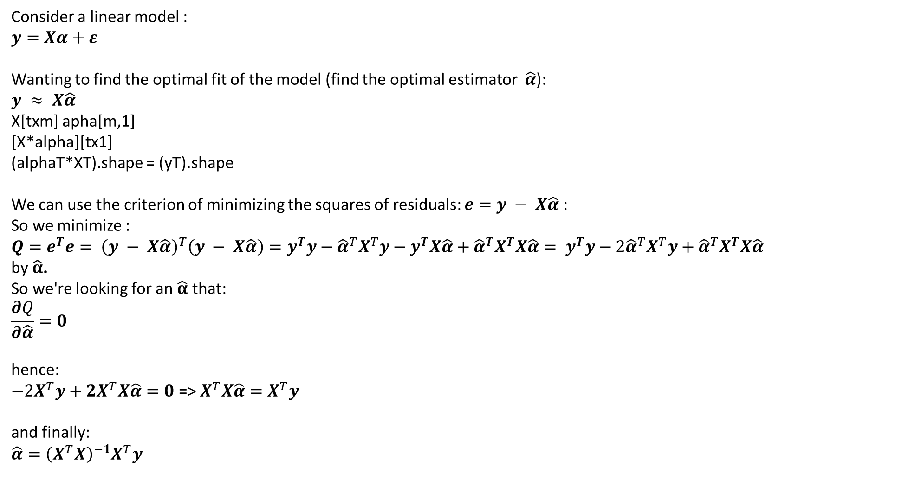
Linear Regression
Consider a linear model :
$$y=Xα+ε$$
Wanting to find the optimal fit of the model (find the optimal estimator $\hat{α}$):
$$y ≈ X\hat{α}$$
X[txm] apha[m,1]
[X*alpha][tx1]
(alphaT*XT).shape = (yT).shape
We can use the criterion of minimizing the squares of residuals: $e=y − X\hat{α}$:
So we minimize :
$Q=e^{T}e= {\left(y − X\hat{α}\right)}^{T}\left(y − X\hat{α}\right)=y^{T}y−{\hat{α}}^{T}X^{T}y−y^{T}X\hat{α}+{\hat{α}}^{T}X^{T}X\hat{α}= y^{T}y−2{\hat{α}}^{T}X^{T}y+{\hat{α}}^{T}X^{T}X\hat{α}$
by $\hat{α}$.
So we're looking for an $\hat{α}$ that:
$$\frac{∂Q}{∂\hat{α}}=0$$
hence:
$−2X^{T}y+2X^{T}X\hat{α}=0$ => $X^{T}X\hat{α}=X^{T}y$
and finally:
$$\hat{α}={\left(X^{T}X\right)}^{−1}X^{T}y$$

Slide 4
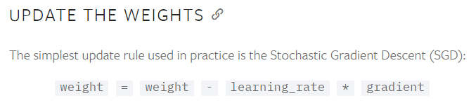
Let us use one of the most popular approaches

Slide 5
import numpy as np import pandas as pd data=np.array(pd.read_csv(‚data.csv',header=None)) X = np.concatenate((np.ones((data.shape[0],1)),data[:,:2]), axis=1) y = data[:,2] # alpha_ols = np.matmul(np.matmul(np.linalg.inv(np.matmul(X.T,X)), X.T),y) alpha_ols = np.linalg.solve(np.matmul(X.T,X), np.matmul(X.T,y)) alpha = np.random.randn(X.shape[1]) learning_rate = 0.01 for i in range(1000): gradient_alpha = (- 2 * np.matmul(X.T,y)) + 2 * np.matmul(np.matmul(X.T,X), alfa) alpha = alpha - learning_rate * gradient_alpha print(alpha_ols) print(alpha)
program1
Returns:
[0.32441002 0.11990305 0.09178414]
[0.32441002 0.11990305 0.09178414]

Slide 6
For logistic regression
import numpy as np import pandas as pd import statsmodels.api as sm data=np.array(pd.read_csv('data.csv',header=None)) X = np.concatenate((np.ones((dane.shape[0],1)),data[:,:2]), axis=1) y = data[:,2] glm_binom = sm.GLM(y, X, family=sm.families.Binomial()) res = glm_binom.fit() alpha = np.random.randn(X.shape[1]) learning_rate = 0.01 for i in range(1000): p = (np.exp(np.dot(X, alpha)) / (1 + np.exp(np.dot(X, alfa)))) gradient_alpha = np.matmul(X.T, y-p) alpha = alpha + learning_rate * gradient_alpha print(res.params) print(alpha)
program2
We get:
[-0.90111567 0.58614026 0.43306491]
[-0.90111608 0.58614042 0.43306495]
but „plus” (why not minus?)

Slide 7
For logistic regression
import numpy as np import pandas as pd import statsmodels.api as sm data=np.array(pd.read_csv('data.csv',header=None)) X = np.concatenate((np.ones((data.shape[0],1)),data[:,:2]), axis=1) y = data[:,2] glm_binom = sm.GLM(y, X, family=sm.families.Binomial()) res = glm_binom.fit() alpha = np.random.randn(X.shape[1]) learning_rate = 0.01 for i in range(1000): p = (np.exp(np.dot(X, alpha)) / (1 + np.exp(np.dot(X, alfa)))) gradient_alpha = np.matmul(X.T, y-p) alpha = alpha + learning_rate * gradient_alpha print(res.params) print(alpha)
program2
We get:
[-0.90111567 0.58614026 0.43306491]
[-0.90111608 0.58614042 0.43306495]
but „plus” (why not minus?)
formally we don't want to maximize something now?

Slide 8

Tensorflow
All of this may be cool, but why bother with differentiation?
https://www.tensorflow.org/

Slide 9
import numpy as np import pandas as pd import tensorflow as tf data=np.array(pd.read_csv('data.csv',header=None)) X = np.concatenate((np.ones((data.shape[0],1)),data[:,:2]), axis=1) y = data[:,2][:,np.newaxis] print(y.shape) X_pl = tf.placeholder(dtype=tf.float32, shape=[None, X.shape[1]]) y_pl = tf.placeholder(dtype=tf.float32, shape=[None,1]) weights = tf.Variable(tf.random_normal([X.shape[1],1])/10) y_est = tf.matmul(X_pl,weights) def my_goal_function(y_true, y_pred): e_ = tf.add(y_true,-y_pred) y = tf.reduce_mean(tf.multiply(e_,e_)) return y loss = my_goal_function(y_pl, y_est) # loss = tf.losses.mean_squared_error(labels = y_pl, predictions=y_est) # optimizer = tf.train.RMSPropOptimizer(learning_rate=0.01) optimizer = tf.train.AdamOptimizer(learning_rate=0.01) train = optimizer.minimize(loss) init = tf.global_variables_initializer() training_epochs = 1000 sess = tf.Session() sess.run(init) for epoch in range(training_epochs): _, c = sess.run([train, loss], feed_dict={X_pl: X, y_pl: y}) weights_,something_ = sess.run([weights, loss], feed_dict={X_pl: X, y_pl: y}) sess.close() print(weights_) print("_"*10) print(something_)
Returns:
[[0.32441014]
[0.11990301]
[0.09178414]]
__________
0.18051705
program3

Slide 10
import numpy as np import pandas as pd import tensorflow as tf data=np.array(pd.read_csv('data.csv',header=None)) X = np.concatenate((np.ones((data.shape[0],1)),data[:,:2]), axis=1) y = data[:,2] print(y.shape) X_pl = tf.placeholder(dtype=tf.float32, shape=[None, X.shape[1]]) y_pl = tf.placeholder(dtype=tf.float32, shape=[None]) weights = tf.Variable(tf.random_normal([X.shape[1]])) y_est = tf.reduce_sum(tf.multiply(X_pl,weights), axis=1) def my_goal_funcion(y_true, y_pred): e_ = tf.add(y_true,-y_pred) y = tf.reduce_mean(tf.multiply(e_,e_)) return y loss = my_goal_function(y_pl, y_est) # loss = tf.losses.mean_squared_error(labels = y_pl, predictions=y_est) # optimizer = tf.train.RMSPropOptimizer(learning_rate=0.01) optimizer = tf.train.AdamOptimizer(learning_rate=0.01) train = optimizer.minimize(loss) init = tf.global_variables_initializer() training_epochs = 1000 with tf.Session() as sess: sess.run(init) for epoch in range(training_epochs): _, c = sess.run([train, loss], feed_dict={X_pl: X, y_pl: y}) weights_,something_ = sess.run([weights, loss], feed_dict={X_pl: X, y_pl: y}) print(weights_) print("_"*10) print(something_)
Returns:
[0.3244101 0.11990298 0.09178417]
__________
0.18051703
program4

Slide 11
for logistic regression:
import numpy as np import pandas as pd import tensorflow as tf data=np.array(pd.read_csv('data.csv',header=None)) X = np.concatenate((np.ones((data.shape[0],1)),data[:,:2]), axis=1) y = data[:,2] print(y.shape) X_pl = tf.placeholder(dtype=tf.float32, shape=[None, X.shape[1]]) y_pl = tf.placeholder(dtype=tf.float32, shape=[None]) weights = tf.Variable(tf.random_normal([X.shape[1]])/100.0) y_est = tf.nn.sigmoid(tf.reduce_sum(tf.multiply(X_pl,weights), axis=1)) def my_goal_function(y_true, y_pred): y_pred = tf.minimum(tf.maximum(y_pred,1E-10),1.0-1E-107) z1 = tf.multiply(y_true ,tf.log(y_pred)) + tf.multiply(1.0-y_true , tf.log(1.0-y_pred)) z2 = -tf.reduce_sum(z1) return z2 loss = my_function_goal(y_pl, y_est) optimizer = tf.train.AdamOptimizer(learning_rate=0.01) train = optimizer.minimize(loss) init = tf.global_variables_initializer() training_epochs = 1000 with tf.Session() as sess: sess.run(init) for epoch in range(training_epochs): _, c = sess.run([train, loss], feed_dict={X_pl: X, y_pl: y}) weights_,something_ = sess.run([weights, loss], feed_dict={X_pl: X, y_pl: y}) print(weights_) print("_"*10) print(something_)
returns:
[-0.9011156 0.5861403 0.43306497]
__________
8.12075
Although it is not the optimal way.
program5

