Slide 1
INCIDENT FORECASTING
and
Predicting priorities
By – Sampada Barhanpurkar

Slide 2
Project Summary
Objectives covered:
Review Incident trends for causes.
Predicting Priority Tickets
Forecast the incident volume
The project is done with the purpose of:
Identifying factors affecting priority of incident and develop a training a model which will accurately predicts it so that preventive measures can be taken for High Priority Tickets and reassigning can be reduced or fix the problem before it surfaces.
2. Forecasting Incident Volume in the future so that they can be better prepared with resources and technology planning and minimize business disruption.
Steps are carried out:
1. Importing the data, necessary libraries, & exploring the data
2. Selecting the features for analysis, label encoding the ordinal column and splitting the data into test & train.
3. Develop training data using algorithms like Decision Tree, Random Forest, K-Nearest Neighbor, Exporting the model with highest accuracy.
4. Exporting the model with highest accuracy.
5. For Incident Volume Forecasting, Ticket Opening Time is taken and Time Series Forecasting is used.

Slide 3
Features considered for Analysis :
Incident reference number, Incident_state,Incident Priority, Incident Urgency, Incident Closure code,Incident Symptom code, Solution code, Incident Start Date and Time, Incident End Date and Time,Incident CI ID,Incident CI name,Incident Cause CI ID, Incident Cause CI Name,.
Derived columns :rec_no (referes to INC_ref) , Weekday (The day the INC was raised) ,
Total_time (Time between INC start and inc end date) ,total_minutes,
total_hours, Day of week and Months
The analysis is done in 3 parts:
1. Analyzing the data : Data Cleaning, Looking at the trends, Visualizing the data from different feature aspects.
2. Predicting Priorities: The predictor variables like CI, Symptom code ,etc are used.
3Forecasting the Incident Volume: The predictor variable is opening time.

Slide 4
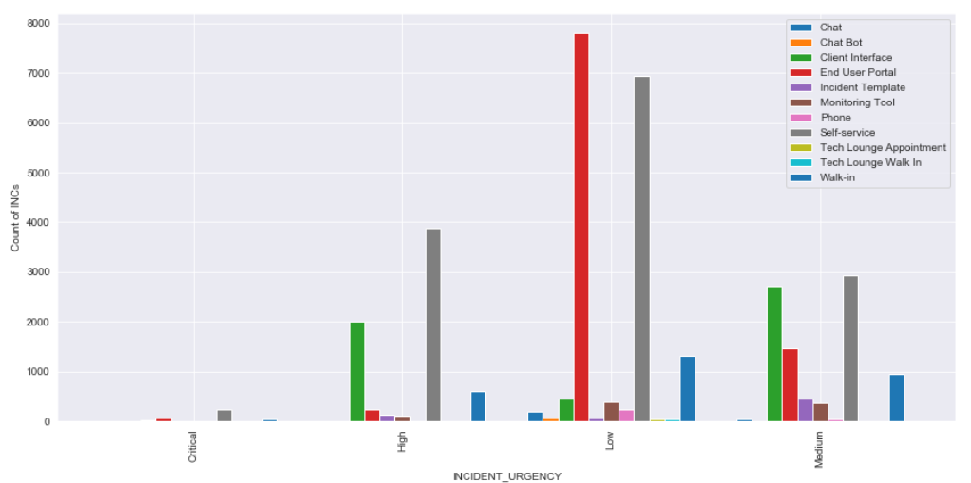
Exploring and Analyzing The data
Incident Source based on the INC Urgency.
Observed many INCs were logged either via Self service portal or by End user for all the Incidents.

Slide 5
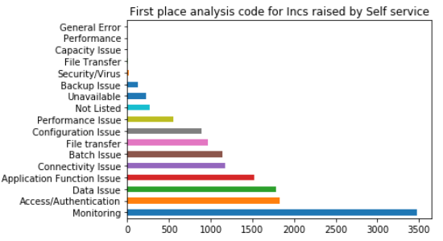
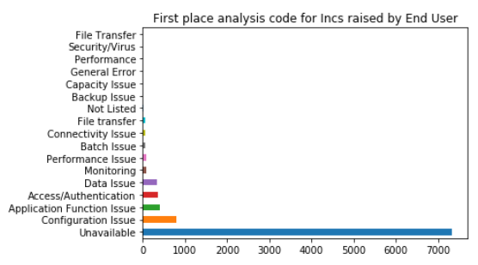
Exploring and Analyzing The data….
As the Number of Self raised and end user reported INCs were more , looking at exactly what kind of SYMPTOM code where
Observed .
Incase of Self Service ,Monitoring related and In case of End user, Service Unavailable were recorded at the highest

Slide 6
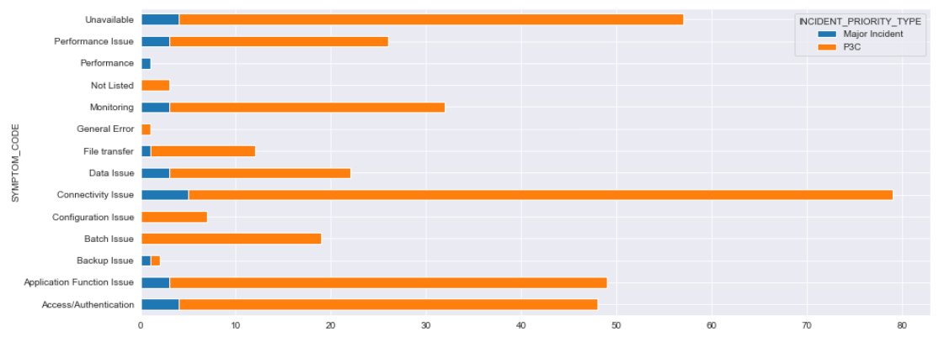
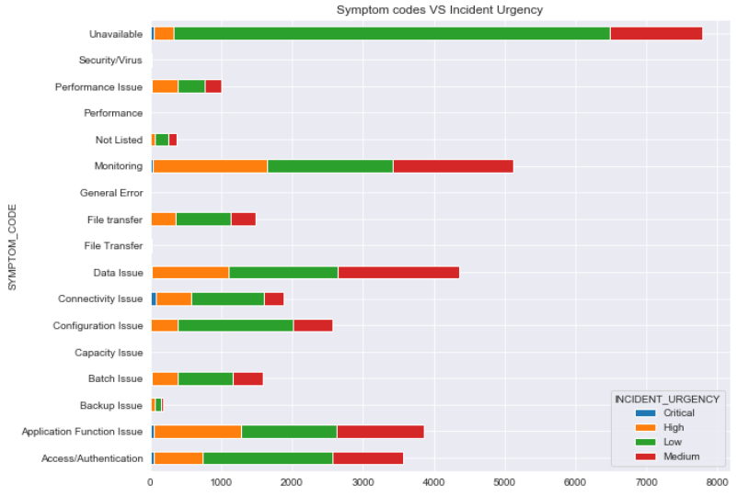
Exploring and Analyzing The data….
Analyzing more from Symptom codes,
Where as in case of P3C
and Major Incidents ;
Connectivity Issue Category was recorded the most
The Application/System Unavailable has mostly been logged for Other Incident type which includes Medium low and High Incidents

Slide 7
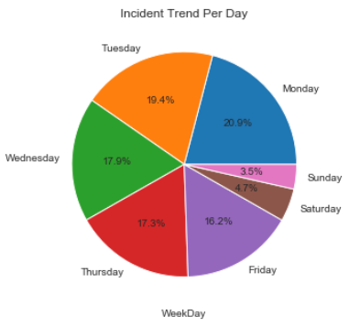
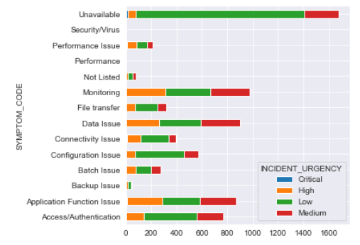
Exploring and Analyzing The data….
Looking at the Incident trend raised in Weekday/
30% were observed to be raised on Monday and gradually descreasing.
Looking ,further on the INC symptoms for INC raised on Monday .

Slide 8
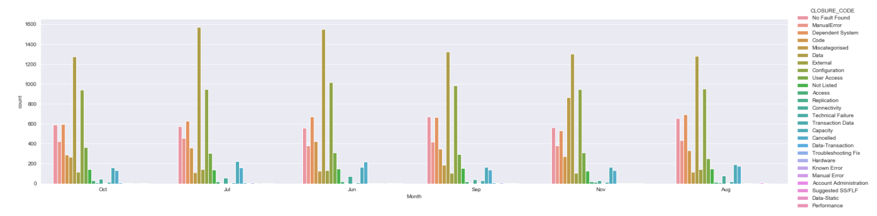
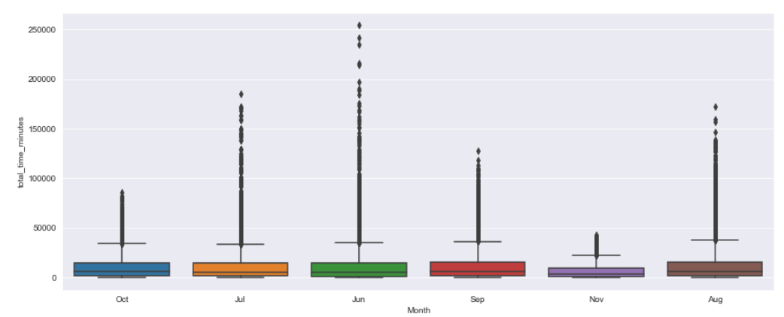
Exploring and Analyzing The data….
Distribution of Closed Incidents by month

Slide 9
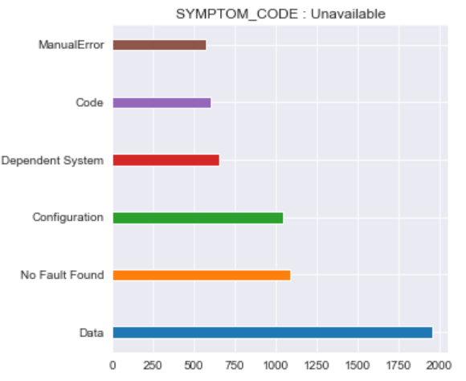
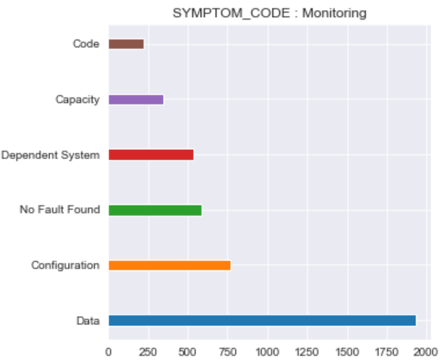
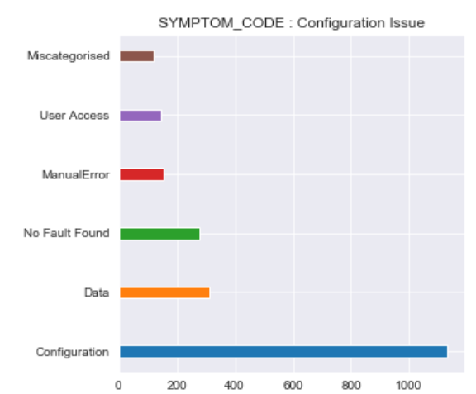
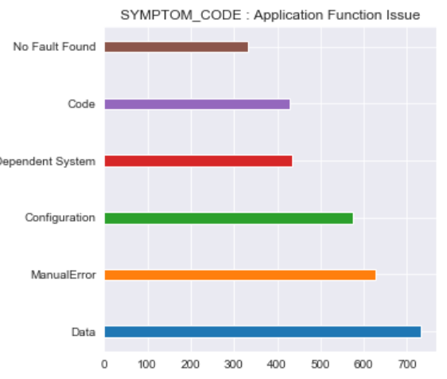
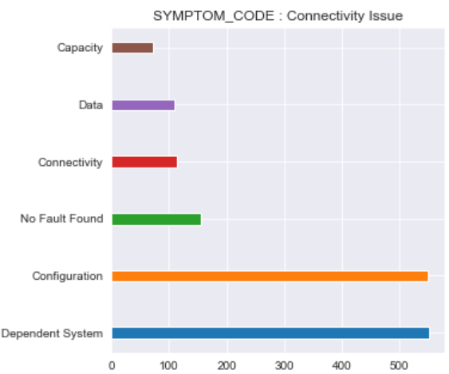
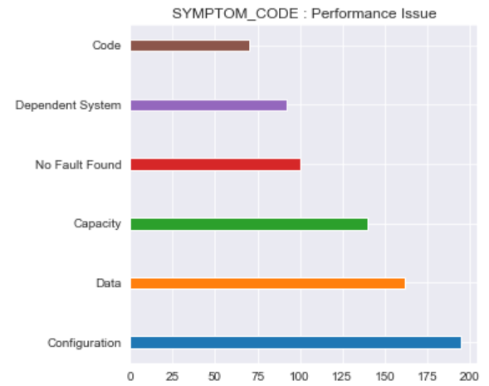
Below Analysis was done to verify the conflict between the SYMPTOM CODE and the CLOSURE CODE

Slide 10
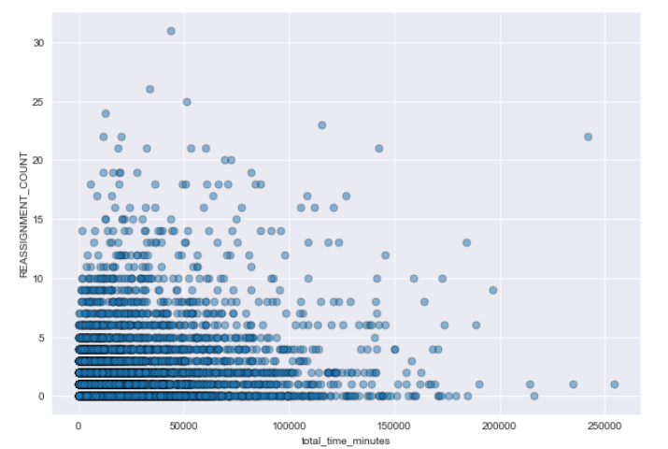
Multiple reassignments, leading to longer Closure time for
incidents, will lead to breach the incidents SLA.

Slide 11
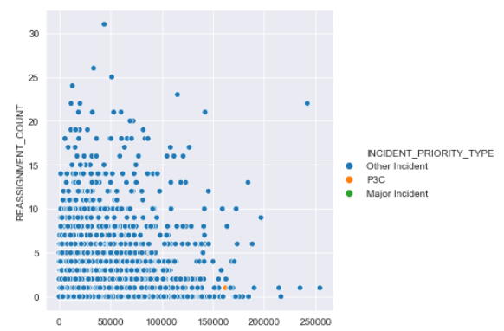
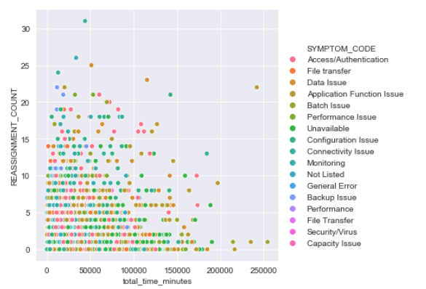
The below graphs demonstrate Reassigned counts based on Symptom code and Incident Priority type.

Slide 12
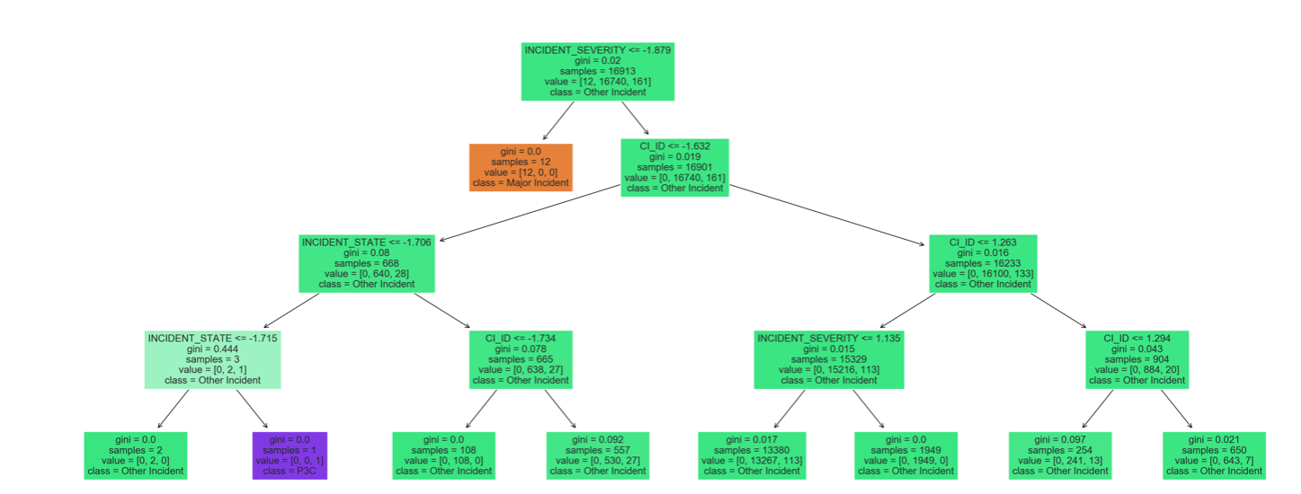
Part2 : Predicting Priorities Using Classification Algorithms
For predicting priorities considered Only the features which are available when the tickets arrives can be used to predict priority. Therefore, we have used only 4 predictors. Incident reference, Symptom code, CI Name, Incident severity.

Slide 13
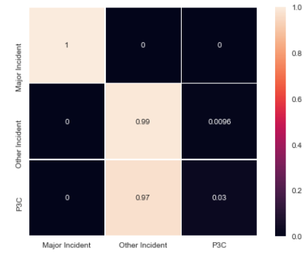
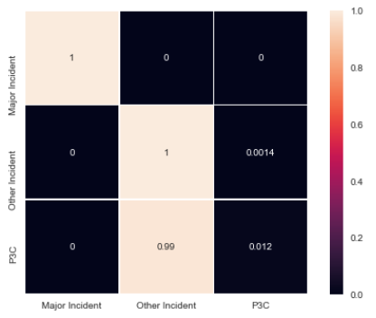
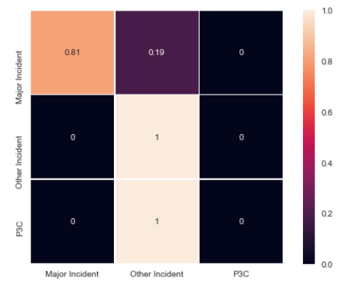



Looking at Models giving better accuracy for Predicting the Priorities.
Accuracy: 0.9808431384142375
Accuracy : 0.9887660379589664
Accuracy : 0.9898303080470644

Slide 14
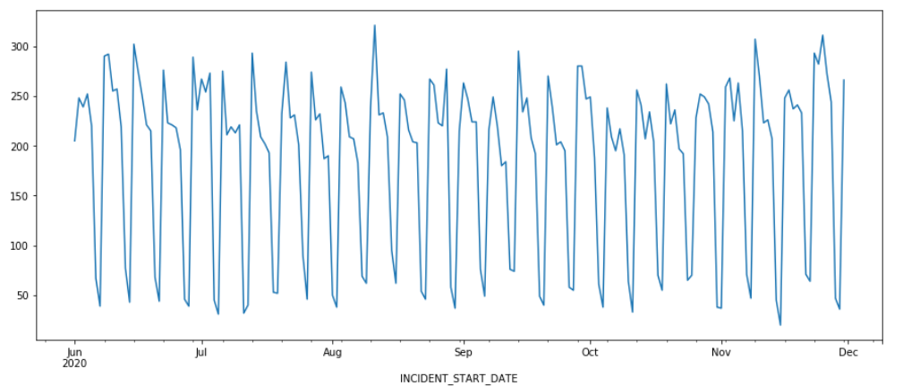
Forecasting The Incident trend
Plotting number of tickets per day

Slide 15
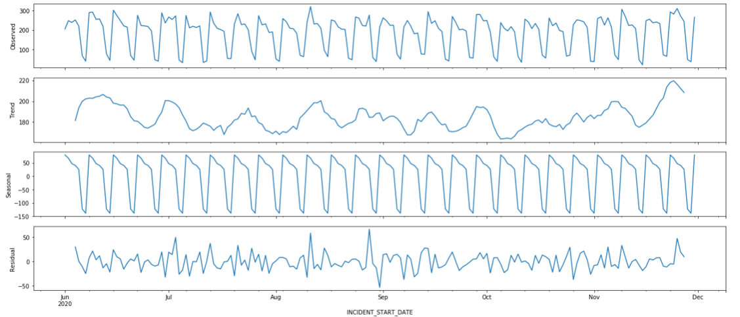
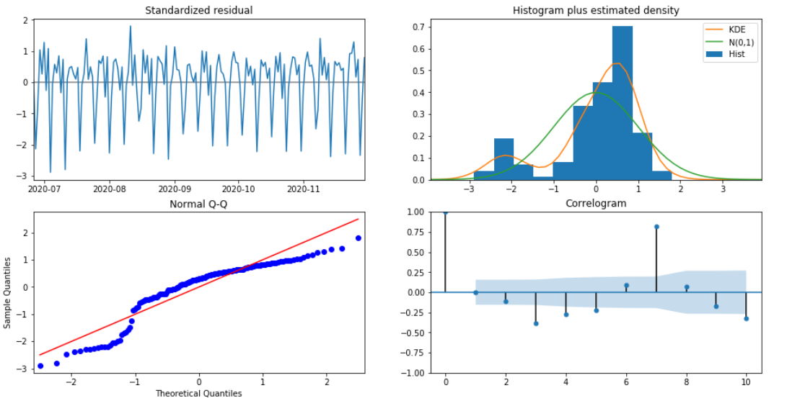
Decomposition Plot
Some distinguishable patterns appear when we plot the data. The time-series has seasonality pattern,
such as count is always low at the beginning of the week, month and high at the end
The model diagnostics suggests that the model residuals are near normally distributed.

Slide 16
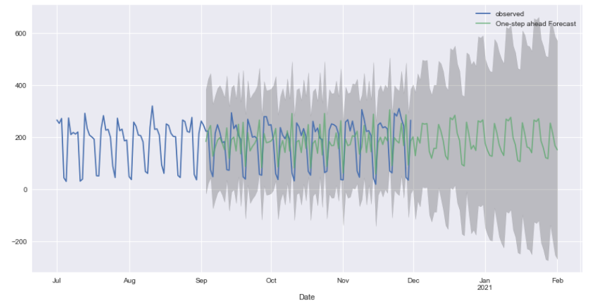
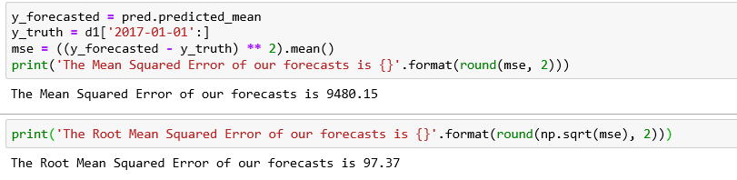
Incident Volume Forecast

Slide 17
Summary:
We tried to look and understand the source of Incidents logged in System.
Visualized data from different features perspectives
For predicting Ticket Priority, Random Forest gives almost 99% accuracy.
Forecasted the Incident volume for Upcoming months.
Future enhancement
Natural language analysis on short description & summary to provide tentative ETA post ticket submission
Understanding the stability of the applications based on Problem tickets and KB articles for most Inc raised and Priorities.
Analyzing ticket trend with respect to the Changes raised and visa versa.

Slide 18
THANKYOU

