Slide 1
Dr. D.Y.Patil Institute of Engineering and Technology, Pimpri-411018. Department of Computer Engineering Mini-Project Presentation on DMW Mini Project using Naive Bayes
Presented By:
Sampada Gaonkar
Anubhuti Rane

Slide 2
Index
Problem Statement
Introduction
Dataset Details
Selection of Classification Models.
Implementation
Feature Selection
Accuracy and Prediction Result
Statistics
Simple Charts
Advantages
Application
Conclusion

Slide 3
Problem Statement
Consider a labelled dataset belonging to an application domain. Apply suitable data pre-processing steps such as handling of null values, data reduction, discretization. For prediction of class labels of given data instances, build classifier models using different techniques (minimum 3), analyse the confusion matrix and compare these models. Also apply cross validation while preparing the training and testing datasets.

Slide 4
Introduction
Classification Model:
Classification predictive modelling is the task of approximating a mapping function (f) from input variables (X) to discrete output variables (y).
Types : Lazy Learners and Eager Learners
Used : Eager Learners

Slide 5
Dataset Details
Name: Golf Dataset.
Attributes: Outlook, Temperature, Humidity, Windy, Play Golf.
No of tuples: 13
Source: In-built dataset in Rapid Miner
Description: We classify whether the day is suitable for playing golf, given the features of the day. The columns represent these features and the rows represent individual entries.

Slide 6
Selection of Classification Models
I. Decision Tree:
Decision Trees are very flexible, easy to understand, and easy to debug.
They will work with classification problems and regression problems.
Why not ideal ?
They only need a table of data and they will build a classifier directly from that data without needing any up front design work to take place.
Simple decision trees tend to over fit the training data .

Slide 7
Selection of Classification Models
II. Support Vector Machine
A Support Vector Machine (SVM) is a discriminative classifier formally defined by a separating hyperplane.
Why not ideal?
Best in condition for extreme points and higher dimensionality problems.
The data points are considered dependent upto some extent

Slide 8
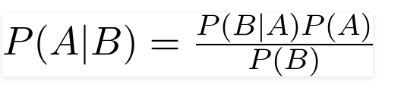
Selection of Classification Models
III. Naive Bayes:
Bayes Theorem :
A Naive Bayes classifier is a probabilistic machine learning model that’s used for classification task.
Why ideal?
It eliminates overfitting of data.
It’s a classification by hand.
The variables are considered independent to provide more accuracy.

Slide 9
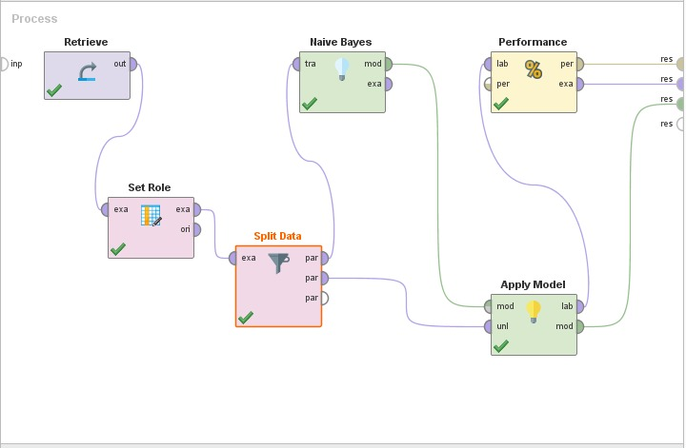
Implementation

Slide 10
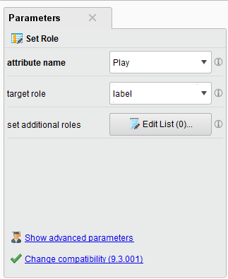
Feature Selection

Slide 11
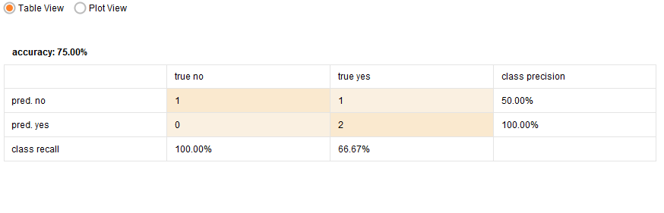
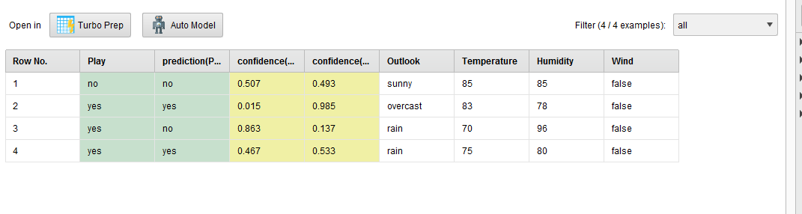
Accuracy and Prediction Result

Slide 12
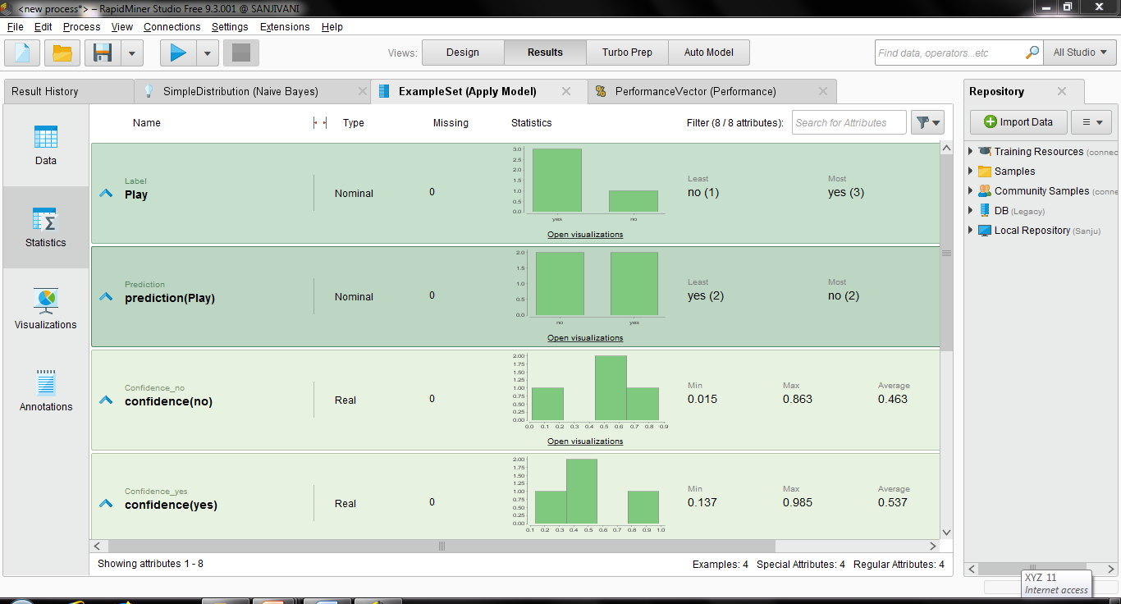
Statistics

Slide 13
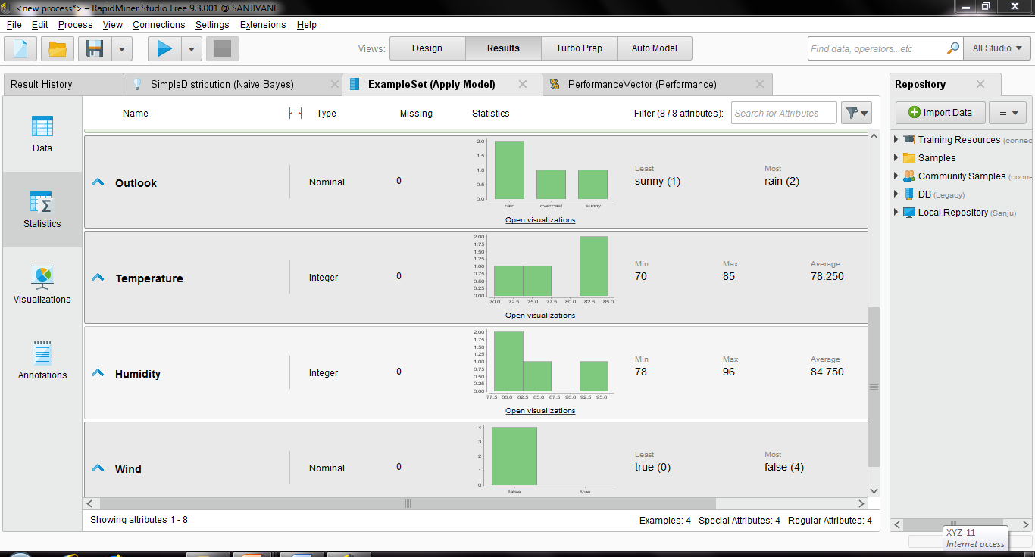
Statistics

Slide 14
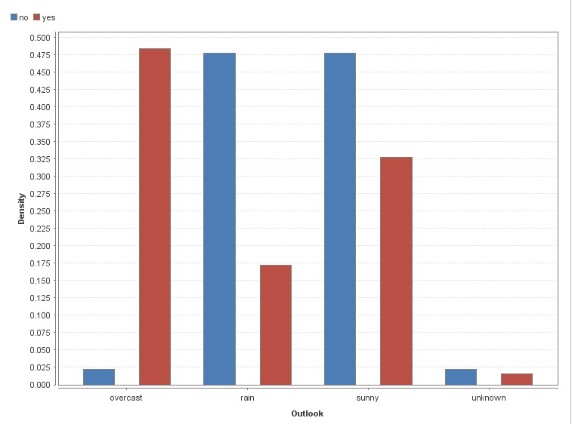
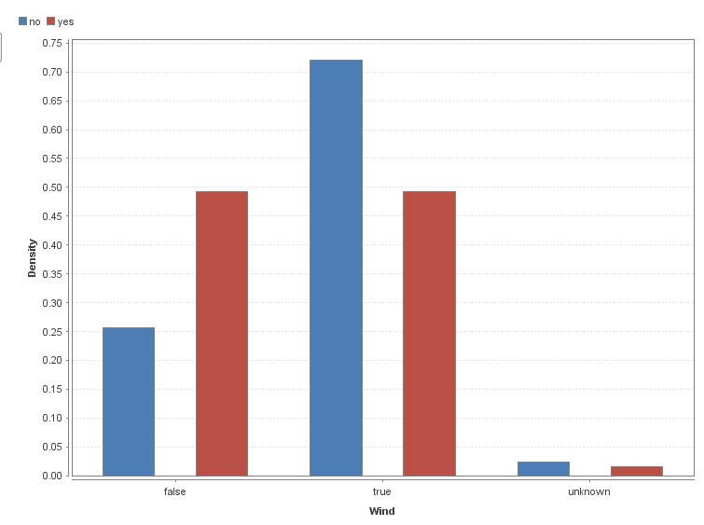
Simple Charts

Slide 15
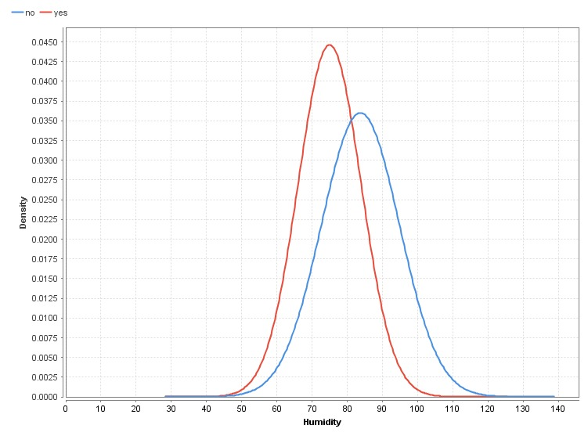
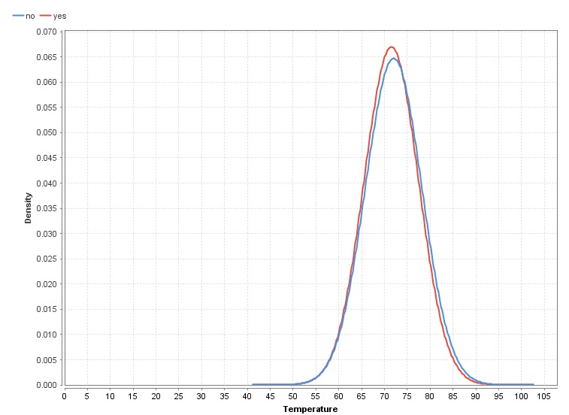
Simple Charts

Slide 16
Advantages
It is easy and fast to predict a class of test dataset
it performs better compared to other models assuming independence.
It performs well in case of categorical data inputs compared to numerical variables.

Slide 17
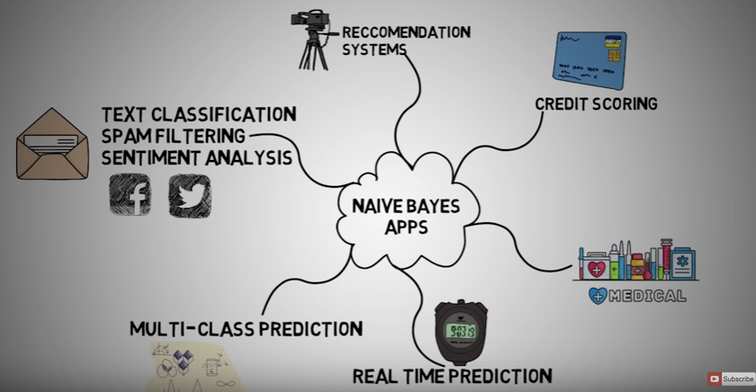
Application

Slide 18
Conclusion
Naive Bayes algorithms are mostly used in sentiment analysis, spam filtering, recommendation systems etc. They are fast and easy to implement but their biggest disadvantage is that the requirement of predictors to be independent. In most of the real life cases, the predictors are dependent. This hinders the performance of the classifier. The golf dataset follows the Gaussian Naive Bayes classification and thus a accurate result is obtained.

