Slide 1
Mini-Project Presentation on Selenium Automation Testing (Library System)
Submitted By:
Sampada Gaonkar
Anubhuti Rane

Slide 2
Index
Problem Statement
Objectives
Introduction
Automation Testing
Selenium Automation Testing
Selenium Features
TestNg
XML Suite
Implementation
TestNg Output
Extent Report
Default Html Report
Limitation of Selenium
Conclusion

Slide 3
Problem Statement
Create a small web-based application by selecting relevant environment/platform and programming languages. Narrate concise Test Plan consisting features to be tested and bug taxonomy. Narrate scripts in order to perform regression tests. Identify the bugs using Selenium WebDriver and IDE generate test reports encompassing exploratory testing.

Slide 4
Objectives
To create a web based application with various functionalities that are to be tested.
To create test cases to test each of the functionalities of the web application.
To generate html report and extent report through TestNg for the status of the test cases after execution.

Slide 5
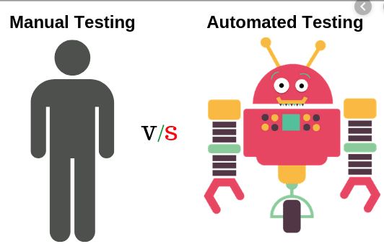
Introduction
Traditional testing method: Manual Testing
Why to reject it?

Slide 6
Automation Testing
Reasons:
Manual Testing of all workflows, all fields, all negative scenarios is time and money consuming
It is difficult to test for multilingual sites manually
Automation does not require Human intervention
70% faster than the manual testing
Automation increases the speed of test execution

Slide 7
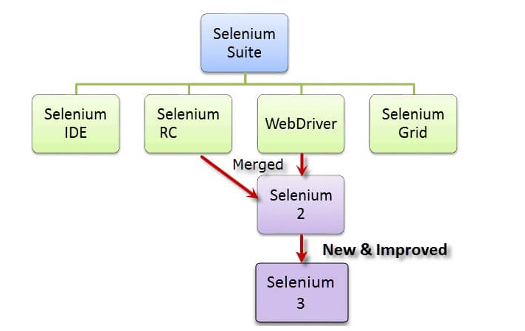
Selenium Automation Testing
Latest Version
Selenium
4

Slide 8
Selenium Features
It supports the different languages and browsers.
Selenium server initializing is not required.
It supports iPhone and Android testing also.
WebDriver finds any co-ordinates of any object.
One can create movement of a mouse using selenium.

Slide 9
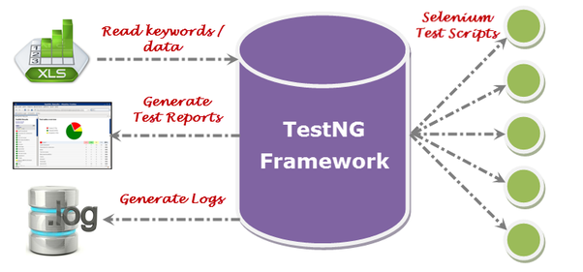
TestNg
Why Use TestNG with Selenium?

Slide 10
Types of Selenium testing
The type of testing used are:
Integration Testing
Regression Testing

Slide 11
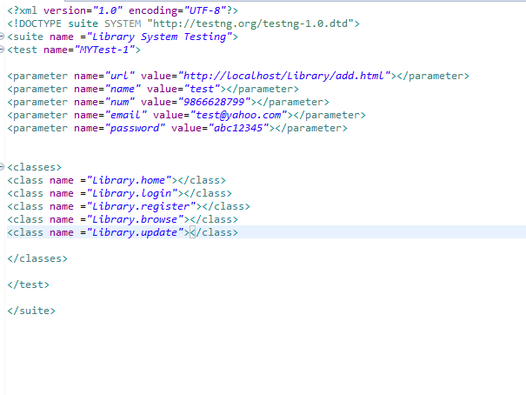
Xml Suite

Slide 12
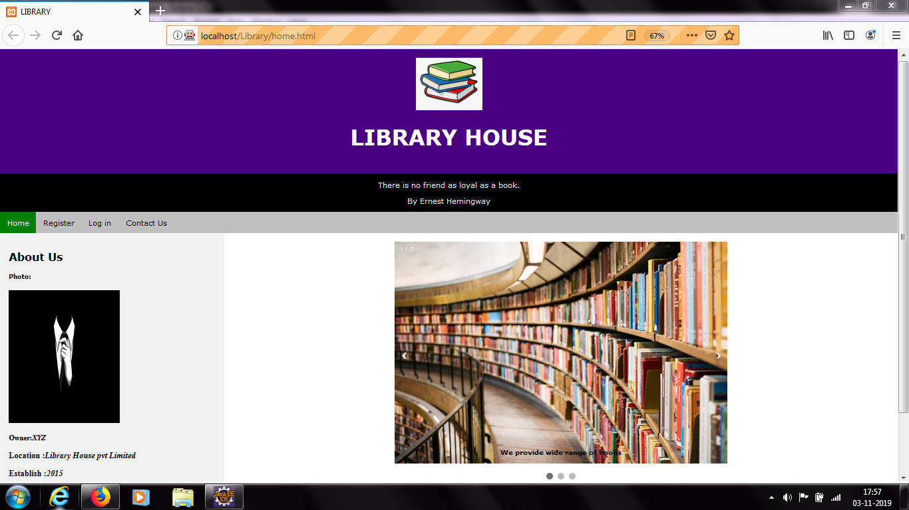
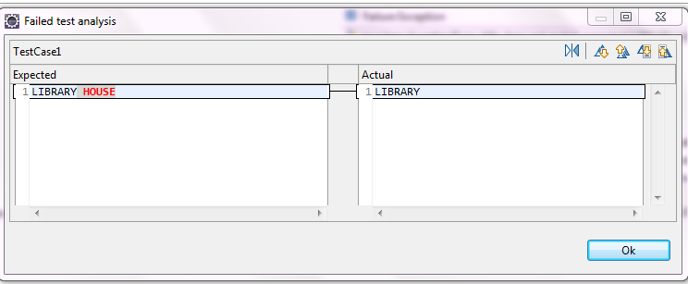
Implementation
Title Test ---Failed

Slide 13
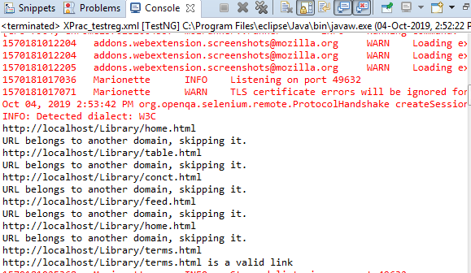
Implementation
Link Test---Passed

Slide 14
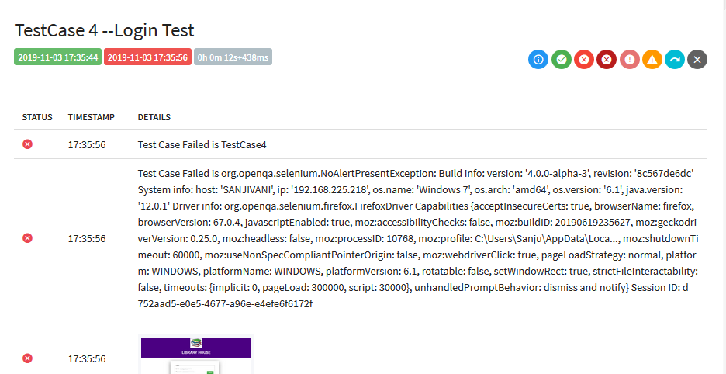
Implementation
Login Test –Failed

Slide 15
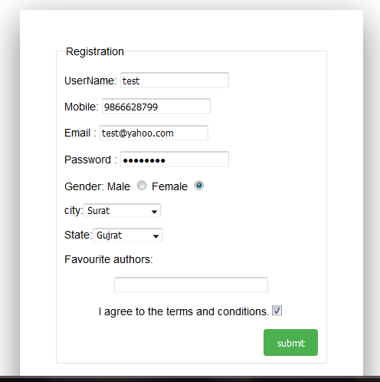
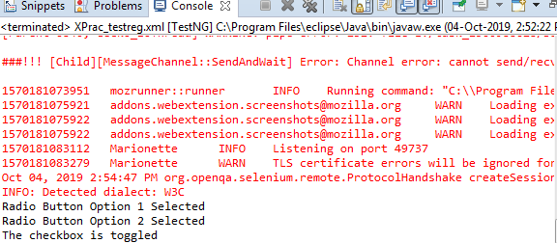
Implementation
Register Test ---Passed

Slide 16
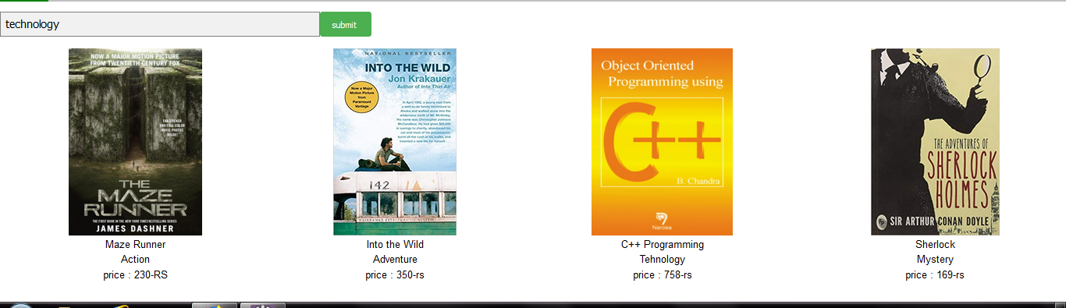
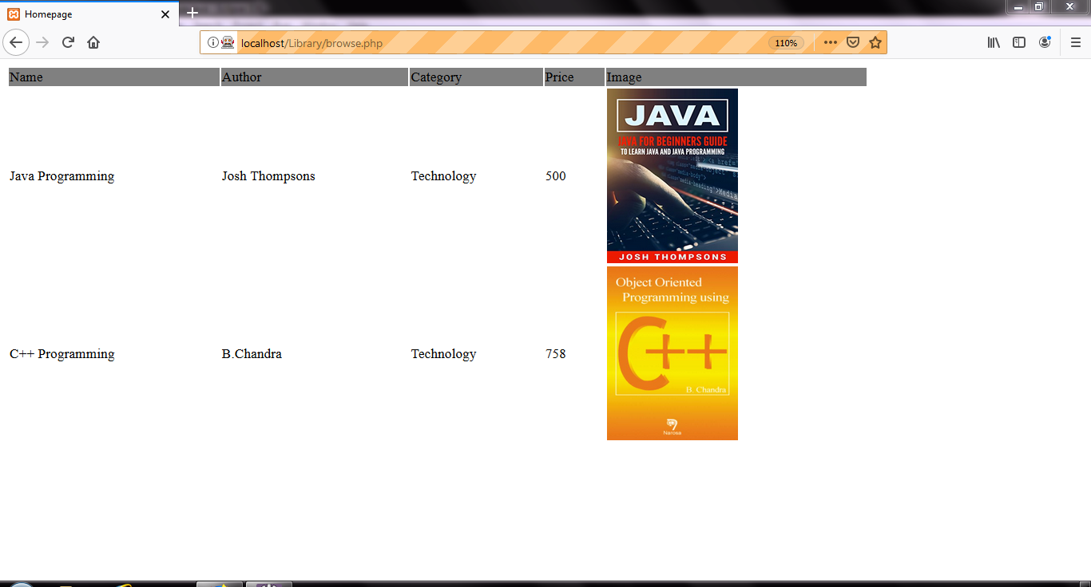
Implementation
Browse Test--- Passed

Slide 17
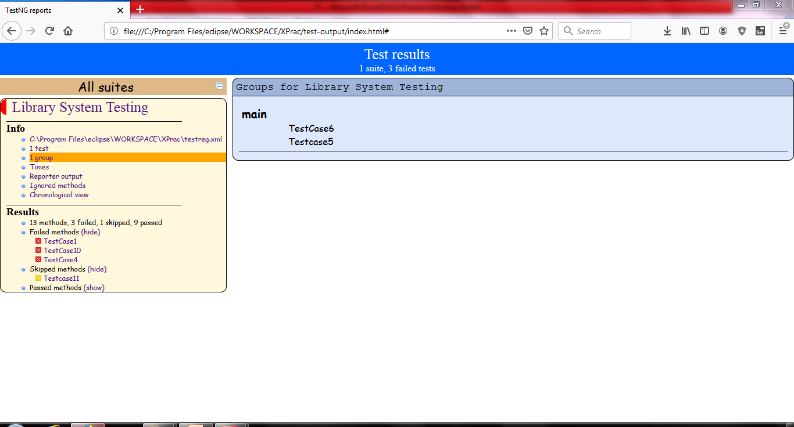
Implementation
Group Tests

Slide 18
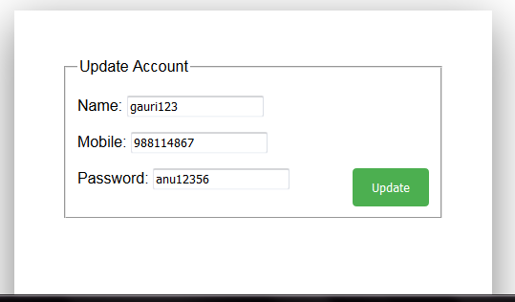
Implementation
Update Test

Slide 19
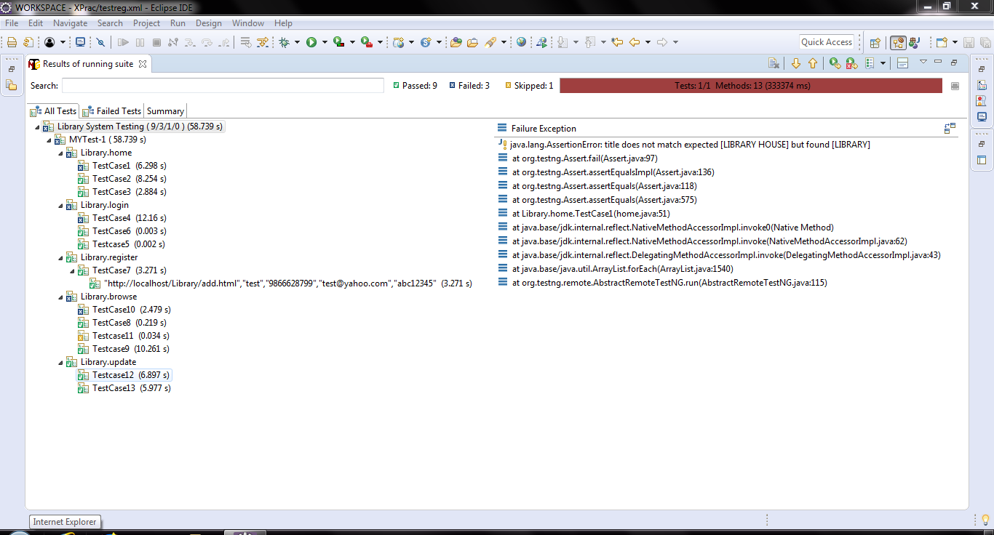
TestNg Output

Slide 20
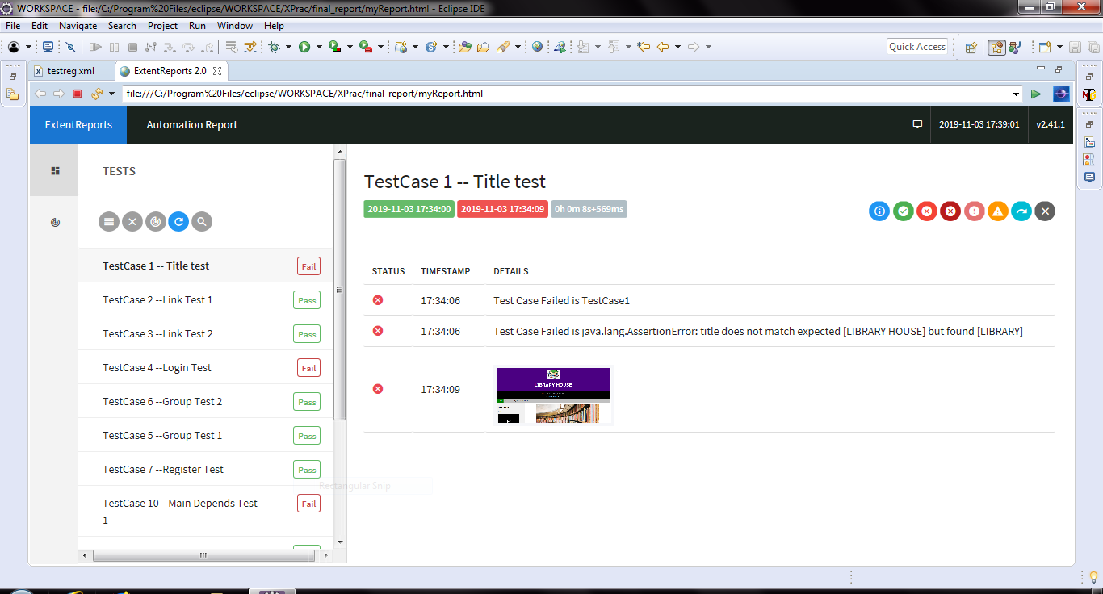
Extent Report

Slide 21
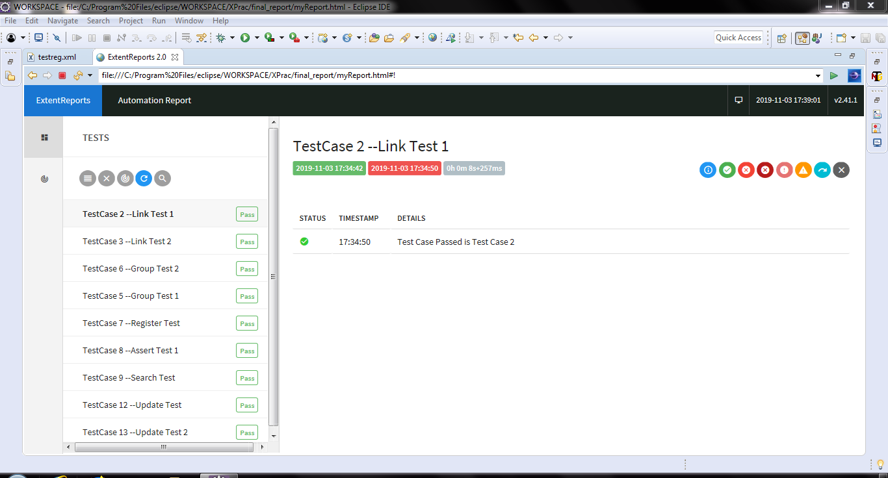
Extent Report
Pass

Slide 22
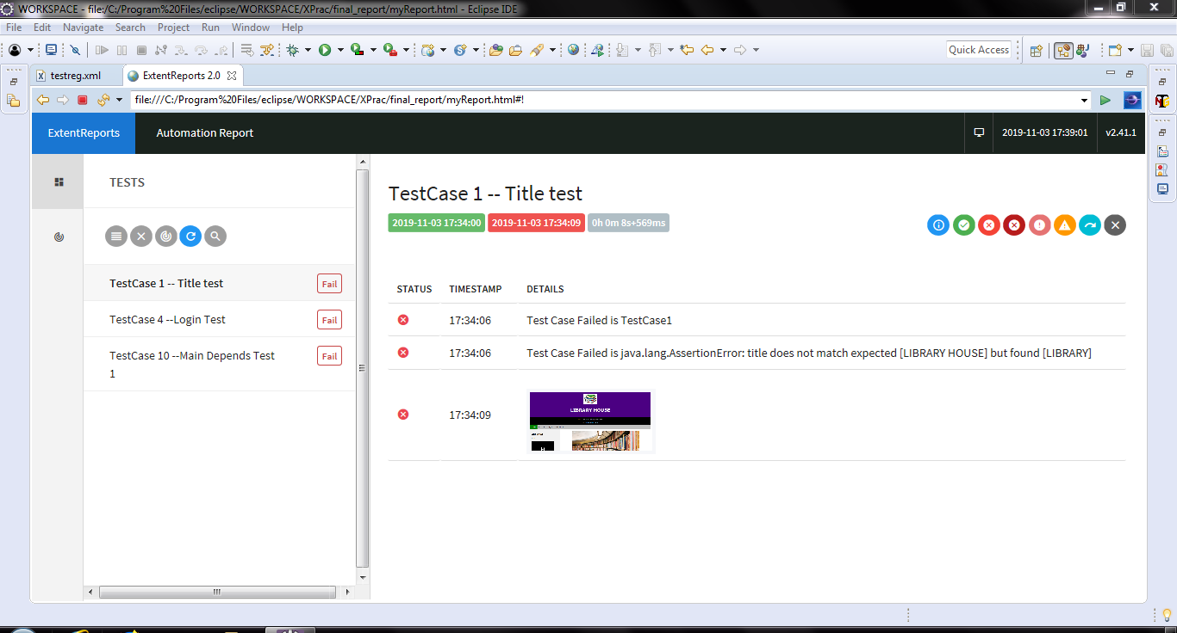
Extent Report
Fail

Slide 23
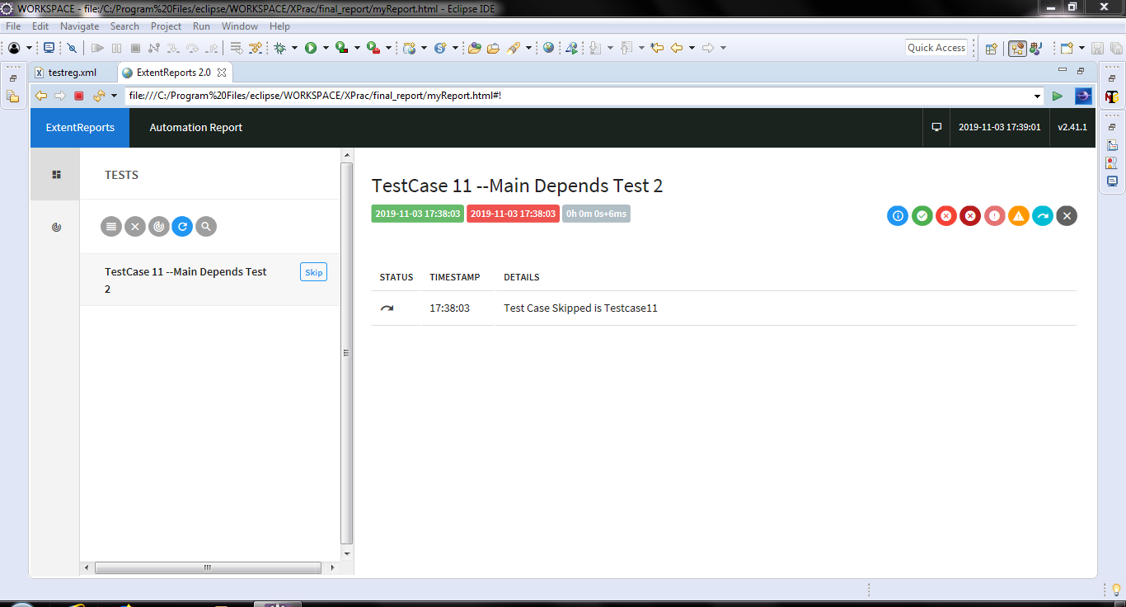
Extent Report
Skip

Slide 24
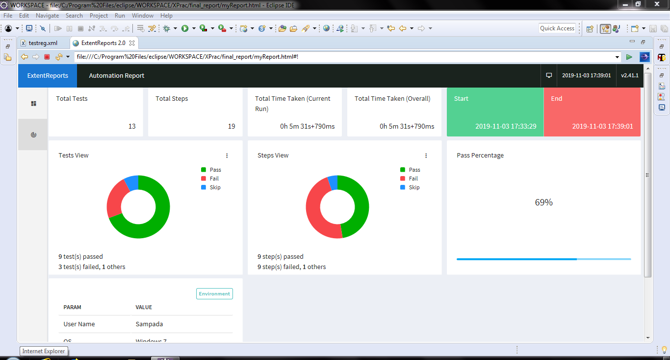
Extent Report

Slide 25
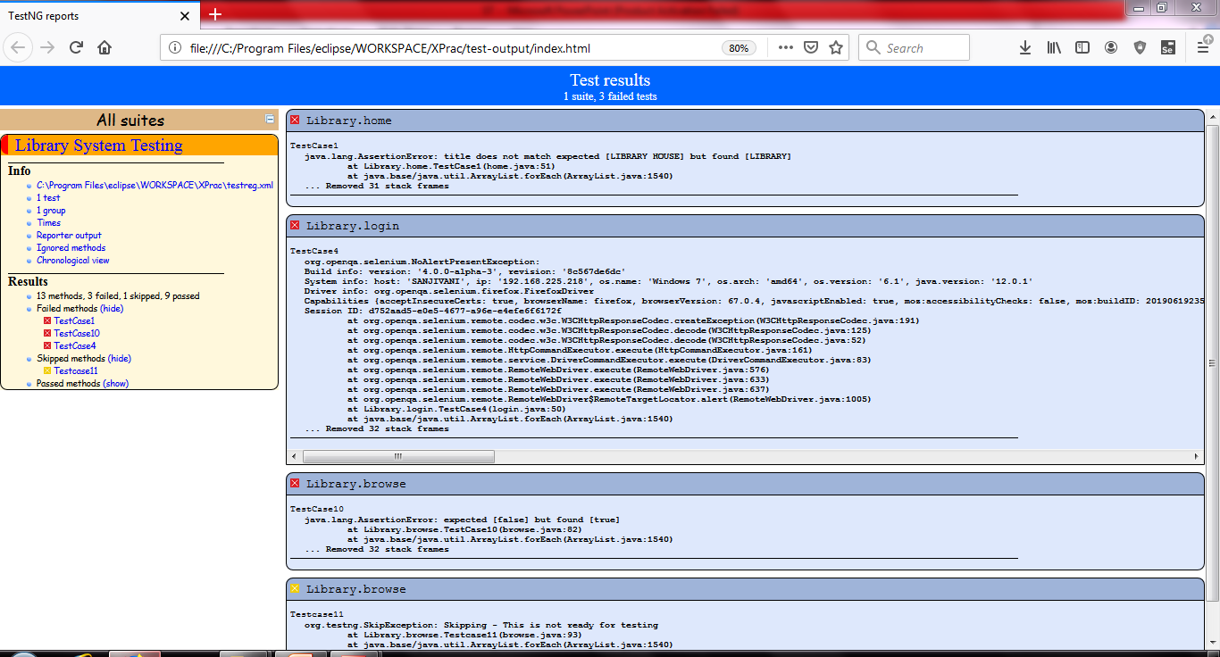
Default Html Report

Slide 26
Pros and Cons
Limitations of Selenium
We cannot test desktop based application.
We can test android application but we need a proper API for that.
We cannot automat CAPTCHa ,Flash ,Sliverlight Components.

Slide 27
Conclusion
While TestNG with Selenium is useful and effective. It should follow a risk-based approach to balance the testing effort with consequences of software failure. Architectural and design-level risk analysis provide the right context to plan and perform testing. This system tests for all types of Test Cases with various possibilities and shows which part of the design of the webpage does not follow the testing standards

