Slide 1

SDLC
Software Development Life Cycle

Slide 2
An Insight into SDLC
Introduction
- A systematic and step by step approach to develop software.
-Detailed roles involved in each phase.
Why SDLC?
-Without any action plan can be a disaster.
-Pipeline to align the whole piece of the development cycle.
-To provide the product in a systematic manner.

Slide 3
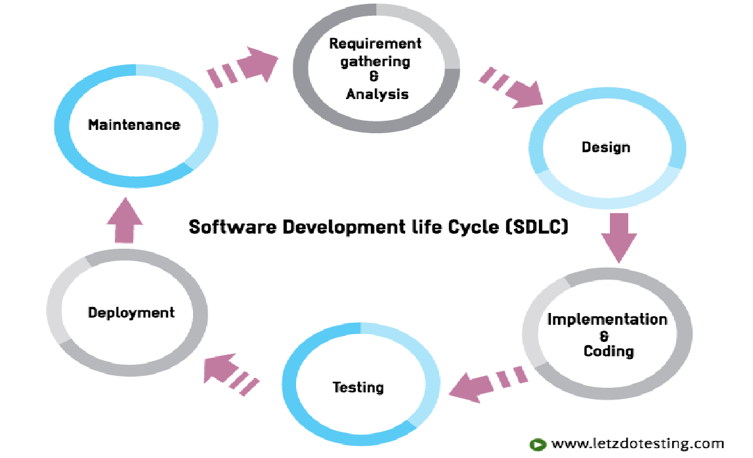
Steps of SDLC

Slide 4

Requirement Gathering and Analysis
Business requirements and specifications are gathered.
Top level management of the company.
Analyze product feasibility and user needs.
What, how and who of the system under consideration.
BRD/ BRS, SRS, Technical requirement documents.

Slide 5
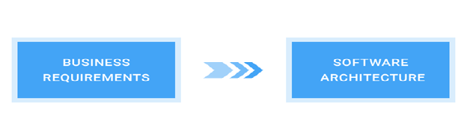
Design
System Architecture is designed.
High-level design (HLD) and Low-level design (LLD).
Design documents help in developing the software effectively.
System Architecture, HLD, LLD, Detailed Design Specifications (DDS)

Slide 6
Implementation and Coding
Focus of this phase is development.
Entire design will be broken into modules and developers will work on individual modules.
JAVA, PHP, C++, C#, ASP.NET are used to develop the software
Working software is developed.

Slide 7

Testing
Working software is used for testing.
Ensure quality and validate the tests against the customer requirements.
Test cases and test scripts are used for testing to validate the requirements.
Different testing types performed.
product bugs, issues, defects are tracked, reported and retested.
Test summary report, test results, test plan, defect list, User Acceptance test, sign-offs.

Slide 8
Deployment
Released or deployed to the customers for their usage.
Beta testing is done at the customer’s site.
Beta testing feedback and issues are reported.
Finalized and will be ready for final deployment.
Deployed software, Customer’s review, Live Production environment, and Data

Slide 9
Maintenance
Issues faced by customers are addressed.
Support provided for the deployed software.
Missed bugs are taken care of.
The existing system should be maintained and
Re-designed to accommodate the new changes.

Slide 10




