Slide 1
IDENTIFIER RULES
Can use a-z,A-Z,_,$,0-9
First digit can't be 0-9
Can't use reserved names like if, for, int, float etc.
Can use class names like String, StringBuffer etc. but not recommended.

Slide 2
Keywords
USED KEYWORDS
UNUSED KEYWORDS
DATA TYPES | FLOW | MODIFIERS | EXCEPTION | CLASS | OBJECT | OTHER
Byte | if | public | try | class | new | void
Short | else | private | catch | extends | instanceof | enum
int | switch | protected | finally | implements | super
long | case | static | throw | interface | this
float | default | final | throws | package
double | while | abstract | assert | import
boolean | do | synchronized
char | for | native
 | break | strictfp
 | continue | transient
 | return | volatile
goto
const
RESERVED LITERALS
true
false
null

Slide 3
IS JAVA STATICALLY TYPED ?
Yes BECAUSE the type of the variable is checked at the compile-time of the code HENCE called a statically typed language.
Code won’t be compiled until error is corrected.
IS JAVA STRONGLY TYPED ?
Yes BECAUSE the type of the variable Should be specified by the programmer.
IS JAVA OBJECT ORIENTED?
No because primitive data types are used & MULTIPLE inheritance, operator overloading features not available.

Slide 4
DATA TYPE RANGE
byte -> 1 byte
short -> 2 byte
int -> 4 byte (declaration int hex = 0xa [=10]or int oct = 010[=8] or int bin=0b111[=7] )
long -> 8 byte (declaration long l = 20L )
float -> 4 byte (declaration float f = 20.0f)
double -> 8 byte (declaration double d = 1.2e9 [=1.2*10^9])
boolean -> compiler dependent(1 bit)
char -> 2 byte (declaration can be char x = 97)
Ex:- int x = 11_11_1; o/p-> x=11111
double x = 11_11.11_11; o/p-> x=1111.1111
But double y = 11_11.11_; =>error

Slide 5
SPECIAL CHARACCTERS
\n -> newline
\b -> backspace (points cursor in one back direction)
\r -> carriage return (returns to position in a given line)
\t -> tab
\’ -> single quote
\” -> double quote
\\ -> backslash

Slide 6
ARRAYS
int x[] = new int[size]; size= 0 to Integer.MAX_VALUE
int x[][] = new int[size1][size2]; size1*size2= 0 to Integer.MAX_VALUE
Can also declare like this => int x[][] = new int[size1][]; & then do as follows x[0] = new int[3]; x[1] = new int[2]; … till x[size1-1] = new int[4]
Can also declare like this => int x[] = {1,2,3}; or int x[][] = {{1,2},{1,3,4}}
And int x[]; x = new int[2]; is valid But int x[]; x = {1,2,3}; is invalid.
To get length final variable length is used.
If we have x as 2D array then to get the length of entire array we must use x[0].length+x[1].length[]+x[2].length+…+x[n-1].length
If we use x.length then we will get n but not the number of elements in the array.
Anonymous arrays can be created while passing parameters or other cases like fun(new int[2][2]{{1,2},{1,3}}) and also like int x = new int[3]{1,2,3} or x=new int[]{1,2,3} (now it is not anonymous any more) etc.

Slide 7
VARIABLES
We can categorizes variables under 2 division-
Division1 -> 1)Primitive 2)Reference
Division2 -> 1)instance(heap area) 2)static(heap area) 3)local(stack area)
Default values of instance and static variables are as follows -
1)Numbers =0 2)references=null 3)Boolean=false so don’t need to initialize.
Local variables don’t have default values so they must be initialized.
Local variables also cannot be used with any modifiers except final. i.e final int x = 20 is valid.
If we have instance/static variable like these 1) int x[]; 2)int x[] = new int[3] in 1) will get null pointer exception if accessing x[0] 2)will give 0 if accessed x[0].

Slide 8
VARARGS
public static void main(String[] args) {
m1();// or m1(1,2,3)
m2(new int[]{}); // or m2(new int[]{1,2})
}
public static void m1(int... x){
for(int i = 0; i < x.length; i++)System.out.print(x[i]+" ->");
}
public static void m2(int[] x){
for(int i = 0; i < x.length; i++)System.out.print(x[i]+" ->>");
}

Slide 9
MAIN METHOD
1)public -> To be accessible to JVM from anywhere
2)static -> To be able to call main without creating object
3)void -> not returning anything to JVM
4)main -> name of the function called by JVM
5)string []args -> accepts input runtime
i.e. when using command [ java filename arg1 arg2 arg3 so on ] can be used to get arguments run time & to access these args just use args[i].
Overloading of main will be done but string[] args one will be called.
Overriding is possible(called method hiding as at compile time itself the method is resolved) hence child main will be called.
final, synchronized, strictfp are the only modifiers that can be used with main method.
Without main method error occurs.
Parameter -> method variables Argument -> variables/values passed while calling method

Slide 10
++ Operator usecase
1)byte b = 10; b = b+1; error (Since byte + int = int)
2)byte b = 10; b++; o/p →b=11
3)byte b = 10; b = (byte)(b+1); o/p → b=11
In 1) compiler thinks that operation is on int hence returns int result but in 2&3) compiler performs operation and then converts back to byte.
Basically compile returns maximum data type result after computing.
Ex: public class Main{
public static void main(String[] args) {
long value = 10;
value = value + Integer.MAX_VALUE;(long + int = long)
System.out.println(value); O/P→ 2147483657
}
}

Slide 11
JAVA STANDARD
Class name, interface name starts with capital letter & camel casing followed.
Variable name, method name starts with small letter & camel casing followed.
Constants are separated by underscore & all letter are capital.
SAMPLE EXAMPLES
SOP(10/0) -> RE:ArithmeticException
SOP(10.0/0.0) -> Infinity
SOP(-10.0/0)-> -Infinity
SOP(0.0/0) -> Nan
SOP(-0.0/0) -> Nan
NOTE :- Only operator overloaded in java is ‘+’ operator for arithmetic & string concatenation.

Slide 12
== VS .equals in String
== basically compares if the two references are pointing to the same object or not, if yes then it returns true.
.equals checks the content pointed by two references & if they are equal then return true.
Ex :
String str1 = new String(“abc”);
String str2 = new String(“abc”);
System.out.println(str1==str2);// O/P-> false
System.out.println(str1.equals(str2)); O/P-> true
If new String was not used then at run time actually str1 will be pointing to str2 so that time it would give true in both cases. So new was used.

Slide 13
“instanceof” METHOD
Used to check if a particular reference is an instance of the class specified.
Here one of the reference and class name should be either child/ parent of the other. Else it will throw CE saying incompatible types.
Ex :- (We know that Object->Person>Student [Parent→→child order])
Person p = new Person();
System.out.println(p instanceof Object);//true
System.out.println(p instanceof Person);//true
System.out.println(p instanceof Student);//false
System.out.println(p instanceof String);//CE incompatible types

Slide 14
BITWISE OPERATOR
For &,|,^ can be used for all data types(except float & double).
! Can be used only for Boolean types.
~ is used for all data types except Boolean,float,doubt.
&&,|| (Short circuit operator) can be used only for Boolean types.
And main thing about &&,|| is that if first based on first argument if the result can be formed then second argument will not be checked.
ASSIGNMENT OPERATOR
+=, -=, *=, /=, %=, &=, |=, ^=, >>=, >>>=,<<=.
>>= → It shifts the bits to right and MSB will be retained.
>>>= → It shifts the bits to the right and MSB will be 0.
<<= → It shifts the bits to left and LSB will be 0.

Slide 15
TYPE CASTING
There are two types 1) Implicit, 2) Explicit.
1)Implicit : Called widening or upcasting. This is implicitly done by java compiler.
Ex : byte b =12; int x = b;=>implicit typecasting
2)Explicit : Called narrowing or down casting. This is explicitly done by the programmer.
Ex : int i = 115; byte b = (int)i;=>explicit typecasting
TERNARY OPERATOR
(boolean)?condition1:condition2;
If Boolean = true condition1 will be executed else if Boolean = false condition2 will be executed.

Slide 16
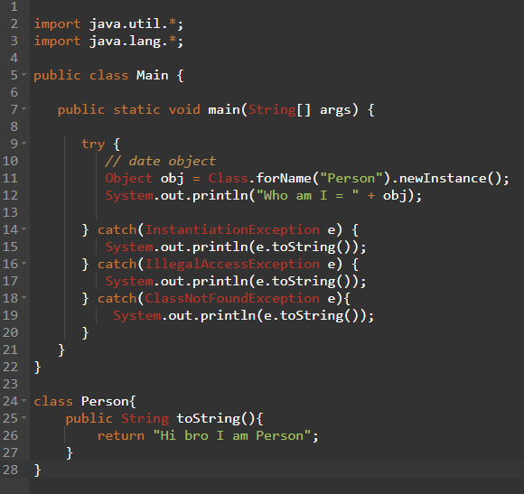
new Vs newInstance
If you only know the name of the class at run time then newInstance is used. newInstance method returns Object type hence type casting is done.
Ex:
OUTPUT
Only Problem is that Object class method can only be called.
& Class having parameterized constructor can’t be used

Slide 17
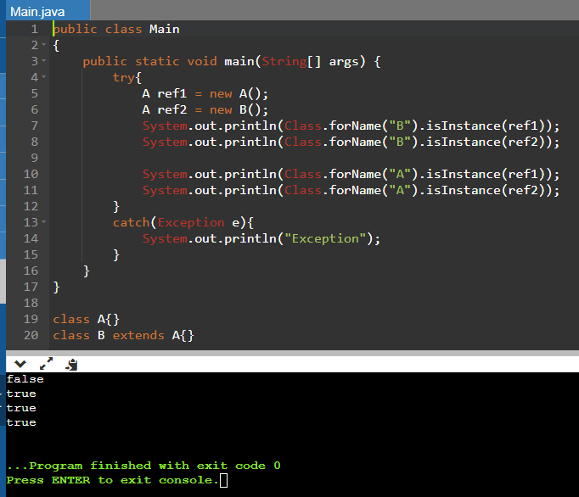
Instanceof vs isInstance
isInstance method is similar to instance of method but With just string as argument check can be done.
Try to read isInstance method from last to first to think similar to instance of method.

Slide 18
FLOW CONTROL
Ex 1:- boolean b = false;
if(b=true){SOP(“HI”);} -> o/p HI
Ex 2:- boolean b = true;
switch(b){…} -> long, boolean, float, double can’t be used in switch.
In case (of switch) only final variables can be used.
Ex : final int x =20;
switch(x){
case x: SOP(“HI”);
} -> o/p HI
Duplicate case label will give compile time error
Ex : switch(9){
case ‘a’ : sop(“HI”);break;
case 9 : sop(“HELLO”);break;
case 97 : sop(“WELCOME”);break;
}
CE : duplicate case label

Slide 19
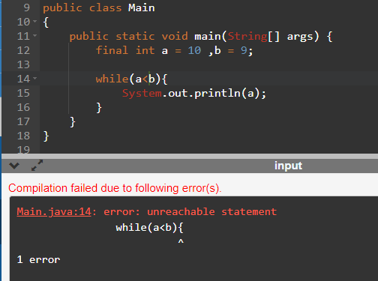
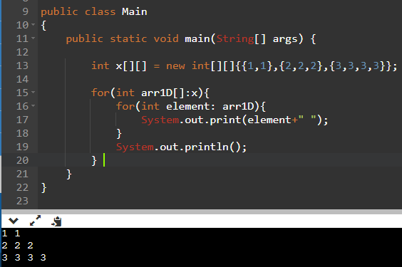
If used a>b or a==b for the image on right then it will be
an infinite loop printing 10.
Appart from for loop to retrieve all elements of arrays
or collections for each loop can be used.
Ex :->

Slide 20
ITERATOR & ITERABLE
Iterable {present in java.lang package} is an interface having one method called Iterator(){present in java.util package}.
The target element in for each loop should be Iterable type. (i.e. for(element in:target))
An object is said to be Iterable if and only if corresponding class implements Iterable.
All array related classes & collection implemented classes implement iterable interface.
Iterator has three methods hasNext(), next() & remove().

Slide 21
A

