Slide 1
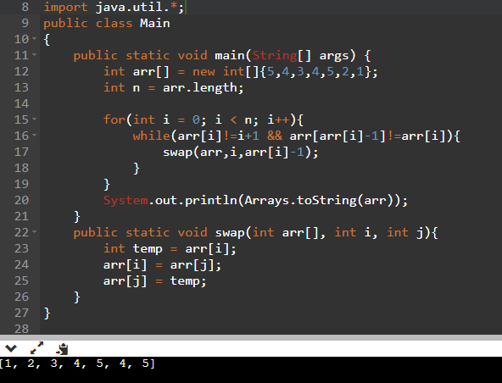
If array can be modified & all elements are between 1-N are present (size>=N)
We can find any no. of duplicate elements and
Print them using swap sort.
Complexity is O(n).

Slide 2
If array can be modified & all elements are between 1-N are present (size>=N)
We can find any no. of duplicate elements and
Print them using swap sort.
Complexity is O(n).

Slide 3
If array can’t be modified and only 1 duplicate present then (elements from 1-N size=N+1)
Ex:- [1,2,4,4,5,3]
If this is the array then [1^2^4^4^5^3]^[1^2^3^4^5] will give 4. Hence duplicate found easily.

