Slide 1
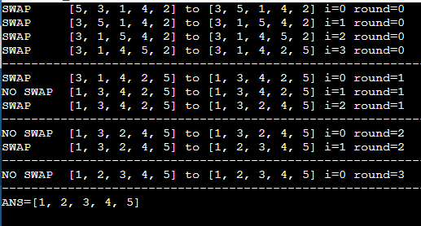
Bubble sort
Logic
Outer loop representing the number of rounds runs (N-1) times.
Inner loop representing the number of swaps runs for (N-1-round) times(initially round = 0 for which N-1 rounds).
Ex-> Let n=5 & arr[] = {5,3,1,4,2}
No. of times inner loop runs
OuterLoop -> InnerLoop
Round 0 -> 4
Round 1 -> 3
Round 2 -> 2
Round 3 -> 1

Slide 2
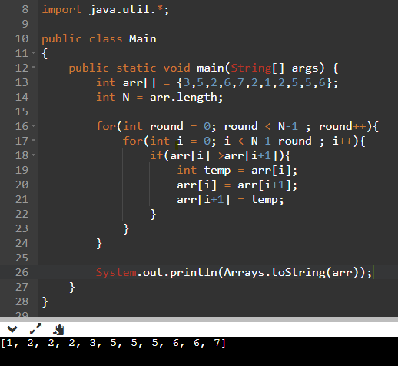
NORMAL BUBBLE SORT CODE

Slide 3
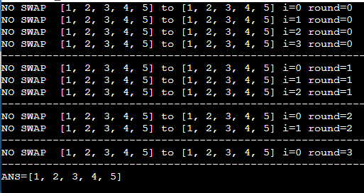
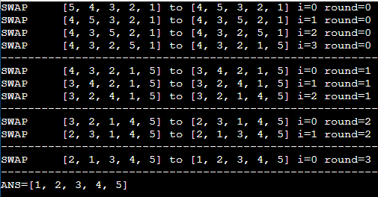
If Array is in ascending order
If Array is in descending order
No matter how the input is the best and worst case time complexity is O(n^2).
Hence normal bubble sort is not adaptable (means if able to provide @ faster complexity for certain inputs).
Bubble sort is stable(because if there are two or more same elements then it’s order is preserved after sorting).
Space complexity is O(1)

Slide 4
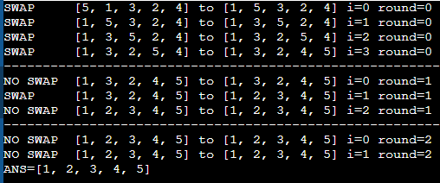
Modified Bubble sort
Logic
If in any one of the rounds no swaps happen then It’s guaranteed that the array is already sorted. So we don’t have to go through any other iterations.
Hence for normal case input like int arr[]={5,3,1,4,2} in just 3 rounds the bubble sorting is done. Where as it would have taken one more round in normal bubble sort.
In best case (arr in ascending order) then time complexity will be O(n) & in worst case (arr in descending order) it will take O(n^2) time.
Any other input will have time complexity between O(n) & O(n^2).
Space complexity is O(1)

Slide 5
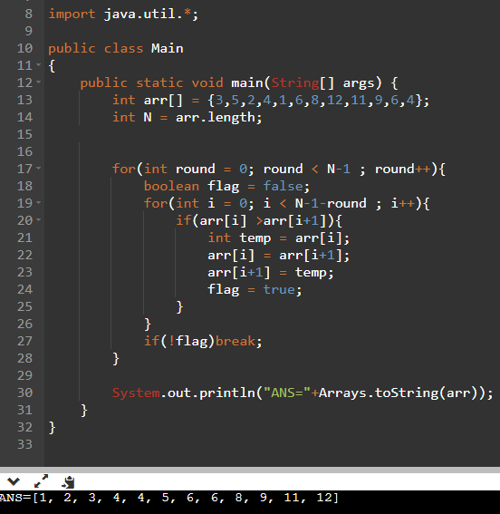
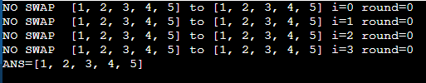
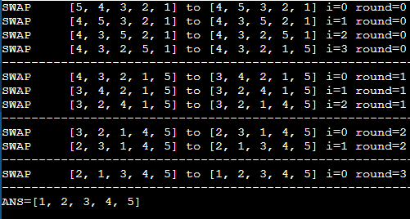
MODIFIED BUBBLE SORT CODE
If Array is in ascending order
If Array is in descending order

Slide 6
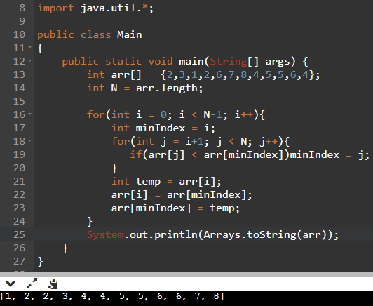

Selection sort
CODE
Logic
Outer loop runs for (N-1) times.
Inner loop runs for (N-1-i) times(initially i=0 hence N-1 times).
Ex -> Let arr[] = {5,3,4,1,2}
OuterLoop -> InnerLoop
Round 0 -> 4
Round 1 -> 3
Round 2 -> 2
Round 3 -> 1

Slide 7


Ascending order
Descending order
Since selection sort is not adaptable both best and worst case time complexity is O(n^2).
Selection sort is not stable ( consider arr = 4A,4B,1,2 if you dry run in first iteration itself 4A will be replace with 1 & hence it’s position already altered so.)
Space complexity is O(1)

Slide 8
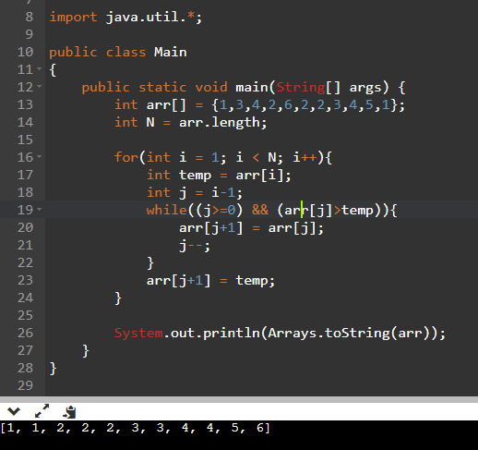
Insertion sort
CODE
Logic
Outer loop runs for (N-1) times.
Inner loop runs for i times.
Ex -> Let arr[] = {5,3,4,1,2}
OuterLoop -> InnerLoop
i = 1 -> j = 0 to 0
i = 2 -> j = 1 to 0
i = 3 -> j = 2 to 0
i = 4 -> j = 3 to 0

Slide 9



Normal Case O(N^2)
Insertion sort for ascending order takes O(n) time i.e best case and takes O(n^2) times in worst case i.e. descending order hence it is adaptive.
Insertion sort is also stable.
Space complexity is O(1)
Ascending Case O(N)
Descending Case O(N^2)

Slide 10
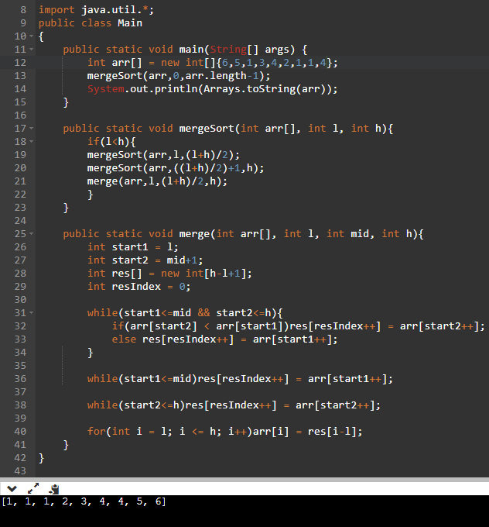
Merge sort
CODE
Logic
Here merge sort works on the principle of divide & conquer. Where array size is divided into small piece until only 1 element is present.
As we already know that 1 element is already sorted. We start merging 2 elements and then 4 and then so on till the array is sorted.
Note : First merging happens in the lower level(i.e elements of size 1 gets merged first)

Slide 11
Complexity
Merge sort is stable.
Merge sort is not adaptive.
All, best worst and average case is O(nlogn) & space complexity is O(n).
Complexity calculation
T(n) = 2T(n/2)+n
= 4T(n/4)+2n
= 8T(n/8)+3n
= (2^k)*T(n/2^k)+kn
If 2^k = n then T(n) = n*T(1) + ((logn)*n) = n + n*logn = nlogn

Slide 12
7
9
6
5
1
MS(arr,0,4)
0
1
2
3
4
MS(arr,0,2)
MS(arr,3,4)
M(arr,0,2,4)
O(n)
MS(arr,3,3)
MS(arr,4,4)
M(arr,3,3,4)
O(n)
O(nlogn)
MS(arr,0,1)
MS(arr,2,2)
M(arr,0,1,2)
O(n)
M(arr,0,0,1)
MS(arr,0,0)
MS(arr,1,1)
Since in merge sort every time array size reduces as N, N/2, N/4,…. 1
i.e N,N/2,N/2^2,…,N/2^k
This height of the above tree is 2^k = N => k = logN
Also in every stage O(n) space is used

Slide 13
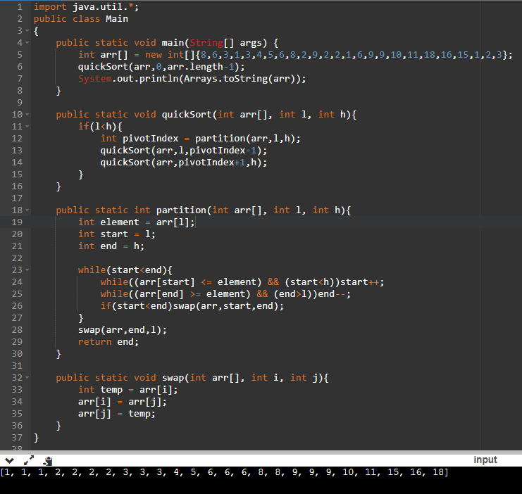
Quick sort
CODE
Logic
Partition method basically returns the exact
position of element (i.e element’s index after sorting) & puts pivot element in it’s index.
Quick sort method basically gets that pivot index and calls itself to reposition other elements(i.e. other than the pivot element).
In simple words ever quicksort call will first position the pivot element at the right position and does the same for the rest.
Best case scenario is O(nlogn) [same as merge sort recurrence relation] & worst case is O(n^2).

