Slide 1


THE NATIONAL INSTITUTE OF ENGINEERING MYSURU DEPARTMENT OF ELECTRONICS AND COMMUNICATION ENGINEERING MAJOR PROJECT [EC0304] AUTOMATIC ACCIDENT DETECTION AND AMBULANCE RESCUE Under the guidance of Dr. Anjanappa C Assistance Professor, Dept. of ECE.
Submitted By:
Sampanna T : 4NI17EC104
M Shamitha : 4NI15EC096
Sagar Ashok Ganagi : 4NI17EC072
Vishnu Bhargav B Jois : 4NI17EC100

Slide 2
INTRODUCTION
The usage of vehicles are rapidly increasing and at the same time the number of accidents has also increased.
Many a times an accident goes unnoticed.
The objective of our project is to detect the location of the vehicle where accident has occurred.
This scheme is fully automated.
This project consists of microcontroller board with sensors and display. This display unit is provided for user to view the parameters like distance, location and accident occurred.
The GPS is used to find the location where accident had occurred as it continuously reads the data from satellite.
Whenever accident occurs, it sends the data to the microcontroller.

Slide 3
Existing System
Proposed System
PROBLEM STATEMENT
Technology improvements has helped to reduce traffic.
The late response to the emergency services, when accident occurs in the remote area and in late nights.
They are mostly focused on detecting the accident location.
We have implemented the new system in which there is an automatic detection of accident and avoidance of collision.
A sensor unit fitted in the vehicle detects the accident and sends the message to not only the emergency number but also to the victims relatives.
Alerts the driver when unnoticed obstacle comes on the way.

Slide 4
LITERATURE SURVEY
AUTHOR | TITLE | IDEA | PROPOSED SYSTEM
Prashant Kapri, Shubham Patane, Arul Shalon | Accident detection and Alert system (2018) | A mobile application (ADAS software) helps in finding whether accident occurred or not by using the sensors present in the mobile phone (like accelerometer). | Instead of using accelerometer, vibration sensor is used which decreases the chances of false responses.
T Kalyani, S monika, B Naresh, Mahendra Vucha | Accident detection and Alert system (2019) | GSM, GPS, vibration sensors are used here to detect accident and send SMS. | In our system buzzer alert options are available.

Slide 5
Vaishali Shrivastava, Manasi Gyanchandani | Pre and post Accident Detection and Alert System: an IoT Application for Complete Safety of the Vehicles (2020) | The vehicles can be equipped with certain devices that allows vehicles to communicate with each other called VANET (Vehicular Adhoc Network) and hence accidents can be avoided. For detection GSM, GPS, Accelerometer and vibration sensors are used. | Accident avoidance is done using Ultrasonic sensor and hence is also applicable for older devices as well. Hardware cost is less when compared to VANET.
S.S.Kanase, S.A.Yadav, S.B.Jadav, M.M.Kadam | Tracking the Stolen Vehicle (2018) | Here vehicles are tracked by sending SMS “Track Vehicle” to the device mounted, the SMS is received by the vehicle and it will send their positions using GPS and GSM. | Here mobile application is used which gives more accurate GPS location when compared to the GPS module when accident is encountered. It automatically works without any external input.

Slide 6
Amit Bhoyar, Rajeev Verma | GPS based real time Vehicle tracking system for Kids safety using RFID and GSM (2018) | The system consists of RFID tags and reader which is designed to note the entry and exit of person. In school vehicles the tags of each kid holds the identification details and when kids enter and leave the vehicle the reader reads the tags and stores the details. The details will be updated in the school database. | All the details will be saved and notified to concerned authority via Android app through SMS(in case of an accident).

Slide 7
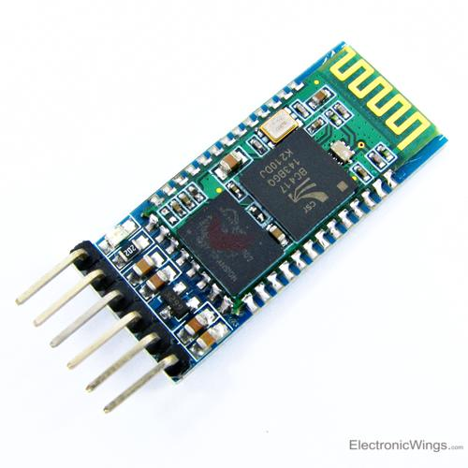
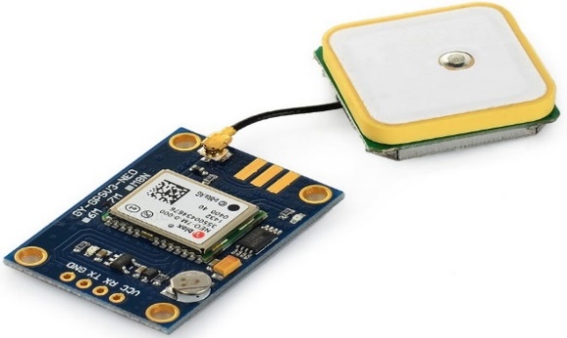
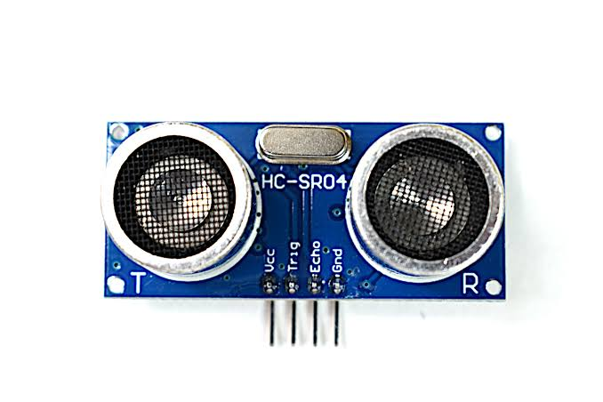
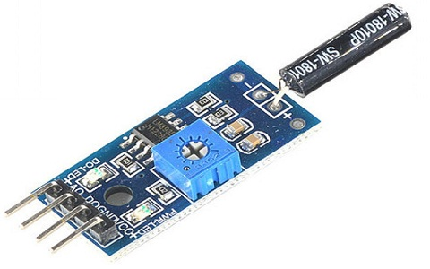
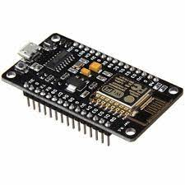
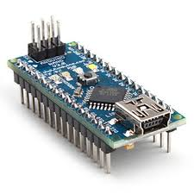
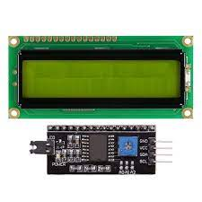
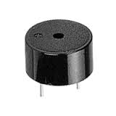
HARDWARE COMPONENTS USED
1)NEO-6M GPS Module
2)HC-SR04
Ultrasonic sensor
3)HC-05
Bluetooth module
4)Vibration sensor
5)ESP8266
7)LCD+I2C
connector
8)Buzzer
6)Arduino Nano

Slide 8

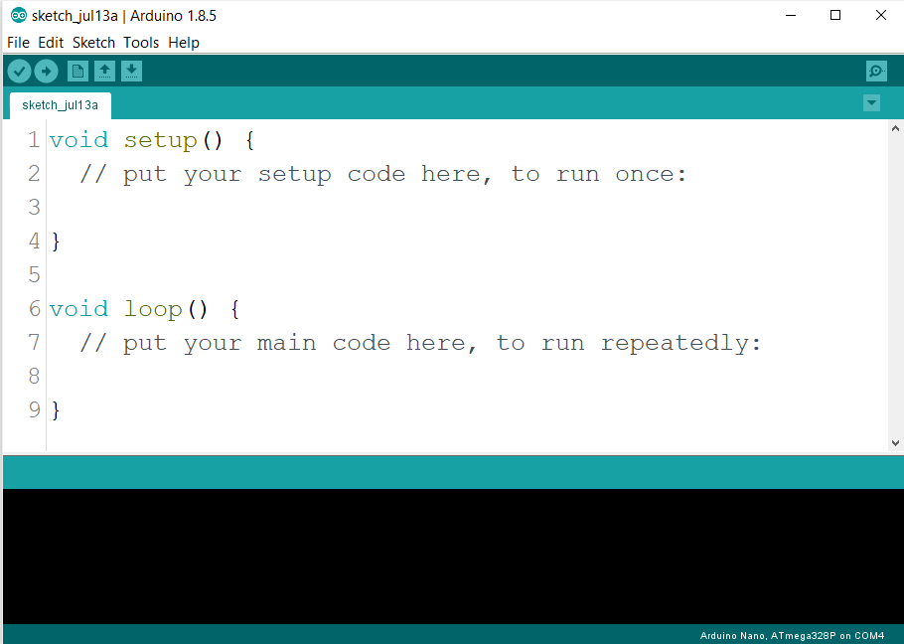
SOFTWARE COMPONENTS USED
Ubidots IOT platform
Arduino IDE

Slide 9
BLOCK DIAGRAM
LCD DISPLAY
UBIDOTS
ULTRASONIC SENSOR
HOSPITAL
SMS
GPS
SMS
ARDUINO NANO
ESP8266
SMS_APP
RELATIVES
CAR_CONTROL APP
COLLISION SENSOR
BUZZER
Bluetooth
MOTOR CONTROL

Slide 10
WORKING(SUMMARY)
When other vehicles are nearby, buzzer will be turned on and the distance along with GPS location will be displayed in the LCD.
Similarly when accident occurs the GPS location will be displayed along with a message ACCIDENT on the LCD screen.
Not only that, the accident status variable in the UBIDOTS will be updated and thus the mobile phone application(SMS_APP) will send SMS to the numbers being saved.

Slide 11
SOFTWARE IMPLEMENTATION
1)ARDUINO NANO & CAR_CONTROL APP
START
IF ARDUINO IS ON
YES
YES
STOP
COMPUTE DISTANCE USING HC-SR04
IF DISTANCE < THRESHOLD
GET LOCATION FROM GPS MODULE.
YES
TURN ON THE BUZZER
DISPLAY INFO ON LCD
READ DATA SERIALLY FROM HC-05
CONTROL MOTOR
IF 1 RECEIVED FROM ESP8266
YES
DISPLAY ACCIDENT INFO ON THE LCD

Slide 12
2)ESP8266 & SMS APP
START
IF ESP8266
Is ON
YES
STOP
READ FROM VIBRATION SENSOR
NO
IF HIGH
YES
SEND 1 TO ARDUINO
UPDATE VARIABLE IN UBIDOTS
NO
IF UPDATED
YES
SEND SMS TO EMERGENCY NUMBERS VIA SMS_APP AND INITIALIZE THE VARIABLE AGAIN

Slide 13
ADVANTAGES
Time required to save the people is less.
Reduces the loss of Human life.
Low cost for maintenance.
Can be used by any moving vehicle as it is not bulky.
We can avoid the collisions.
It does not need any operation manually.

Slide 14
LIMITATIONS
The whole system is based on the fact that network is available, if network fails then the entire system fails.
Constant supply of power is essential and incase batteries are used it has to be replaced every time when it gets discharged completely.
Might have a bit of delay because of all the circuit components.

Slide 15
FUTURE ENHANCEMENT
The proposed system deals with the detection of the accidents. But this can be extended by providing medication to the victims at the accident spot.
We can also improve our system by getting the mobile numbers dynamically.
We can use Fire detection Sensor in case of any fire accident.
We can make the entire system work without Internet.

Slide 16
APPLICATIONS
Stolen vehicle recovery.
School bus, cab companies to detect if any accident occurs.
This can be implemented to brake system to avoid accident and control speed.

Slide 17
CONCLUSIONS
The proposed system is developed to provide the information about the accident occurred and the location of the accident.
The SMS is sent to the emergency numbers.
The system alerts driver if obstacle is very near to the car.
Minimizes unwanted collisions to a great extent compared to normal behavior.

Slide 18
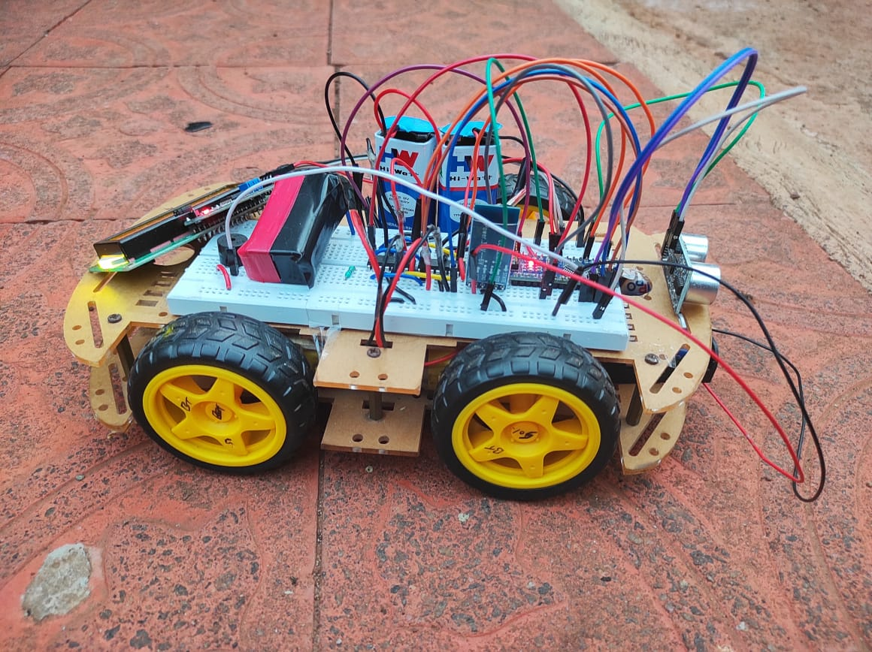
RESULT

Slide 19
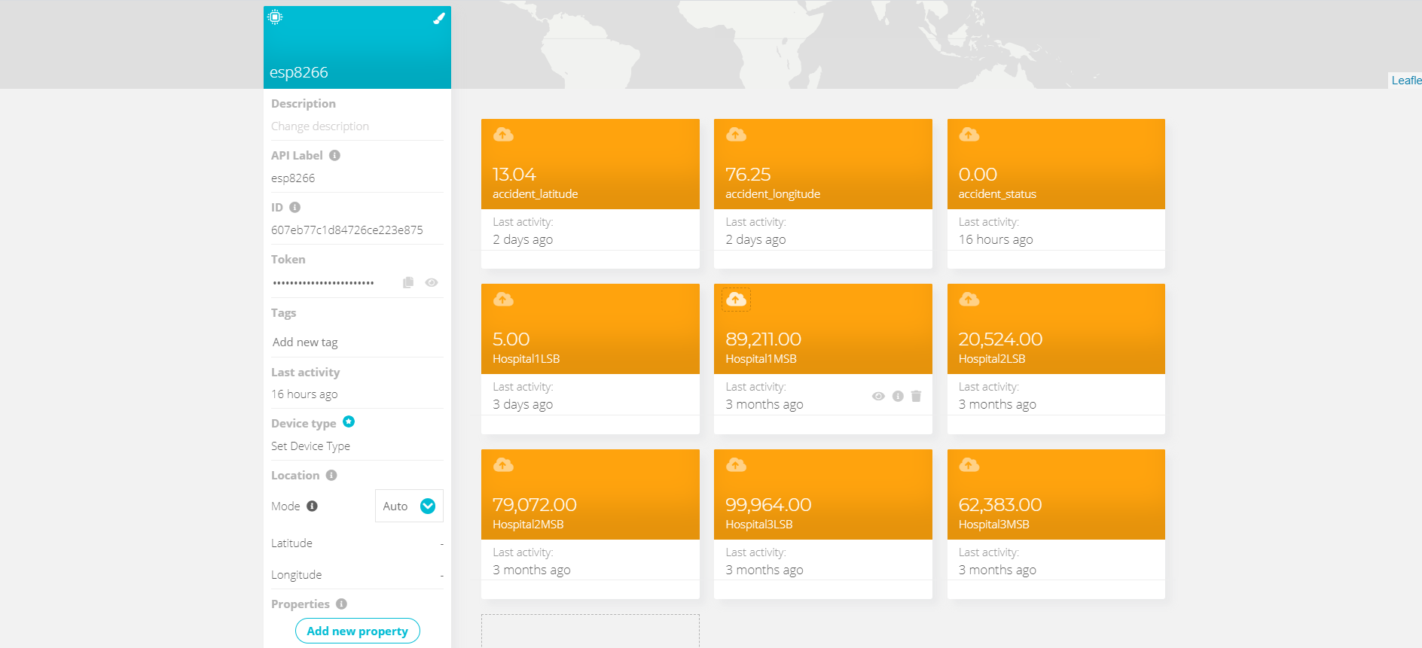
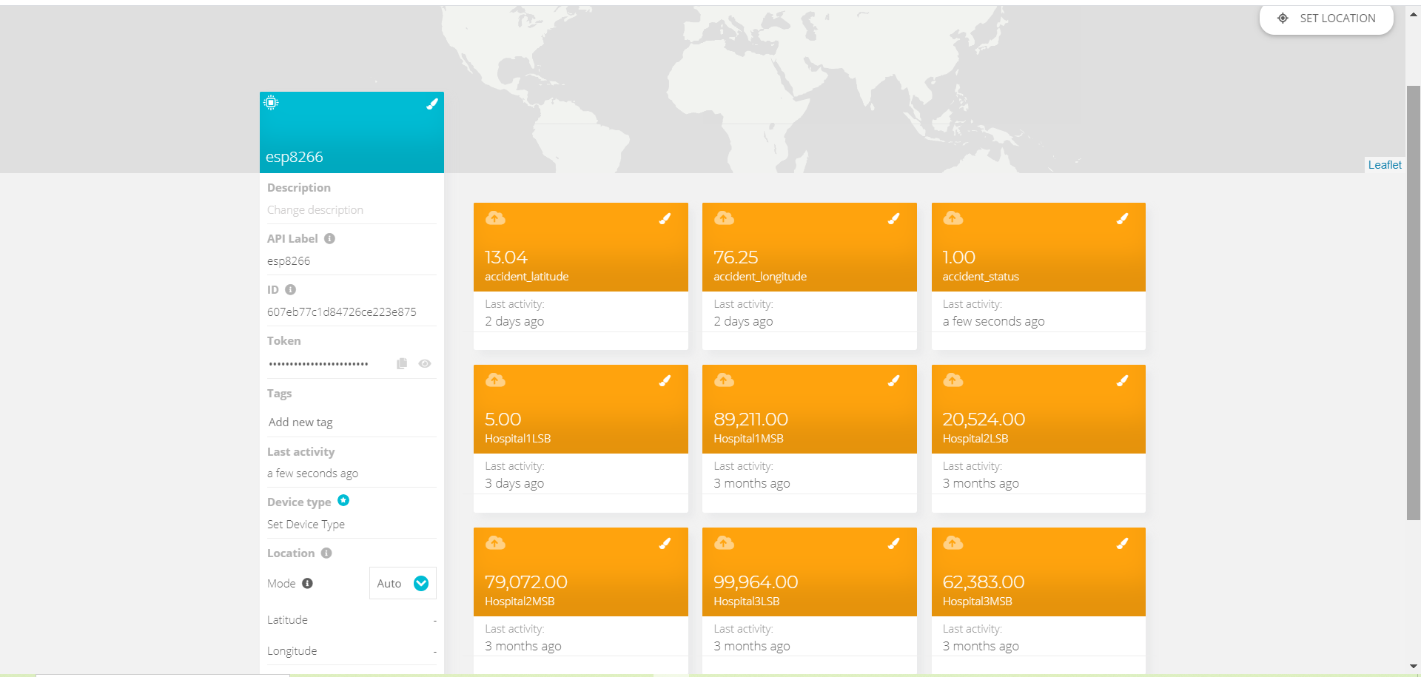
ACCIDENT STATUS IN UBIDOTS SERVER BEFORE AND AFTER :
Accident occurred

Slide 20
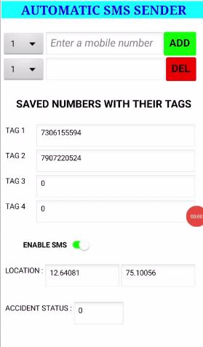
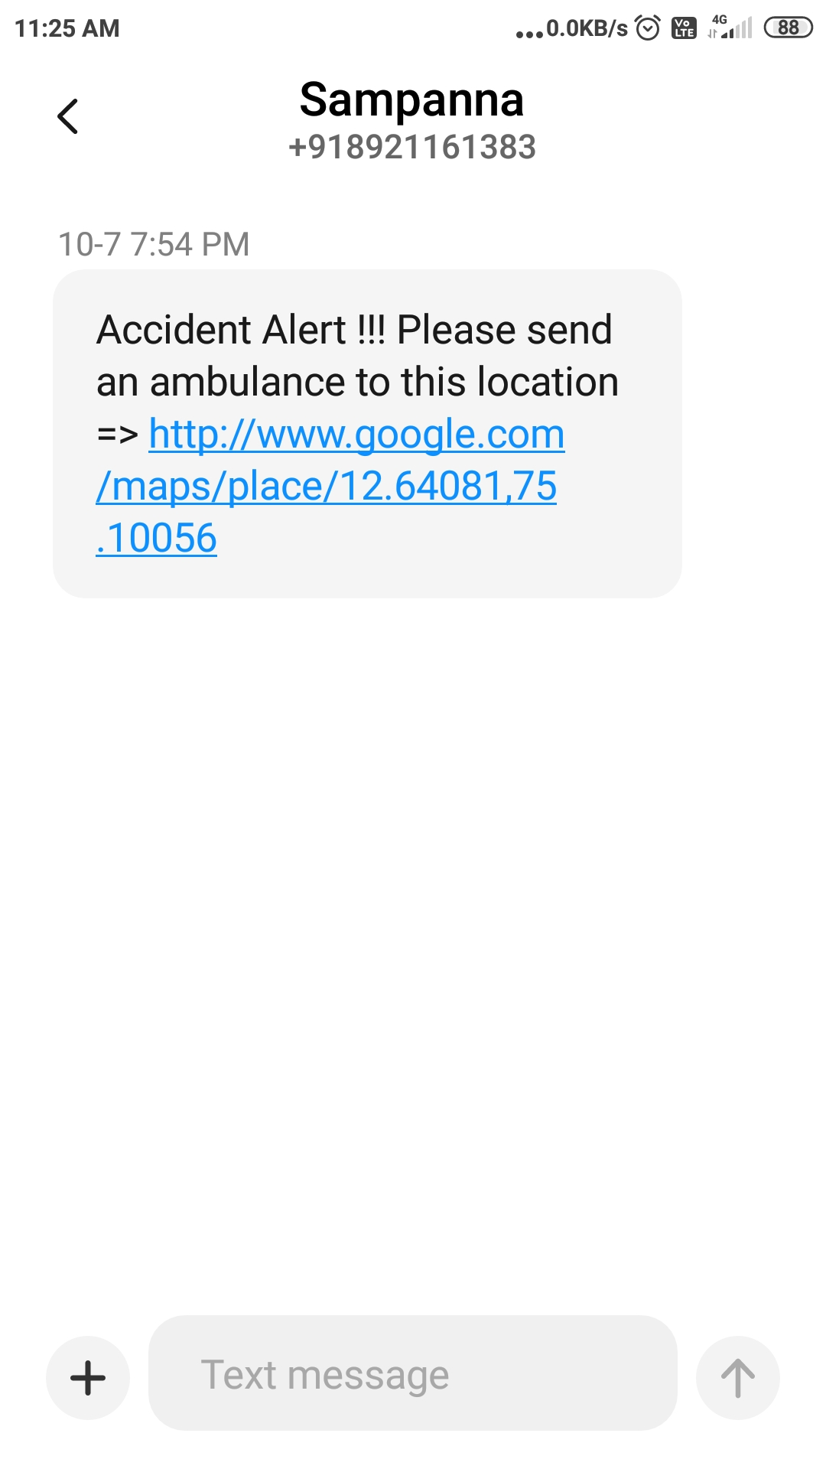
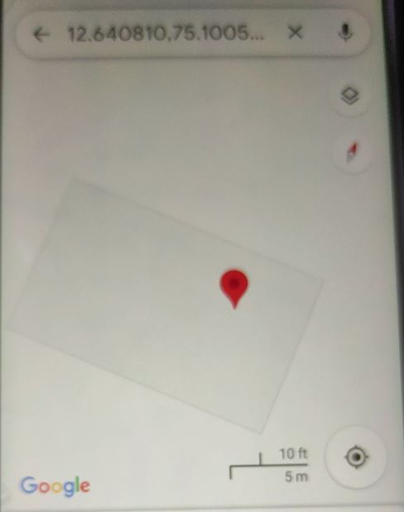
MOBILE APPLICATION
SMS DETAILS
GPS LOCATION

Slide 21
Implementation Video
phase1 video => https://drive.google.com/file/d/1A0ZYztwv8MT9_U6fgL6bj3JlaJL8NRi8/view?usp=sharing
phase2 video => https://drive.google.com/file/d/1iBRatA6kA1TU5_nEr0qQfQeY0tBu33Tb/view?usp=sharing
phase3 video
=> https://drive.google.com/file/d/1vuV9zdcO2ioR7ldzeNKlt-gpCNgZObQ8/view?usp=sharing
code => https://github.com/Sampanna-T/Major_Project

Slide 22
REFERENCE
[1] “GSM & GPS Based Vehicle Theft Control System” S.S. Kanese, S.A. Yadav, S.B Jadav, M.M Kadam (IRJET-- Volume: 05 Issue: 03 | Mar-2018).
[2] Automatic Vehicle Accident Detection and Messaging System Using GSM and GPS Modem by Nimisha Chaturvedi, Pallika Srivastava.(IRJET--Volume: 05 Issue: 03 | Mar-2018).
[3] WOMEN SAFETY DEVICE WITH GPS, GSM AND HEALTH MONITORING SYSTEM Piyush Kumar Verma, Arpit Sharma, Dhruv Varshney, Manish Zadoo (IRJET--Volume: 05 Issue: 03 | Mar-2018).

Slide 23
[4] GPS Based Real Time Vehicle Tracking System for Kid’s Safety Using RFID and GSM.(IJARIIT-- Volume: 04 Issue: 01 | 2018).
[5] Road Traffic Accidents in India: Issues and Challenges, Sanjay Kumar Singh https://doi.org/10.1016/j.trpro.2017.05.484.

Slide 24
THANK YOU

