Slide 1


THE NATIONAL INSTITUTE OF ENGINEERING MYSURU DEPARTMENT OF ELECTRONICS AND COMMUNICATION ENGINEERING MAJOR PROJECT [EC0304] AUTOMATIC ACCIDENT DETECTION AND AMBULANCE RESCUE Under the guidance of Dr. Anjanappa C Assistance Professor, Dept. of ECE.
Submitted By:
Sampanna T : 4NI17EC104
M Shamitha : 4NI15EC096
Sagar Ashok Ganagi : 4NI17EC072
Vishnu Bhargav B Jois : 4NI17EC100

Slide 2
INTRODUCTION
The usage of vehicles are rapidly increasing and at the same time the occurrence of accident has also increased.
No one can prevent the accident, but can save their life.
The objective of our project is to detect the location of the vehicle where accident has occurred.
This scheme is fully automated.
This project consists of microcontroller board with sensors and display. This display unit is provided for user to view the parameters like accident occurred.
The GPS is used to find the location where accident occured as it continuously reads the data from satellite.
Whenever accident occurs it sends the data to the microcontroller.

Slide 3
Existing System
Proposed System
PROBLEM STATEMENT
Technology improvements in traffic management helped to reduce traffic
The late response to the emergency services when accident occurring in the remote area and in the late nights.
Many a times an accident goes unnoticed.
High rate of mortality of the accident victims.
We will implement the new system in which there is an automatic detection of accident.
A sensor unit fitted in the vehicle detects the accident and sends the message to not only the emergency number but also to the victims relatives.
Alerts the driver when unnoticed obstacle comes on the way

Slide 4
LITERATURE SURVEY
1)
AUTHOR :
Prashant Kapri, Shubham Patane and Arul Shalon A presented an idea on Accident detection and Alert system in 2018.
IDEA : In the project they have used a smart phone application called ADAS software which helps in finding whether accident occured or not by using the sensors present in the mobile phone (like accelerometer). It basically stores the accident related information in the ADAS software, so the internet is mandatory.

Slide 5
ADVANTAGES :
No additional hardware is required (mobile phone is sufficient).
Even tracking the location and velocity of the vehicle can be easily calculated by using the GPS and accelerometer present in the vehicle.
Maintenance cost is less.
LIMITATIONS :
Requires internet all the time.
Readings from the accelerometer may give positive response (i.e even if brake is applied suddenly the accelerometer says that accident is detected)
User has to carry mobile phone all the time.

Slide 6
2)
AUTHOR :
T Kalyani, S monika, B Naresh, Mahendra Vucha presented an idea on Accident detection and Alert system in 2019 in International Journal of Innovative Technology and Exploring Engineering (IJITEE).
IDEA :
Additional hardware like GSM, GPS, vibration sensors are used here to detect accident and send SMS. And even Internet connectivity option is not available.

Slide 7
ADVANTAGES :
Uses separate hardware like GPS, GSM, vibration sensor for detection and alerting.
The device doesn’t have to be connected to the internet.
LIMITATIONS :
Doesn’t have the option to connect to the internet (This is important because near by hospitals contact information has to be fetched using google server. But in this case the contacts are hardcoded).
Also doesn’t have an option of buzzer to alert other vehicles from coming close .

Slide 8
3)
AUTHOR :
Vaishali Shrivastava, Manasi Gyanchandani presented a review paper on pre and post Accident Detection and Alert System: an IoT Application for Complete Safety of the Vehicles in 2020.
IDEA :
In this project it is stated that vehicles can be equipped with certain devices that allows vehicles to communicate with each other. The technology used is called VANET (Vehicular Adhoc Network). In VANET each vehicle is treated as a node and hence accident can be avoided.
For detection GSM, GPS, Accelerometer and vibration sensors are used.

Slide 9
ADVANTAGES :
Initially accident is avoided using VANET technology and for detection GSM, GPS, accelerometer etc are used.
More accurate results are obtained due to accident avoidance and accident detection.
LIMITATIONS :
Older vehicles are not equipped with VANET devices, So accident avoidance cannot be used in older vehicles.
Hardware cost increases.
Entire plan is based on the fact that vehicles are connected via VANET, which means if network is not available then the entire concept fails.

Slide 10
4)
AUTHOR :
S.S.Kanase, S.A.Yadav, S.B.Jadav, M.M.Kadam have presented an idea on Tracking the Stolen Vehicle in 2018.
IDEA :
In this project it is stated that we can track our vehicles just by sending the SMS “Track Vehicle” to the device mounted, the SMS is received by the vehicle and it will send their positions.
GPS is used for getting information about where our vehicle is present.
GSM is used for giving commands to Arduino so that we can track and monitor the Vehicle.

Slide 11
ADVANTAGES :
Is used to track stolen vehicles.
Can be used to find Vehicles location in a Crowded Area.
LIMITATIONS :
This device works only when we send SMS to track the Vehicle.

Slide 12
5)
AUTHOR :
Amit Bhoyar, Rajeev Verma have presented an idea on GPS based real time Vehicle tracking system for Kids safety using RFID and GSM in 2018.
IDEA :
In this the system consists of RFID tags and reader which is designed to note the entry and exit of person in vehicle the tags of each person holds the identification details, when Children enter the vehicle the reader reads the person tags and stores the details of entry and exit.
This system facilitates to know about the area where the vehicle has crossed using GPS. The details will be updated in the School database.

Slide 13
ADVANTAGES :
Safe transportation of School Children.
We can track the position of Bus if it travels in unusual path using GPS.
LIMITATIONS :
They should have those tags which have Identification details else it wont be able to record the details of a person.

Slide 14
BLOCK DIAGRAM
LCD DISPLAY
UBIDOTS
ULTRASONIC SENSOR
HOSPITAL
SMS
GPS
SMS
ARDUINO NANO
ESP8266
SMS_APP
RELATIVES
CAR_CONTROL APP
COLLISION SENSOR
BUZZER
Bluetooth
MOTOR CONTROL

Slide 15
WORKING(METHODOLOGY)
When other vehicles are nearby, buzzer will be turned on and the distance along with GPS location will be displayed in the LCD.
Similarly when accident occurs the GPS location will be displayed along with a message ACCIDENT on the LCD screen.
Not only that, the accident status variable in the UBIDOTS will be 1. And hence the mobile phone application(SMS_APP) will send SMS to the numbers being saved.

Slide 16
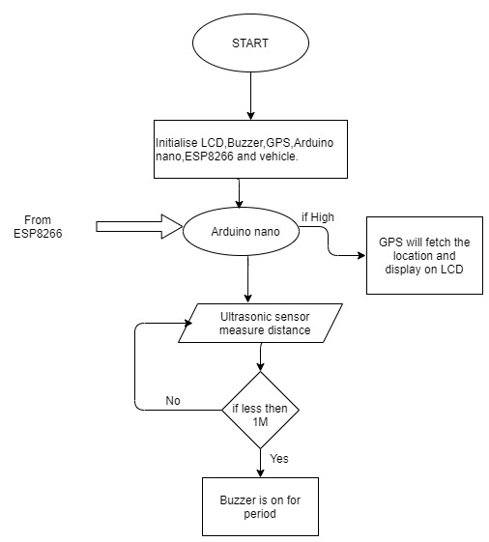
SOFTWARE IMPLEMENTATION
Arduino unit

Slide 17
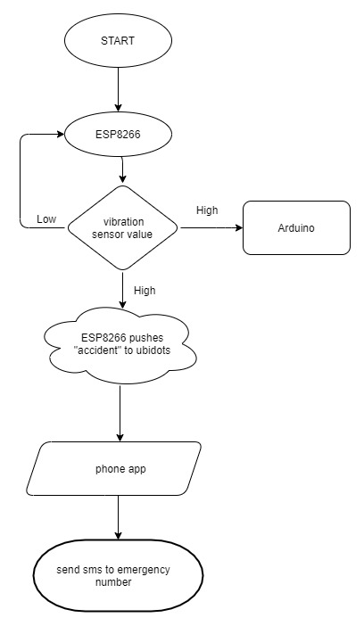
ESP8266 unit

Slide 18
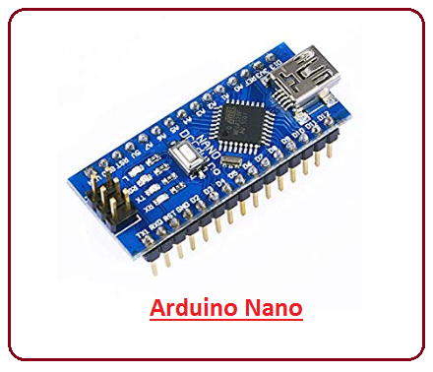
SOFTWARE TOOL
Arduino IDE :
It is used for writing code, compiling the code to check if any errors are there and uploading the code to the Arduino.
Arduino IDE is an open source software that support C/C++ languages.
It supports most of the available Arduino board including Arduino mega, Arduino Leonardo, Arduino Ethernet and more.
When a user writes code and compiles, the IDE will generate a Hex file for the code which will be sent to the board using a USB cable.

Slide 19
UBIDOTS :
UBIDOTS is an IOT platform used to send/receive data to/from the cloud from any Internet-enabled device.
We can also deal with data in real-time.
UBIDOTS offers a REST API that allows us to read and write data to the resources available: data sources, variables, values.
UBIDOTS supports both HTTP and MQTT protocols.
Data in UBIDOTS is stored along with their timestamps.
Variables can be values such as numerical, context such as strings.

Slide 20
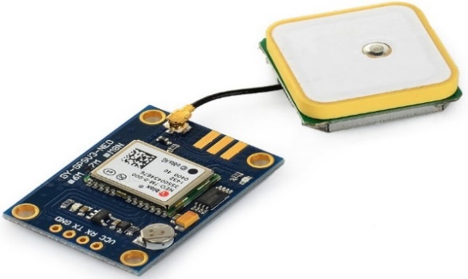
NEO-6M-0-001 GPS Module
The u-blox NEO-6M GPS engine on these modules is quite a good one, and it also has high sensitivity for indoor applications.
It has one MS621FE-compatible rechargeable battery for backup and EEPROM for storing configuration settings. The module works well with a DC input in the 3.3- to 5-V range
The NEO-6M module includes one configurable UART interface for serial communication, but the default UART (TTL) baud rate here is 9,600.
GPS signal is right-hand circular-polarized (RHCP), the style of the GPS antenna is the patch antenna.
The antenna must have full sky view for LOS with at least three satellite to calculate 2d position

Slide 21
Features
This module has an external antenna and built-in EEPROM.
Interface: RS232 TTL
Power supply: 3V to 5V
Default baudrate: 9600 bps
Works with standard NMEA sentences

Slide 22
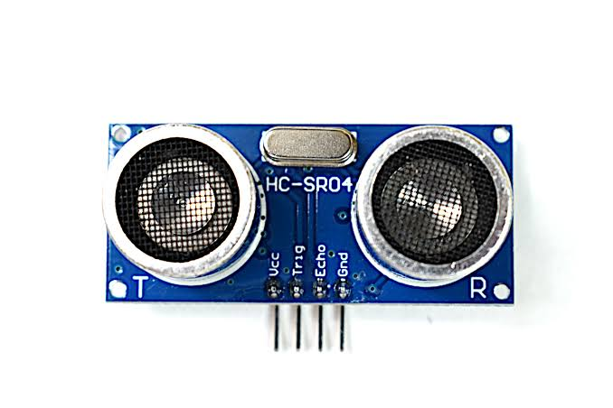
HC SR04 ULTRASONIC SENSOR
HC-SR04 Ultrasonic (US) sensor is a 4 pin module, whose pin names are VCC, Trigger, Echo and Ground respectively.
The module has two eyes like projects in the front which forms the Ultrasonic transmitter and Receiver. The sensor works with the simple high school formula that Distance = Speed × Time
The Ultrasonic transmitter transmits an ultrasonic wave, this wave travels in air and when it gets objected by any material it gets reflected back toward the sensor this reflected wave is observed by the Ultrasonic receiver module
Universal speed of US wave at room conditions which is 330m/s. The circuitry inbuilt on the module will calculate time taken for US wave come back.

Slide 23
HC-SR04 Sensor Features
Operating voltage: +5V
Theoretical Measuring Distance: 2cm to 450cm
Practical Measuring Distance: 2cm to 80cm
Accuracy: 3mm
Measuring angle covered: <15°
Operating Current: <15mA
Operating Frequency: 40Hz

Slide 24
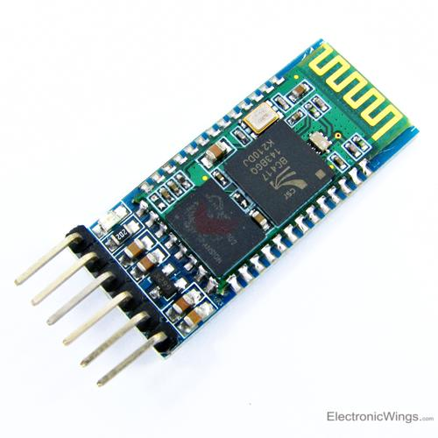
HC-05 BLUETOOTH
The HC-05 has two operating modes, one is the Data mode in which it can send and receive data from other Bluetooth devices
The other is the AT Command mode where the default device settings can be changed. . We can operate the device in either of these two modes by using the key pin
It has a operating voltage 4-6V and current 30mA and a range of less then 100m.
Works with USART and TTL compatible. Follows IEEE 802.15.1 standard.
Frequency-Hopping Spread Spectrum is used. Can operate in master and slave mode.

Slide 25
HC-05 Default Settings
Default Bluetooth Name: “HC-05”
Default Password: 1234 or 0000
Default Communication: Slave
Default Mode: Data Mode
Data Mode Baud Rate: 9600, 8, N, 1
Command Mode Baud Rate: 38400, 8, N, 1
Default firmware: LINVOR

Slide 26
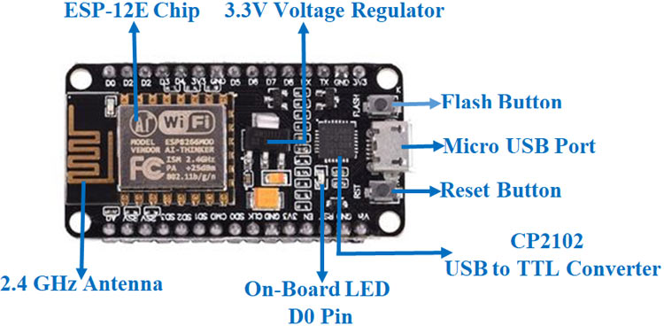
NODEMCU /ESP8266
ESP-12E module containing ESP8266 chip having TENSILICA XTENSA 32-bit LX106 RISC microprocessor.
This microprocessor supports RTOS and operates at 80MHz to 160 MHz adjustable clock frequency. ESP8266 has 128 KB RAM and 4MB of Flash memory to store data and programs.
Its high processing power with in-built Wi-Fi / Bluetooth and Deep Sleep Operating features make it ideal for IOT projects.
ESP8266 can be powered using Micro USB jack and VIN pin (External Supply Pin). It supports UART, SPI, and I2C interface.

Slide 27
NODEMCU ESP8266 Specifications & Features
Microcontroller: TENSILICA 32-bit RISC CPU XTENSA LX106
Operating Voltage: 3.3V
Input Voltage: 7-12V
Digital I/O Pins (DIO): 16
Analog Input Pins (ADC): 1
UARTs: 1
SPIs: 1
I2Cs: 1
Flash Memory: 4 MB
SRAM: 64 KB
Clock Speed: 80 MHz
USB-TTL based on CP2102 is included onboard, Enabling Plug n Play
PCB Antenna
Small Sized module to fit smartly

Slide 28
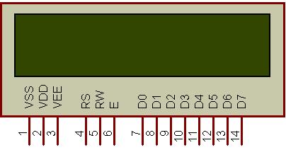
LCD 1602 Parallel LCD Display and I2C adapter
LCD is 16 character by 2 line display has a very clear and high contrast white text upon a blue background/backlight. This is great blue backlight LCD display.
An I2C adapter is directly soldered right onto the pins of the display. Which saves 8 pins on controller. It is a type of serial bus which uses two bidirectional lines, serial data line and serial clock line.
These modules are currently supplied with a default I2C address of either 0x27 or 0x3F.
The module has a contrast adjustment pot on the underside of the display. This may require adjusting for the screen to display text correctly. Operating Voltage: 5V

Slide 29
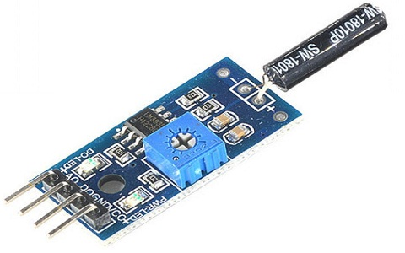
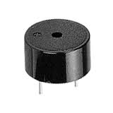
Vibration Sensor
These are piezoelectric accelerometers that sense vibration.
The sensitivity of these sensors normally ranges from
10 mV/g to 100mV/g. we use accelerometer sensor.
Buzzer
It is a piezoelectric buzzer uses piezoelectric effect ,that uses pulse
current to drive the vibration of metal. operates at 1.5-15V DC,
multi resonator oscillates and o/p 1.5-2.5KHz audio signal.
L293d Motor Driver
The motor driver is a module for motors that allows you to control the working speed and direction of two motors simultaneously. This is designed to provide bidirectional drive currents at 5-36V.

Slide 30
ARDUINO NANO
Arduino board designs use a variety of microprocessors and controllers. The boards are equipped with sets of digital and analog input/output (I/O) pins that may be interfaced to various expansion boards ('shields') or breadboards (for prototyping) and other circuits.
The boards feature serial communications interfaces, including Universal Serial Bus (USB) on some models, which are also used for loading programs. The microcontrollers can be programmed using the C and C++ programming languages, using a standard API which is also known as the "Arduino language".
It consist of ATmega328 AVR microcontroller ,has a flash memory 32KB and clock 16MHz
8 analog and 22 digital pins (PWM pins 6)
Arduino microcontrollers are pre-programmed with a boot loader that simplifies uploading of programs to the on-chip flash memory. The default bootloader of the Arduino Uno is the Opti boot bootloader

Slide 31
ImplementationVedio
phase1 vedio => https://drive.google.com/file/d/1A0ZYztwv8MT9_U6fgL6bj3JlaJL8NRi8/view?usp=sharing
phase2 vedio => https://drive.google.com/file/d/1iBRatA6kA1TU5_nEr0qQfQeY0tBu33Tb/view?usp=sharing
phase3 vedio
=> https://drive.google.com/file/d/1vuV9zdcO2ioR7ldzeNKlt-gpCNgZObQ8/view?usp=sharing
code =>
https://github.com/Sampanna-T/Major_Project

Slide 32
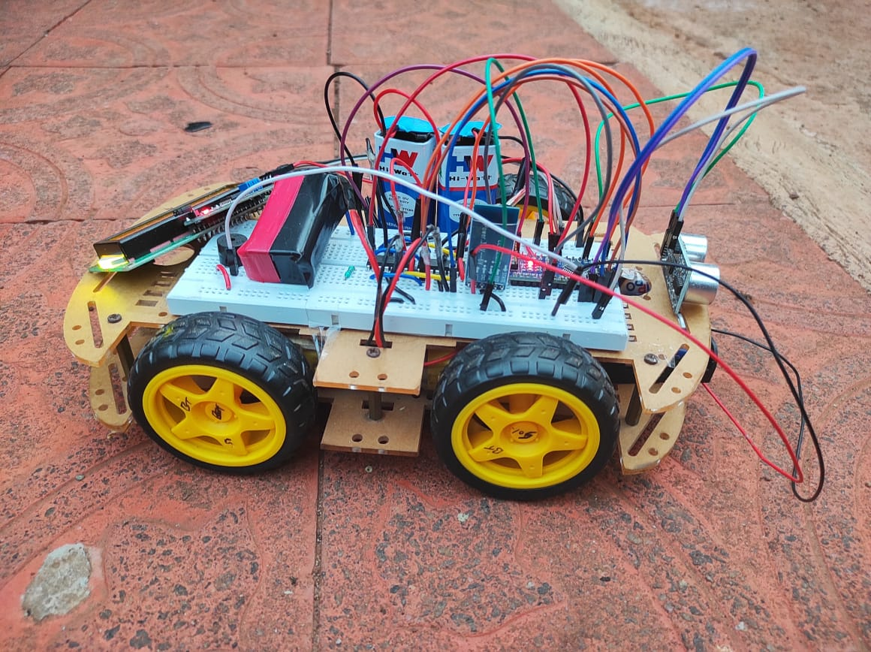
RESULT
Vehicle unit

Slide 33
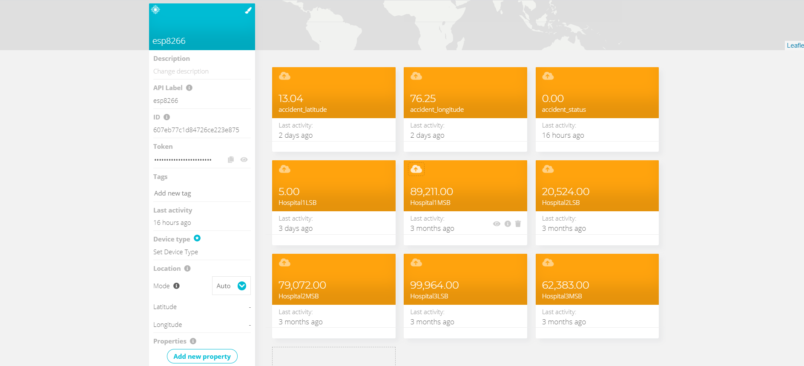
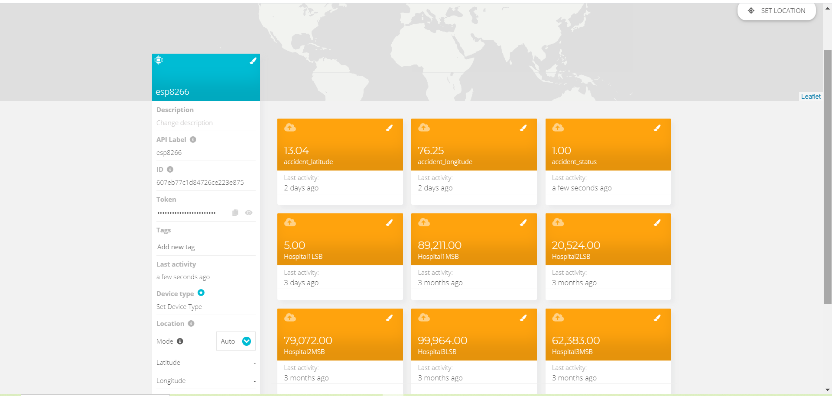
Accident status in ubidots server before and after :

Slide 34
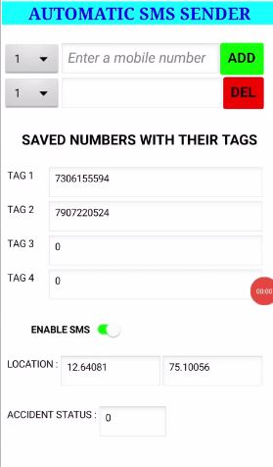
Mobile application :

Slide 35
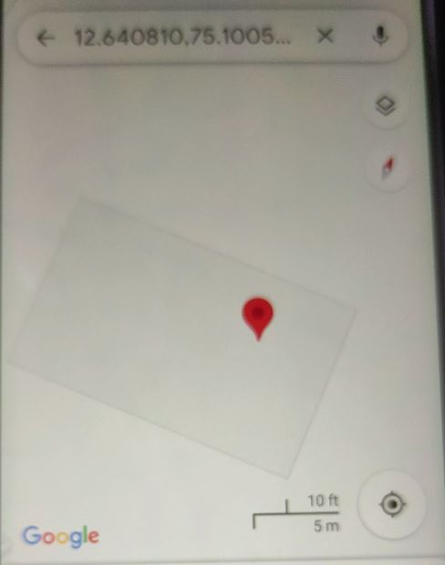
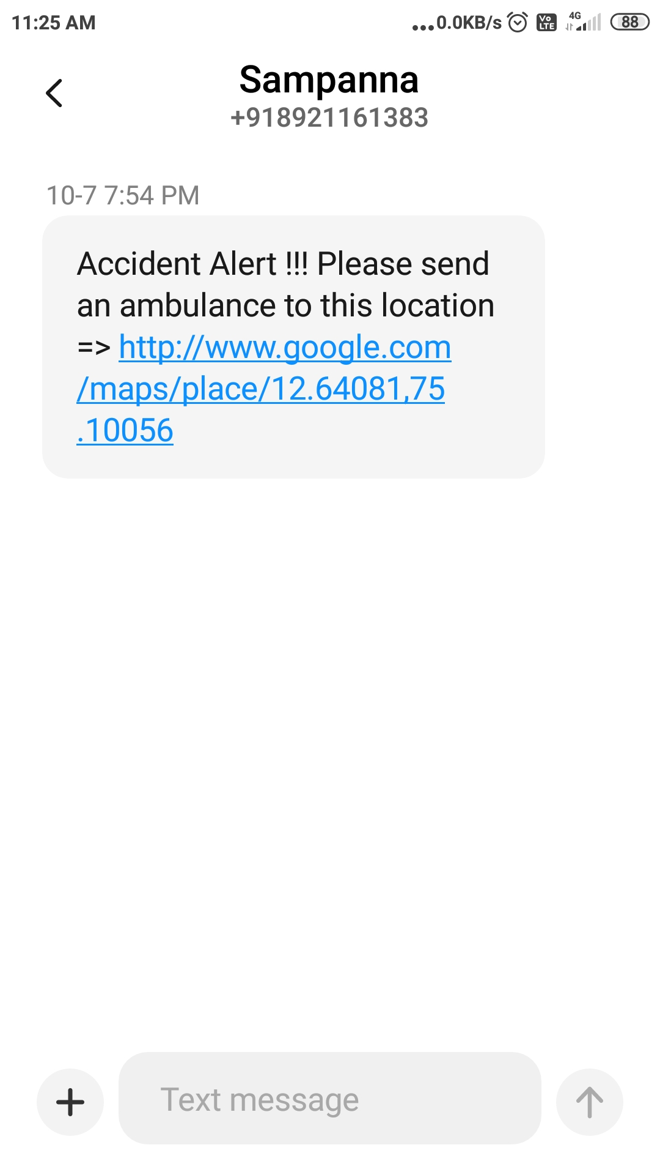
SMS message to number and the location of accident on the map

Slide 36
ADVANTAGES
As soon as accident occurs, the message is sent to the nearby hospital which saves the time in case of emergency.
Low cost for maintenance.
Can be used by any moving vehicle as it is not bulky.
The alert message regarding the accident is sent automatically.
This system can be used for a social cause.
It does not need any operation manually.

Slide 37
LIMITATIONS
The whole system is based on the fact that network is available, if network fails then the entire system fails.
Constant supply of power is essential and incase batteries are used it has to be replaced every time when it gets discharged completely.
Gps receiver consumes more power.
Might have a bit of delay because of all the circuit components.

Slide 38
FUTURE ENHANCEMENT
APPLICATIONS
The proposed system deals with the detection of the accidents. But this can be extended by providing medication to the victims at the accident spot.
We can also improve our system by
getting the mobile numbers dynamically.
Stolen vehicle recovery
This system can be integrated with air bags system
School bus, cab companies to detect if any accident occurs.
This can be implemented to brake system to avoid accident and control speed.

Slide 39
CONCLUSIONS
The proposed system is developed to provide the information about the accident occured and the location of the accident. It helps to easily provide the assistant and help to the victim of the accident. This system uses GPS module to locate the vehicle. The system alerts driver if obstacle is very near to the car. The SMS is sent to the emergency number. The use of Automatic vehicle accident alert system to minimize unwanted accidents to a great extent compared to normal behavior.

Slide 40
REFERENCE
[1] “GSM & GPS Based Vehicle Theft Control System” S.S. Kanese, S.A. Yadav, S.B Jadav, M.M Kadam (IRJET-- Volume: 05 Issue: 03 | Mar-2018).
[2] Automatic Vehicle Accident Detection and Messaging System Using GSM and GPS Modem by Nimisha Chaturvedi, Pallika Srivastava.(IRJET--Volume: 05 Issue: 03 | Mar-2018)
[3] WOMEN SAFETY DEVICE WITH GPS, GSM AND HEALTH MONITORING SYSTEM Piyush Kumar Verma1, Arpit Sharma2, Dhruv Varshney3, Manish Zadoo4(IRJET--Volume: 05 Issue: 03 | Mar-2018 )

Slide 41
[4] GPS Based Real Time Vehicle Tracking System for Kid’s Safety Using RFID and GSM.(IJARIIT-- Volume: 04 Issue: 01 | 2018)
[5] Marie Bernadette Pautet and Michel Mauley, “The GSM system for mobile communications,” 1992.

Slide 42
THANK YOU

