Slide 1


THE NATIONAL INSTITUTE OF ENGINEERING MYSURU DEPARTMENT OF ELECTRONICS AND COMMUNICATION ENGINEERING MAJOR PROJECT [EC0304] AUTOMATIC ACCIDENT DETECTION AND AMBULANCE RESCUE Under the guidance of Dr. Anjanappa C Assistance Professor, Dept. of ECE.
Submitted By:
Sampanna T : 4NI17EC104
M Shamitha : 4NI15EC096
Sagar Ashok Ganagi : 4NI17EC072
Vishnu Bhargav B Jois : 4NI17EC100

Slide 2
INTRODUCTION
Recently due to technological and population development, the usage of vehicles are rapidly increasing and at the same time the occurrence of accident has also increased. No one can prevent the accident, but can save their life by expediting the ambulance to the hospital in time.
The objective of our project is to detect the location of the vehicle where accident has occurred and to save their lives in the shortest time.
This scheme is fully automated, as it locates the accident spot accurately and sends SMS via phone for the emergency service to reach the location and to the hospital in time.
This project consists of microcontroller board with sensors and display. This display unit is provided for user to view the parameters like accident occurred.
The GPS is used to find the location where accident occured as it continuously reads the data from satellite. Whenever accident occurs it sends the data to the microcontroller. Also the microcontroller will communicate with the phone vai server to send

Slide 3
Existing System
Proposed System
PROBLEM STATEMENT
Technology improvements in traffic management helped to reduce traffic
The late response to the emergency services when accident occurring in the remote area and in the late nights.
Many a times an accident goes unnoticed for hours before help comes in.
Due to all these factors there is a high rate of mortality of the accident victims.
To overcome these problem we will implement the new system in which there is an automatic detection of accident.
A sensor unit fitted in the vehicle detects the accident and sends the message to not only the emergency number but also to the victims relatives.
Alert the driver when unnoticed obstacle comes on the way

Slide 4
LITERATURE SURVEY
1)
AUTHOR :
Prashant Kapri, Shubham Patane and Arul Shalon A presented an idea on Accident detection and Alert system in 2018.
IDEA : In the project they have used a smart phone application called ADAS software which helps in finding whether accident occured or not by using the sensors present in the mobile phone (like accelerometer). It basically stores the accident related information in the ADAS software, so the internet is mandatory.

Slide 5
ADVANTAGES :
No additional hardware is required (mobile phone is sufficient).
Even tracking the location and velocity of the vehicle can be easily calculated by using the GPS and accelerometer present in the vehicle.
Maintenance cost is less.
LIMITATIONS :
Requires internet all the time.
Readings from the accelerometer may give positive response (i.e even if brake is applied suddenly the accelerometer says that accident is detected)
User has to carry mobile phone all the time.

Slide 6
PROPOSED SYSTEM :
In our system Internet is mandatory .
Reading is not taken only from accelerometer, even vibration sensor is also used which decreases the chances of false responses.
User need not carry the smart phone all the time but internet connection is mandatory.

Slide 7
2)
AUTHOR :
T Kalyani, S monika, B Naresh, Mahendra Vucha presented an idea on Accident detection and Alert system in 2019 in International Journal of Innovative Technology and Exploring Engineering (IJITEE).
IDEA :
Additional hardware like GSM, GPS, vibration sensors are used here to detect accident and send SMS. And even Internet connectivity option is not available.

Slide 8
ADVANTAGES :
Uses separate hardware like GPS, GSM, vibration sensor for detection and alerting.
The device doesn’t have to be connected to the internet.
LIMITATIONS :
Doesn’t have the option to connect to the internet (This is important because near by hospitals contact information has to be fetched using google server. But in this case the contacts are hardcoded).
Also doesn’t have an option of buzzer to alert other vehicles from coming close and even fire detection functionality is also missing.

Slide 9
PROPOSED SYSTEM :
It has internet connectivity feature that allows us to take contact information dynamically.
It even has buzzer alert options ( that alerts other vehicles if the other vehicles get nearby).

Slide 10
3)
AUTHOR :
Vaishali Shrivastava, Manasi Gyanchandani presented a review paper on pre and post Accident Detection and Alert System: an IoT Application for Complete Safety of the Vehicles in 2020.
IDEA :
In this project it is stated that vehicles can be equipped with certain devices that allows vehicles to communicate with each other. The technology used is called VANET (Vehicular Adhoc Network). In VANET each vehicle is treated as a node and hence accident can be avoided.
For detection GSM, GPS, Accelerometer and vibration sensors are used.

Slide 11
ADVANTAGES :
Initially accident is avoided using VANET technology and for detection GSM, GPS, accelerometer etc are used.
More accurate results are obtained due to accident avoidance and accident detection.
LIMITATIONS :
Older vehicles are not equipped with VANET devices, So accident avoidance cannot be used in older vehicles.
Hardware cost increases.
Entire plan is based on the fact that vehicles are connected via VANET, which means if network is not available then the entire concept fails.

Slide 12
PROPOSED SYSTEM :
Accident avoidance is done using Ultrasonic sensor and hence is also applicable for older devices as well.
Hardware cost is less when compared to VANET technology.
The limitation of the entire system failing when network is not available is also true in this case as well.

Slide 13
4)
AUTHOR :
S.S.Kanase, S.A.Yadav, S.B.Jadav, M.M.Kadam have presented an idea on Tracking the Stolen Vehicle in 2018.
IDEA :
In this project it is stated that we can track our vehicles just by sending the SMS “Track Vehicle” to the device mounted, the SMS is received by the vehicle and it will send their positions.
GPS is used for getting information about where our vehicle is present.
GSM is used for giving commands to Arduino so that we can track and monitor the Vehicle.

Slide 14
ADVANTAGES :
Is used to track stolen vehicles.
Can be used to find Vehicles location in a Crowded Area.
LIMITATIONS :
This device works only when we send SMS to track the Vehicle.

Slide 15
PROPOSED SYSTEM :
In our system it automatically sends message and Location without any external input.
The limitation of the entire system failing when network is not available is also true in this case as well.

Slide 16
5)
AUTHOR :
Amit Bhoyar, Rajeev Verma have presented an idea on GPS based real time Vehicle tracking system for Kids safety using RFID and GSM in 2018.
IDEA :
In this the system consists of RFID tags and reader which is designed to note the entry and exit of person in vehicle the tags of each person holds the identification details, when Children enter the vehicle the reader reads the person tags and stores the details of entry and exit.
This system facilitates to know about the area where the vehicle has crossed using GPS. The details will be updated in the School database.

Slide 17
ADVANTAGES :
Safe transportation of School Children.
We can track the position of Bus if it travels in unusual path using GPS.
LIMITATIONS :
They should have those tags which have Identification details else it wont be able to record the details of a person.

Slide 18
PROPOSED SYSTEM :
Is to ensure the Safety of Children those who use transportion.
All the details will be saved and notified to concerned authority via Android app and Website.

Slide 19
BLOCK DIAGRAM
LCD DISPLAY
HOSPITAL
Ultrasonic sensor
SMS
SMS
GPS
Phone app
RELATIVES
MICROCONTROLLER
COLLISION SENSOR
BUZZER
Bluetooth

Slide 20
WORKING(METHODOLOGY)
When a vehicle meets with an accident immediately collision sensor will detect the signal and sends it to Microcontroller.
In case the accident is severe then the microcontroller will find the location coordinates of accident spot using GPS and sends a URL using mobile phone,so that ambulance could reach the accident spot in the shortest way possible.
Not only that the device also sends SMS alerts to his relatives and nearest health care (so that emergency rooms are kept vacant).
With help of ultrasonic sensor minimum distance can be measured between obstacle and car incase if its too close can alert the driver with help of buzzer.
All the details for the purpose of understanding will be displayed in the LCD.

Slide 21
NEO-6M-0-001 GPS Module
The u-blox NEO-6M GPS engine on these modules is quite a good one, and it also has high sensitivity for indoor applications.
It has one MS621FE-compatible rechargeable battery for backup and EEPROM for storing configuration settings. The module works well with a DC input in the 3.3- to 5-V range
The NEO-6M module includes one configurable UART interface for serial communication, but the default UART (TTL) baud rate here is 9,600.
GPS signal is right-hand circular-polarized (RHCP), the style of the GPS antenna is the patch antenna.
The antenna must have full sky view for LOS with at least three satellite to calculate 2d position

Slide 22
Features
This module has an external antenna and built-in EEPROM.
Interface: RS232 TTL
Power supply: 3V to 5V
Default baudrate: 9600 bps
Works with standard NMEA sentences

Slide 23
HC SR04 ULTRASONIC SENSOR
HC-SR04 Ultrasonic (US) sensor is a 4 pin module, whose pin names are VCC, Trigger, Echo and Ground respectively.
The module has two eyes like projects in the front which forms the Ultrasonic transmitter and Receiver. The sensor works with the simple high school formula that Distance = Speed × Time
The Ultrasonic transmitter transmits an ultrasonic wave, this wave travels in air and when it gets objected by any material it gets reflected back toward the sensor this reflected wave is observed by the Ultrasonic receiver module
Universal speed of US wave at room conditions which is 330m/s. The circuitry inbuilt on the module will calculate time taken for US wave come back.

Slide 24
HC-SR04 Sensor Features
Operating voltage: +5V
Theoretical Measuring Distance: 2cm to 450cm
Practical Measuring Distance: 2cm to 80cm
Accuracy: 3mm
Measuring angle covered: <15°
Operating Current: <15mA
Operating Frequency: 40Hz

Slide 25
HC-05 BLUETOOTH
The HC-05 has two operating modes, one is the Data mode in which it can send and receive data from other Bluetooth devices
The other is the AT Command mode where the default device settings can be changed. . We can operate the device in either of these two modes by using the key pin
It has a operating voltage 4-6V and current 30mA and a range of less then 100m.
Works with USART and TTL compatible. Follows IEEE 802.15.1 standard.
Frequency-Hopping Spread Spectrum is used. Can operate in master and slave mode.

Slide 26
HC-05 Default Settings
Default Bluetooth Name: “HC-05”
Default Password: 1234 or 0000
Default Communication: Slave
Default Mode: Data Mode
Data Mode Baud Rate: 9600, 8, N, 1
Command Mode Baud Rate: 38400, 8, N, 1
Default firmware: LINVOR

Slide 27
NODEMCU /ESP8266
ESP-12E module containing ESP8266 chip having TENSILICA XTENSA 32-bit LX106 RISC microprocessor.
This microprocessor supports RTOS and operates at 80MHz to 160 MHz adjustable clock frequency. ESP8266 has 128 KB RAM and 4MB of Flash memory to store data and programs.
Its high processing power with in-built Wi-Fi / Bluetooth and Deep Sleep Operating features make it ideal for IOT projects.
ESP8266 can be powered using Micro USB jack and VIN pin (External Supply Pin). It supports UART, SPI, and I2C interface.

Slide 28
NODEMCU ESP8266 Specifications & Features
Microcontroller: TENSILICA 32-bit RISC CPU XTENSA LX106
Operating Voltage: 3.3V
Input Voltage: 7-12V
Digital I/O Pins (DIO): 16
Analog Input Pins (ADC): 1
UARTs: 1
SPIs: 1
I2Cs: 1
Flash Memory: 4 MB
SRAM: 64 KB
Clock Speed: 80 MHz
USB-TTL based on CP2102 is included onboard, Enabling Plug n Play
PCB Antenna
Small Sized module to fit smartly

Slide 29
LCD 1602 Parallel LCD Display and I2C adapter
LCD is 16 character by 2 line display has a very clear and high contrast white text upon a blue background/backlight. This is great blue backlight LCD display.
An I2C adapter is directly soldered right onto the pins of the display. Which saves 8 pins on controller. It is a type of serial bus which uses two bidirectional lines, serial data line and serial clock line.
These modules are currently supplied with a default I2C address of either 0x27 or 0x3F.
The module has a contrast adjustment pot on the underside of the display. This may require adjusting for the screen to display text correctly. Operating Voltage: 5V

Slide 30
Vibration Sensor
These are piezoelectric accelerometers that sense vibration. The sensitivity of these sensors normally ranges from 10 mV/g to 100mV/g. we use accelerometer sensor.
Buzzer
It is a piezoelectric buzzer uses piezoelectric effect ,that uses pulse current to drive the vibration of metal. operates at 1.5-15V DC, multi resonator oscillates and o/p 1.5-2.5KHz audio signal.
L293d Motor Driver
The motor driver is a module for motors that allows you to control the working speed and direction of two motors simultaneously. This is designed to provide bidirectional drive currents at 5-36V.

Slide 31
ARDUINO NANO
Arduino board designs use a variety of microprocessors and controllers. The boards are equipped with sets of digital and analog input/output (I/O) pins that may be interfaced to various expansion boards ('shields') or breadboards (for prototyping) and other circuits.
The boards feature serial communications interfaces, including Universal Serial Bus (USB) on some models, which are also used for loading programs. The microcontrollers can be programmed using the C and C++ programming languages, using a standard API which is also known as the "Arduino language".
It consist of ATmega328 AVR microcontroller ,has a flash memory 32KB and clock 16MHz
8 analog and 22 digital pins (PWM pins 6)
Arduino microcontrollers are pre-programmed with a boot loader that simplifies uploading of programs to the on-chip flash memory. The default bootloader of the Arduino Uno is the Opti boot bootloader

Slide 32
SOFTWARE TOOL
Arduino IDE :
It is used for writing code, compiling the code to check if any errors are there and uploading the code to the Arduino.
Arduino IDE is an open source software that is mainly used for writing and compiling the code into the Arduino Module.
It supports C/C++ language
It supports every available Arduino board including Arduino mega, Arduino Leonardo, Arduino Ethernet and more
When a user writes code and compiles, the IDE will generate a Hex file for the code. (Hex file are Hexa Decimal files which are understood by Arduino) and then sent to the board using a USB cable.

Slide 33
UBIDOTS :
UBIDOTS is an IOT Platform empowering innovators and industries to prototype and scale IOT projects to production. Use the UBIDOTS platform to send data to the cloud from any Internet-enabled device.
You can then configure actions and alerts based on your real-time data.
UBIDOTS offers a REST API that allows you to read and write data to the resources available: data sources, variables, values, events and insights.
The API supports both HTTP and HTTPS and an API Key is required.
Every time a device updates a sensor value in a variable, a data-point or "dot" is created. UBIDOTS stores dots that come from your devices inside variables, and these stored dots have corresponding timestamps
Variables can be values such as numerical, context such as strings.

Slide 34
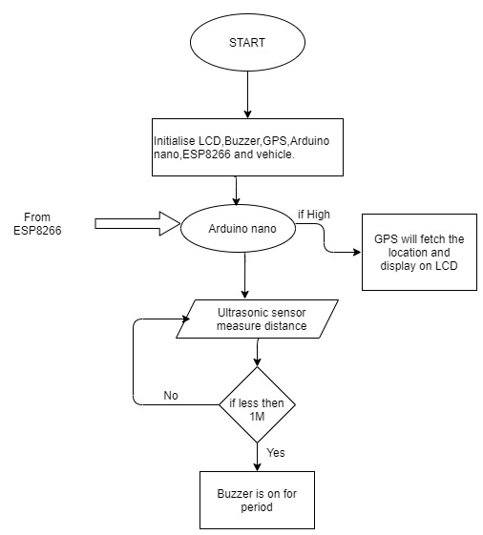
SOFTWARE IMPLEMENTATION
Arduino unit

Slide 35
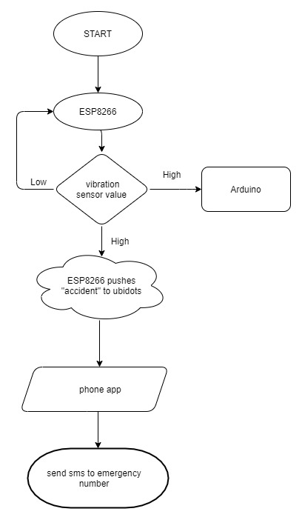
ESP8266 unit

Slide 36
ImplementationVedio
https://drive.google.com/file/d/1vuV9zdcO2ioR7ldzeNKlt-gpCNgZObQ8/view?usp=sharing
code =>
https://github.com/Sampanna-T/Major_Project

Slide 37
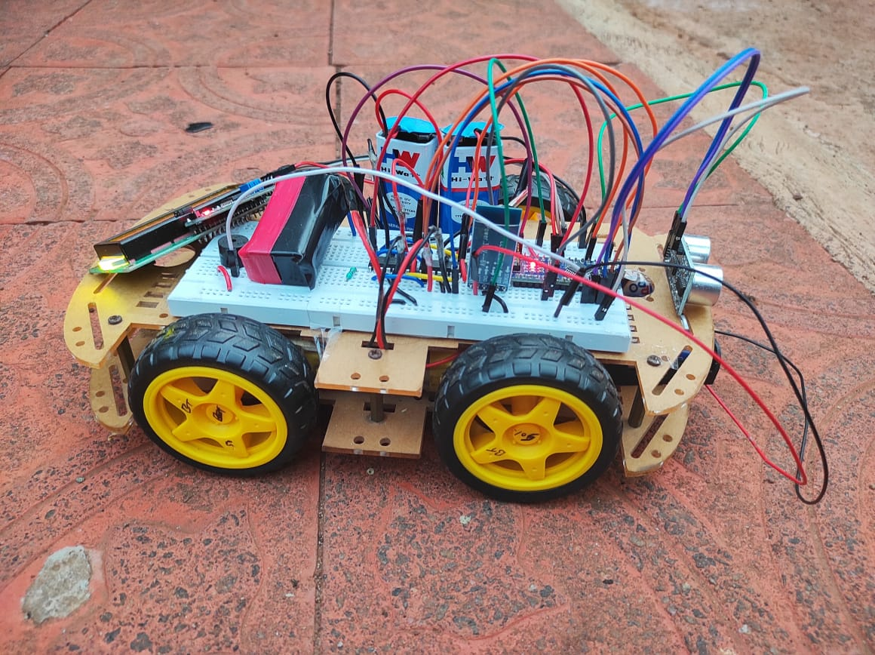
RESULT
Vehicle unit

Slide 38
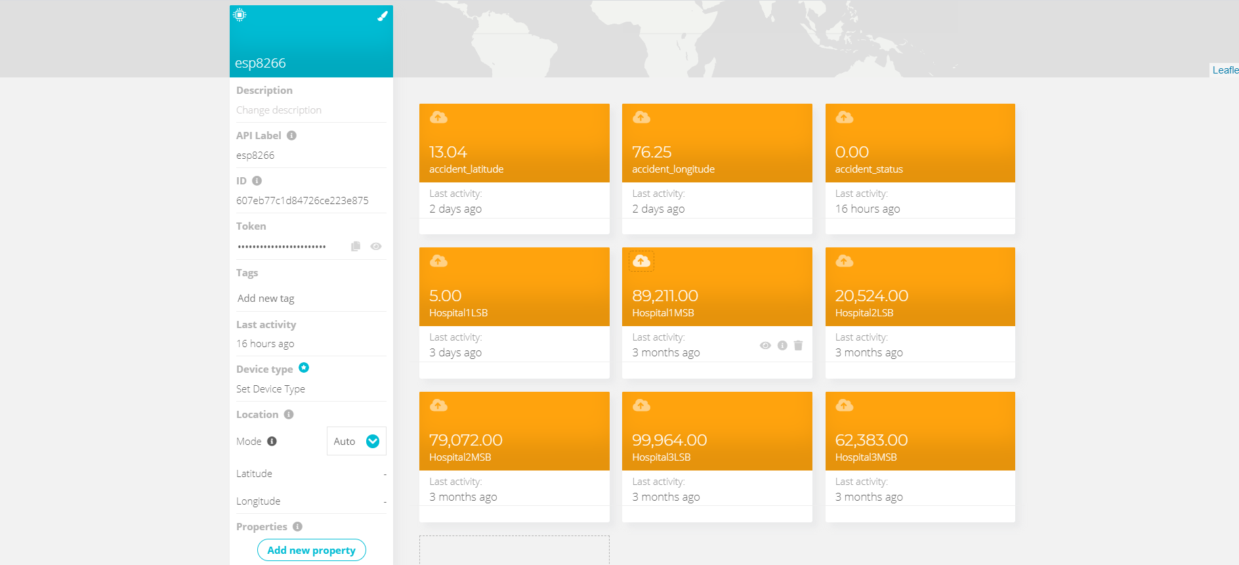
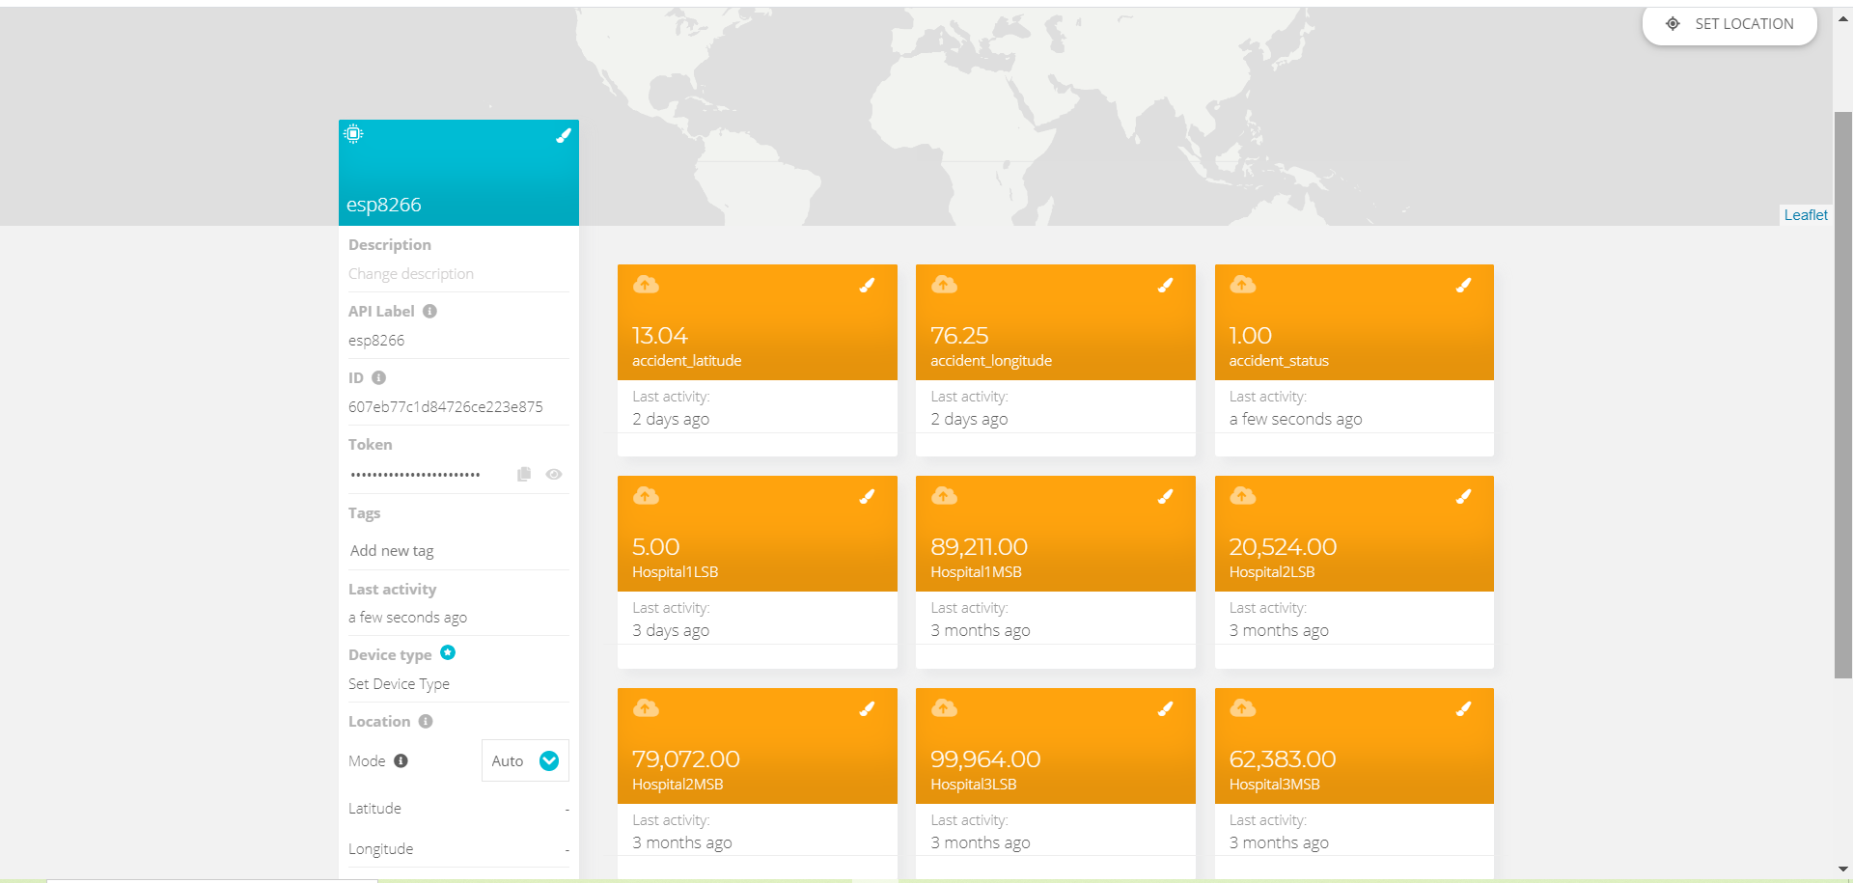
Accident status in ubidots server before and after :

Slide 39
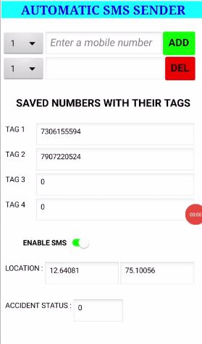
Mobile application :

Slide 40
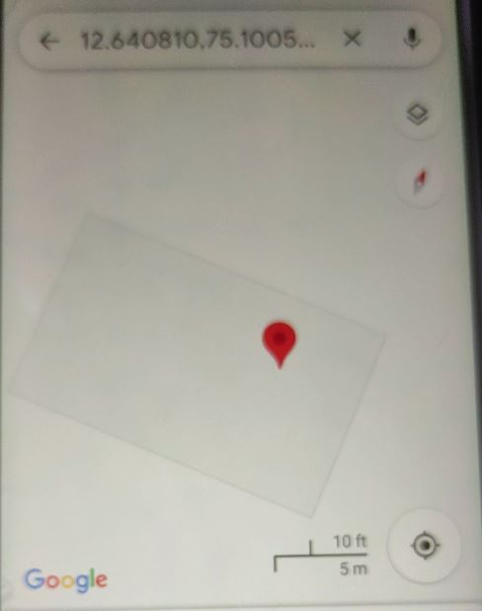
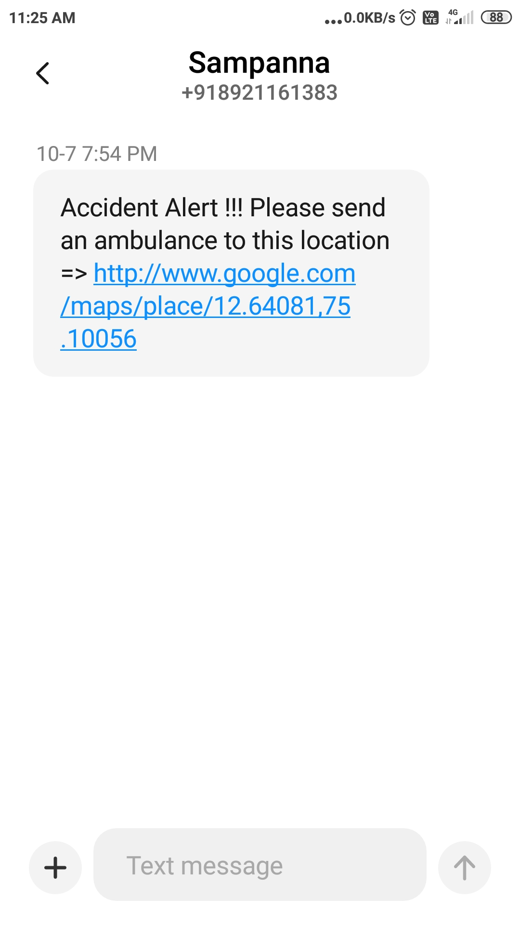
SMS message to number and the location of accident on the map

Slide 41
ADVANTAGES
As soon as accident occurs, the message is sent to the nearby hospital which saves the time in case of emergency.
Low cost for maintenance.
Can be used by any moving vehicle as it is not bulky.
The alert message regarding the accident is sent automatically.
This system can be used for a social cause.
It does not need any operation manually.

Slide 42
LIMITATIONS
The whole system is based on the fact that network is available, if network fails then the entire system fails.
Constant supply of power is essential and incase batteries are used it has to be replaced every time when it gets discharged completely.
Gps receiver consumes more power.
Might have a bit of delay because of all the circuit components.

Slide 43
FUTURE ENHANCEMENT
APPLICATIONS
The proposed system deals with the detection of the accidents. But this can be extended by providing medication to the victims at the accident spot.
By increasing the technology we can also avoid accidents by providing alerts systems that can stop the vehicle to overcome the accidents.
Stolen vehicle recovery
This system can be integrated with air bags system
School bus, cab companies to detect if any accident occurs.
This can be implemented to brake system to avoid accident and control speed.

Slide 44
CONCLUSIONS
The proposed system is developed to provide the information about the accident occured and the location of the accident. It helps to easily provide the assistant and help to the victim of the accident. This system uses GPS module to locate the vehicle. The system alerts driver if obstacle is very near to the car. The SMS is sent to the emergency number. The use of Automatic vehicle accident alert system to minimize unwanted accidents to a great extent compared to normal behavior.

Slide 45
REFERENCE
[1] “GSM & GPS Based Vehicle Theft Control System” S.S. Kanese, S.A. Yadav, S.B Jadav, M.M Kadam (IRJET-- Volume: 05 Issue: 03 | Mar-2018).
[2] Automatic Vehicle Accident Detection and Messaging System Using GSM and GPS Modem by Nimisha Chaturvedi, Pallika Srivastava.(IRJET--Volume: 05 Issue: 03 | Mar-2018)
[3] WOMEN SAFETY DEVICE WITH GPS, GSM AND HEALTH MONITORING SYSTEM Piyush Kumar Verma1, Arpit Sharma2, Dhruv Varshney3, Manish Zadoo4(IRJET--Volume: 05 Issue: 03 | Mar-2018 )

Slide 46
[4] GPS Based Real Time Vehicle Tracking System for Kid’s Safety Using RFID and GSM.(IJARIIT-- Volume: 04 Issue: 01 | 2018)
[5] Marie Bernadette Pautet and Michel Mauley, “The GSM system for mobile communications,” 1992.

Slide 47
THANK YOU

