Slide 1
Capstone Project
Face Emotion Recognition
(Live Class Monitoring)
SUBMITTED BY
SAMPANNA MISHRA

Slide 2

CONTENTS
BUSINESS UNDERSTANDING
DATA SUMMARY
DEPENDENCIES
MODEL BUILDING
MODEL EVALUATION
WEB APP CREATION
CLOUD DEPLOYMENT
SAMPLE IMAGE DETECTION
CHALLENGES
CONCLUSION

Slide 3
BUSINESS UNDERSTANDING
The Indian education landscape has been undergoing rapid changes for the past 10 years owing to the advancement of web-based learning services, specifically, eLearning platforms.Digital Learning is further going to increase in future however there are some challenges.
Digital classrooms are conducted via video telephony software program where it’s not possible for educator to see all students and access the mood. Because of this drawback, students are not focusing on content due to lack of surveillance.
We will solve the above-mentioned challenge by applying deep learning algorithms to live video data. The solution to this problem is by recognizing facial emotions

Slide 4
DATA SUMMARY
The model is trained on FER-2013 dataset.This dataset consists of 48x48 pixel grayscale images of faces. The training set consists of 28,709 images and the test set consists of 7,178 images.
The dataset consists of 7 different facial expressions as follows:
Label
Emotions
No.of Training Images
No.of Test Images
0
1
2
3
4
5
6
Angry
3995
958
Disgust
436
111
Fear
4097
1024
Surprise
831
3171
Sad
4830
1247
Neutral
4965
1233
Happy
7215
1774

Slide 5
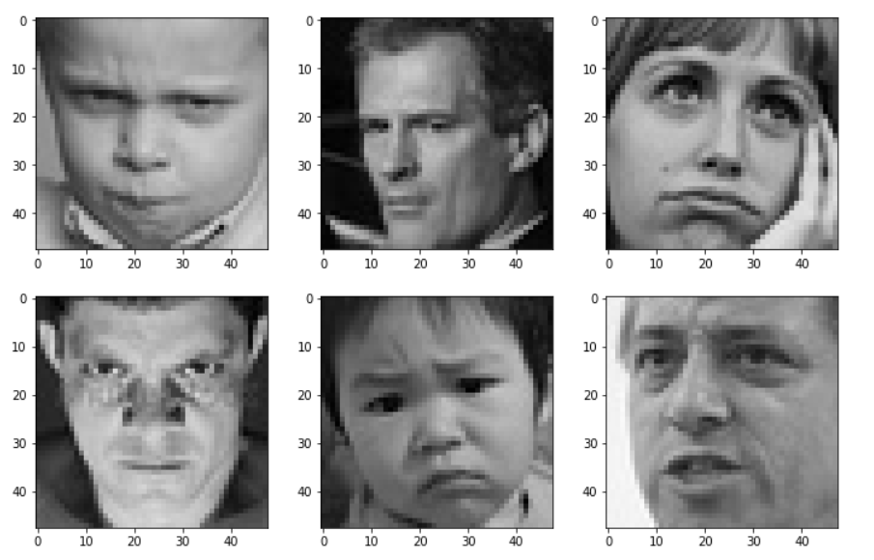
DATA SUMMARY
Trained images used in the model are as follows:

Slide 6
DEPENDENCIES
Python
Tensorflow
Keras
Opencv
Pre Trained Haar Cascade
Streamlit
Streamlit - webrtc

Slide 7
MODEL BUILDING
Convolution Neural Network model has been used for processing the training images.
Customed CNN model has been built using Conv2D, Max Pooling, Batch Normalization, Dropout and Dense parameters.
Activation function used is Relu and softmax.
Adam optimizer has been used in the model.
The model was trained for 40 epochs.
The total parameters generated during the training process is 4,478,727.
The output has 7 nodes because our output emotions are seven in number.

Slide 8
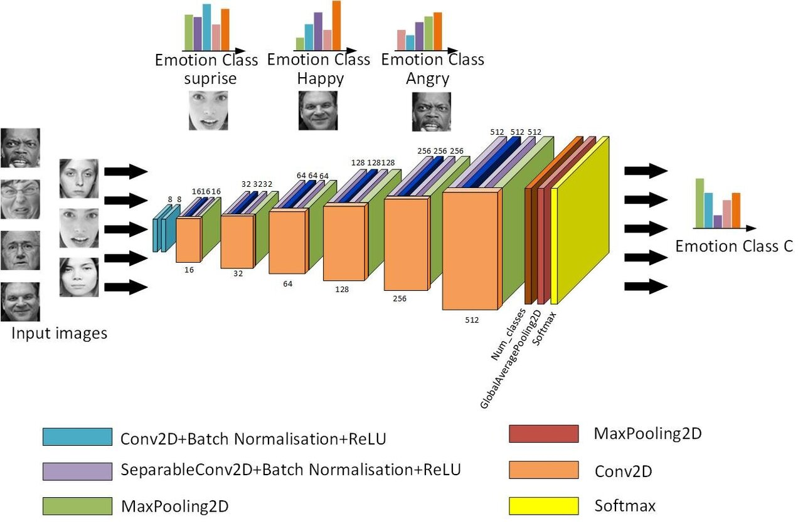
MODEL BUILDING
CNN ARCHITECTURE:

Slide 9
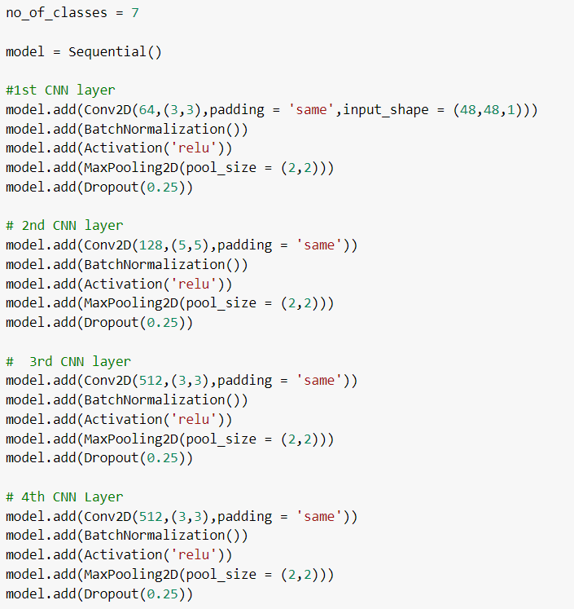
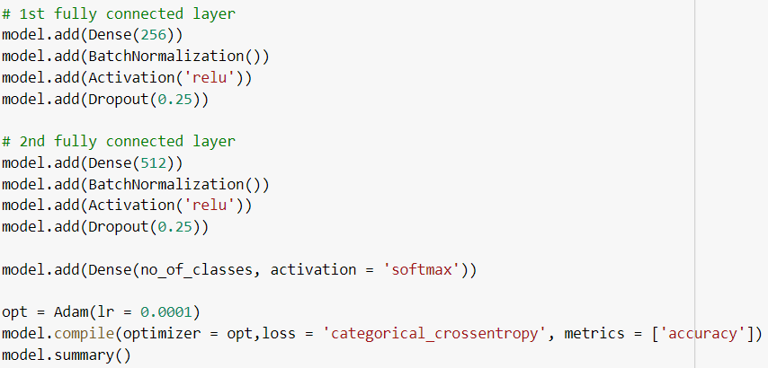
MODEL BUILDING
The images shown below display the steps involved in building the CNN model

Slide 10
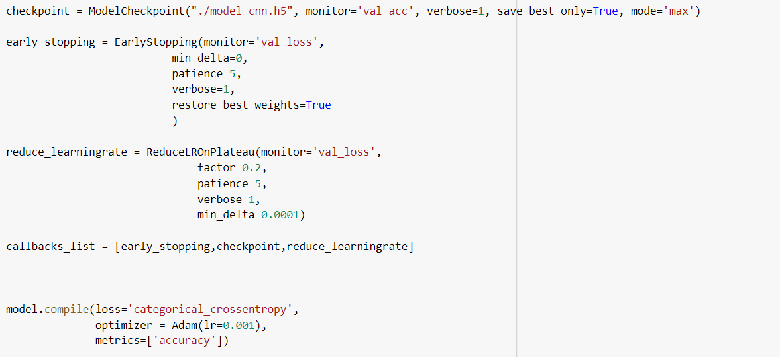
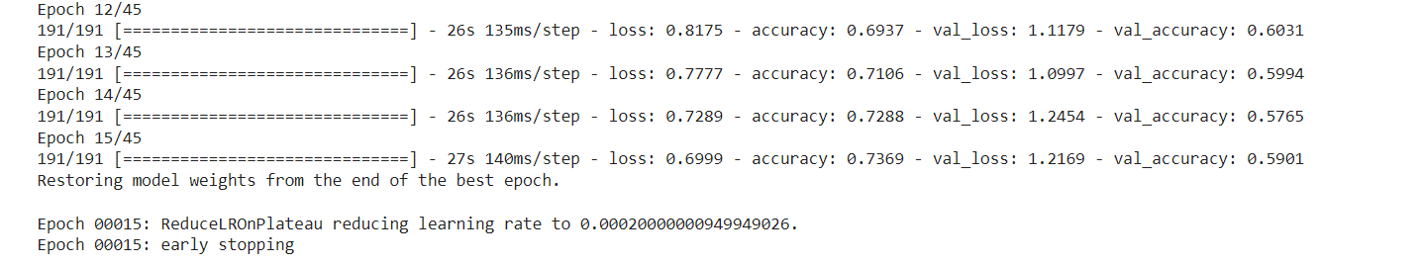
Model Building
Model Callbacks Used

Slide 11
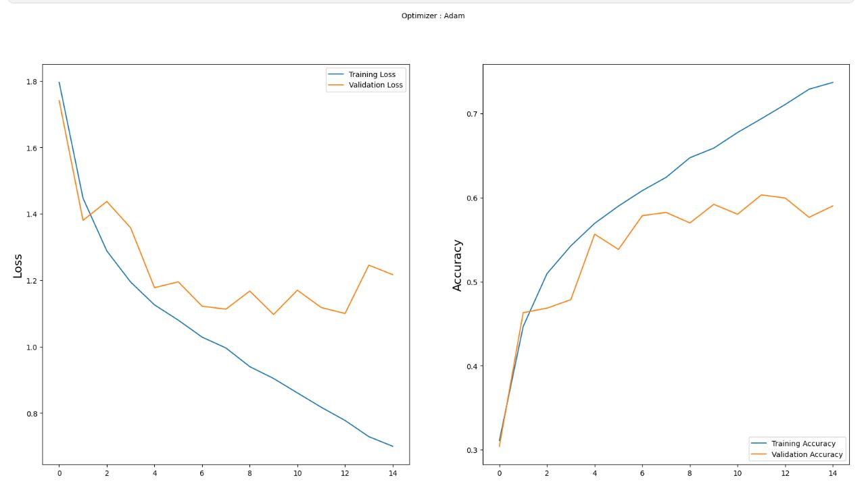
MODEL EVALUATION
A convolutional neural network can be evaluated using the ‘evaluate’ method. This method takes the test data as its parameters. Before this, the data is plotted on the console using ‘matplotlib’ library and ‘imshow’ methods.The accuracy versus epoch data is visualized.This is done using matplotlib library.The model is evaluated, and the loss and accuracy are determined.

Slide 12
WEB APP CREATION
Streamlit which is an open source web framework has been used to build face emotion recognition web app.
OpenCV an open source computer vision and machine learning software library has also been used for real time face reading.
The model weights were saved in json and h5 file format which were later used.
Created a function FaceEmotion to detect multiple faces in videocam which further provides bounding box around faces and predicts face emotion.
Streamlit library does not provide the live capture feature itself ,instead uses a third party API.
Therefore,used streamlit-webrtc which helped to deal with real-time video streams.

Slide 13
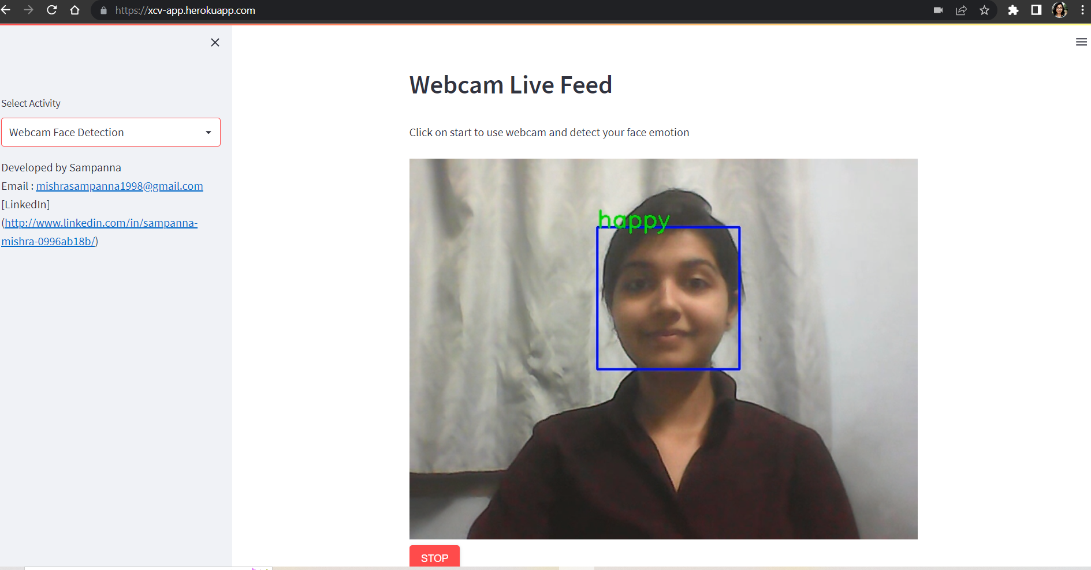
CLOUD DEPLOYMENT
Heroku Cloud Platform was used to deploy the web app.
The link to the web app is https://xcv-app.herokuapp.com/

Slide 14
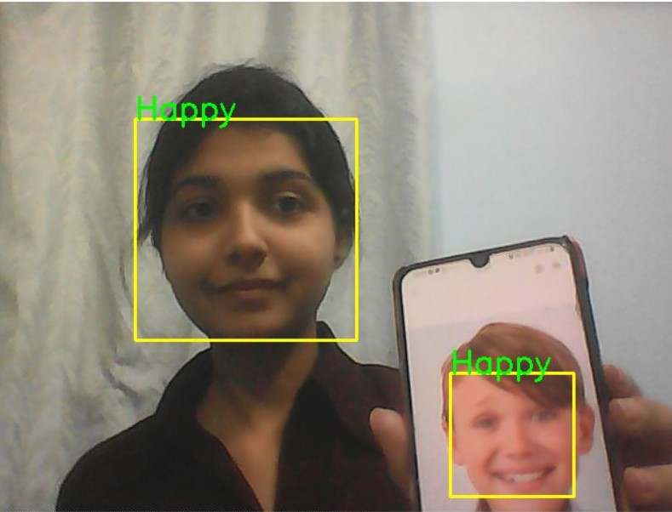
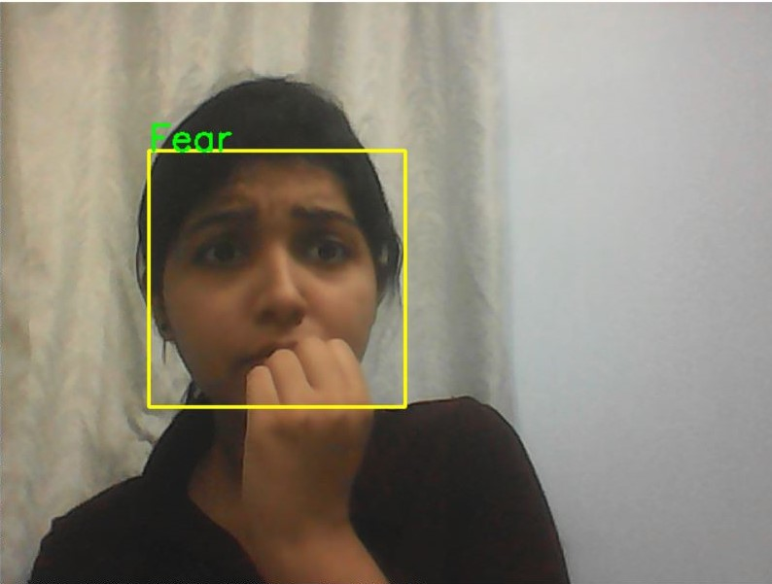
SAMPLE IMAGE DETECTION

Slide 15
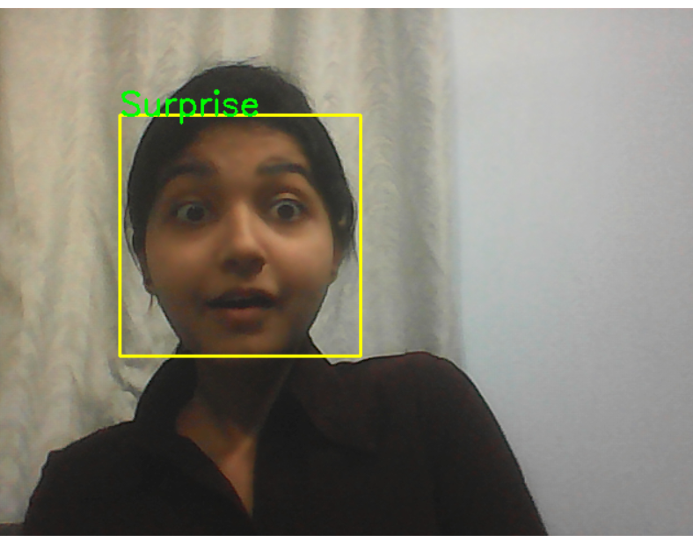
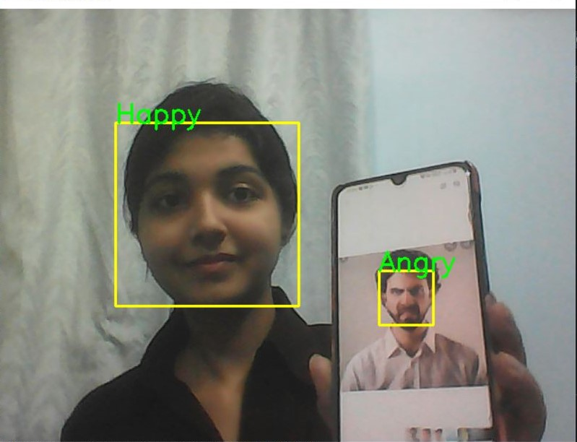
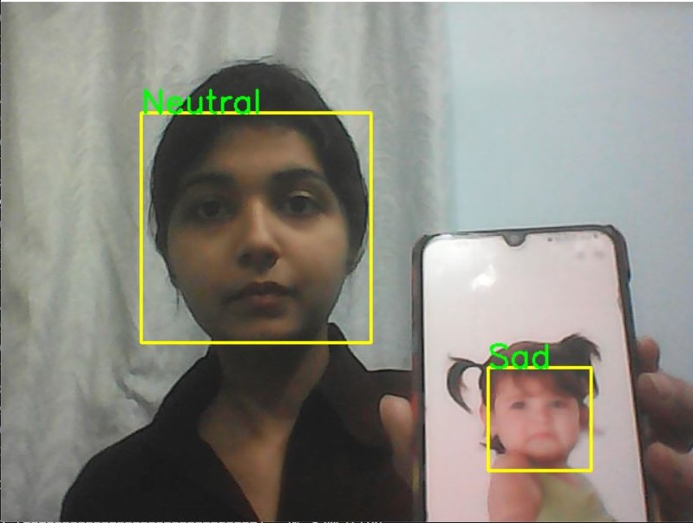
SAMPLE IMAGE DETECTION

Slide 16
CHALLENGES
Large image dataset
Various times training the model with different epochs exhausted the GPU runtime in Google Colab. And Jupyter Notebook had no provision of inbuilt GPU.Training the model consumed time.
Attempt to access live webcam in streamlit app .

Slide 17
CONCLUSION
Built a Face Emotion Recognition web app using streamlit and deployed on heroku cloud, which predicts the face emotions on live webcam.
The total epochs considered initially for the training the images was 45.Too many epochs can lead to overfitting of the training dataset, whereas too few may result in an underfit model. However by usage of early stopping which allowed to specify an arbitrary number of training epochs and stop training once the model performance stops improving on a hold out validation dataset.
The model created with CNN layers gave training accuracy 73.69% and validation accuracy 59.01% after 15 epochs.
The Fer2013 dataset used had less number of disgust images. So the model is unable to distinguish the disgust emotion.

