Slide 1
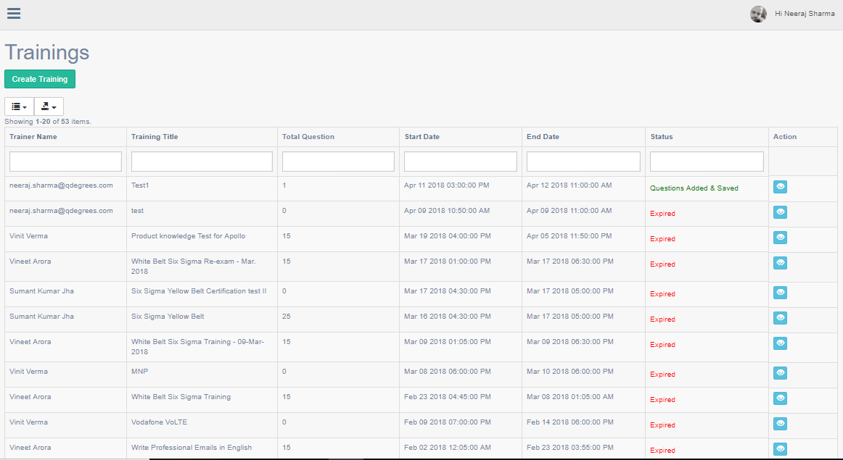

Slide 2
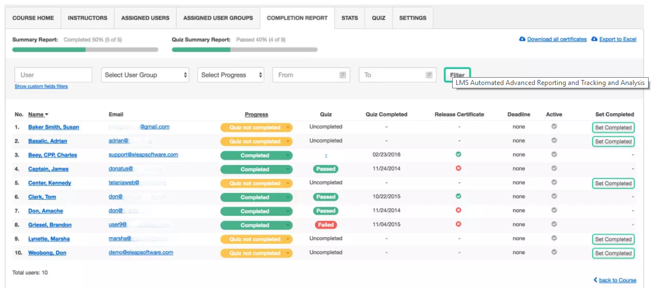
Completion Report Tab

Slide 3
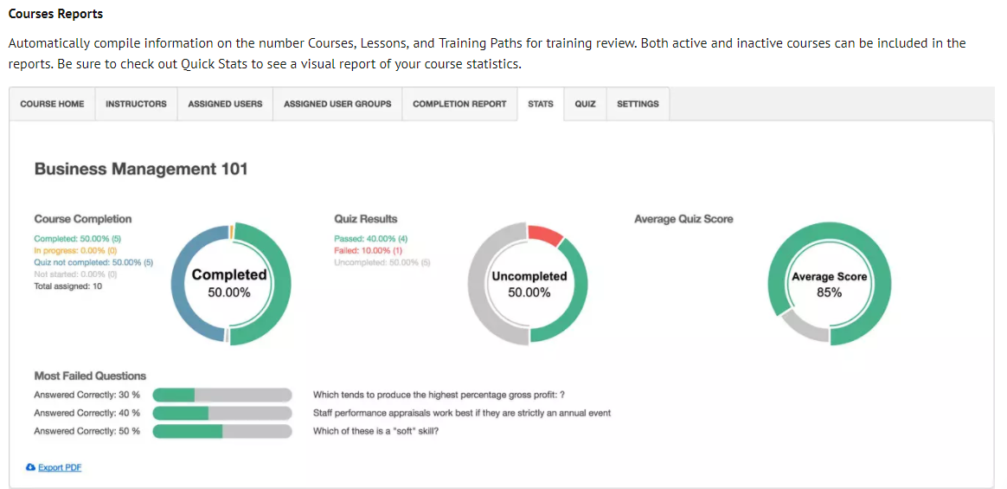
Stats Tab

Slide 4
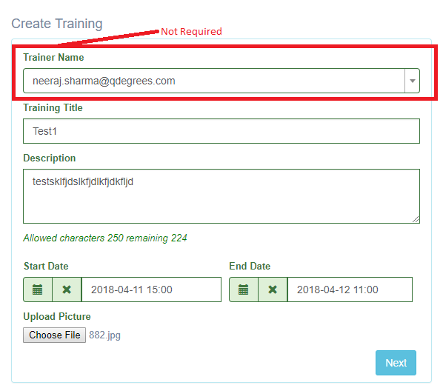
Step:1 Add Training
( system should automatically pick the learner name from profile name)
( Welcome Screen + Editor required for formatting basis)
SAVE

Slide 5
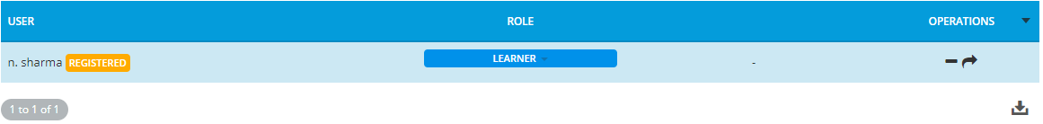
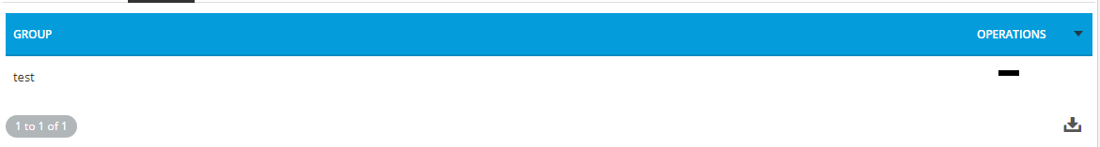

Step:2 Add Users\Groups
User
Groups
Remove
View
User
Groups
PREVIOUS
SAVE

Slide 6
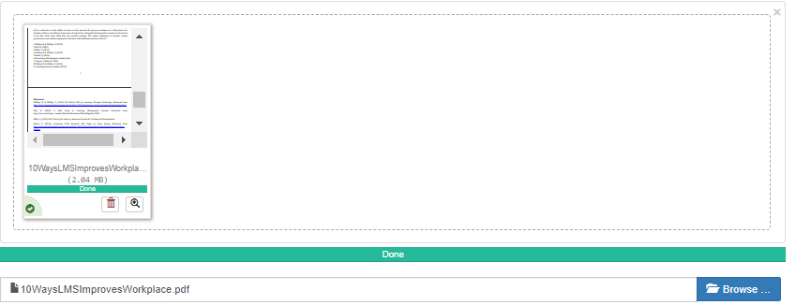
Step:3 Add Content
Add File
Add YouTube Video
FileName
FileType
Upload Date & Time
Permission
Operations
PDF
09-04-2018 12:00
Read
Download
PREVIOUS
SAVE

Slide 7
Step:4 Add Content
Add File
Add YouTube Video
FileName
Length
Upload Date & Time
Permission
Operations
How to test
2:00 Min
09-04-2018 12:00
Read
Download
PREVIOUS
SAVE

Slide 8
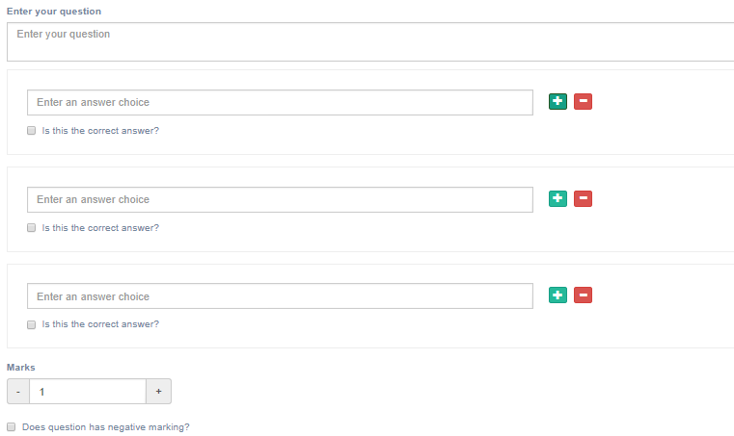
Step:5 Add Question
Select Question Format
Show Result
No
Only Appear if Assessment is selected, In Case of survey system will show selected options against answers as preview
Survey
Assessment
Yes
Select Question Type
Radio
Multiple Choice
Single Choice
ADD
Question Type
Question
Score
Negative Marking
Created Time
Question Order
Options
Operations
09-04-2018 12:00
View
Remove
PREVIOUS
SAVE

Slide 9
Step:6 Settings
Duration (Minutes)
Pass Score
RANDOMIZATION
Shuffle Questions
COMPLETION
Show Correct Answers
Show Given Answers
Show Corrector Wrong Indicators
Show Score
BEHAVIOUR
Allow to download the certificate if candidate got pass score
Allow Movement to next/previous questions
Check Answers and do not continue until the answer selected
If timeups save answers and submit the survey
Feedback required after completing test or survey
MESSAGE
Message (If Passed)
Message (If not Passed)
Save & Activate
Deactivate
Delete

