Slide 1

Android Projects
By:
Sanjeev Poonia

Slide 2
KRA/KPI
Measures (Key Performance Indicator) |  | Measurement Criteria
Projects | Project Timelines/automation | you should work as per the timelines given and also need to ensure that these projects should be 95% bug free ,so that reworking time can be saved. Also you should keep documentation of task given to on timely manner and need to ensure that no verbal communication to client/project.
 | Adherence of Team Leader Instruction | work Adaptability as per TL guidance and ensure that every code and database design instruction should be standard as per the guidelines.
 | Backups | you should understand the criticalness of codes and database and it is required that your production system code should be backed up on daily basis. Its your responsibility to store backup of code and database on core server
Process Management | Defect Removal | Defect removal process should be fast and as per timelines and it should be documented
 | Code & Database Backup/Application maintenance | Application maintenance task should be in given time frame and well executed with 0 bugs
 | Reporting | Daily reporting to manager/TL on given task

Slide 3




Android Applicatios
QTyre
QRetention
Mystery Audit
SAMPARQ

Slide 4


QTyre
Project: Apollo
Application Features:
Weighbridge Activity
Fitment
LCV/SCV
Claim Process
Offline Data Submit

Slide 5
QRetention
Project: Retention
Application Features
My Data
My Followup
Reports
FOS Reports
Telecaller Report
Track FOS

Slide 6

Mystery Audit
Project: National Retail
Application Features:
Upcoming
Pending
Saved
Submitted
Notification
Inbox
Sent
Drafts

Slide 7

SAMPARQ APP
Contents
Security Features
Application Features
Application Advantages
Future enhancement
Supportive OS version

Slide 8

Security Features
Automatic Logout : User gets automatically logged out in next 24 hours after login .
OTP : User need to get authenticated by OTP before login.
Admin Approval: Admin approval is required to complete new user registration.
Screenshot disable: Screenshot and Screen video capturing is disabled.
Reverse Engineering: Proguard is enabled in app so reverse engineering cannot be done.
REST API: Every request from user first get authenticated before passing the response from API.
Basically Authentication means encryption of username and password .

Slide 9

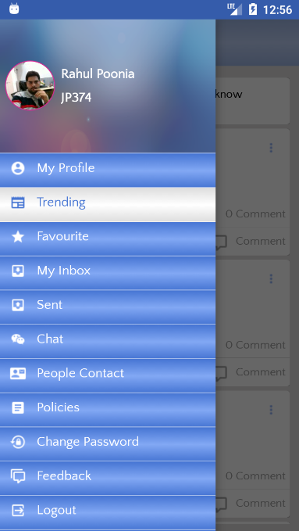
Application Features
Trending
Favourite
My Inbox
Sent
Chat
People Contact
Policies
Change Password
Feedback

Slide 10

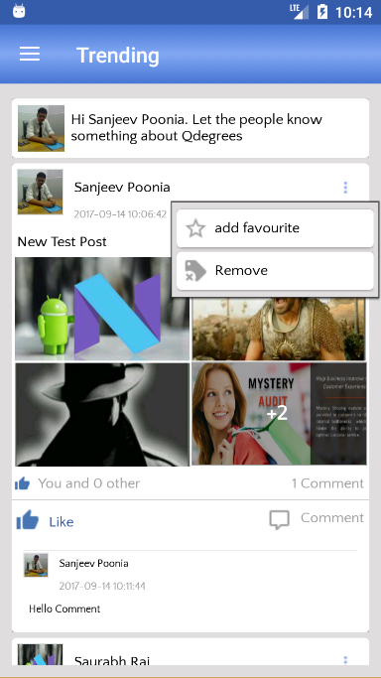
Trending
Create new post
Like Post
Post Comment
Add to Favourite
Remove Post
Last Comment on Post
View Post

Slide 11

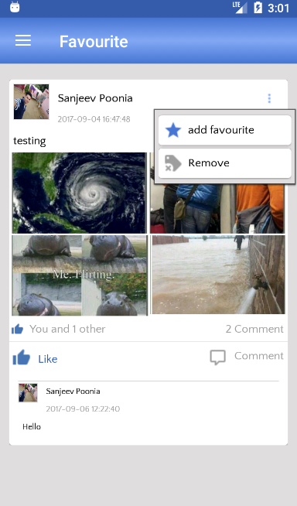
Favourite
Remove from Favourite
Remove Post
View Post
Post Comment
Like Post

Slide 12

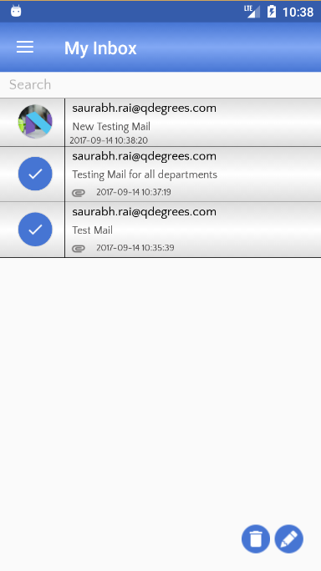
My Inbox
Search
Delete Multiple mail
Compose mail
View Mail
Download Attachments

Slide 13

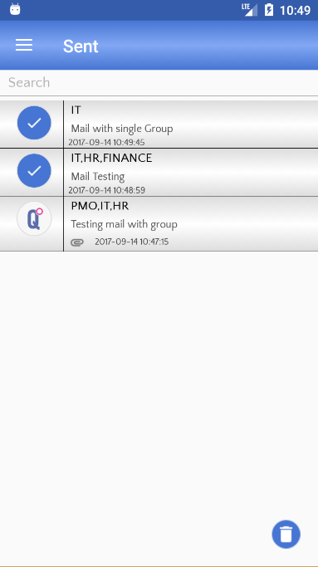
Sent
Search
Delete mail
View
Download Attachment

Slide 14

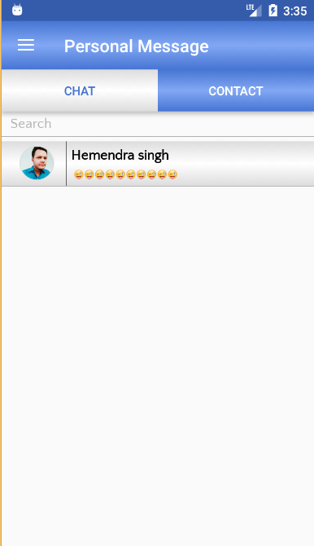
Chat
Search Chat
Create New Chat
Chat with emoji and Images

Slide 15

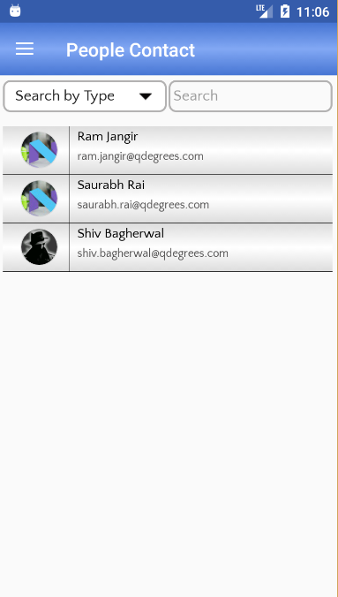
People Contact
Search by Department
View Profile

Slide 16

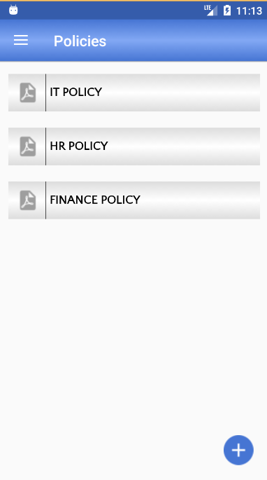
Policies
Create New Policy
View Policy Online
Search

Slide 17

Application Advantages
Staying Connected with QDegrees Family.
Accessing news about QDegrees in real time.
Real-Time Information Sharing.
Increased News Cycle Speed.
Improves company cohesiveness.
Satisfies workers.

Slide 18

Future enhancement

Slide 19
Supportive OS version
Minimum OS Required: Android 4.1( Jelly Bean )
Supportive OS versions:
Jelly Bean (4.1 - 4.3.1)
KitKat( 4.4 - 4.4.4)
Lollipop( 5.0 – 5.1.1 )
Marshmallow(6.0 – 6.0.1)
Nougat( 7.0 – 7.1.2 )

Slide 20
Thank You !

