Slide 1
AlzNet Application
Smoke Testing & Framework Demo
Automated Testing with Playwright

Slide 2
Agenda
1. Project Overview
2. Testing Framework Architecture
3. Smoke Test Scenarios
4. Page Object Model Pattern
5. Third-Party Utilities & Libraries
6. Test Data Management
7. Reporting & Logging
8. Live Demo

Slide 3
Project Overview
Application:
AlzNet - Alzheimer Network Dashboard
Purpose:
Comprehensive smoke and end-to-end testing of registration and case management features
Type:
Smoke Tests - Critical path validation
Environment:
UAT - https://alznetdashboard-uat.acr.org/
Test Suite:
8 Core Smoke Test Cases

Slide 4
Smoke Test Scenarios
Test ID | Test Case Name
ALZ-T134 | Okta Integration & Login
ALZ-T135 | Landing Page Validation
ALZ-T136 | Dementia Site Registration Form
ALZ-T137 | Imaging Facility Registration Form
ALZ-T138 | Site Staff Registration
ALZ-T139 | Imaging Facility Staff Registration
ALZ-T140 | Case Registration & Submission
ALZ-T141 | View Cases & Apply Filters

Slide 5
Framework Architecture
Test Layer
Test Specs (TypeScript)
Page Object Layer
LoginPage, HomePage, RegistrationForm, etc.
Utilities Layer
ActionUtils, CommonUtils, DBUtils, etc.
Framework Layer
Playwright, Configuration, Logging, Reporting

Slide 6
Page Object Model Pattern
Maintainability
Centralized element selectors & methods
Reusability
Page methods can be reused across tests
Readability
Tests read like business logic, not code
Scalability
Easy to add new pages and test cases

Slide 7
Third-Party Utilities & Libraries
Library | Version | Purpose
@playwright/test | ^1.57.0 | Core E2E testing framework
playwright | ^1.57.0 | Browser automation library
@faker-js/faker | ^10.2.0 | Test data generation
googleapis | ^171.0.0 | Gmail API integration for email validation
xlsx | ^0.18.5 | Excel file parsing for test data
dotenv | ^17.2.3 | Environment variable management
typescript | ^5.9.3 | Type-safe JavaScript development
prettier | ^3.7.4 | Code formatting

Slide 8
Custom Utility Classes
ActionUtils
Common UI interactions (click, fill, select, etc.)
CommonUtils
General helper functions and validations
DateUtils
Date manipulation and formatting utilities
DBUtils
Database connection and query execution
FileUtils
File read/write operations for test data
GmailUtils
Gmail integration for email-based test validation
TestDataUtils
Test data loading and management

Slide 9
Test Execution Flow
1
2
3
4
5
6
7
1. Load Environment Configuration
2. Initialize Page Objects & Fixtures
3. Execute Test Scenarios
4. Capture Screenshots on Failure
5. Record Video Traces
6. Generate HTML Report
7. Log Results to Console

Slide 10
Configuration & Timeouts
Default Test Timeout:
10 minutes
Browser:
Chromium (headless: false)
Expect-level Timeout:
90 seconds
Screenshots:
Only on failure
Action Timeout:
30 seconds
Videos:
Enabled
Navigation Timeout:
60 seconds
Traces:
Always enabled
Base URL:
https://alznetdashboard-uat.acr.org/

Slide 11
Test Data Management
Organization:
test-data/Staging/alznetapplication/[e2e|smoke]/
Format:
JSON files containing test scenarios and assertions
Data Generation:
@faker-js/faker for random test data
Externalized:
Separate from test code for easy maintenance

Slide 12
Reporting & Logging
HTML Reports
• Automatic test result summaries
• Screenshots & videos attached
• Detailed error messages
Video Traces
• Complete test execution video
• Trace files for debugging
• Inspector for detailed analysis
Logging
• Console output for each step
• Custom logger utility
• Trace-level debugging info

Slide 13
Running the Tests
Run All Smoke Tests:
npx playwright test tests/specs/alznetapplication/smoke
Run Single Test:
npx playwright test tests/specs/alznetapplication/smoke/ValidateLandingPage_ALZ-T135.spec.ts
Run with Custom Config:
npx playwright test --config=playwright.config.ts --workers=1
View HTML Report:
npx playwright show-report

Slide 14
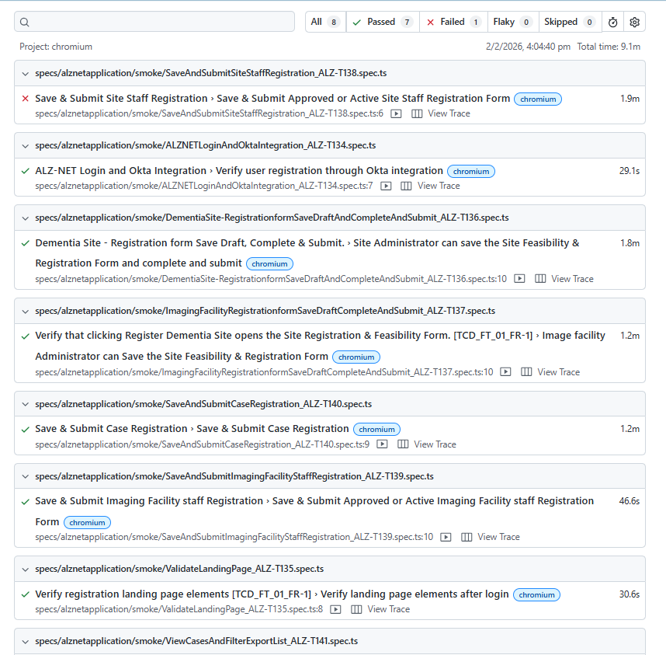
Test Report
npx playwright test tests/specs/alznetapplication/smoke
npx playwright test --config=playwright.config.ts --workers=1
npx playwright show-report

Slide 15
Key Features & Benefits
✓ Cross-browser testing (Chromium, Firefox, WebKit)
✓ Network interception capabilities
✓ Parallel test execution for faster feedback
✓ Strong TypeScript support
✓ Automatic retry on failure
✓ Built-in debugging with Inspector

Slide 16
Testing Best Practices
Use Page Objects
Data Cleanup
Centralize element selectors and methods
Clean up test data after execution
Isolate Tests
Waits
Each test should be independent and repeatable
Use explicit waits instead of hard sleeps
Fail Fast
Assertions
Stop test execution on critical failure
Use meaningful and specific assertions

Slide 17
Questions & Answers
Thank You!

