Slide 1

cropify
GOKARAJU RANGARAJU INSTITUTE OF ENGINEERING AND TECHNOLOGY
Bachupally, Kukatpally, Hyderabad - 500090
DEPARTMENT OF INFORMATION TECHNOLOGY
MINI PROJECT ABSTRACT PRESENTATION
ON
BATCH No. 7
Dhavaleswarapu Anudeep 18241A1215
Potluri Sai Sampath 18241A1249
Tejaswi Krishna Kosaraju 16241A12B1
P Parasuram 18241A1244
Under the guidance of
Project Guide
Head of the Department
V. Padma
Associate Professor
Dr. K Prasanna Lakshmi

Slide 2
PROJECT ARCHITECTURE
SOIL MOISTURE LEVELS
ARDUINO UNO BOARD
EMBEDDED SERVER
PREDEFINED DATASET
SENSOR DATA
TEMPERATURE AND HUMIDITY LEVELS
WI-FI MODULE
PASS THE
CURRENT INPUTS
DISPLAY ON WEBPAGE
PREDICTION
MODEL
PASS THE RESULTS

Slide 3
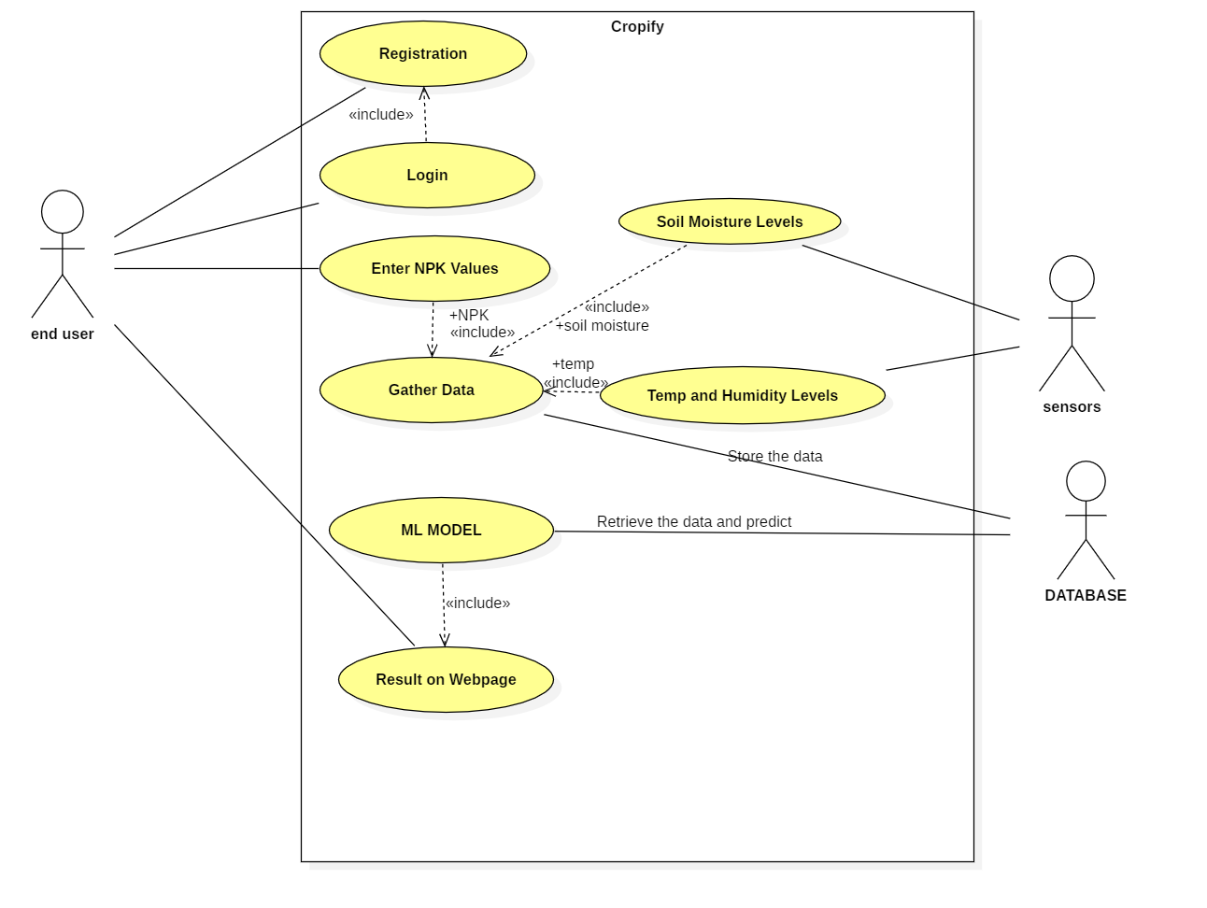
USE CASE DIAGRAM

Slide 4
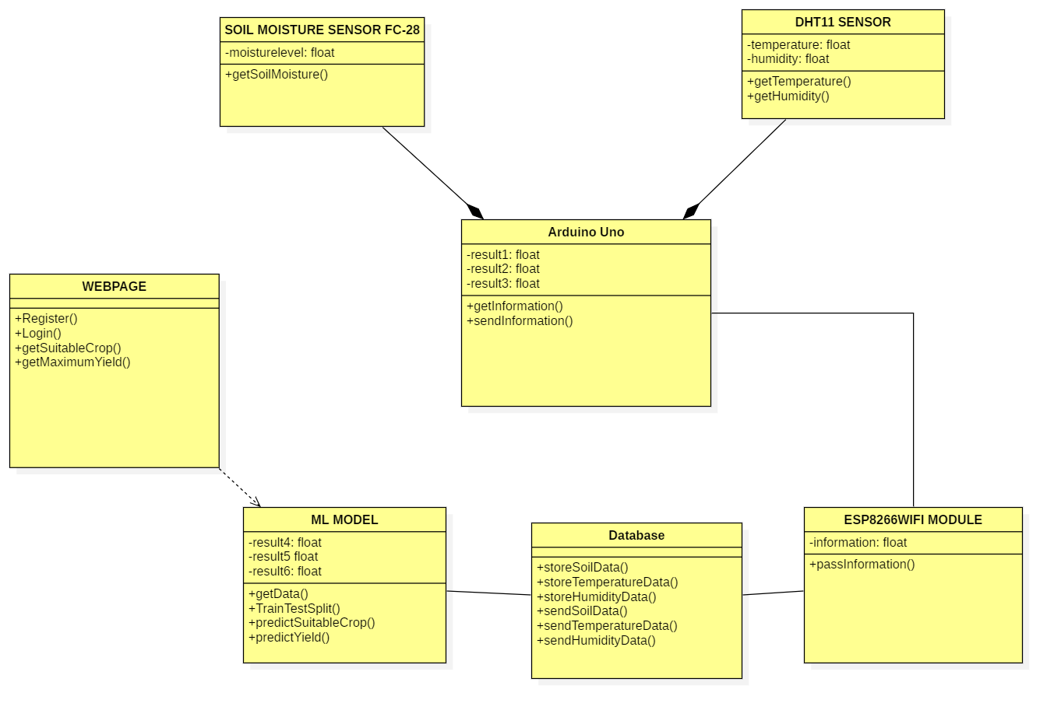
CLASS DIAGRAM

Slide 5
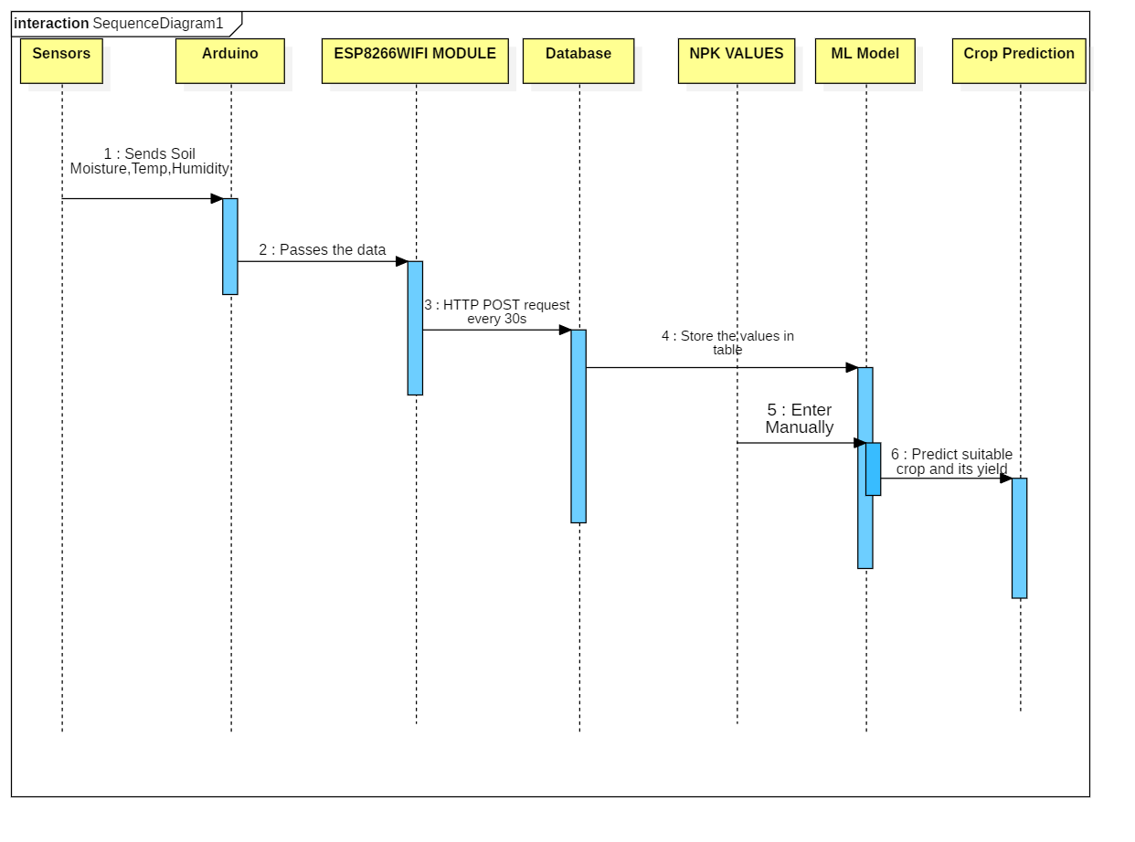
SEQUENCE DIAGRAM

Slide 6
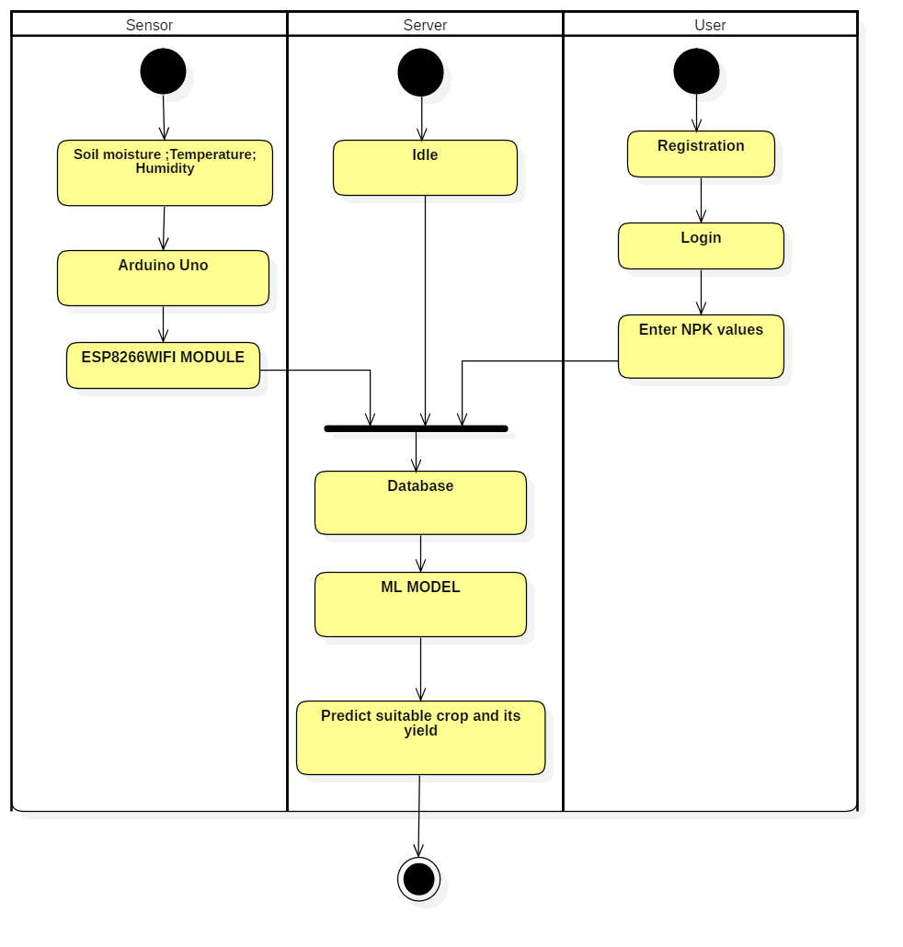
ACTIVITY DIAGRAM

Slide 7

THANK YOU

