Slide 1




HOW TO IMPLEMENT CONVERSATIONAL AI
Sampath Vagicharla-S533978
Jeevan Sai Subhash-S533979
Sandeep Devineni-S533620
Rahul Reddy Dayam-S533901

Slide 2
OVERVIEW
How Alexa Works?
Create an interactive service with slots.
Summary

Slide 3
What is Alexa?
Alexa is a virtual voice assistant developed by Amazon corporation which is helpful in answering our queries.
Alexa Skill:
Alexa Skill is a capability of your Alexa device to answer your queries.
Different types of Alexa skills include
1. Smart Home Skill
2. Flash Briefing Skill
3. Custom Skill

Slide 4
Overview of Custom Skill:
Define skill & setup interaction model
Define invocation name
Setup intent schemas
Define sample utterances
Develop and deploy endpoint
Test, Associate, Test and Publish endpoint

Slide 5
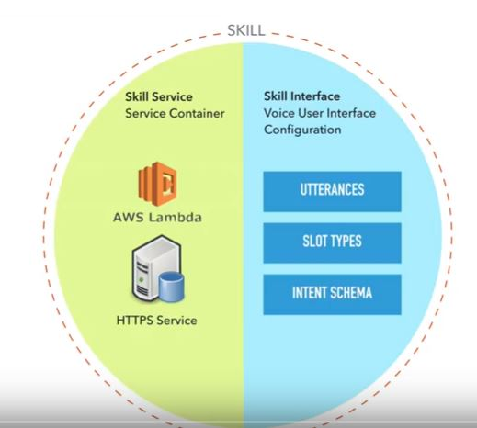
Skills of Alexa:
Skills are divided into
Skill Service: Containers provide a standard way to package your application's code, configurations, and dependencies into a single object Ex: AWS Lambda etc.
Skill Interface: It is a Voice User Interface used to define the utterances , slot types and intent schema of your device.

Slide 6
Components of an Custom skill in Alexa:
The components of an Alexa sill include:
Intents: Represents the action that users can do with your skill
Sample Utterances: Specify the words and phrases.
Invocation name: Identifies the skill.
Cloud-based Service: Accepts the Intent and acts on them.
Configuration: Combines all this and creates in a developer portal.

Slide 7
Example:
CountryInfoIntent the capitol of {Country}
CountryInfoIntent get the capitol of {Country}
CountryInfoIntent country info for {Country}
CountryInfoIntent what is the capitol of {Country}
CountryInfoIntent about {Country}
CountryInfoIntent {Country}
CountryInfoIntent tell me the capitol of {Country}

Slide 8
Continue….
“Alexa , get the capitol of Brazil from Country Pool”.
Sample utterance: get the capitol of.
Invocation name: Country Pool.
Slot : Brazil.
This model is called as an Interaction model.
Thus, we have created an interactive service with slots.

Slide 9
Steps Involved:
The User’s speech is streamed to the Alexa service in the cloud.
Alexa recognizes that country pooler skill belongs to Country Intent.
Alexa structures into a request and sends the request to the service defined, then the request includes the value “Brazil” as city.
The Country pooler service gets the request and takes the action.
The Country pooler sends the Alexa service a structured response with a text to speak to the user.
The Alexa-enabled device speaks the response back to the user.

Slide 10
AWS Lambda:
AWS Lambda lets you run code without provisioning or managing servers. You pay only for the compute time you consume - there is no charge when your code is not running. With Lambda, you can run code for virtually any type of application or backend service - all with zero administration. Just upload your code and Lambda takes care of everything required to run and scale your code with high availability. You can set up your code to automatically trigger from other AWS services or call it directly from any web or mobile app.

Slide 11
Requirements to build a Alexa Skill set:
Visual Studio (2015) or newer with AWS Toolkit for Visual Studio.
Sign up for an AWS Account.
Sign up for an Amazon Developer Account.

Slide 12
Steps to build an Alexa skill set:
Build an Alexa skill at https://developer.amazon.com/alexa
Create your intents with sample utterances and slots .
Build a function in your amazon developer console.
Give your amazon credentials and select the platform in which you want to develop an application.
Develop the code and deploy it in the Amazon developer account with the end points this deployment is serverless.

Slide 13
Conclusion:
Hence, using the Amazon aws we can develop cool Alexa skills so that it answer our queries.

Slide 14
References:
https://blogs.msdn.microsoft.com/appconsult/2018/11/02/build-your-first-alexa-skill-with-alexa-net-and-azure-functions-the-basics/
https://www.youtube.com/watch?v=BPWmaYJIjCk&t=1723s
http://timheuer.com/blog/archive/2016/12/12/amazon-alexa-skill-using-c-sharp-dotnet-core.aspx

Slide 15
THANK YOU!

