Slide 1
DEPLOYING A WEB APPLICATION USING AZURE APP SERVICE
Team Members:
Sampath Bunga Manideep Chittimodu Laxmi Prasanna Garishe Likhitha Bodige

Slide 2
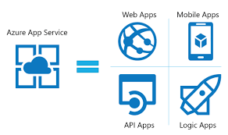
Why Azure App Service?:
Azure App Service is a fully managed platform for building, deploying, and scaling web applications. It supports multiple programming languages and frameworks, including .NET, Java, Node.js, and Python. This service simplifies the deployment process and offers integrated DevOps capabilities.

Slide 3
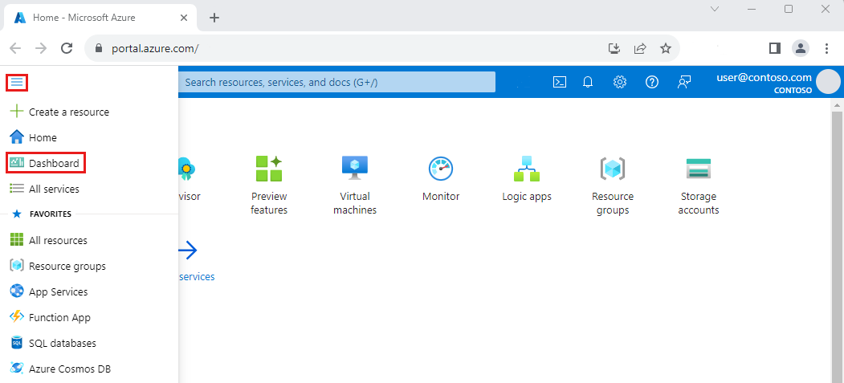
Prerequisites for Deployment:
You need an active Azure subscription to get started with Azure App Service. Familiarity with the programming language and framework of your web application is essential. Ensure you have the necessary tools for deployment, such as Visual Studio, Azure CLI, or Git.

Slide 4
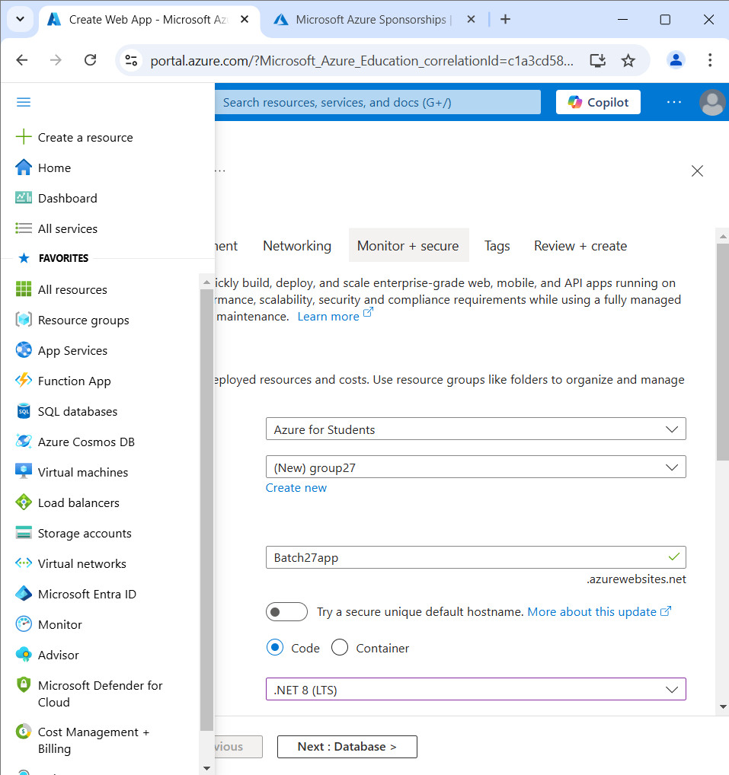
Login to Azure Portal:
Go to Azure Portal.
Log in with your Azure credentials.
Create a Resource Group

Slide 5
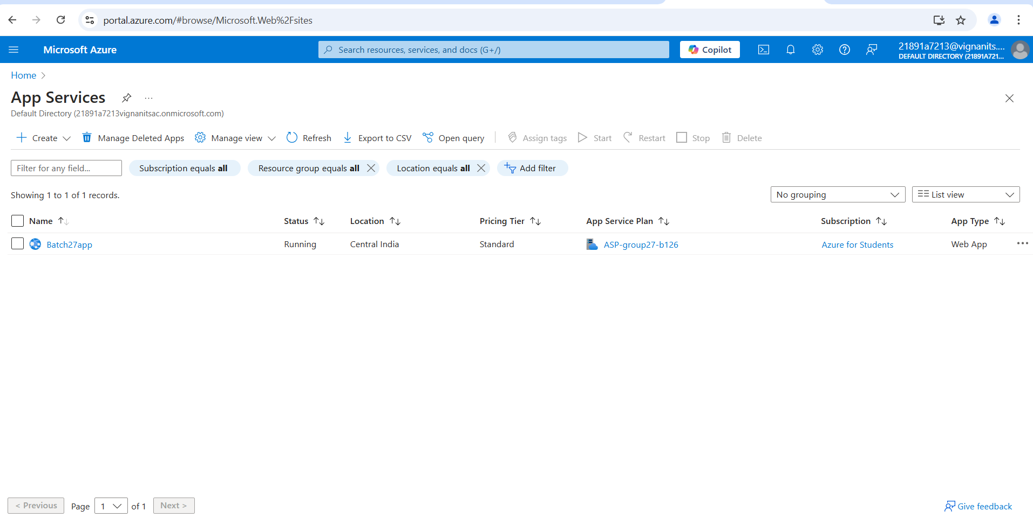
Create an App Service Plan:

Slide 6
Create an App Service :
Navigate to “Create a Resource” > Search for “App Service”.
Click on “Create”.
Fill in details:
Resource Group: Select or create a new one.
App Name: Enter a unique name for your app.
Runtime Stack: Choose the technology stack (e.g., .NET Core, Node.js).
Region: Select the appropriate region.
App Service Plan: Create a new one or select an existing plan.
Click “Review + Create” and then “Create”.

Slide 7
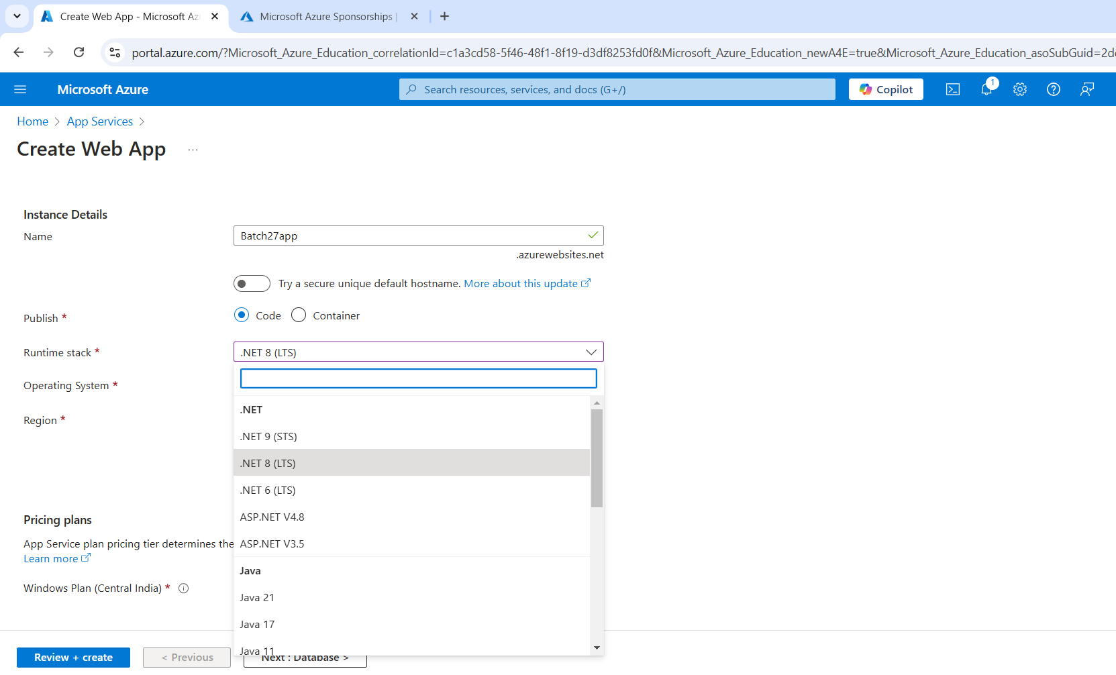
The user is at the "Basics" tab and has the option to proceed to the next configuration steps, such as database, deployment, networking, etc., before finalizing and creating the web app.

Slide 8
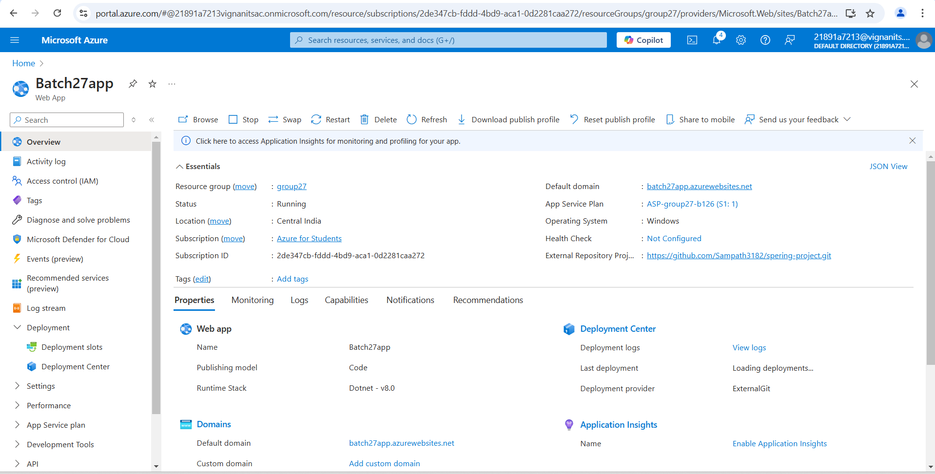
Successfully created the App Service in Azure portal.

Slide 9
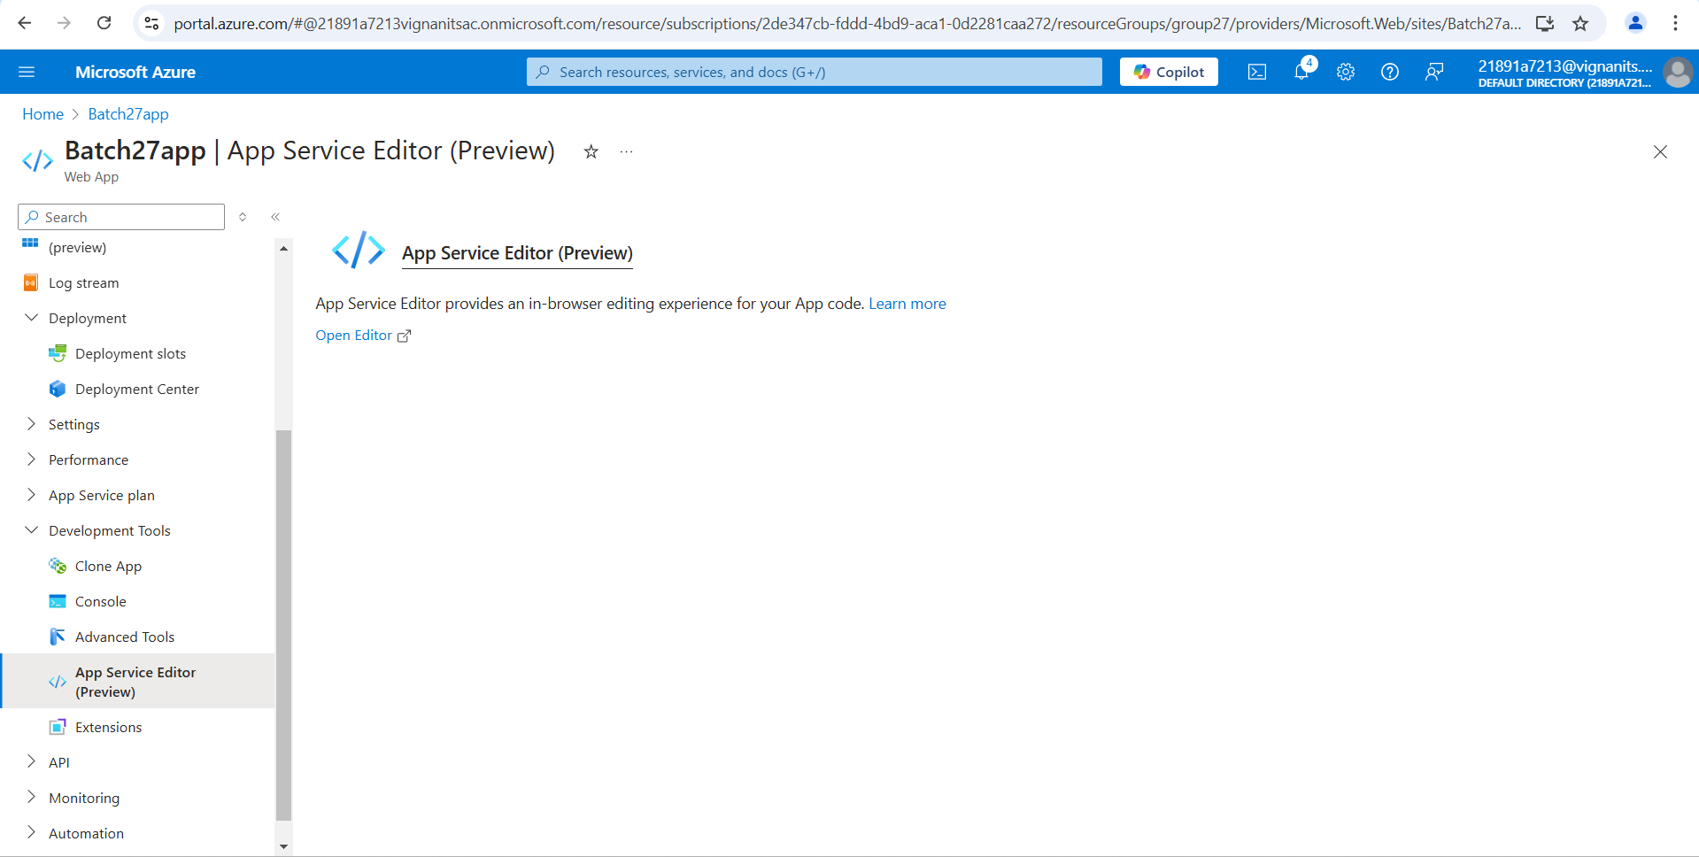
After creating the app service go to Development tools.
Open App service Editor,
Click on Open editor.

Slide 10
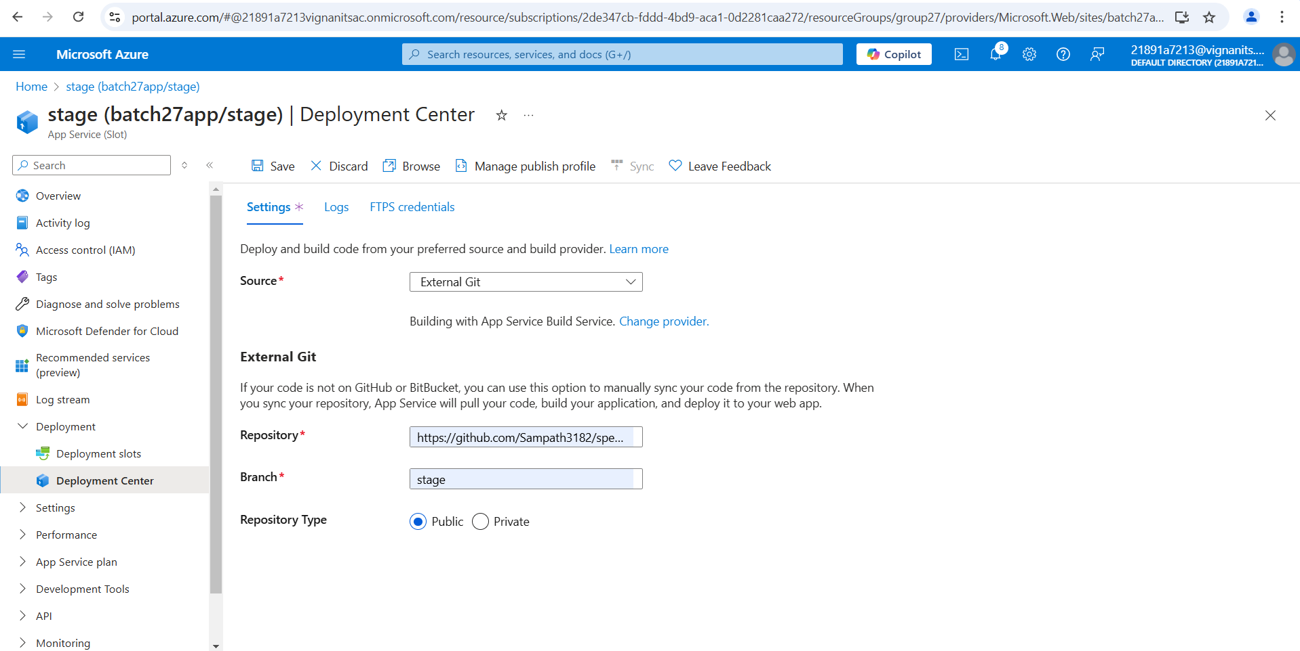
Cloning project from Repository:

Slide 11
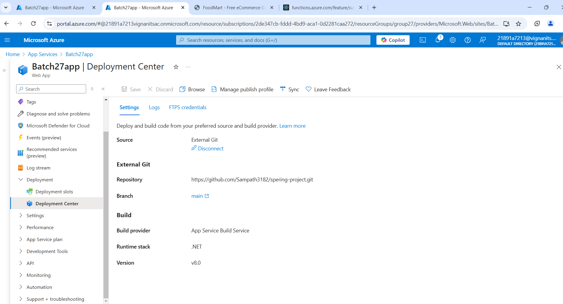
All files from the repository have been successfully imported into the App Service Editor, and the application has been deployed successfully.

Slide 12
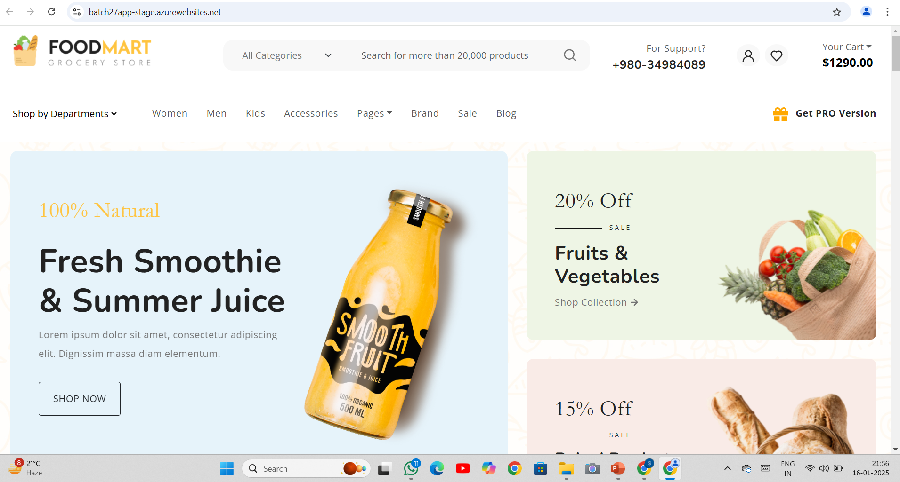
To check the deployed application, open App Service Overview, Click on Browse in the right panel, Below page will appear.

Slide 13

Conclusion
Azure App Service simplifies web app deployment and management.
Offers scalability, monitoring, and ease of integration with other Azure services.

Slide 14

THANK YOU

