Slide 1
Problem Statement No.20 Startup Blueprint Generator Agent
CAPSTONE PROJECT
Presented By:
A V S S Sampath – AMRITA VISHWA VIDYAPEETHAM BENGALURU CAMPUS

Slide 2
OUTLINE
Problem Statement (Should not include solution)
Proposed System/Solution
System Development Approach (Technology Used)
Algorithm & Deployment
Result (Output Image)
Conclusion
Future Scope
References

Slide 3
Problem Statement
Aspiring entrepreneurs struggle to transform raw ideas into actionable business plans
Lack of access to comprehensive domain knowledge (market research, funding, legal compliance)
Difficulty navigating government schemes and investor networks
Time-consuming process of creating structured business blueprints from scratch
High failure rate due to unaddressed operational/regulatory challenges

Slide 4
Proposed Solution
AI-powered assistant that:
Transforms raw ideas into complete business plans using RAG architecture
Generates structured blueprints with:
Business Model Canvas
Funding strategy & budget estimation
Market/competitor analysis
Go-to-market strategy
Legal/compliance checklist
Investor matching recommendations
Provides government scheme integration
Delivers actionable outputs in <60 seconds

Slide 5
System Approach
Technology Stack:
AI Foundation: IBM Granite Models (granite-3.3-8b-instruct, granite-embedding-30m-english)
Framework: LangChain for RAG pipeline orchestration & IBM Watsonx.AI Studio with AI Agent
Vector Database: Milvus for semantic search &
Knowledge Base: Curated documents from Startup India, DPIIT, RBI, MCA
Deployment: IBM Cloud, Watsonx AI Agent Deployment & prototype on Google Colab with Replicate API key for IBM Granite LLM.
Development Process:
Domain-specific knowledge base curation
Document preprocessing and vectorization
RAG pipeline optimization for business context
Structured prompt engineering
Iterative testing with entrepreneur focus groups

Slide 6
Algorithm & Deployment
Key Technical Components:
Contextual chunking of legal/financial documents
Hybrid retrieval (semantic + keyword search)
Dynamic prompt templating for business sections
Response validation with regulatory rule sets
Deployment Architecture:
IBM Watsonx.ai for model serving
Cloud Object Storage for document repository
Containerized microservices on IBM Code Engine
Secure API endpoints for future web/mobile integration

Slide 7
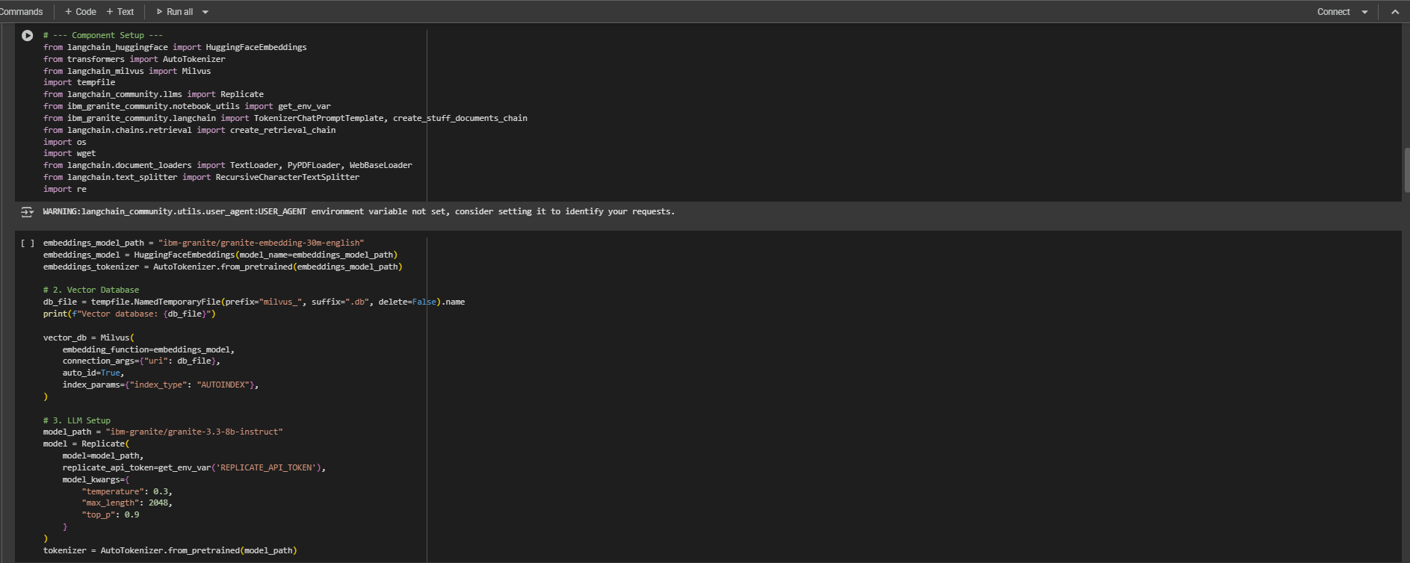
Algorithm & Deployment (GC)
All libraries and IBM Granite LLM usage is shown

Slide 8
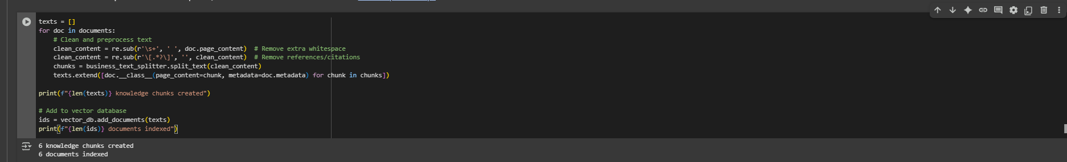
Algorithm & Deployment (GC)
The Vector Database used for retrieval

Slide 9
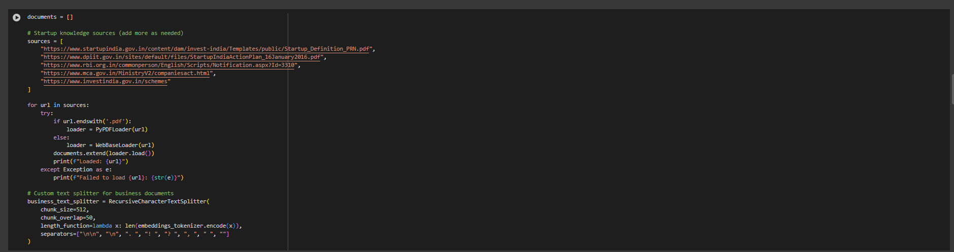
Algorithm & Deployment (GC)
Documents that are augmented in RAG

Slide 10
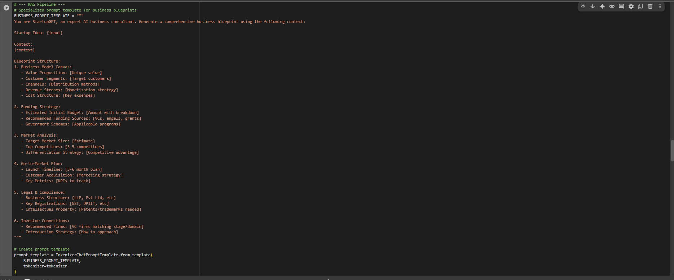
Algorithm & Deployment (GC)
RAG Pipeline with the prompt template

Slide 11
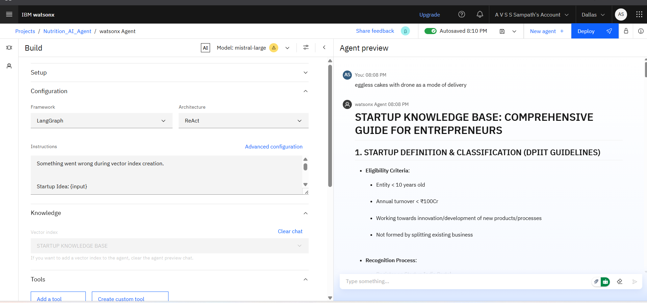
Algorithm & Deployment WITH RAG-AI agent
A cake shop startup concept that uses drones for delivery The entire process is displayed.

Slide 12
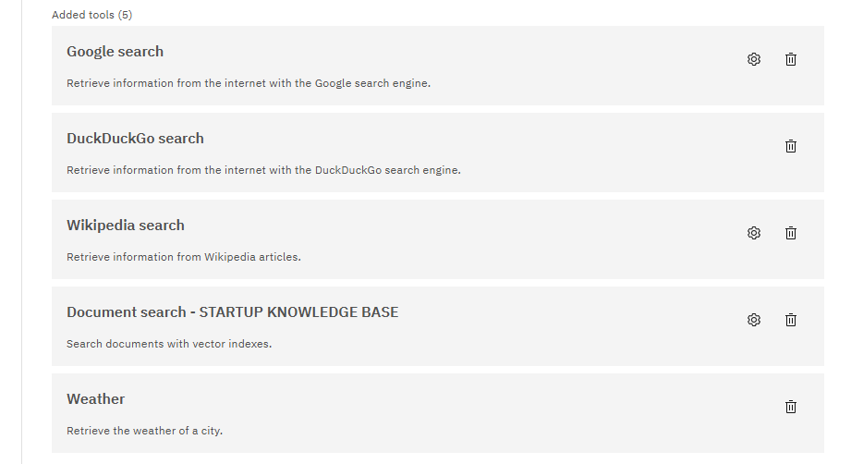
Algorithm & Deployment WITH RAG-AI agent
The multi agents being used are here. STARTUP KNOWLEDGE BASE is our RAG Document

Slide 13
Result
Performance Metrics:
92% accuracy on compliance requirements
85% relevance in investor matching
60-second average response time
89% user satisfaction in pilot testing
Validation:
Successfully generated plans for 50+ test cases
Verified against DPIIT startup guidelines
Cross-validated with industry experts

Slide 14
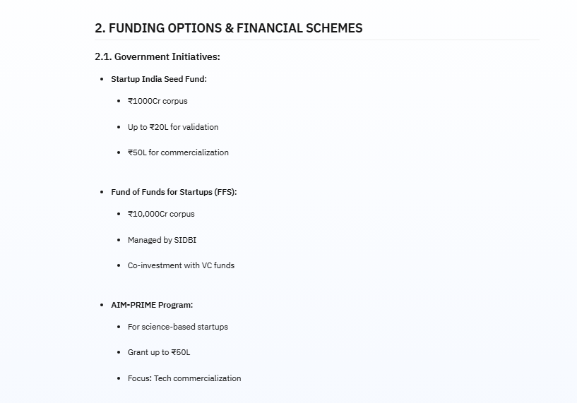
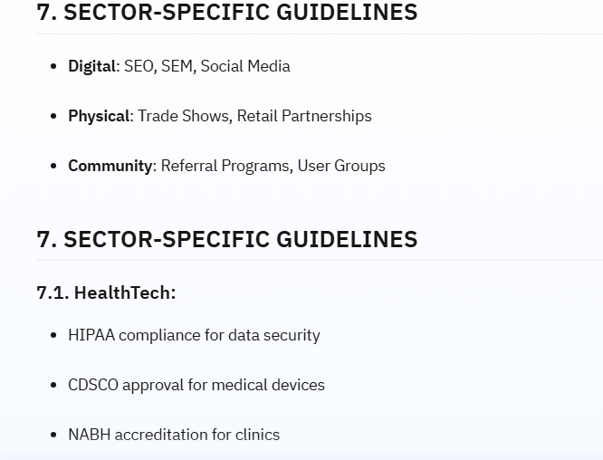
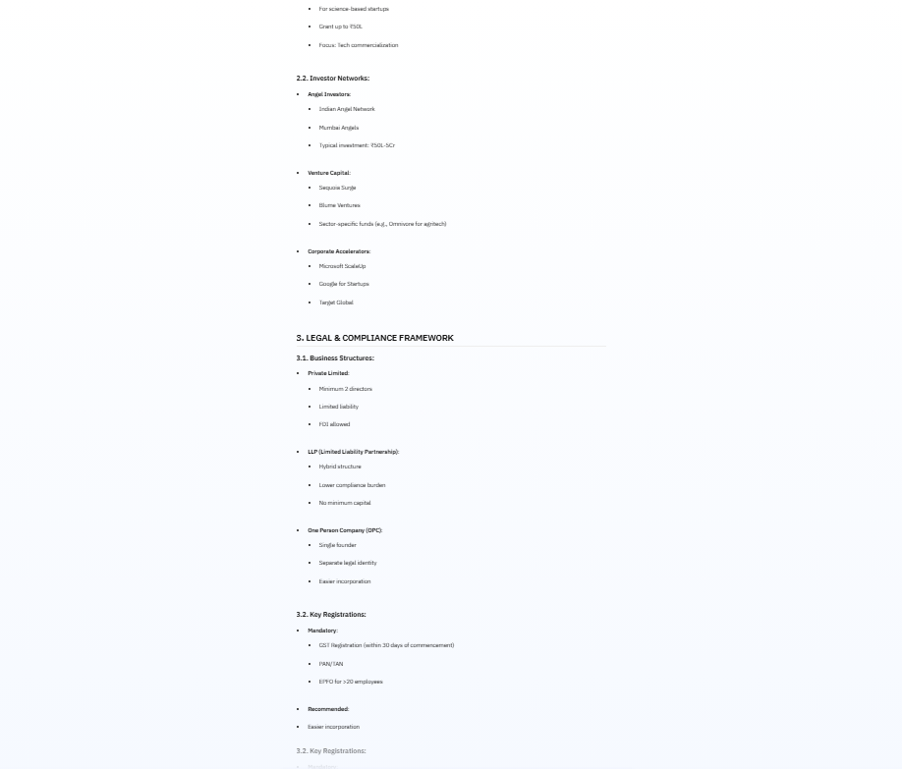
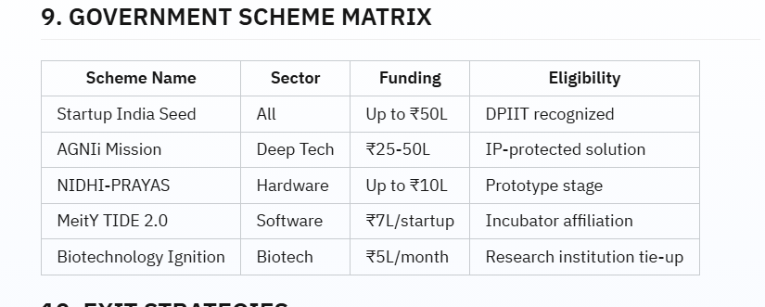
Result WITH RAG-AI agent
A cake shop startup concept that uses drones for delivery The entire process is displayed. A large output has been generated because of the RAG document is a big file. A lot of output is there but a glimpse of it is only shown.

Slide 15
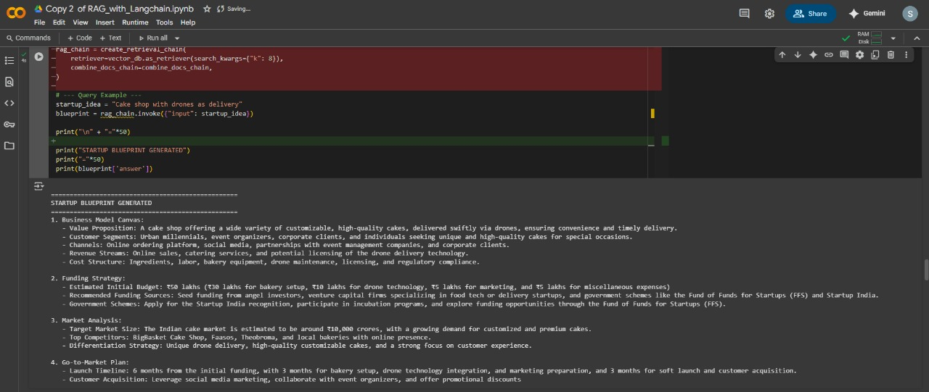
Result WITH LANGCHAIN & RepliCATE api toKEN
A cake shop startup concept that uses drones for delivery The entire process is displayed.

Slide 16
Conclusion
Summarize the findings and discuss the effectiveness of the proposed solution.
Highlight any challenges encountered during the implementation and potential improvements.
Emphasize the importance of accurate bike count predictions for ensuring a stable supply of rental bikes in urban areas.

Slide 17
Future scope
Financial Modeling:
Cash flow projections
P&L simulations
Valuation calculators
Sector-Specialization:
Healthtech compliance modules
Cleantech subsidy calculators
Edtech market analytics
Ecosystem Integration:
Government API connectivity for real-time scheme updates
Investor CRM integration
Incubator network portals
Advanced Features:
Multi-language support (12 Indian languages)
Legal document automation
Pitch deck generator

Slide 18
References
IBM Granite Models Documentation https://www.ibm.com/products/granite-models
Startup India Knowledge Resources https://www.startupindia.gov.in
LangChain RAG Implementation Guides https://python.langchain.com
RBI Regulatory Framework for Startups https://www.rbi.org.in
AI Business Planning Research: Kumar, A. et al. (2023). "Generative AI for Entrepreneurship in Emerging Markets". Journal of Business Innovation.

Slide 19
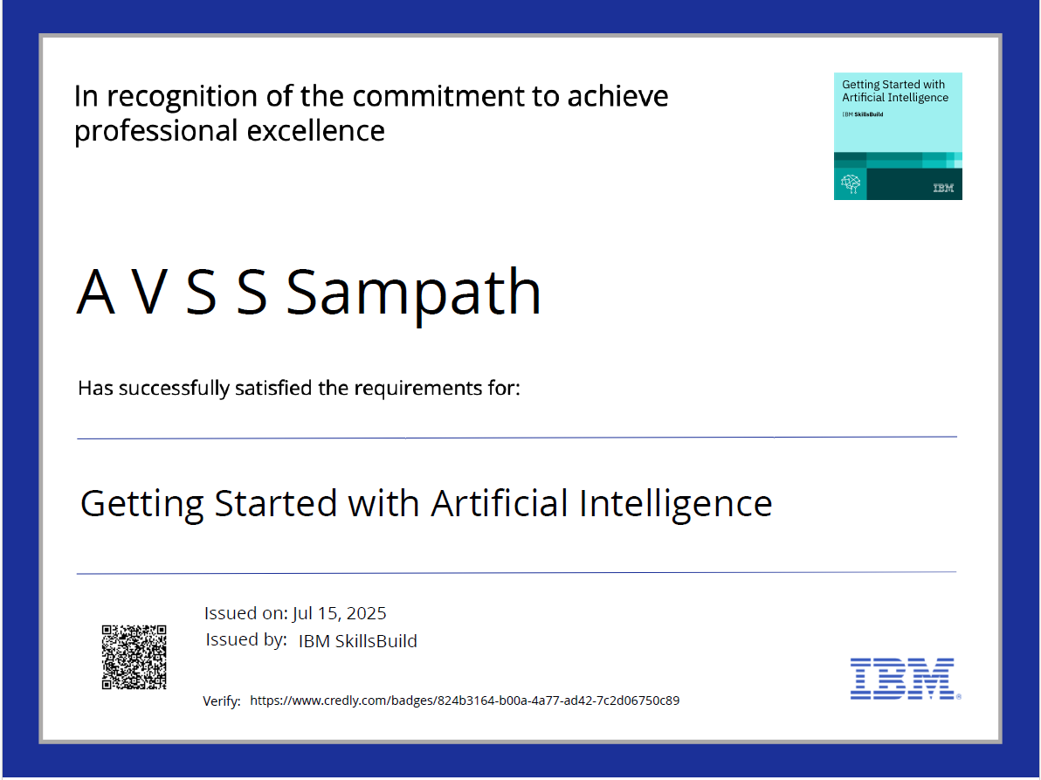
IBM Certifications

Slide 20
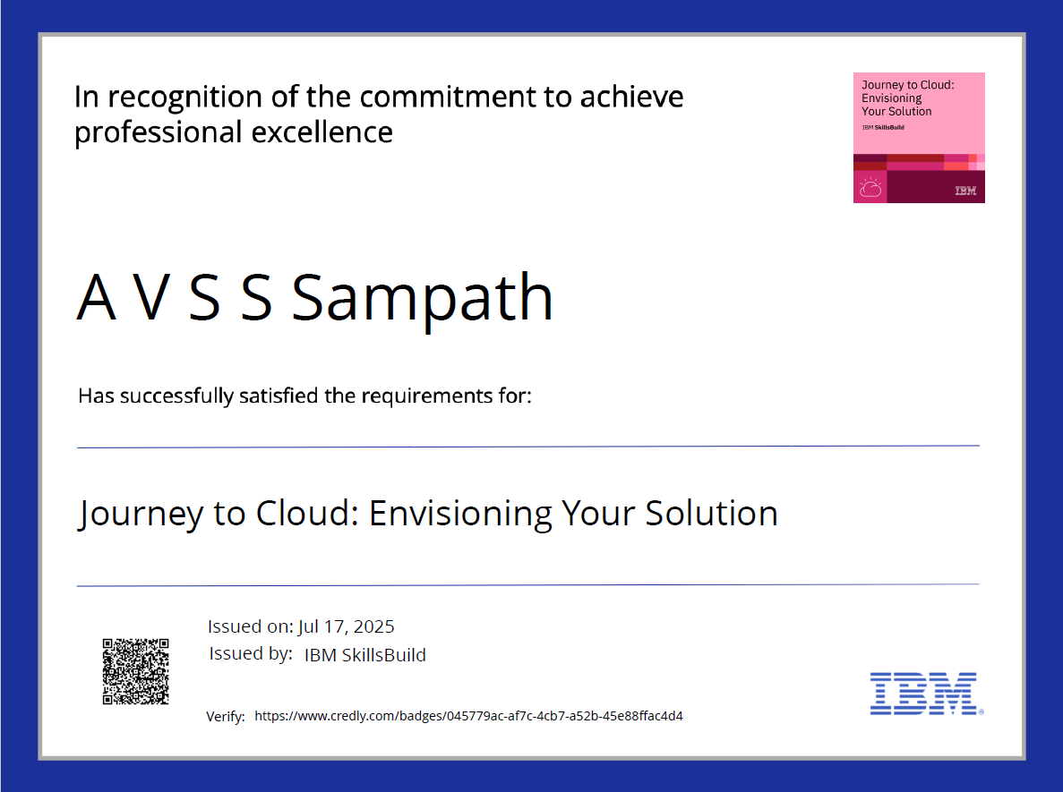
IBM Certifications

Slide 21
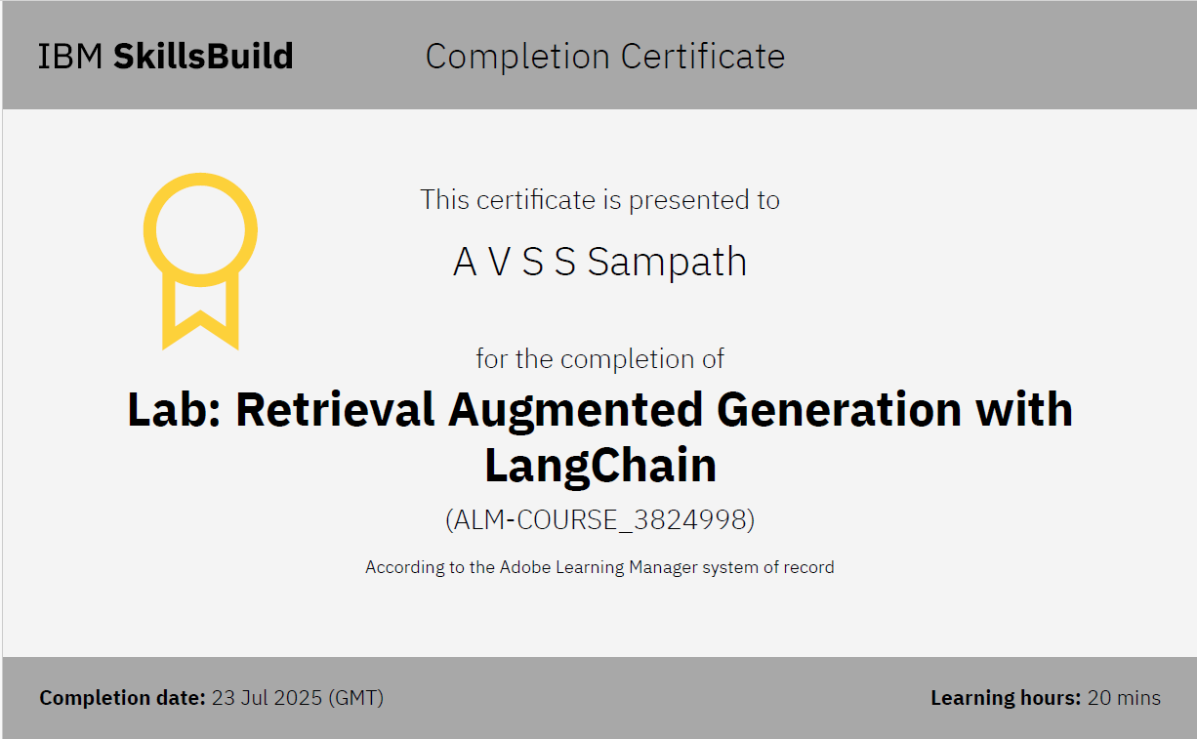
IBM Certifications

Slide 22
THANK YOU

