Slide 1
AgentDiag v2
Probabilistic root-cause attribution for multi-agent LLM traces
Fresh implementation and held-out evaluation
Who&When benchmark
Results generated from agentdiag_v2 artifacts

Slide 2
Problem and intended outputs
Given a failed execution trace, identify the most likely responsible agent.
Return a probability for every candidate agent; all probabilities sum to 1.
Handle missing agent logs by marginalizing their evidence.
Track reliability through turns and test whether warnings arrive before the first faulty message.
Post-mortem diagnosis and early warning are evaluated separately

Slide 3
Data and evaluation protocol
184 traces parsed; question IDs kept together across partitions.
Primary four-agent experiment: train 65, validation 13, test 13.
Training fits probabilities; validation selects features, calibration, and warning threshold.
The original BN was frozen before its test evaluation; later exploratory models inspected this test set.
The source benchmark contains failed traces only

Slide 4
System architecture
Trace JSON → validated agents and message order → evidence flags
Evidence → categorical culprit Bayesian network → custom Variable Elimination
Posterior → validation-fitted temperature scaling → root-cause distribution
Turn evidence → HMM filtering → early-warning evaluation
The network uses data-driven CPTs with smoothing

Slide 5
Inference and missing logs
A single categorical variable represents the culprit, so exactly one root cause is modeled.
Each agent contributes observable error, uncertainty, and correction signals.
Custom Variable Elimination marginalizes missing evidence.
Small-network results are cross-checked against full joint enumeration.
A missing log is never treated as a clean log

Slide 6
Held-out attribution and calibration
Bayesian network: 5/13 correct (38.5%); Brier 0.689; ECE 0.146.
Position-prior baseline: 4/13 correct (30.8%); Brier 0.741; ECE 0.144.
Accuracy bootstrap interval: 15.4%–61.5%.
Small test set: competitive accuracy and superior calibration are not established.
No direct AgenTracer claim without a matched protocol

Slide 7
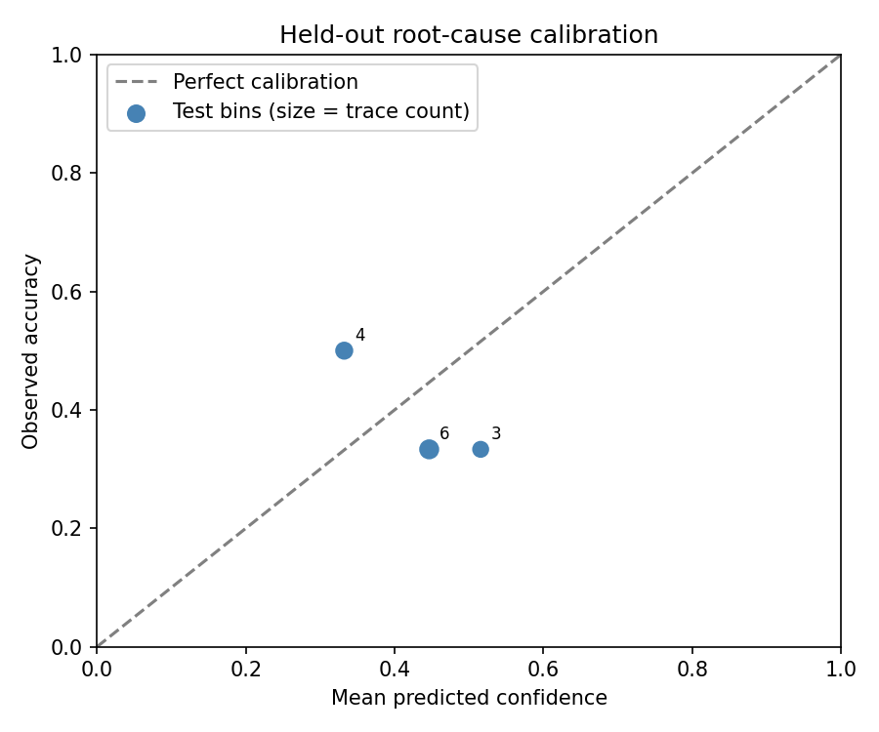
Reliability diagram
Held-out test set; point size indicates number of traces per bin

Slide 8
Missing evidence and temporal monitoring
Complete logs: 38.5% attribution accuracy.
One random missing agent: 46.2%; two missing agents: 30.8%.
HMM correct early warnings: 2/10 eligible traces.
HMM wrong-agent warning traces: 11/12.
Keyword baseline: 1/10 early; 6/12 wrong-agent warnings.
Missing-log results use the same validation-fitted calibration

Slide 9
New evidence-backed review output
The true agent is in the BN's top-two shortlist for 10/13 four-agent test traces (76.9%).
Each packet shows ranked probabilities and excerpts with source-message indices.
Leave-one-agent-evidence-out sensitivity shows how the saved model reacts to that agent's evidence.
This supports human review; top-choice accuracy remains 5/13, and the ablation is not a causal intervention.
Phase 9: agentdiag_v2/artifacts/phase9_evidence_triage/

Slide 10
What is complete, and what remains unproven
Implemented: parsing, data-driven BN, hand-written VE, valid probabilities, missing-log inference, calibration evaluation, evidence review packets, HMM, and reproducible phase outputs.
Unproven: high top-choice accuracy, reliable early warning, publication-level novelty, and competitive results versus AgenTracer.
Multimodal performance is not claimed: no separate modality-specific test was run.
Use the measured results in this deck; improve evidence or add suitable labeled data before stronger claims.
Full evidence: agentdiag_v2/artifacts/phase8_final_report/Final_Report.md

