Slide 1


Title
AgentDiag
Calibrated Probabilistic Root-Cause Attribution for Multi-Agent LLM
By
G Shiva (CH.SC.U4AIE24020)
Pabbathi Nikhil (CH.SC.U4AIE24049)
Sri Nivya Saladi (CH.SC.U4AIE24064)
E Nishnath (CH.SC.U4AIE24088)
Notes:
1

Slide 2
Introduction
Modern LLM systems increasingly use multiple specialized agents such as planners, retrievers, coders, and reviewers working together.
When the final pipeline fails, the observed error does not directly reveal which agent introduced the original failure.
An early mistake may propagate through later agents, while a later agent may fail to detect or correct an existing error.
This project frames multi-agent failure diagnosis as a probabilistic root-cause attribution problem rather than a single-label classification problem.
Key idea:
Instead of saying “Agent 2 is responsible,” AgentDiag estimates a probability distribution over possible root causes.
Notes:
1

Slide 3
Problem Statement
Multi-agent LLM pipelines contain dependent stages, making failures difficult to localize.
Existing LLM-based diagnosis approaches often produce a single root-cause prediction rather than calibrated probabilities.
A diagnosis can be correct while its confidence is misleading—for example, predicting 90% confidence but being correct only 60% of the time.
Agent logs or intermediate outputs may sometimes be missing or incomplete, making deterministic diagnosis unreliable.
Agent reliability can also change over time, causing degradation that may only become visible after the final failure.
Consequence:
A system needs to identify who most likely caused the failure, how uncertain that attribution is, and whether its confidence is trustworthy.
Notes:
1

Slide 4
Literature Review
Paper | Year | Authors | Key Findings | Limitation / Gap
Which Agent Causes Task Failures and When? (Who&When) | 2025 | Zhang et al. | Introduced automated failure attribution and the Who&When benchmark; best method achieved 53.5% agent-level and 14.2% step-level accuracy. | Primarily uses LLM-based attribution; produces a discrete attribution rather than calibrated probability.
Automatic Failure Attribution and Critical Step Prediction Based on Causal Inference | 2025/26 | Guoqing Ma et al. | Uses causal inference, Shapley values and causal discovery; achieved up to 36.2% step-level accuracy. | Focuses on causal attribution and optimization rather than probabilistic confidence/calibration.
StepFinder: A Temporal Semantic Framework for Failure Attribution | 2026 | Taiyu Zhu et al. | Models temporal and cross-step dependencies; improves step-level attribution and reduces inference time by 79%. | Designed primarily for identifying the failure step; does not provide Bayesian root-cause probabilities or calibration.
Agentic Confidence Calibration | 2026 | Jiaxin Zhang, Caiming Xiong, Chien-Sheng Wu | Introduces Holistic Trajectory Calibration for confidence estimation across agent trajectories; improves calibration and generalization. | Focuses on confidence calibration, not identifying which agent caused a system failure.
Uncertainty Quantification in LLM Agents | 2026 | Changdae Oh et al. | Establishes foundations for uncertainty quantification in interactive LLM agents and identifies challenges in uncertainty dynamics and heterogeneous entities. | Highlights the need for agent-level UQ but does not provide a specific probabilistic root-cause attribution system.
Notes:
1

Slide 5
Objectives & Proposed Solution
Model dependencies between agent failures using a Bayesian Network.
Compute root-cause probabilities using hand-implemented Variable Elimination.
Learn model parameters from real multi-agent execution data instead of manually assigning probabilities.
Handle missing observations/logs through probabilistic inference.
Produce a calibrated probability distribution over candidate root causes.
Track changing agent reliability across multiple turns using an HMM.
AgentDiag combines:
Bayesian Network → Variable Elimination → Data-driven Parameter Learning → Calibration → HMM
Notes:
1

Slide 6
Methodology / Algorithms & Techniques
Bayesian Network:
Models dependencies among agent failures.
Variable Elimination: Computes P(Agenti failed∣Pipeline Failure) without relying on a BN library.
Parameter Learning: CPT values are estimated from actual pipeline runs.
Calibration:
Checks whether predicted probabilities correspond to actual frequencies.
HMM:
Tracks hidden agent reliability states over multiple turns.
Notes:
1

Slide 7
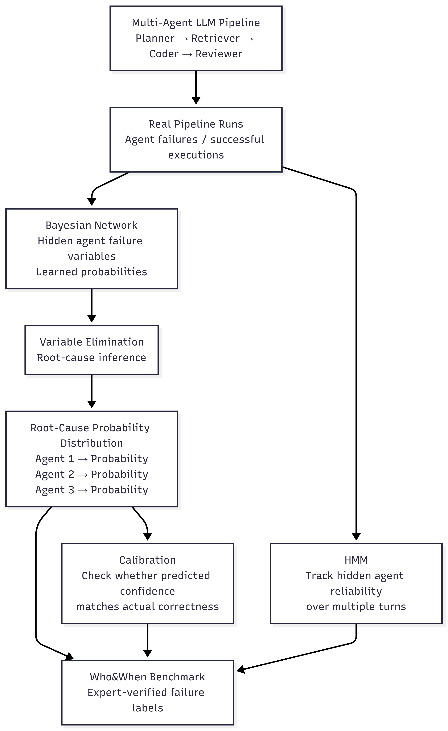
System Architecture
Notes:
1

Slide 8
Expected Outcomes
Probability distribution over possible root-cause agents instead of a single guess.
Data-driven probabilistic model learned from actual executions.
Ability to reason with missing agent observations.
Quantitative calibration of diagnosis confidence.
Early identification of agent reliability degradation using HMM.
Evaluation against the Who&When benchmark and comparison with existing approaches.
Future work: full implementation, quantitative evaluation and benchmark analysis.
Notes:
1

