Slide 1
Hackathon Spring 2015
Submitted by,
Haricharana Kanamarlapudi(24)
Sandhya Sannapareddy(45)
SAMPATH MADINENI
RaghavENDRA CHIRUMALLA

Slide 2
Use case - YouTube v3 Ranking System Based On Object Search
Once logged in, users should be presented with a keyword search page, where the user enters a keyword and the app retrieves a list of relevant videos along with some metadata tied to the videos (avg. views per day, category, total views, author etc.). The result list should contain thumbnails and all the metadata and should be sortable.

Slide 3
tools
Visual Studio 2013
HTML Language
Ajax

Slide 4
Implementation
Created a login page
Created data base
User and password authenication
By Visual studio
By ajax Programming

Slide 5
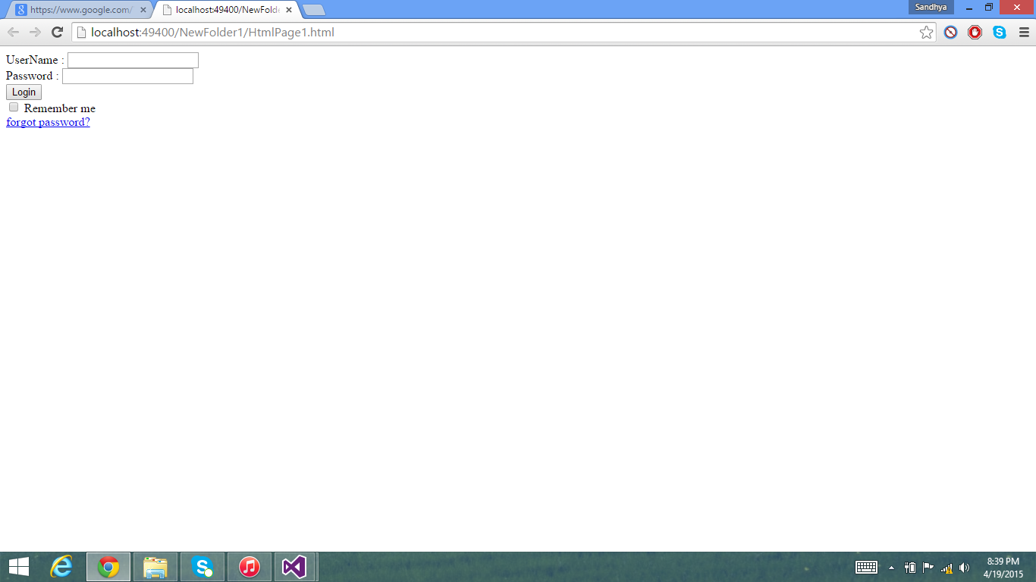
SCREENSHOTS

Slide 6
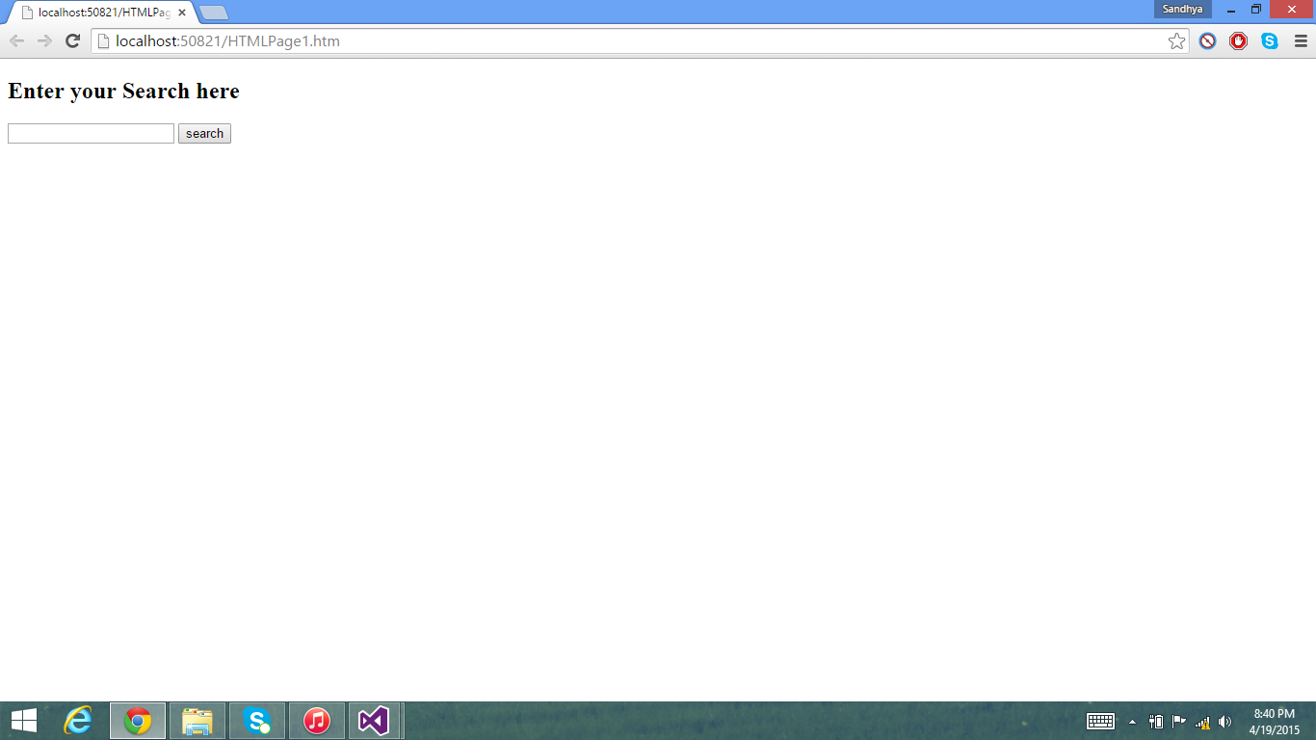
SCREENSHOTS

