Slide 1
Customer Segmentation Using K-Means

Slide 2
Customer segmentation:
Customer segmentation is the process of dividing customers into groups based on common characteristics so companies can market to each group effectively and appropriately.
Segmentation allows marketers to better tailor their marketing efforts to various audience subsets.
Those efforts can relate to both communications and product development. Specifically, segmentation helps a company:

Slide 3
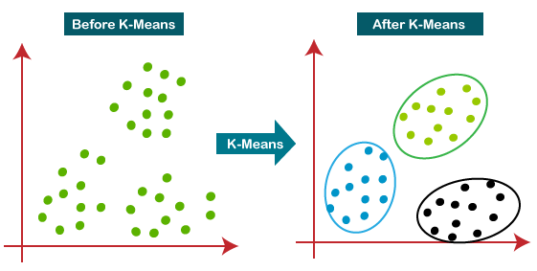
K-means Clustering:
K-Means Clustering is an unsupervised learning algorithm.
It allows us to cluster the data into different groups.
It is a centroid-based algorithm, where each cluster is associated with a centroid.

Slide 4
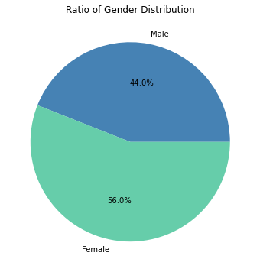
Gender Distribution:

Slide 5
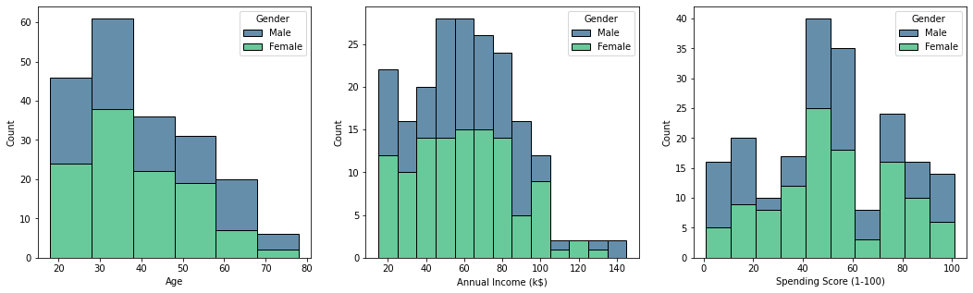
Gender distribution in Age annual income and Spending Score

Slide 6
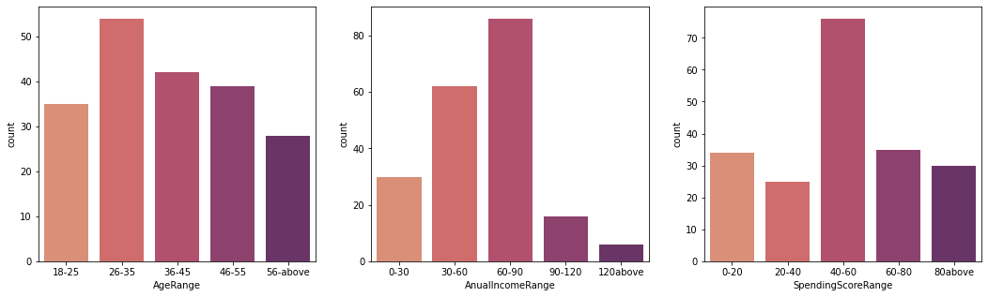
EDA:

Slide 7
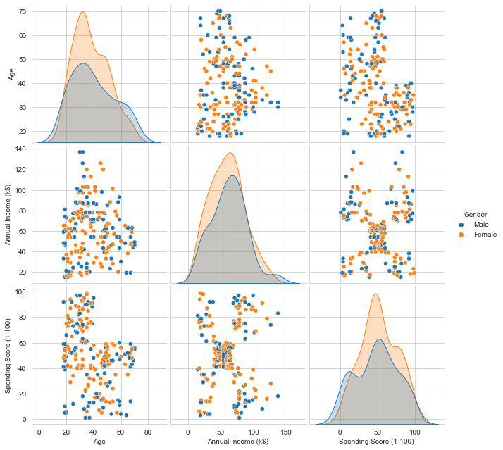
Pair Plot

Slide 8
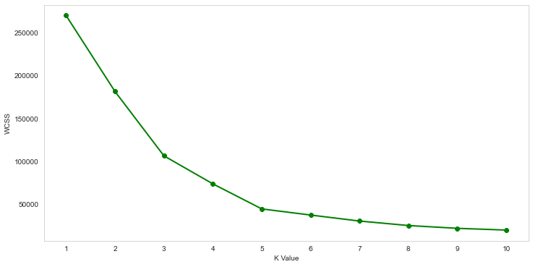
Elbow method :

Slide 9
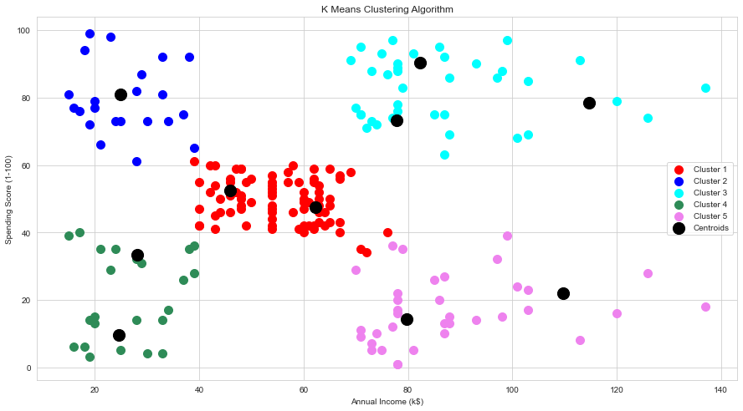
K-Means clustering :

Slide 10
Clusters:
CLUSTER 1 - Medium Income(40-70 k) and Medium Spending Score(40-60)
CLUSTER 2 - Low Income(20-40 k) and High Spending Score(60-100)
CLUSTER 3 - High Income(70-140 k) and High Spending Score(60-100)
CLUSTER 4 - Low Income(20-40 k) and Low Spending Score(0-40)
CLUSTER 5 - High Income(70-140 k) and Low Spending Score(0-40)

