Slide 1
Service Organization Controls
Managing Risks by Obtaining a Service Auditor’s Report
Name of the Presenter: Karthikeyan K
Date: 26/03/2014

Slide 2

Agenda
Introduction on SOC Reports
SOC 1 Report
SOC 2 Report
SOC 3 Report
Choosing a SOC Report

Slide 3

Introduction
Outsourcing -
Today, it is common for entities to outsource to a service organization certain tasks or functions related to their business, even those that are core to their operations.
User Entities Risk-
When users of a service organization’s services (user entities) outsource tasks and functions, many of the risks of the service organization become risks of the user entities.
In light of several prominent internal-control breakdowns (e.g., security and privacy breaches, and frauds) and increasing regulatory focus on internal control (e.g., Sarbanes-Oxley Act, Basel II, HITECH and HIPAA), user-entity management is increasing its due diligence for prospective service organizations and governance oversight of current service organizations

Slide 4
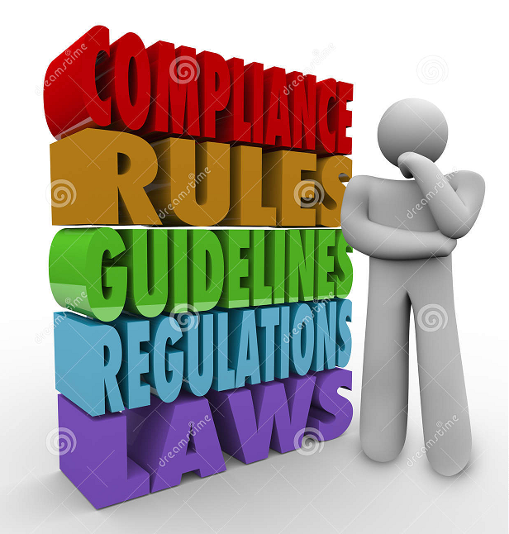
Introduction
Need for controls in Service Organization -
Technological, regulatory and other changes have heightened the need for information and assurance that enable management to demonstrate it has addressed stakeholder concerns related to the security, availability and processing integrity of the systems a service organization uses to process user entities’ data, and the confidentiality and privacy of the information these systems process.
By engaging an independent CPA to examine and report on a service organization’s controls, service organizations can respond to meet the needs of their user entities and obtain an objective evaluation of the effectiveness of controls that address operations and compliance, as well as financial reporting at those user entities.
To provide the framework for CPAs to examine controls and to help management understand the related risks, the AICPA has established three Service Organization Control (SOC) reporting options (SOC 1, SOC 2 and SOC 3 reports).

Slide 5

SOC 1 Report
What is it?
Services
Inherent risks
SOC report
User Entity
Service Organization
Reports on Controls at a Service Organization Relevant to User Entities’ Internal Control Over Financial Reporting: SOC 1 engagements are performed under SSAE 16, Reporting on Controls at a Service Organization.
SOC 1 reports are examination engagements undertaken by a service auditor to report on controls at an organization that provides services to user entities when those controls are likely to be relevant to user entities’ internal control over financial reporting.

Slide 6
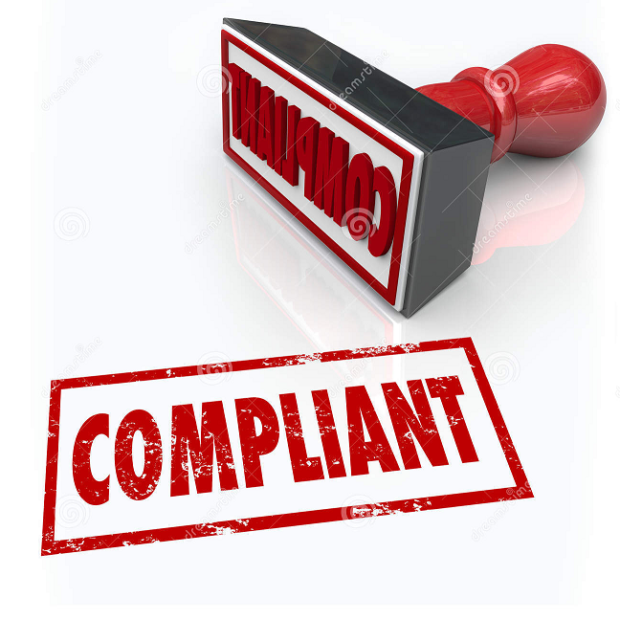
SOC 1 Report
Types of SOC 1 reports -
There are two types of SOC 1 reports:
• Type 1 — A report on management’s description of the service organization’s system and the suitability of the design of the controls to achieve the related control objectives included in the description as of a specified date.
• Type 2 — A report on management’s description of the service organization’s system and the suitability of the design and operating effectiveness of the controls to achieve the related control objectives included in the description throughout a specified period.
Use of a SOC 1 report is restricted to existing user entities (not potential customers).

Slide 7
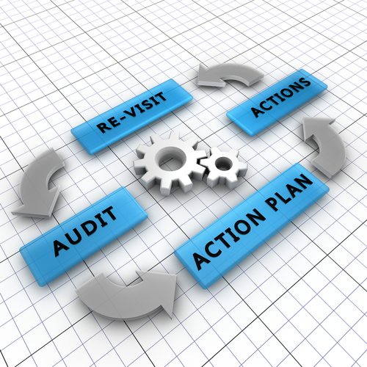
SOC 2 Report
What is it?
Reports on Controls at a Service Organization Relevant to Security, Availability, Processing Integrity, Confidentiality and Privacy: Many entities outsource tasks or entire functions to service organizations that operate, collect, process, transmit, store, organize, maintain and dispose of information for user entities. SOC 2 engagements use the predefined criteria in Trust Services Principles, Criteria and Illustrations, as well as the requirements and guidance in AT Section 101, Attest Engagements (AICPA, Professional Standards, Vol. 1).
A SOC 2 report is similar to a SOC 1 report. Either a type 1 or type 2 report may be issued and the report provides a description of the service organization’s system. For a type 2 report, it also includes a description of the tests performed by the service auditor and the results of those tests.

Slide 8

SOC 2 Report
SOC 2 reports specifically address one or more of the following five key system attributes:
• Security — The system is protected against unauthorized access (both physical and logical).
• Availability — The system is available for operation and use as committed or agreed.
• Processing integrity — System processing is complete, accurate, timely and authorized.
• Confidentiality — Information designated as confidential is protected as committed or agreed.
• Privacy — Personal information is collected, used, retained, disclosed and disposed of in conformity with the commitments in the entity’s privacy notice, and with criteria set forth in Generally Accepted Privacy Principles (GAPP) issued by the AICPA and Canadian Institute of Chartered Accountants.

Slide 9
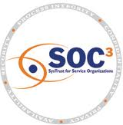
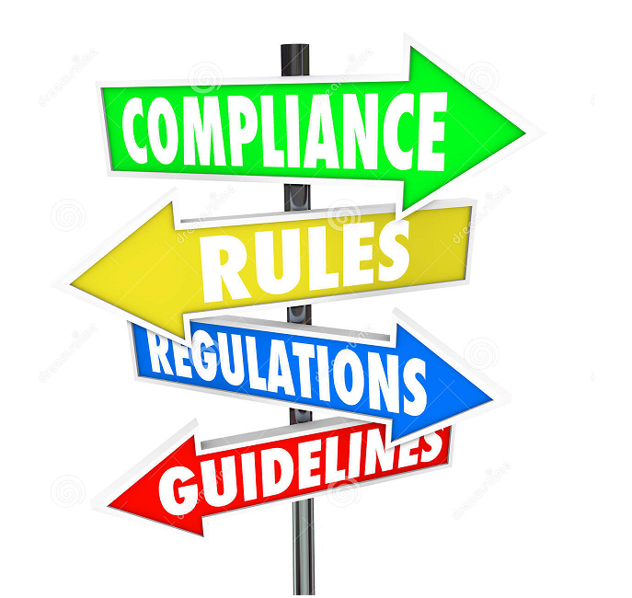
SOC 3 Report
What is it?
Trust Services Report for Service Organization: SOC 3 engagements use the predefined criteria in Trust Services Principles, Criteria and Illustrations that also are used in SOC 2 engagements.
The key difference between a SOC 2 report and a SOC 3 report is that a SOC 2 report, which is generally a restricted-use report, contains a detailed description of the service auditor’s tests of controls and results of those tests as well as the service auditor’s opinion on the description of the service organization’s system.
A SOC 3 report is a general-use report that provides only the auditor’s report on whether the system achieved the trust services criteria (no description of tests and results or opinion on the description of the system). It also permits the service organization to use the SOC 3 seal on its website.
SOC 3 reports can be issued on one or multiple Trust Services principles (security, availability, processing integrity, confidentiality and privacy).

Slide 10
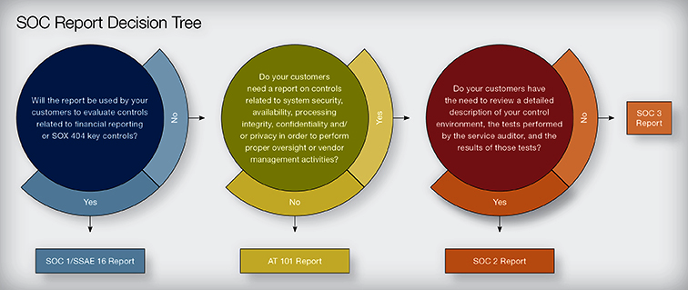
Choosing a SOC Report

Slide 11

Questions?

Slide 12


