Slide 1

Predix Core 14.1
IGATE Corporate University

Slide 2
Goals and Objectives
Best Practices
After completing this course, you will be able to:
Develop, deploy and test services in Predix Core Kernel easy
OSGi best practices
Make development life more enjoyable

Slide 3
Agenda
Best Practices
What’s Predix Core?
Why do I need Predix Core?
How can I use Predix Core in my applications?
How should I use Predix Core? (Hands-On)
How should I use Predix Core? (Best Practices)
Some quick tips for troubleshooting
Use case challenge (Tomorrow)
What’s new in upcoming release

Slide 4
What is Predix Core ?

Slide 5
What’s Predix Core?
Best Practices
A common platform used to build industrial software solutions across various business domains in GE
Built on OSGi R4 specification and Karaf container
Supports different deployment models:
On-premise deployment
GE-managed customer deployment
Cloud-based deployment
Service oriented architecture
Added on common application services

Slide 6
Predix Core (Kernel, Visualization) Overview
Visualization
Kernel
Administration
Console
REST/HTTP
User Defined Services
Play Run time Core
Application Services
Web Based UI
Entitlement
Auditing
Administration Services
REST/HTTP
Cache
Event
Administration
REST/HTTP
Web Application Framework
Notification
Exception
Deployment
Workbench
User Management
Scheduling
Configuration
Data Access
(Spring Data)
Logging
Runtime Repository
Core Services
Service Lifecycle Management
Service Configuration
Security (Identity & Authentication)
Spring/OSGI Container

Slide 7
Introduction to OSGi

Slide 8
What’s the point?
Modularity

Slide 9
Modularity
In the old days…
Java Application
Database stuff
UI Code
Business logic
An abstraction layer
Logging
More Business Logic
Logging
Complicated algorithms

Slide 10
Modularity
In the old days…
Java Application
Database stuff
UI Code
Business logic
An abstraction layer
Logging
More Business Logic
Logging
Complicated algorithms

Slide 11
Modularity
In the old days…
Java Application
Database stuff
UI Code
Business logic
An abstraction layer
Logging
More Business Logic
Logging
Complicated algorithms

Slide 12
Modularity
With OSGi
Java Application
Database
Business Logic
Complicated Algorithm
UI Code
Interfaces
Database stuff
UI Code
Business logic
An abstraction layer
Logging
Logging
Other stuff
Java Application
More Business Logic
Scheduling
Web Services
Logging
Complicated algorithms

Slide 13
What is OSGi?
OSGi Runtime
OSGi

Slide 14
What is OSGi?
Bundle
Bundle
Bundle
Bundle
OSGi
Notes:
Animation slide

Slide 15
Anatomy of a Bundle
Bundle
OSGi
Notes:
Animation slide

Slide 16
Anatomy of a Bundle
Plain old jar with metadata
MANIFEST.MF
Bundle Symbolic Name
Version Number
Imports
Exports
OSGi
Notes:
Animation slide

Slide 17
Anatomy of a Bundle
Plain old jar with metadata
MANIFEST.MF
Bundle Symbolic Name
Version Number
Imports
Exports
OSGi
Notes:
Animation slide

Slide 18
Bundle Interaction
JVM
Bundle1
Bundle2
Import com.ge.bundle2.*;
Notes:
Animation slide

Slide 19
Bundle Interaction
JVM
Bundle1
Bundle2
Notes:
Animation slide

Slide 20
Bundle Interaction
JVM
Bundle1
Bundle2
Classloader 1
Classloader 2
Notes:
Animation slide

Slide 21
Bundle Interaction
Map:
com.ge.bundle2.bar => Classloader 2
JVM
MANIFEST.MF
<Imports>
com.ge.bundle2.bar
</Imports>
MANIFEST.MF
<Exports>
com.ge.bundle2.foo
com.ge.bundle2.bar
</Exports>
Classloader 1
Classloader 2
Notes:
Animation slide

Slide 22
Bundle Interaction
JVM
Installed
Resolved
Starting
Active
Stopping
Uninstalled
MANIFEST.MF
<Imports>
com.ge.bundle2.bar
</Imports>
MANIFEST.MF
<Exports>
com.ge.bundle2.foo
com.ge.bundle2.bar
</Exports>
Classloader 1
Classloader 2
Notes:
Animation slide

Slide 23
Bundle Interaction
JVM
MANIFEST.MF
<Imports>
com.ge.bundle2.bar
com.ge.bundle2.sam
</Imports>
MANIFEST.MF
<Exports>
com.ge.bundle2.foo
com.ge.bundle2.bar
</Exports>
Installed
Resolved
Starting
Active
Stopping
Uninstalled
Installed
Resolved
Starting
Active
Stopping
Uninstalled
Notes:
Animation slide

Slide 24
Service Registry
Bundle1
Bundle2
OSGi

Slide 25
Service Registry
Imports foo
Exports foo
Bundle1
Bundle2
OSGi

Slide 26
Service Registry
Imports foo
Exports foo
Bundle1
Bundle2
get service implementing foo
register bar implements foo
Service Registry
OSGi

Slide 27
Service Registry
Import/Export != Service Registry
What’s the difference???

Slide 28
Services in Practice
Imports API 1.0.0
Exports API 1.0.0 Interfaces
Consumer1
Implements API 1.0.0
API 1.0.0
Impl 1.0.0
Service Registry
OSGi

Slide 29
Services in Practice
Imports API 1.0.0
Exports API 1.0.0 Interfaces
Consumer1
Implements API 1.0.0
API 1.0.0
Impl 1.0.0
find by interface
register by interface
Service Registry
OSGi

Slide 30
Services in Practice
Imports API 1.0.0
Exports API 1.0.0 Interfaces
Consumer1
Implements API 1.0.0
API 1.0.0
Impl 1.0.0
find by interface
Also Implements API 1.0.0
Impl 1.1.0
Service Registry
OSGi

Slide 31
Services in Practice
Imports API 1.0.0
Exports API 1.0.0.0 Interfaces
Consumer1
Implements API 1.0.0
API 1.0.0
Impl 1.0.0
Also Imports API 1.0.0
Consumer2
Also Implements API 1.0.0
Impl 1.1.0
Service Registry
OSGi

Slide 32
Services in Practice
Exports API 1.0.0 Interfaces
Uninstalled
Imports API 1.0.0
Consumer1
Implements API 1.0.0
API 1.0.0
Impl 1.0.0
Also Imports API 1.0.0
Consumer2
Also Implements API 1.0.0
Impl 1.1.0
Service Registry
OSGi

Slide 33
Imports vs Service Registry
Imports/Exports
Defining the classpath
Service Registry
Sharing instances of objects

Slide 34
Why do I need Predix Core?

Slide 35
Why do I need Predix Core?
Best Practices
Provides common services
Security
Logging
Abstracted Data access
Managed transaction
Soap/RESTFul services…
Why not Java EE container, like Jboss, what’s the benefit?
Java has a flat classpath, only one version of the class is supported
Applications can be forced to use a point release.

Slide 36
Why do I need Predix Core?
Best Practices
Benefit of Predix Core
OSGi has a graph classpath - multiple versions of the class can be used.
Modularity – Bundles
Component model – Spring Blueprint
Reuse – Bundle and Service registry
Dynamic Updates – lifecycle support
Align with company’s vision and technology direction
Common architecture stack
Common user experience
Common look and feel, it is built by GE

Slide 37
Why do I need Predix Core?
Best Practices
It can be used for many reasons, but primary motivation is modularity and service oriented
Big systems are hard to maintain and understand because of the relationship between components
Big applications are just as complicated as servers
Division of labor
Services can be consumed by any application, any platforms

Slide 38
How can I use Predix Core in my applications?

Slide 39
How can I use Predix Core in my applications?
Best Practices
Build your business logic as services
Use Predix Core services via OSGi service interface
Expose your business logic as RESTFul, SOAP or Java services
Deploy your services to the Predix Core Kernel
Build your UI tier using Visualization
Use the Predix Workbench to design out UI
Application invokes Predix Core services via RESTful JSON service interface

Slide 40
How can I use Predix Core in my applications?
Best Practices
Invoke Predix Core services using 3rd party UI frameworks
Application can be run outside of the Kernel
Application invokes Predix Core services via SOAP/REST service interface
Independent of Client Consumption frameworks

Slide 41
How should I use Predix Core in my applications?
Hands-On Lesson 1

Slide 42
Hello Predix
Best Practices
Use the Spring Tool Suite
Build a Predix Core service project
Based on Archetype
Based on OSGi best practices
Use dependency injection framework
Deploy, run and test service from the browser

Slide 43
How should I use Predix Core in my applications?
Best Practices, Lesson 1 recap

Slide 44
Best practices
Best Practices
Use Spring Tool Suite as IDE
Eclipse + Maven + Spring framework plugins
The Bundle Hygiene
Well designed object oriented code exhibits good modular properties
These properties rely on classes being cohesive and loosely couple
Bundles should be cohesive and loosely-coupled
Separate interfaces and implementation

Slide 45
Best practices
Best Practices
Avoid Tight Coupling
Use Import-Package
Avoid Require-Bundle
Import needed packages only

Slide 46
Best practices
Best Practices
Don’t do too much in your bundle
Keep APIs simple, it’s hard to use an API with too many methods and arguments
It adds overhead and hurts performance
It is hard to maintain
Huge number of dependencies (Import-Package or Require-Bundles) suffers
Don’t export unless necessary
If a manifest can be measured in megabytes, something is wrong

Slide 47
Best practices
Best Practices
Do enough to be cohesive
OSGi classloader allows packages to come from exactly one bundle
com.ge.gia.xx.api.A
com.ge.gia.xx.Impl
com.ge.gia.xx.api.B

Slide 48
Best practices
Best Practices
Bootstrap classloader
(includes Java standard libraries from jre/lib/rt.jar etc)
Extension classloader
(jvm extension classes)
System classloader
(stuff on $CLASSPATH, including OSGi core code)
Common OSGi classloader
OSGi classloader for bundle 1
OSGi classloader for bundle 2
OSGi classloader for bundle 3
(Map of imported package
--> classloader)
(Map of imported package
--> classloader)
(Map of imported package
--> classloader)

Slide 49
Best practices
Best Practices
Properly version everything
Package Exports can be versioned
Imports can declare a range of accepted versions
Semantic versioning allows clients to declare what functions they required
Major version changes indicate that clients might be broken
Minor version changes indicate backward compatible updates
Micro version changes are for bug fixes

Slide 50
Best practice
Best Practices
Properly version everything
Unversioned packages are like a box of chocolates
If packages are versioned properly, callers can make a choice
com.ge.gia.api
my.api.A
1.0.0
com.ge.gia.xx.Impl
Import-Packages:
my.api;version=“[1,2)”
com.ge.gia.api
my.api.B
2.0.0

Slide 51
How should I use Predix Core in my applications?
Hands-On Lesson 2

Slide 52
Data Service
Best Practices
Use the Spring Tool Suite
Build a Predix Core service project
Based on Spring Data JPA or Spring JDBC Archetype
Based on OSGi best practices
Use dependency injection framework
Consume Configuration service
Deploy, run and test service from the browser

Slide 53
How should I use Predix Core in my applications?
Best Practices Lesson 2 recap

Slide 54
Best practices
Best Practices
Don’t do it all yourself !
Make sure you use Predix Core services
Scheduler Service – schedule job
Data Access Services – access backend database
Logger Service – log business data or debugging
Configuration Service – externalize configuration properties
Notification Service – handle events and notifications
Security Services – authentication, SSL, identify and user preference
Exception Service – centralize and localize application messages

Slide 55
Best practices
Best Practices
Don’t do it all yourself !
Use the dependency injection framework to access those services
Use Spring DM/blueprint component model
Use API only when needed

Slide 56
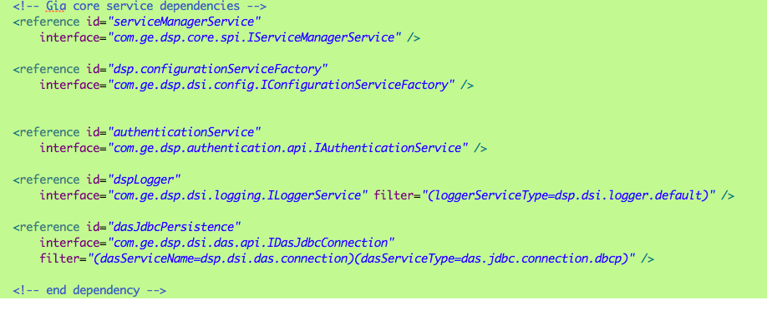
Best practices
Best Practices
Add the Predix Core services to the module-context.xml

Slide 57
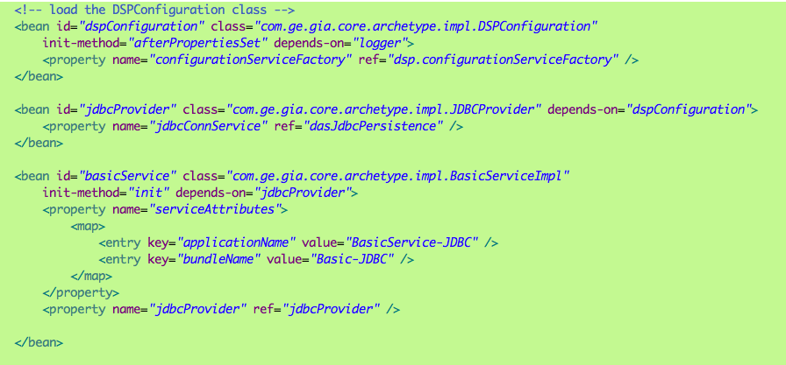
Best practices
Best Practices
Use injection framework to inject in the Predix Core services

Slide 58
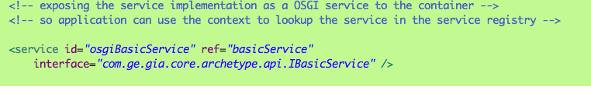
Best practices
Best Practices
Use the declaration to expose as OSGi service

Slide 59
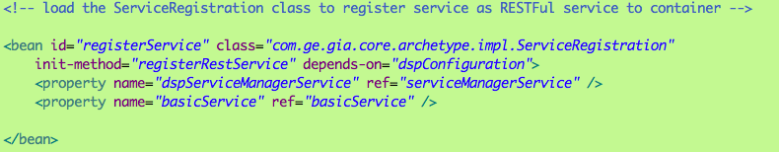
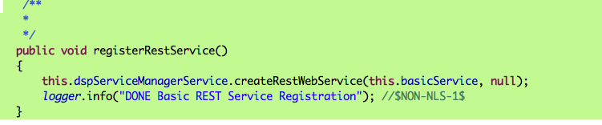
Best practices
Best Practices
Use API to register RESTFul or SOAP service

Slide 60
Best practices
Best Practices
Use JDBC and Spring Data JPA to access data
Use container managed EntityManager and annotation
Use container managed TransactionManager and annotation

Slide 61
Best practices
Best Practices
Don’t add your bundles to the dsp-features.xml
Do create your own features.xml
Don’t embed dependencies in your bundle
Do use Import-Package
Don’t Import-Package *
Don’t Export-Package *

Slide 62
Best practices
Best Practices
Import/Export/Embedded/Required
Export-Package to ensure other bundles can import
Import-Package:{package};{version};{optional}
Dynamic Import-Package: packages will be looked up at runtime
Example: Class.forName
Embedded Jarfiles: classes of jars will be part of the bundle
Required-Bundle: Import * exported by that bundle

Slide 63
Best practices
Best Practices
Don’t embed everything in your persistence.xml
Do use the <bundle>.conf file for configurable properties

Slide 64
How should I use Predix Core in my applications?
Best Practices, Lesson 3

Slide 65
ClassNotFound - Fix it
Best Practices
Use the Spring Tool Suite
Build a Predix Core service project
Compilation error
Fix it
Deploy, run and test service from the browser
Runtime error
Remote debugger
Fix it

Slide 66
How should I use Predix Core in my applications?
Best Practices, Lesson 3 recap

Slide 67
Quick troubleshooting tips
Best Practices
The ClassNotFound nightmare
Compile time dependencies does not resolve runtime dependencies
Avoid using “*” as Import-Package
Check your MANIFEST.MF file for Import-Package

Slide 68
Quick troubleshooting tips
Best Practices
Missing requirement error
[253.0] package; (&(package=javax.persistence)(version>=1.1.0)(!(version>=2.0.0)))
Use the following commands on the dsp console:
$admin@dsp>headers <bundle #> to check the dependencies
$admin@dsp>exports to check packages and versions available

Slide 69
Best practices
Best Practices
Don’t add your bundles to the dsp-features.xml
Do create your own features.xml
Don’t embed dependencies in your bundle
Do use Import-Package
Don’t Import-Package *
Don’t Export-Package *

Slide 70
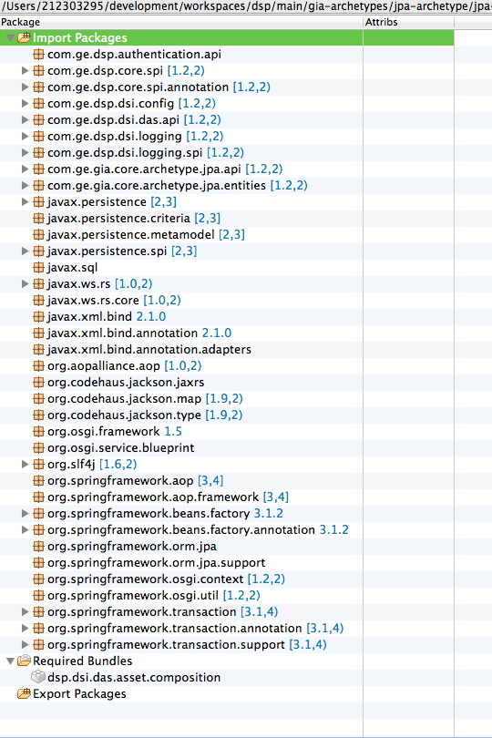
Quick troubleshooting tips
Best Practices
The Bndtools
bndtools.org
shows import
and export
analysis

Slide 71
Existing Archetypes
Best Practices
Archetype Group Id: com.ge.predix.core.archetype
Archetype Artifact Id: predix-basic-archetype, gia-jdbc-archetype, gia-jpa-archetype, predix-spring-data-jpa-archetype, predix-spring-jdbc-tempalte-archetype, predix-debug-archetype
Archetype Version: 14.1.0
Respository URL:
https://devcloud.swcoe.ge.com/artifactory/repo

Slide 72
Thank you

