Slide 1

Bank Customer Segementation using PowerBI
Presented by:
Pujari Sampath kumar

Slide 2
Agenda
Objectives
Dataset Description
Data Preparation and Data Cleaning
Dashboards
Key Insights

Slide 3
Objectives
To analyze customer demographics such as age, gender, and location to discover key customer groups.
To segment customers based on transaction behavior and demographics for better understanding.
To evaluate transaction behavior — volume, frequency, and amount over time.
To identify high-value, loyal, and at-risk customers using RFM (Recency, Frequency, Monetary) analysis.
To compare performance across customer segments based on revenue and activity.
To identify high-value customers contributing most to profitability.
To make data-driven decisions through clean, visual, and dynamic dashboards.
To give insights that help to improve customer retention and loyalty strategies.

Slide 4
Dataset Description
Rows – 10 lakhs
TransactionID – Unique ID assigned to each individual transaction.
CustomerID – Identifier linking each transaction to a specific customer.
CustomerDOB – Date of birth of the customer, useful for calculating age.
CustGender – Gender of the customer (e.g., Male, Female).
CustLocation – Geographic location or city of the customer.
CustAccountBalance – Account balance at the time of the transaction.
TransactionDate – The date when the transaction occurred.
TransactionTime – The exact time the transaction was executed.
TransactionAmount (INR) – The amount of money involved in the transaction in INR.

Slide 5
Data Preparation and Data Cleaning
Removed null values from CustomerDOB, CustGender, and CustomerLocation columns.
Filled null values in the CustAccountBalance column with ‘0’.
Converted data type (CustomerDOB from Text to Date,CustAccountBalance from Text to Decimal Number,TransactionDate from Text to Date,TransactionTime from Text to Time).
Added Columns :
Age: Calculated based on the customer’s date of birth to understand their current age.
Day of the Week: Extracted from the transaction date to identify which days have higher activity.
Hour of the Day: Extracted from the transaction time to analyze peak transaction hours.
Age Group: Categorized customers into groups (0-25,26-35,36-45,46-55,56-65,Above 65) for demographic analysis.
CustomerCategory: Classified customers as Lost, New , and Loyal based on their recent transaction behavior and engagement frequency.
RMF Score: A combined score based on Recency, Monetary, and Frequency metrics to evaluate customer value and loyalty.
RMF Category: Segmented customers according to RMF score thresholds : ≤ 259 → Low, ≤407 → Medium, > 407 → High.

Slide 6
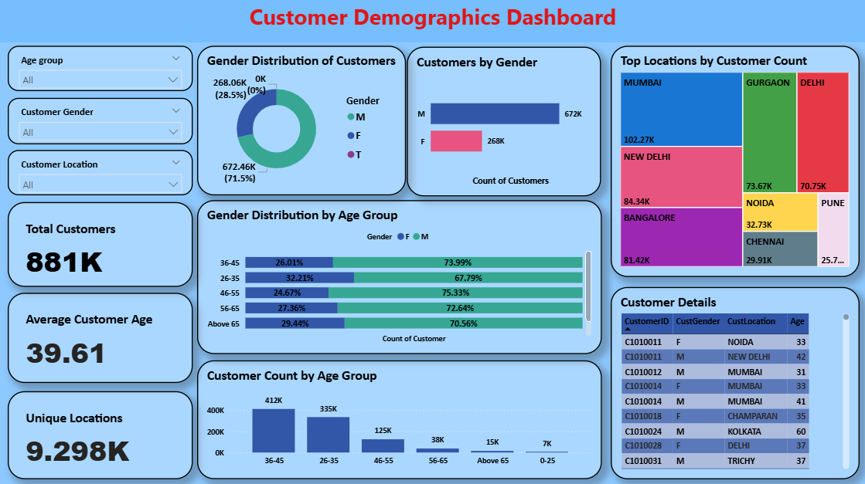

Slide 7
Customer Demographics Insights
Total Unique Customers are around 8,80,962.
Average age of customers is 39 years .
Total unique locations are 9298.
Male customers make up 71.5% of the total, while female customers account for 28.5%, indicating that males are the majority.
The 36–45 age group has the highest number of customers (around 4,11,610).Among males, the 46–55 age group has the most customers (around 95,042).Among females, the 26–35 age group has the most customers (around 1,10,585).
The top customer locations are Mumbai, followed by New Delhi, Bangalore, and Gurgaon. Based on the location data, most customers are from urban areas.

Slide 8
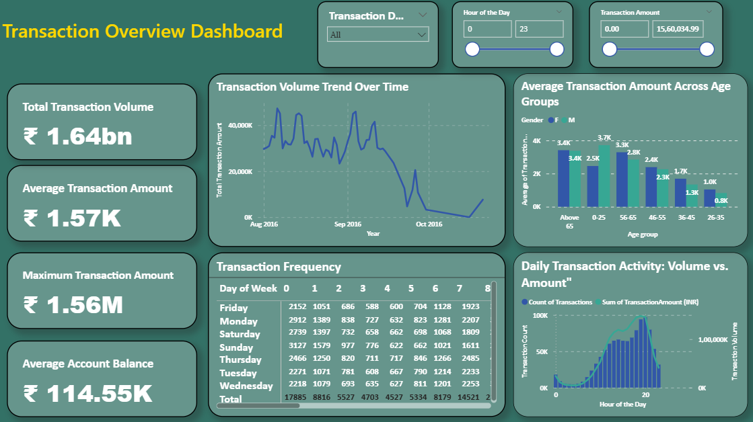

Slide 9
Transaction Behavior Insights
The total transaction volume is approximately 1.64 billion, with an average transaction amount of ₹1.57K.
The maximum transaction amount recorded is ₹1.56 million, while the average account balance is ₹114.55K.
The transaction volume decreased steadily from August 2016 to October 2016.
The highest transaction volume was on 3rd August (₹4,73,16,251), followed by 4th September (₹4,59,15,954).
There was a 97% increase in transaction volume from 29th August to 4th September, followed by a drastic 84% decrease from 14th to 23rd September.
By October, the transaction volume had dropped significantly.
Weekends in August and September had higher transaction volumes compared to weekdays.
The peak transaction time is around 7 PM on Sundays, and on other days, most transactions also occur between 7 PM and 8 PM.
Customers aged above 65 have the highest average transaction amount, while males aged 0–25 also record high average transaction amounts.

Slide 10
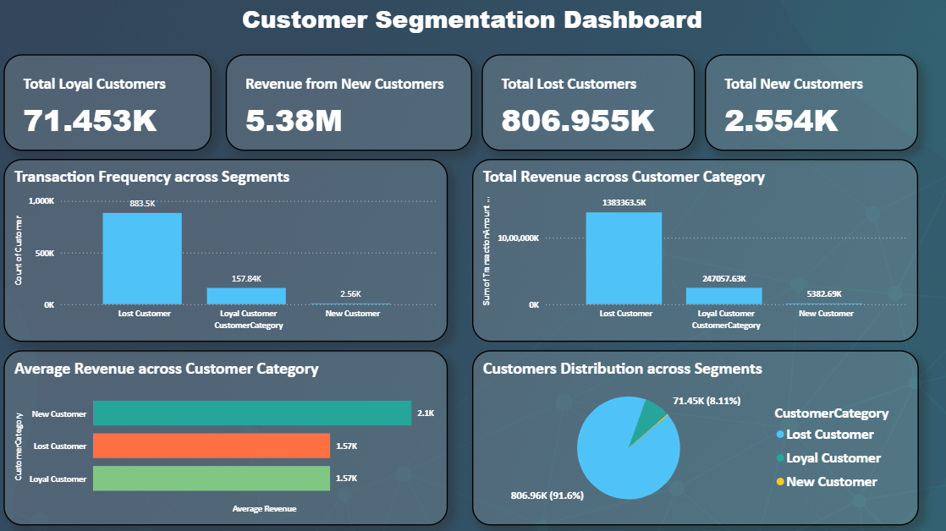

Slide 11
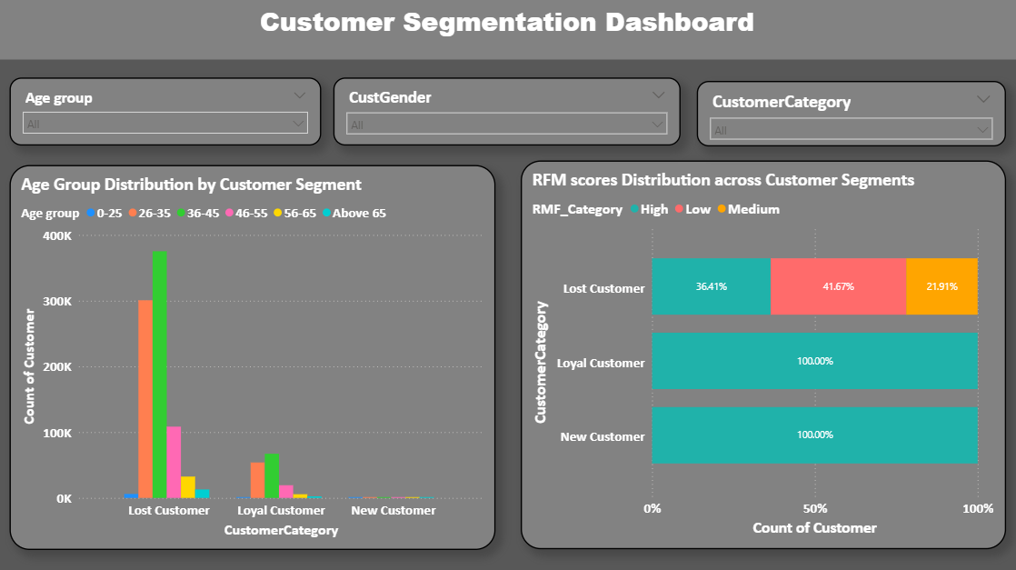

Slide 12
Customer Segmentation Insights
The dataset contains a total of 8,80,962 unique customers.
Customers are segmented into three categories: Lost Customers are 8,06,955 ,Loyal Customers are 71,453, New Customers are 2,554.
New Customers have the highest average revenue compared to Loyal and Lost Customers.
Lost Customers contribute the highest total revenue and have made more transactions, followed by Loyal Customers, and then New Customers.
Based on these insights, the bank should focus on re-engaging Lost Customers to increase overall profitability.
The 36–45 age group has the largest number of customers, followed by the 26–35 age group.
The bank should maintain its reputation among younger customers and understand the needs of other age groups to tailor services and improve engagement.
The number of customers below 25 years is comparatively low . To attract this segment, the bank can introduce joint accounts for customers under 18 years along with their parents or guardians. This may encourage education loan adoption, benefiting both the bank and customers.
In terms of RFM scores, Loyal and New Customers have higher scores compared to Lost Customers, indicating stronger engagement and recent activity.

Slide 13
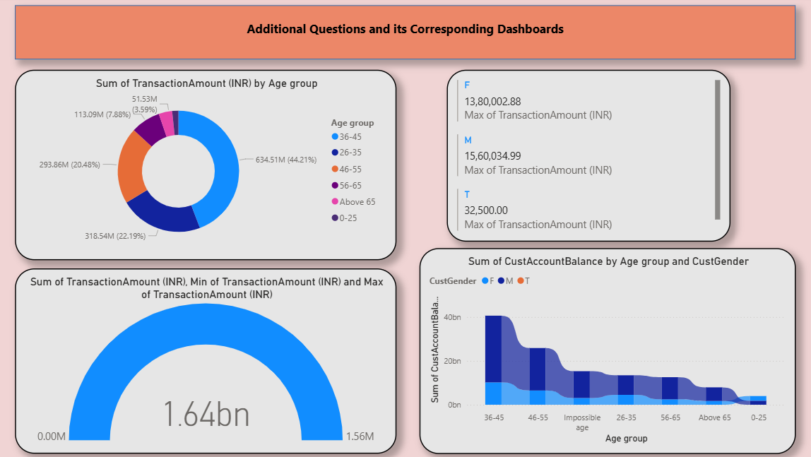

Slide 14
Additional Questions and its Corresponding Dashboards
Donut chart for different age groups why because visually donut chart looks good compared to pie chart for more than 4 segments.
36-45 age group customers contributing 44% of total transactions amount then followed by 26-35 age group customers contributing 22% and 46-55 age group customers contributing 20%.
So, we are getting more transaction fee from these age group customers.
Same like card we can use multirow card for simple segmentation, here we can apply all aggregation functions and easily observe all the values.
By using Gauge, we can see the extreme points in the given data easily. And our dashboard is interactive so if we select different categories from other chart, we can easily see the changes in Gauge chart.
In Ribbon Chart we will give one numerical column and two categorical columns and it gives outcome where we can easily find out which category values is highest because it shows highest category values on top and lowest category values at bottom.

Slide 15
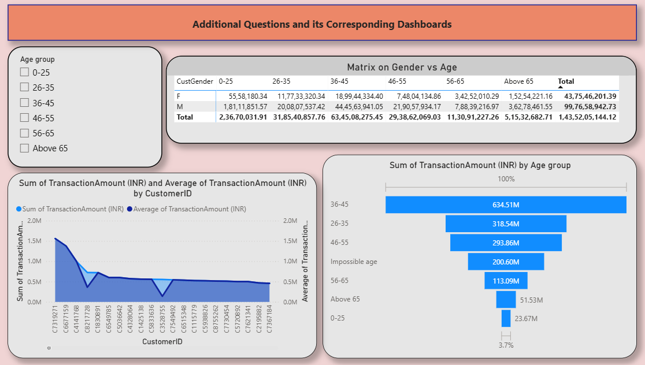

Slide 16
Additional Questions and its Corresponding Dashboards
By using matrix, we can see different combination categories values in the tabular format.
Here we can observe that Male transactions amount is more than 2 times of female transaction amount.
Area chart is performed on sum of transactions and average of transactions. Visually it is one of the best charts to see the difference compared to other charts.
Mostly it shows same because many customers made 1 transaction only for remaining customers it shows different (2-6 transactions) and we can easily observe by seeing the area chart.
Funnel chart is best among the other chart to perform categorial and numerical column because it shows the categories from highest to lowest based on the values.

Slide 17
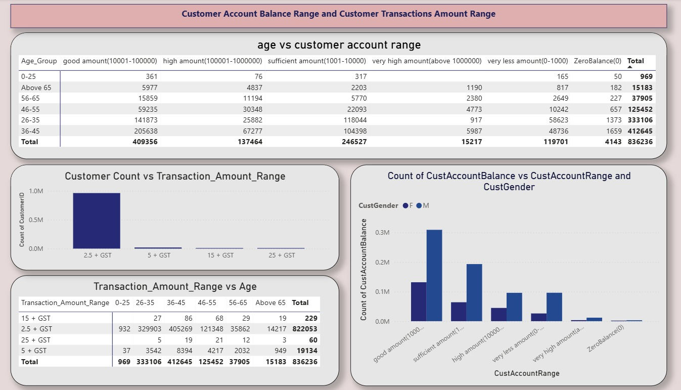

Slide 18
Customer Account Balance Range and Customer Transactions Amount Range
We are adding new column by segmenting customer account balance into six segments.
We created matrix chart based on age and customer account balance segments and customer id then we find 4143 zero balance accounts and tell them to maintain minimum balance otherwise they have to pay fine.
And we observed account balance between ten thousand – one lakh in more customers accounts (48%), we observed good number of customers maintain amount balance 1 lakh – 10 lakhs (16%), we observed good number of customers maintain amount balance more than 10 lakhs.
These customers are crucial for our bank to maintain smoot running of our bank . These amounts only we use to give loans to other customers.
Transaction amount we segmented into 4 categories based on NEFT charges.
We will get more transaction charges If huge amount transactions are made by our customers.
Most of the transactions comes under 2.5 + GST category then followed by 5 + GST.
Huge amount transactions were happening from 26-55 age groups and Huge amount transactions were not happening on customers age less than 25.
Most of the customers are maintain account balance between ten thousand to one lakh followed by one lakh to ten lakh which means customers are feeling safe to deposit amount on our bank.

Slide 19

THANK YOU

