Slide 1

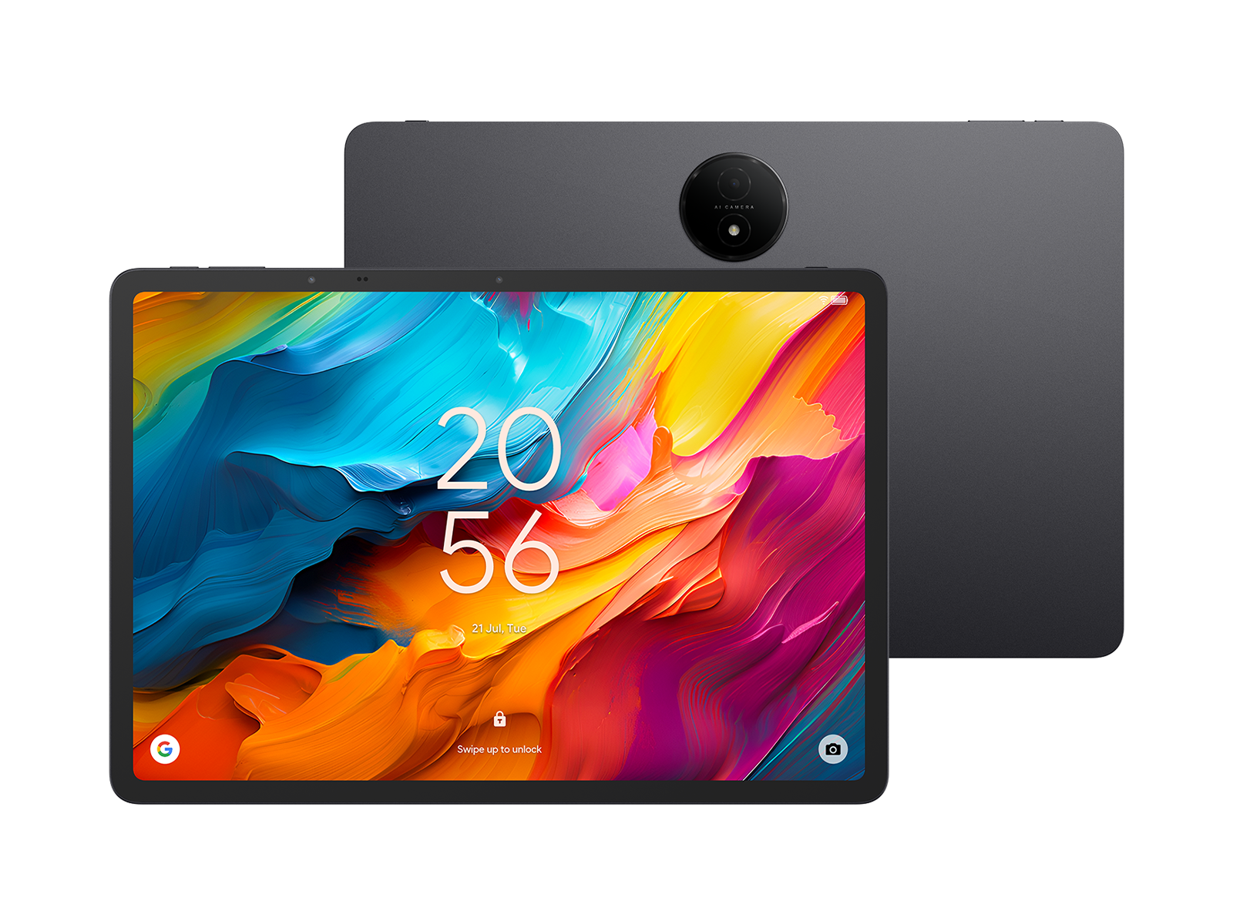
Price Determinants of Tablets in the Indian Market:
A Web Scraping and EDA Project

Slide 2
Agenda
Problem statement
Objectives of Project
Web scraping workflow
Data overview
Data cleaning steps
Univariate Analysis
Bivariate Analysis
Business Questions and Insights
Conclusion
Recommendations
Challenges Faced

Slide 3
Problem statement
Consumers often find it difficult to compare tablet prices because product specifications and pricing details vary widely across brands and online platforms. The dataset, collected through web scraping, includes key attributes such as brand, RAM, ROM, battery capacity, display size, camera details, connectivity type, ratings, and price. The challenge is to analyze this data to:
Understand how specifications influence tablet pricing.
Compare brands based on performance features, build quality indicators, and price ranges.
Identify value-for-money tablets by balancing cost, features, and brand positioning.
Provide insights that help consumers to make informed pricing and purchasing decisions.

Slide 4
Objectives of Project
Help consumers choose the right tablet based on budget, performance features, brand reputation, and specifications such as RAM, ROM, and display size.
Identify trends in brand-wise pricing, feature distribution, and the overall positioning of tablets in the Indian market.
Examine how specifications (RAM, ROM, battery capacity, display size, cameras, connectivity) influence minimum, maximum, and average prices.
Correlate specifications, brand category, and customer ratings to determine which tablets offer the best balance between price and performance.
Detect patterns such as premium pricing clusters, budget segments, and spec combinations commonly used by brands to differentiate their products.

Slide 5
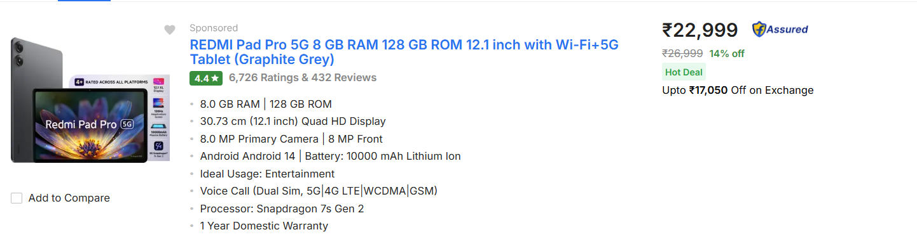
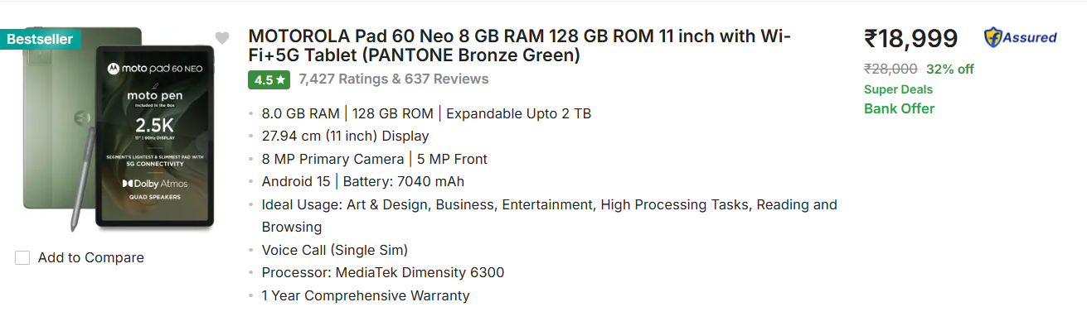
Web scraping workflow
Website scraped: flipkart.com
Pages scraped : 40
Steps followed for Data Extraction:
Scraped tablet listings across multiple Flipkart pages.
Extracted key attributes: Brand, Model, RAM, ROM, Display, Battery, Cameras, Connectivity, Ratings, Reviews, Price.
Converted the data into a pandas DataFrame and exported it to CSV.
Tools used: Python, requests,Regex Expression, BeautifulSoup,Pandas.
Total rows scraped : 960

Slide 6
Data Overview
The dataset contains 960 tablet records, each described by 17 columns. The columns and their contents are:
BRAND: Manufacturer of the tablet (e.g., Samsung, Lenovo, Apple).
MODEL: Model name or series of the tablet.
RAM(GB): Memory capacity used for device performance.
ROM(GB): Storage capacity available on the device.
DISPLAY_SIZE(inch): Screen size measured in inches.
CONNECTIVITY_TYPE: Network options (Wi-Fi only or Wi-Fi + SIM).
REAR_CAMERA(MP): Rear camera resolution in megapixels.
FRONT_CAMERA(MP): Front camera resolution in megapixels.
BATTERY(mAh): Battery capacity in milliampere-hours.

Slide 7
VERSION: Operating system or software version listed in product details.
WARRENTY: Warranty duration provided with the devices
RATINGS: Average user rating on the platform.
REVIEWS_COUNT: Total number of customer reviews.
ORIGINAL_PRICE(INR): Listed price before discount.
FINAL_PRICE(INR): Actual selling price after discount.
DISCOUNT_PERCENT: Percentage discount applied to the tablet price.
EXCHANGE_DISCOUNT_PRICE(INR): Additional discount available under exchange offers.

Slide 8
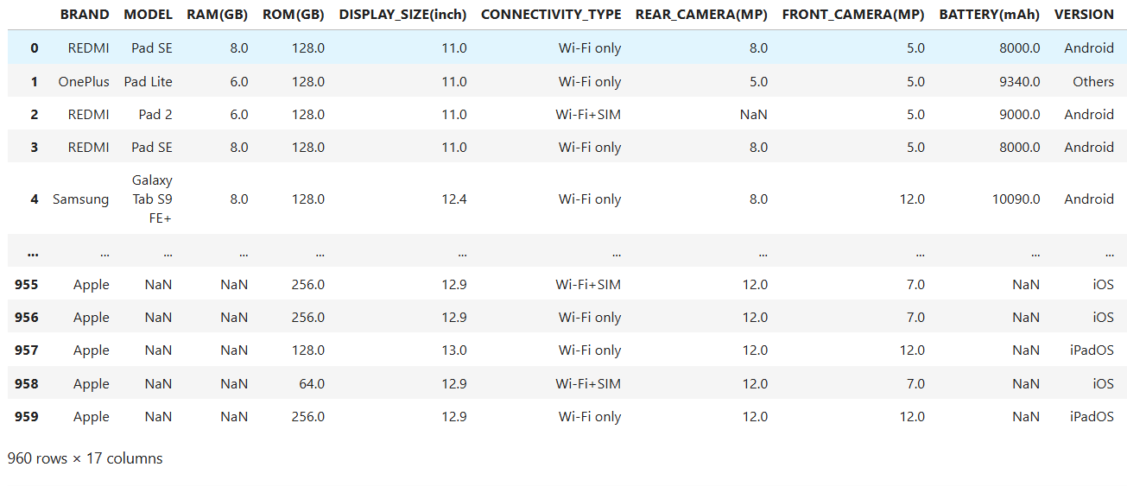
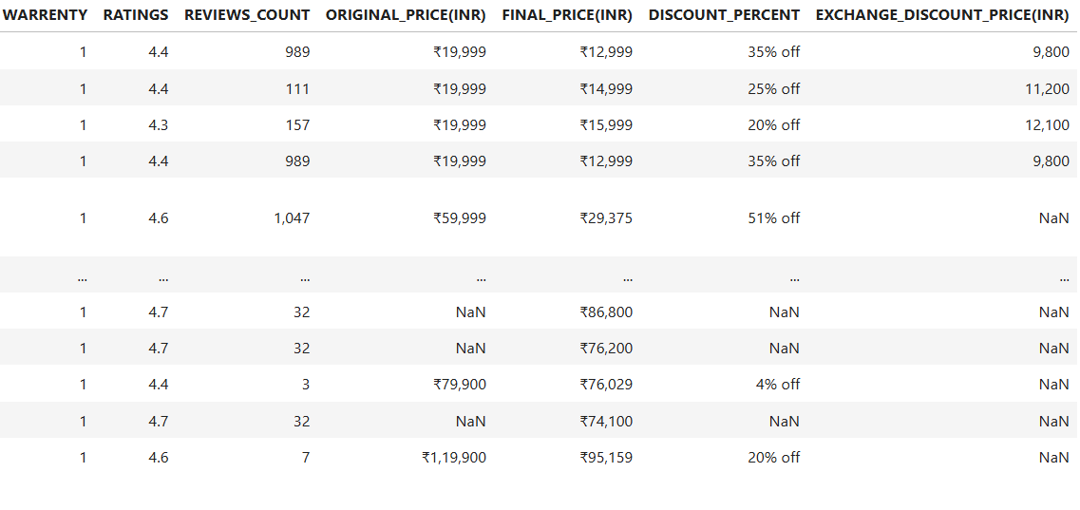
DataFrame

Slide 9
Data cleaning steps
Removed special characters from price and discount columns.
Dropped duplicated rows.
Identified all null values and imputed them using appropriate strategies:
MODEL: filled with "Unknown".
RAM(GB): filled with the mode.
ROM(GB): filled with the mode.
REAR_CAMERA(MP): filled with the mode.
FRONT_CAMERA(MP): filled with the median.
BATTERY(mAh): filled with the median.
VERSION: filled with "Unknown".
RATINGS: filled with the median.
REVIEWS_COUNT: filled with "0".
ORIGINAL_PRICE(INR): filled with values from FINAL_PRICE(INR) where missing.
DISCOUNT_PERCENT: filled with "0".
EXCHANGE_DISCOUNT_PRICE(INR): filled with "0".

Slide 10
Converted all numeric and categorical fields columns into correct data types.
ORIGINAL_PRICE(INR): int
FINAL_PRICE(INR): int
DISCOUNT_PERCENT: int
EXCHANGE_DISCOUNT_PRICE(INR): int
Detected outliers using the IQR method.
Retained them after confirming they represent genuine premium tablets.
Standardized categorical columns by converting all category text to lowercase for consistency.
Standardized categorical columns by converting all category text to lowercase for consistency

Slide 11
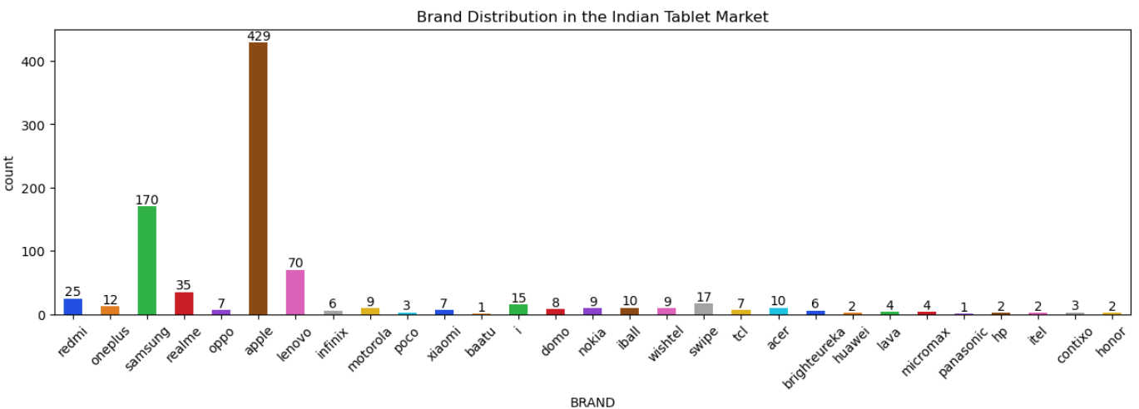
Univariate Analysis
Insight:
The chart shows a highly uneven brand distribution in the Indian tablet market. Apple dominates the dataset with the largest share (429 models), followed by Samsung with a significant but smaller count (170). Lenovo forms the mid-tier segment with around 70 entries. All other brands - including Redmi, OnePlus, Realme, Oppo, Infinix, Motorola, and others - appear in very small numbers, indicating limited product ranges or lower market presence. This imbalance suggests that pricing trends in the Indian tablet market are shaped mainly by Apple and Samsung, with most other brands contributing minimally.

Slide 12
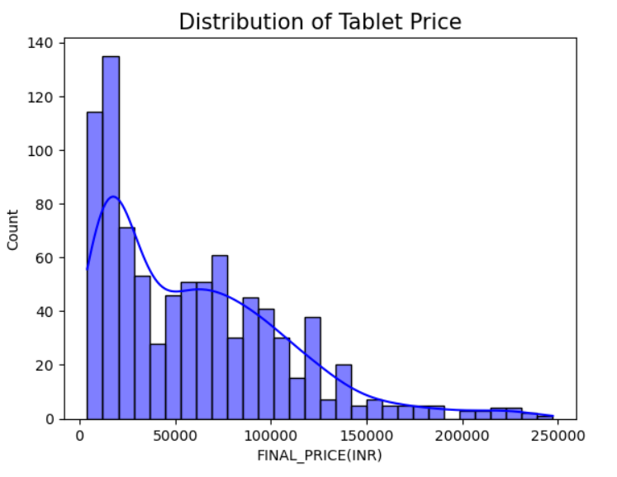
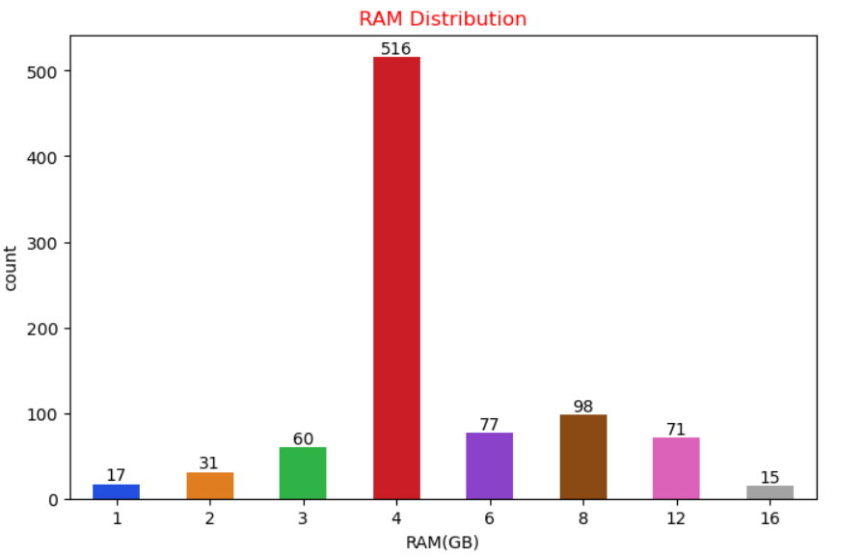
Insight:
The price distribution is heavily right-skewed.Most tablets fall between ₹10,000 and ₹30,000,while high-end models above ₹80,000 are far fewer. This shows that the Indian tablet market is dominated by affordable and mid-range products, with premium devices forming only a small portion of the overall market.
Insight:
Most tablets come with 4GB RAM, making it the dominant configuration. Higher RAM options like 6GB, 8GB, and 12GB appear moderately, while low RAM variants (1GB, 2GB, 3GB) are much less common, indicating that the market has shifted toward mid-range and higher-performance devices.

Slide 13
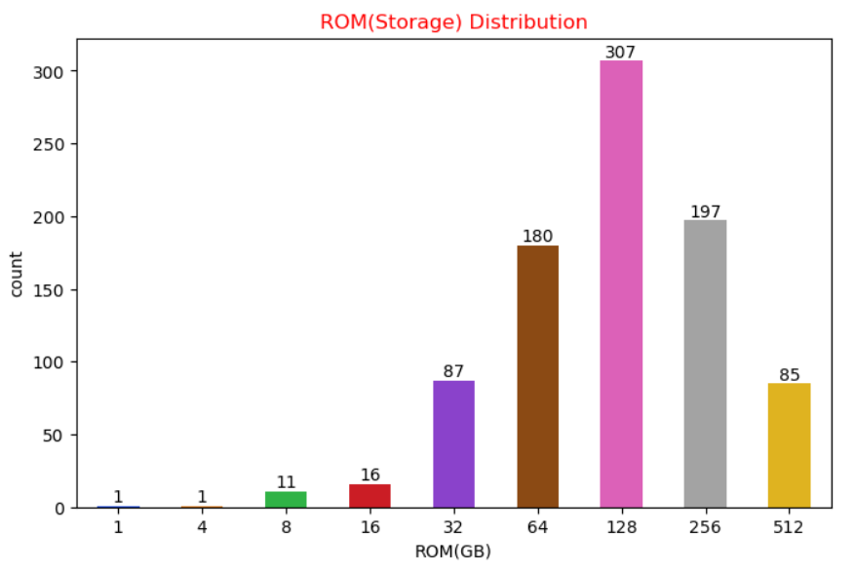
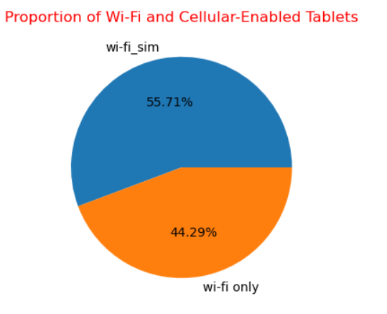
Insight:
Most tablets come with 128GB ROM, followed by 256GB, 64GB, and 512GB.Very low storage options like 1GB, 4GB, 8GB, and 16GB are not practical and should be avoided.For real-world usage, 128GB or 256GB models are ideal, and 64GB should be considered the minimum acceptable storage capacity.
Insight:
Calling tablets are in the majority at roughly 56%, while Wi-Fi-only models account for about 44%. This indicates a stronger market preference for cellular-enabled tablets, likely due to the added flexibility of using mobile data and calling features without relying on Wi-Fi.

Slide 14
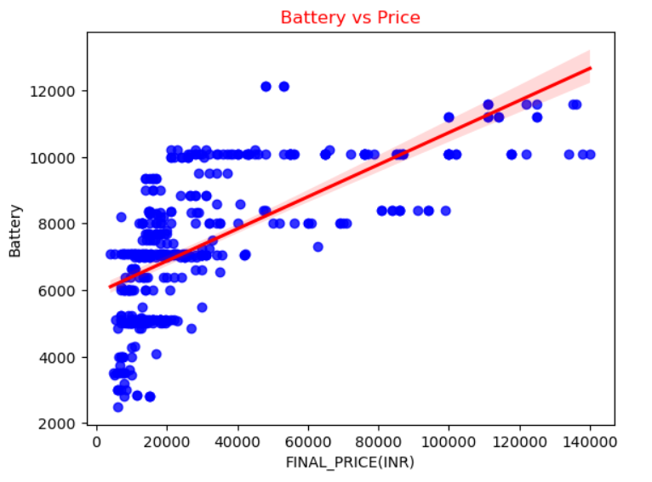
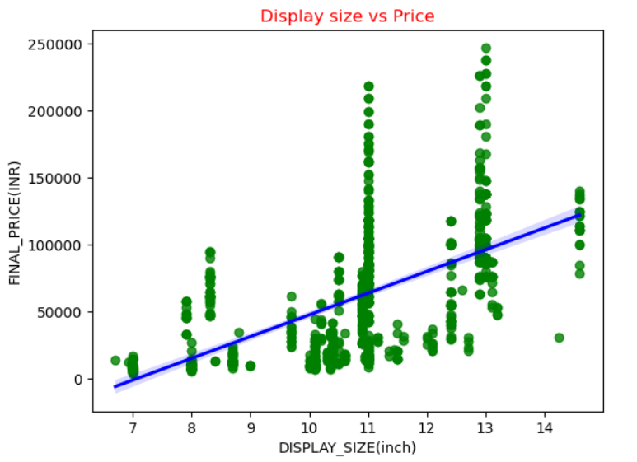
Bivariate Analysis
Insight:
The scatter plot shows that tablets with higher prices usually come with larger battery capacity.Most mid-range models (₹10k–₹40k) use 5,000–8,000 mAh batteries, while premium tablets priced above ₹80k often have batteries over 9,000 mAh. The upward trend line shows a positive relationship between battery size and price, although budget tablets still show mixed battery capacities.
Insight:
The scatterplot shows that tablet prices generally increase with display size. However, some larger-display models are still priced lower, indicating that factors like RAM, storage, brand, and connectivity also influence overall pricing.

Slide 15
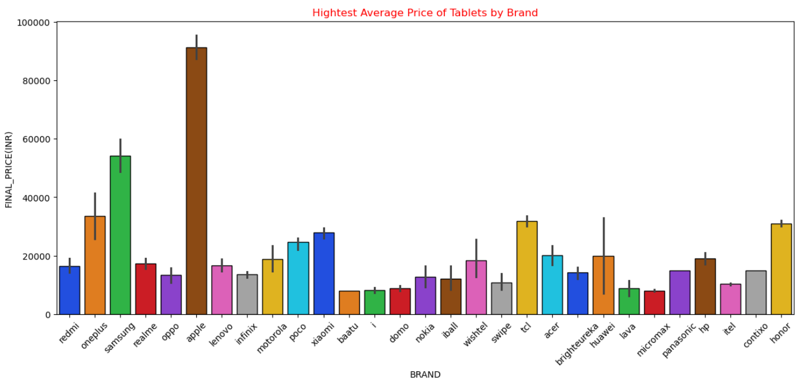
Insight:
Apple has the highest average tablet price by a wide margin, followed by Samsung and OnePlus. Most other brands fall into the budget and mid-range categories, showing that premium pricing is concentrated within only a few top brands.

Slide 16
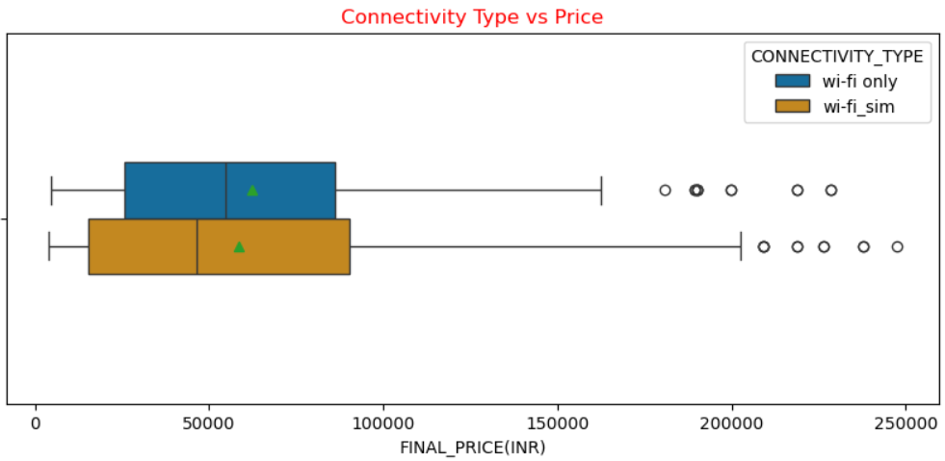
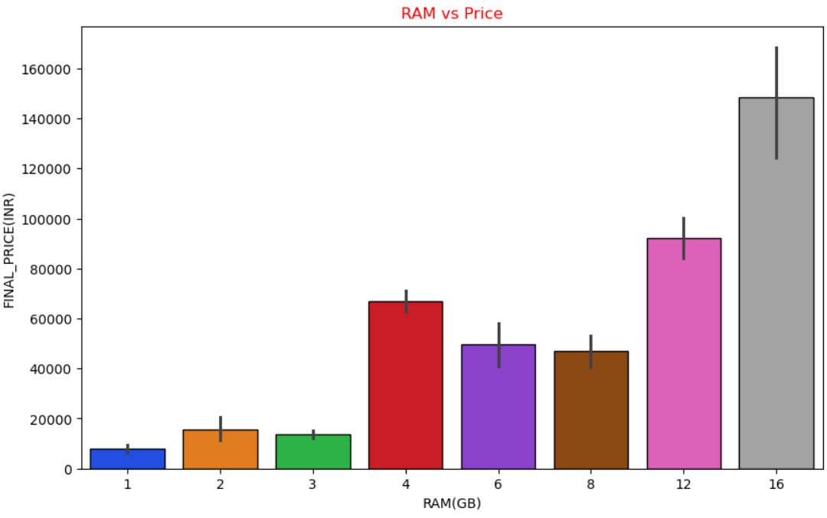
Insight:
Calling tablets show a wider price range and generally higher prices compared to Wi-Fi-only models. The outliers mostly represent premium tablets from brands like Apple.
Insight:
Tablet prices generally increase as RAM increases, especially from 8GB upward.However, some higher-RAM models still show lower prices, indicating that RAM alone doesn’t determine price and other factors like brand, storage, and display size also influence the final cost.

Slide 17
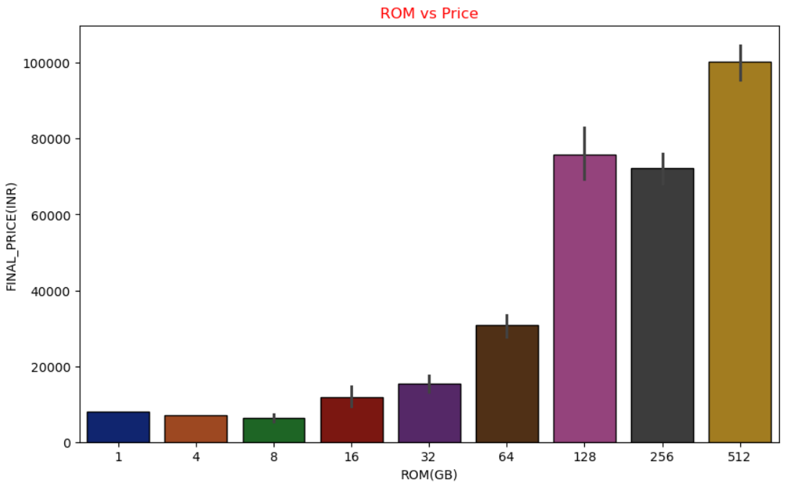
Insight:
Tablet prices increase noticeably with higher ROM, especially from 64GB onward. However, a few higher-ROM models still appear at lower prices, showing that storage capacity is not the only factor determining price -brand, RAM, and display size also influence overall pricing.

Slide 18
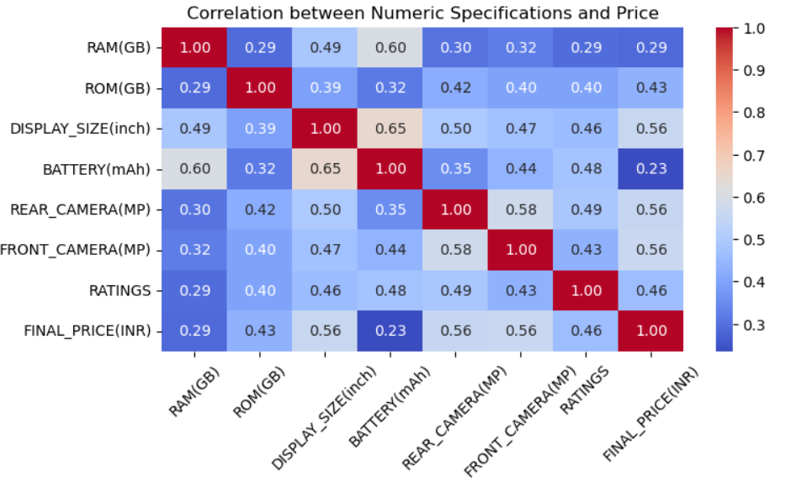
Insight:
Display size, rear camera, and front camera show the moderate positive correlations with price, followed by ROM. Battery capacity and RAM have weaker relationships with price. Overall, the heatmap indicates that larger displays and better camera specs contribute more to higher tablet prices than battery or RAM alone.

Slide 19
Key Business Questions and Insights
1Q. Which brands dominate the Indian tablet market in terms of product availability?
Insight: Apple and Samsung dominate the Indian tablet market in product availability.
2Q. What price ranges are most common in the Indian tablet market?
Insights: Most Tablets in the Indian market in the price range of Rs.10,000 – 40,000.
3Q.How does connectivity type (Wi-Fi vs. Wi-Fi + SIM) influence tablet pricing ?
Insight: Calling Tabs tend to have more price.
4Q. Do larger display sizes command higher prices?
Insight: Most of Tablet Price tend to increase with display size.
5Q.How do camera specifications (front & rear) correlate with price?
Insight: Camera specifications show a moderate positive correlation with tablet prices.

Slide 20
Conclusion
Apple and Samsung dominate the premium tablet segment, while most other brands target the budget range.
Tablet prices rise mainly with larger displays, higher storage (ROM), and better camera specifications.
RAM and battery capacity impact price but are weaker predictors compared to display and storage.
Wi-Fi + SIM models are generally priced higher than Wi-Fi-only versions.
Price variation is driven by brand positioning and feature combinations rather than any single specification.
Discounts and exchange offers vary widely, reflecting competitive pricing strategies across brands.

Slide 21
Recommendations
Consumers should prioritize higher ROM (128GB or 256GB) since storage has a strong impact on usability and is a major price driver.
Choose tablets with at least 4GB or 6GB RAM for smooth performance, as lower RAM options show limited value.
Prefer larger displays (10 inches and above) if the device will be used for entertainment, productivity, or learning, as display size strongly correlates with price and user experience.
Avoid extremely low-priced models with inconsistent specifications, as they often compromise on storage, battery, and camera quality.
Wi-Fi + SIM models are recommended for users who need mobility and calling features; they offer better flexibility despite higher pricing.
Premium brands like Apple and Samsung provide consistent performance and build quality but at a higher cost; buyers should choose based on budget and feature needs.
Check battery capacity carefully, aiming for at least 6000 mAh to ensure full-day usability, especially for students and travelers.
Look for genuine discounts and compare them across brands, as mid-range tablets often offer the best price-to-feature value.

Slide 22
Challenges Faced
Dynamic webpages: Changing HTML structures and scripts affected scraping stability.
Brand and model variations: Minor naming differences caused category mismatches that required manual correction.
Inconsistent data formats: Specifications like RAM, ROM, and battery appeared in multiple formats across pages, requiring heavy cleaning.
Duplicate entries: Repeated listings for the same tablet model had to be identified and removed.
Missing values: Many tablets had incomplete details (especially battery and camera specs), making preprocessing time-consuming.
Choosing Appropriate Visualization : Selecting the right plot types to represent insights.

Slide 23

THANK YOU

