Slide 1
Analyzing COVID-19 Vaccination Rates and its Effectiveness at preventing COVID-19
County: Miami-Dade County, Florida
Question: How does the vaccination rate in Miami-Dade County impact the number of confirmed COVID-19 cases?
Samuel Perebikovsky

Slide 2
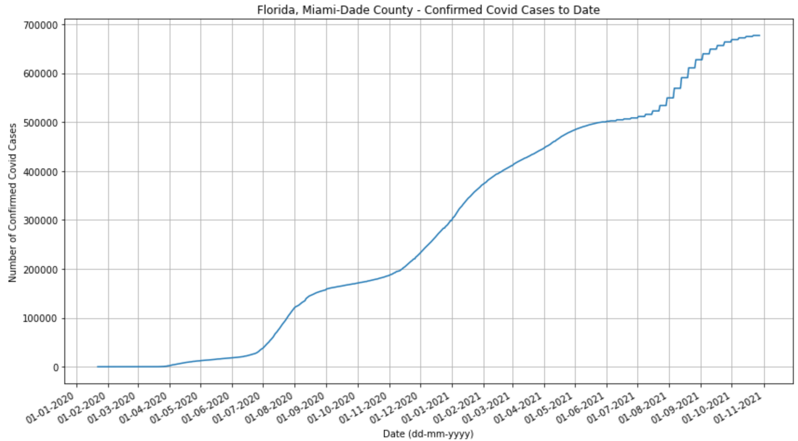
Miami-Dade total COVID cases over time
We expect this function to be monotonically increasing but notice the strange behavior of the function starting in June of 2021
The function becomes almost a step function
What is happening here?

Slide 3
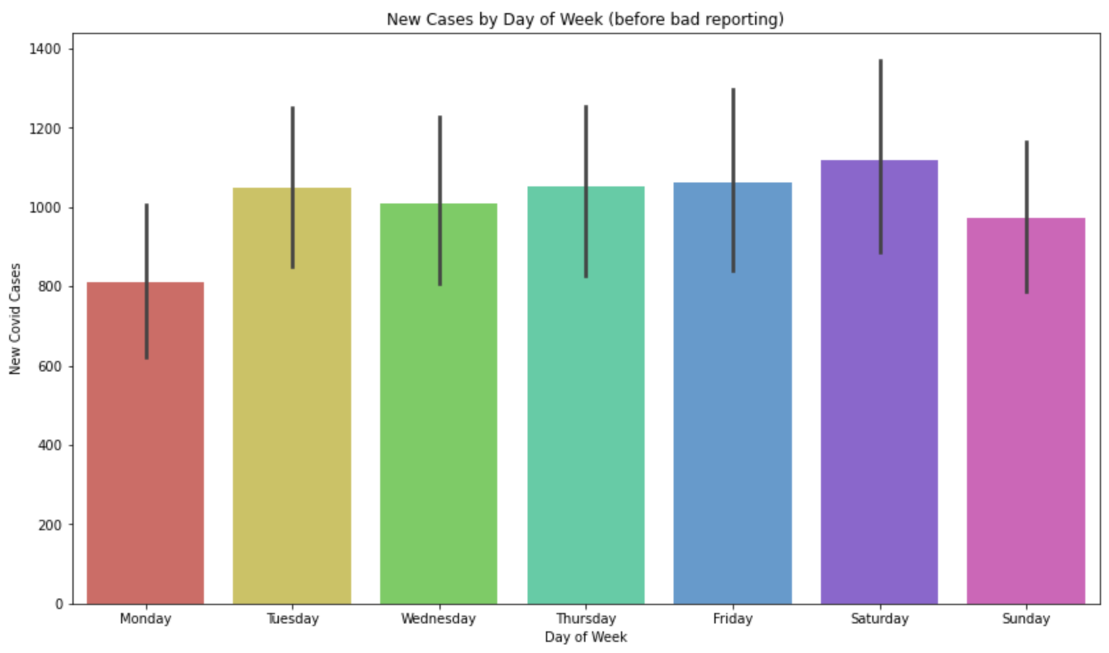
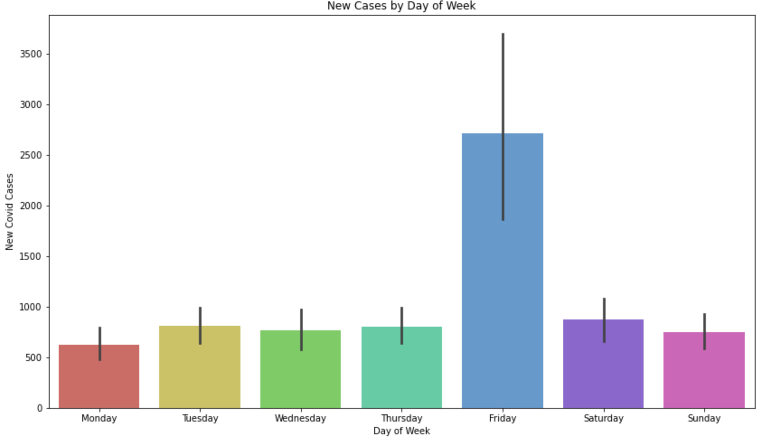
Looking at New COVID cases across weekdays
Below is the bar chart for the entire COVID data and we see Friday is by far the day with the most cases
The right contains the same data, but only from before June 2021.
Turns out, Miami-Dade County started reporting numbers for the whole week, once a week: on Friday. Starting from June 2021

Slide 4
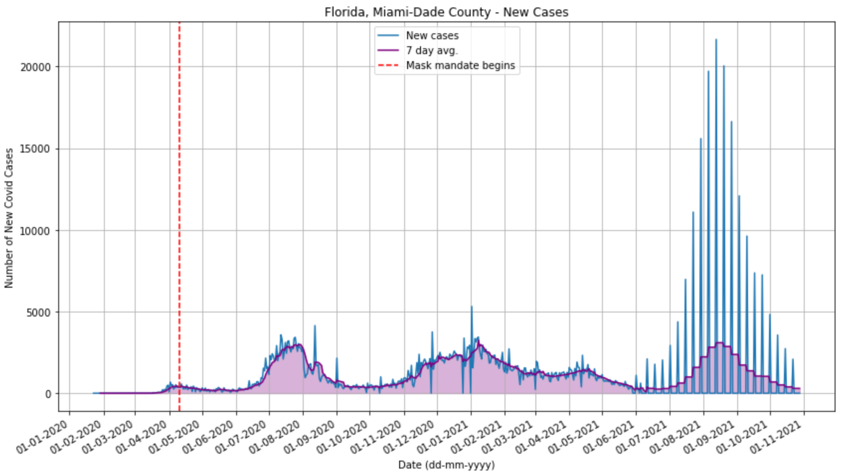
Graphing the New Cases on a Daily Basis
We see how the stepwise function presents itself in this view
At first glance just looking at the new daily cases, it appears like COVID got much worse after about 6 months
Looking at 7-day averages gives us a better understanding of how the COVID cases were behaving during this time
Looking at the vaccination data is the next step for our analysis
Vaccinations start here

Slide 5
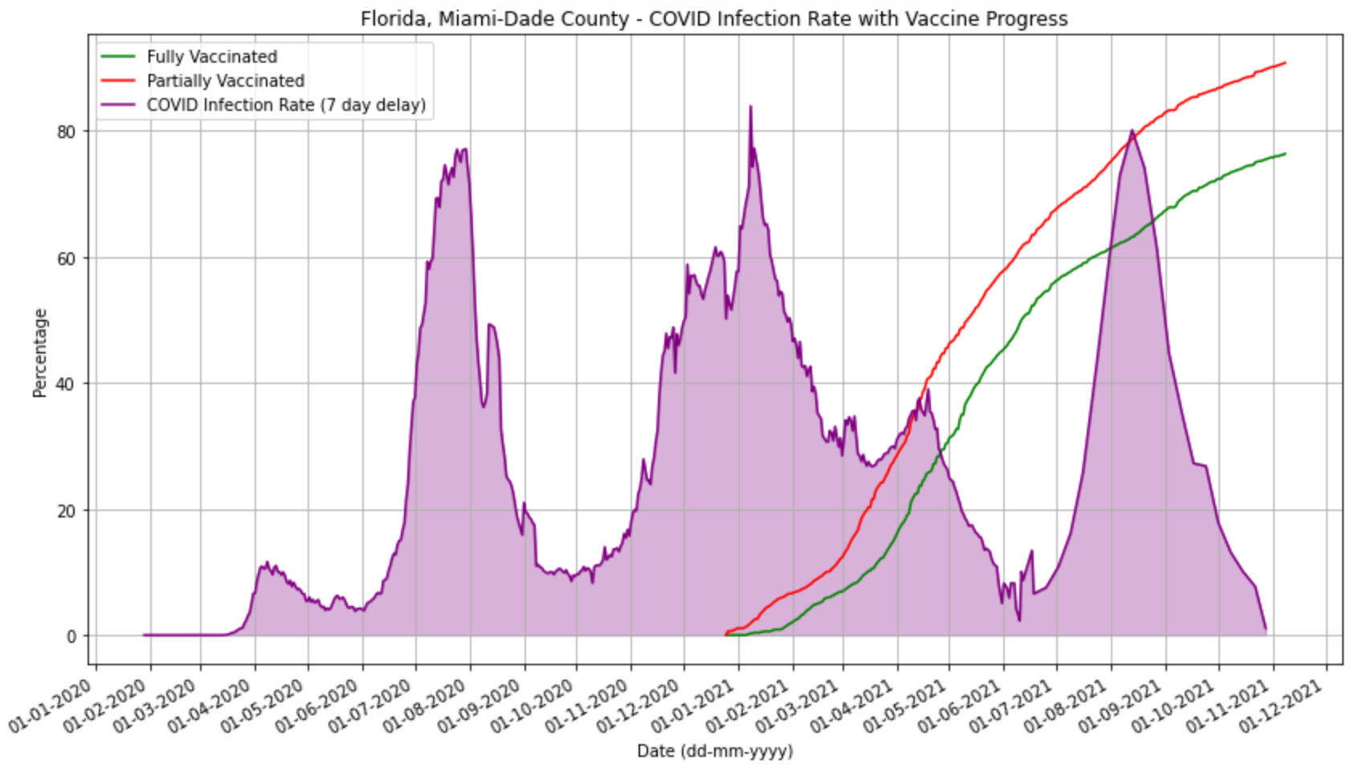
Graphing Infection Rate with Vaccination Rate
Even though 80% of the population of Miami-Dade County was vaccinated at the time, the infection rate was just as high as before the vaccines
This seems to suggest that the vaccinations were not effective in preventing the spread of COVID
But something about this graph seemed problematic

Slide 6
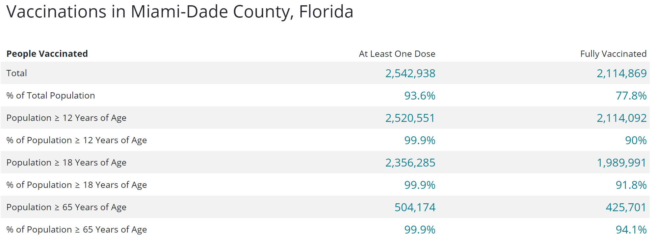
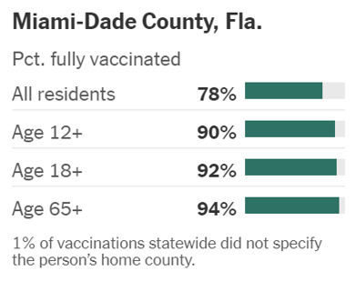
Some Current Statistics
The previous graph seemed to indicate that Miami-Dade County is one of the most vaccinated at the time
Notice the percentage of population over 12 years of age that have had at least 1 dose
Both NY Times and CDC seemed to be displaying the same information which indicated to me there was a likely problem with the source.
*All screenshots taken on November 30th, 2021 using most recent data at each location. Left photo is from NY Times while top is from CDC.

Slide 7
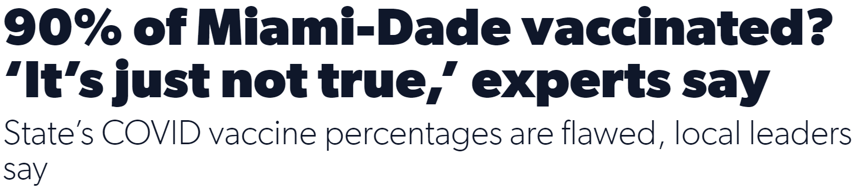
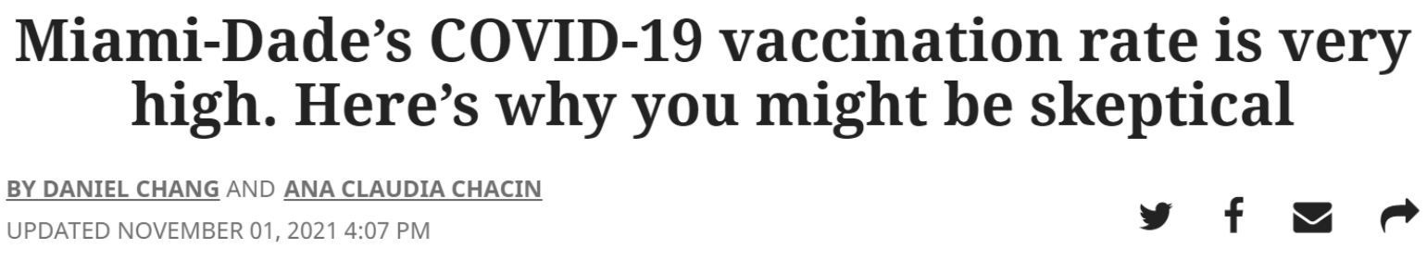
And of Course…
A quick google search seemed I dug up some articles that seemed to reveal a little bit of the truth:
“As of Friday, 24 Miami-Dade ZIP codes logged a mathematically impossible vaccination rate of greater than 100% of eligible residents (those over 12) who have received at least one dose.” –Miami Herald
‘“The true percent vaccinated is nowhere near 90%,” said Dr. Aileen Marty, infectious disease expert at Florida International University. “It’s really giving people a false sense of security. “It’s just not true,” Marty added. “It’s based on a lot of people who gave Miami-Dade addresses who do not live here.’ –Local 10

Slide 8
So how does the Original Question get Answered?
It doesn’t, it literally can’t.
So, my question had to pivot to something a little more feasible while still explaining why the original question couldn’t get answered.
New Q: “How do the reporting practices and lack of transparency of Miami-Dade County’s COVID data impact analysis using that data?”

Slide 9
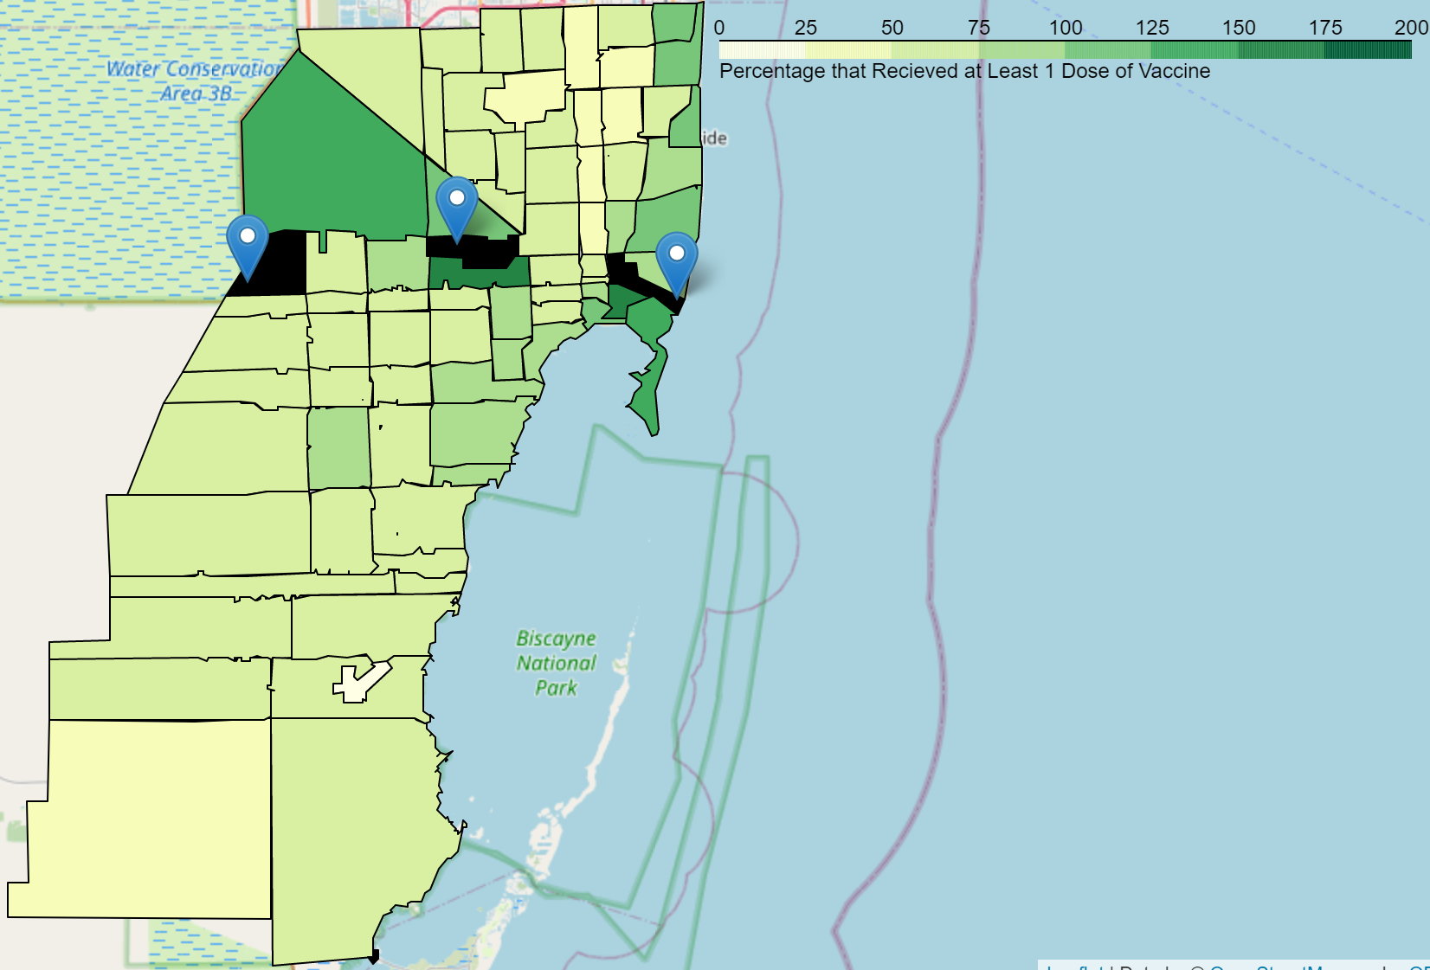
Breaking it Down by Zip Code
Map of Miami-Dade’s Zip codes color coded by percentage of eligible population that has received at least one dose of the vaccine
Note the scale is not from 0-100%, but rather 0-200%
The 3 very dark green zip codes with blue markers indicate a vaccination rate of over 200%
From left to right the vaccination rates in those zip codes are: 203%, 2289%, and 269%
*Data gathered November 13th, 2021 from Miami Herald

Slide 10
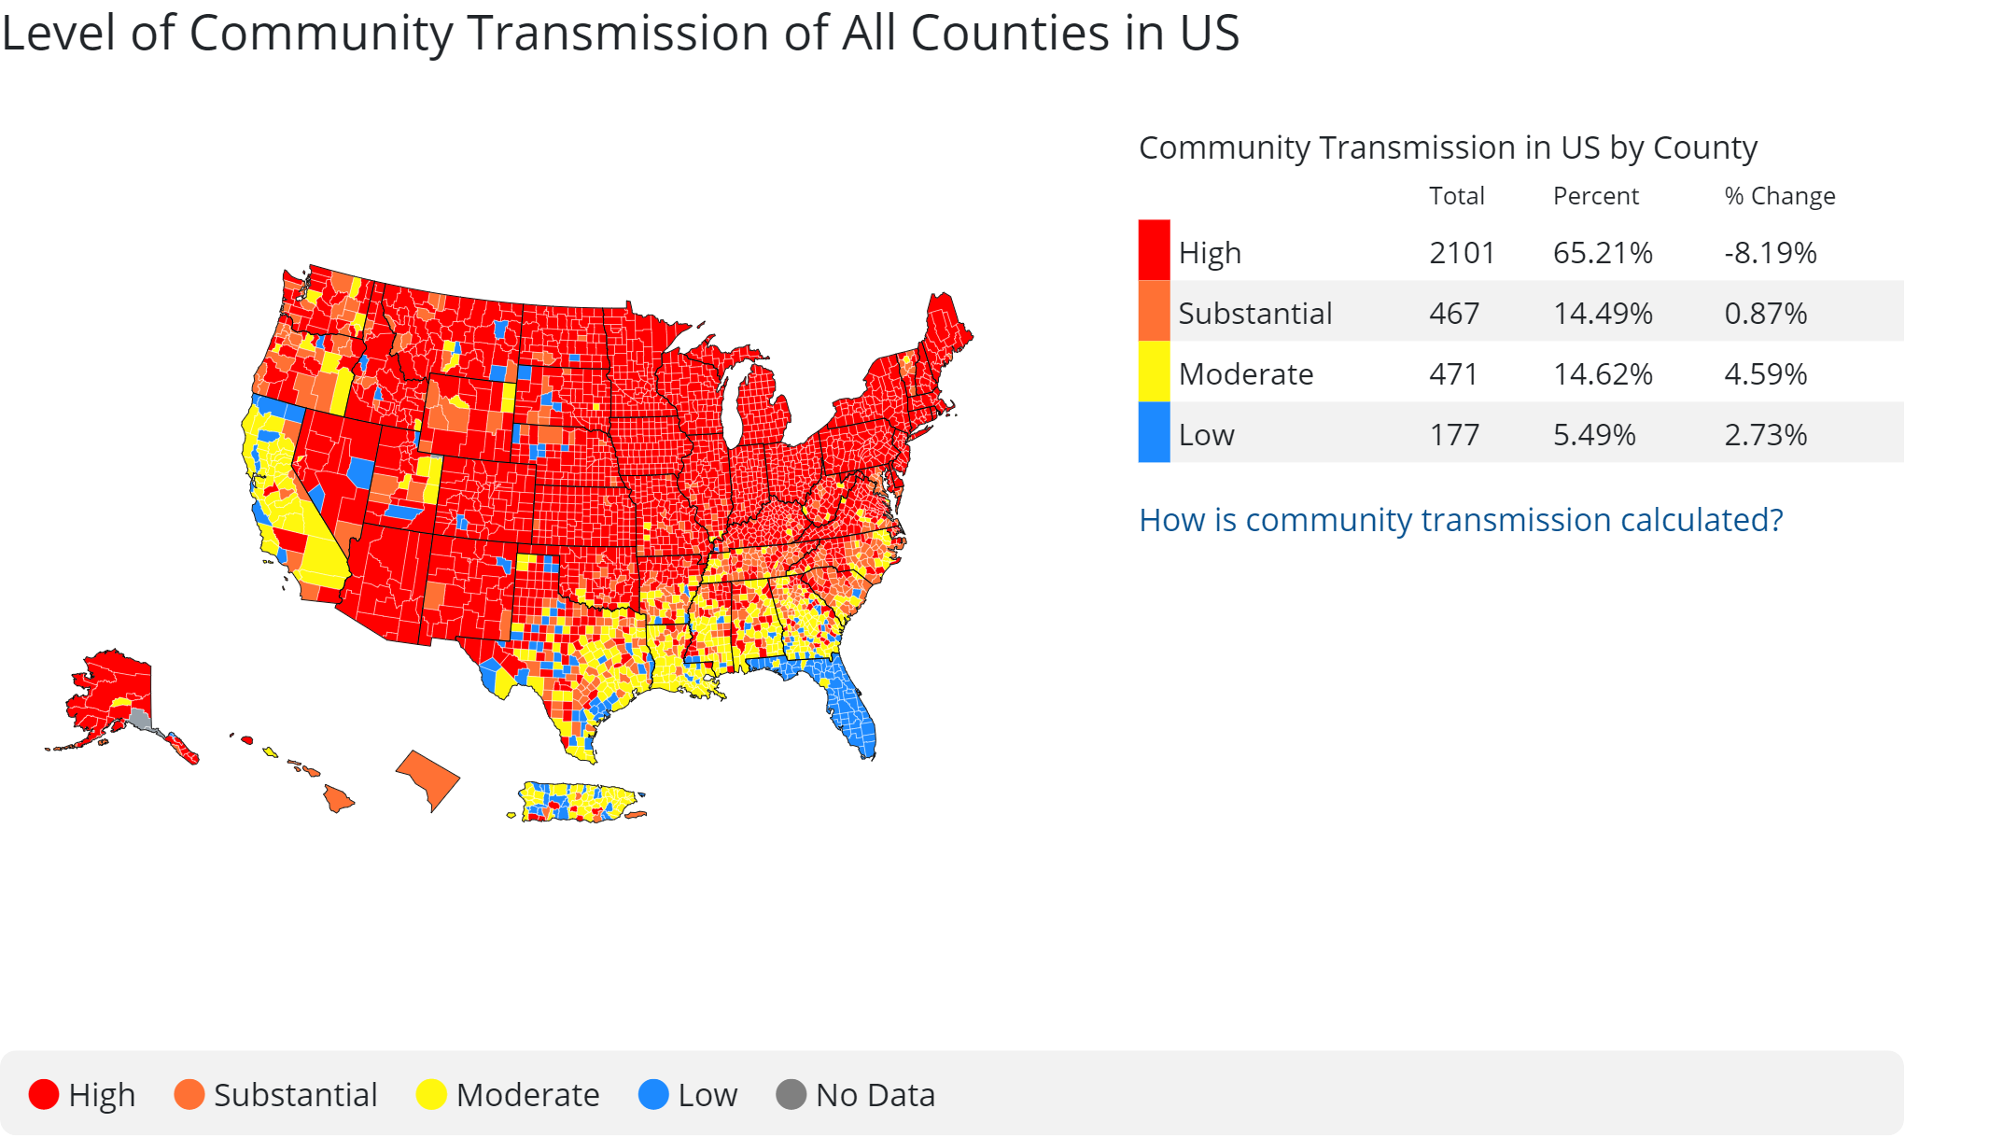
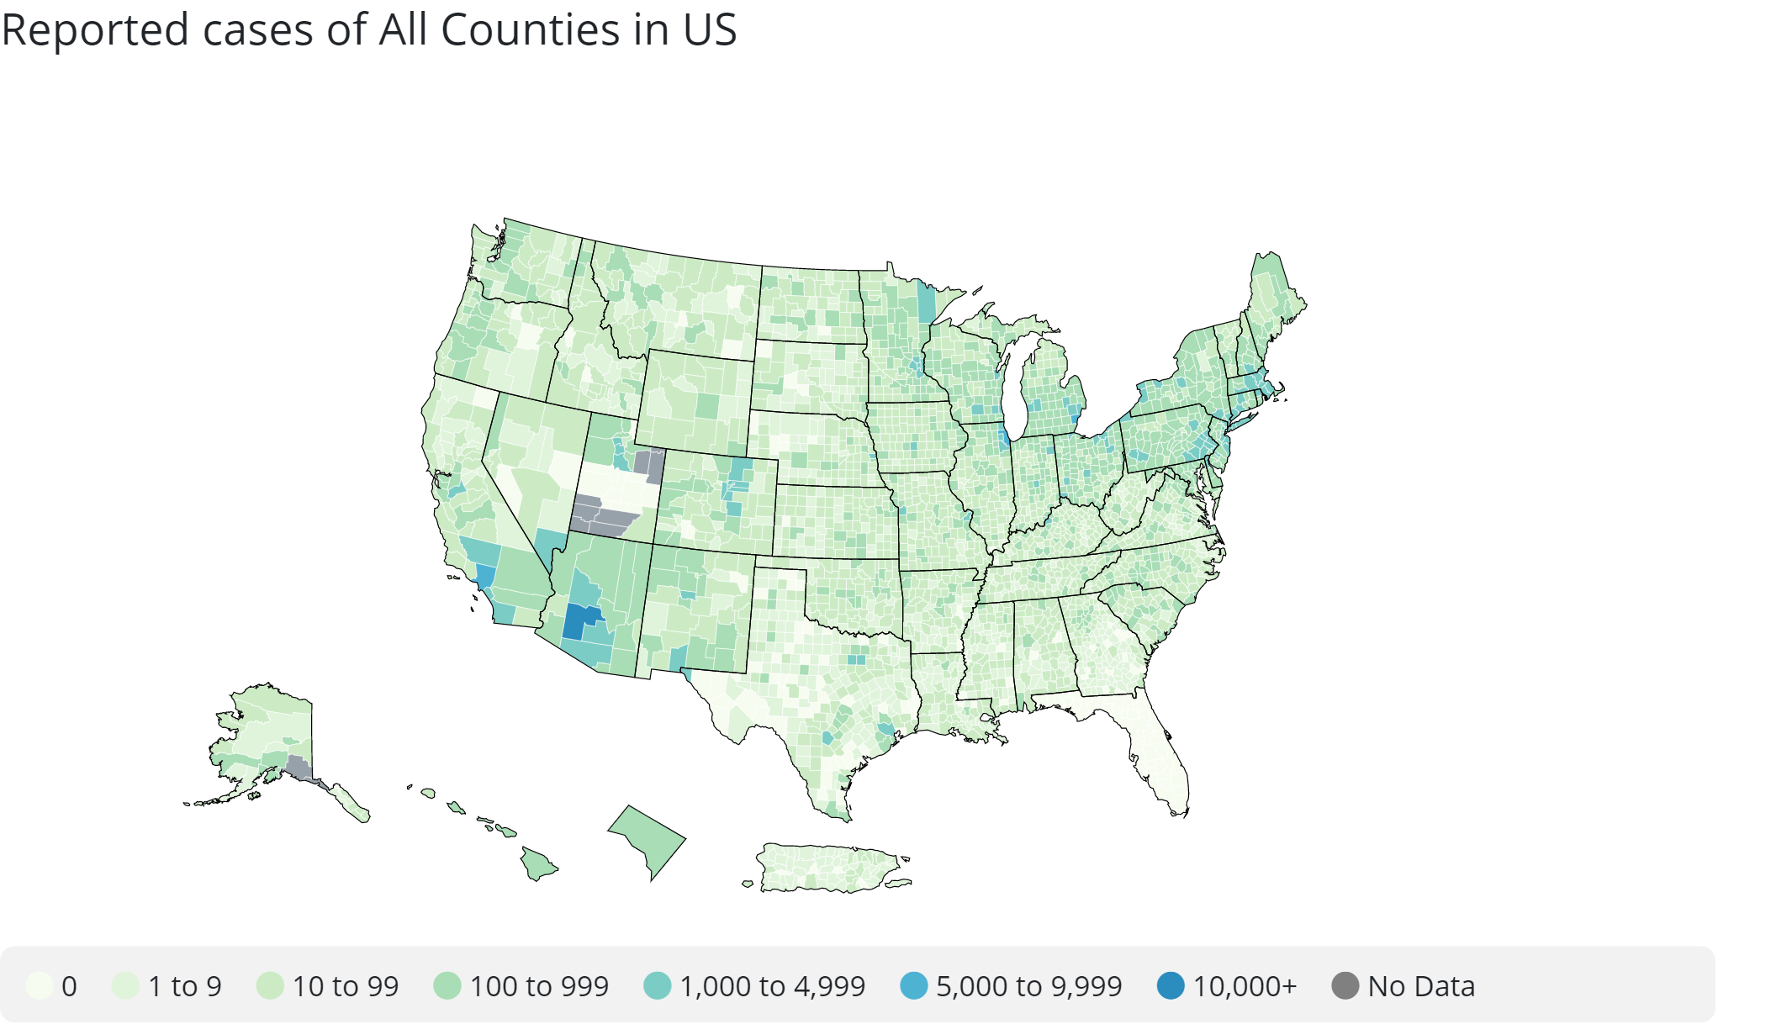
Some more Problems
Miami Dade County and Florida in general had some of the lowest transmission rates and cases in the country for the Thanksgiving week
*Time Period: Mon Nov 22 2021 - Sun Nov 28 2021
“Without mandates or lockdowns, COVID-19 cases in Florida have decreased 90% since August,”
- Governor Ron DeSantis.
But that’s not a bad thing? Right?

Slide 11
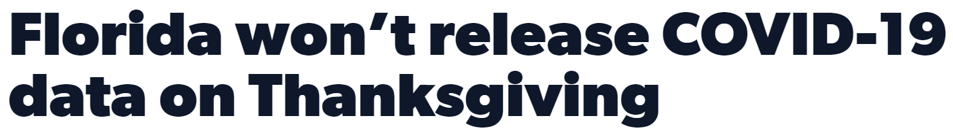
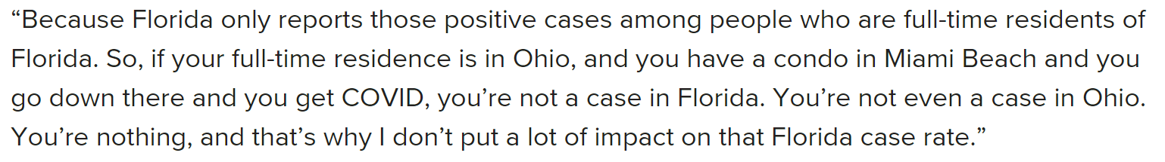
The Reality
The data is framed in such a way to make the situation seem better than it probably is
Recall in the previous slide, the data given to the CDC indicated ‘0’ cases, when it should have been reported as ‘No Data’.
They have a bad case of selection bias to tailor the numbers to their advantage:
For vaccinations: if get vaccinated in Miami but don’t live there you will be counted towards the vaccination rate
For cases: if you don’t live in Miami but get sick there you won't get counted as a case
- clickorlando.com
- Quote from article on healthline.com

Slide 12
Conclusion
The way Florida and Miami-Dade County are reporting the data about COVID leads to a disconnect between what is actually happening and what they want to happen.
The lack of transparency in the reporting causes people to have a false sense of security
Any analysis done with Florida’s COVID data has a high risk of being completely incorrect

