Slide 1

ASP.NET Architecture Internals
Mike Shaw
mikeshaw@microsoft.com
Developer & Platform Group
Microsoft Ltd

Slide 2


Agenda
Handling a request
  IIS5 and IIS6.0
  Threads and ThreadPools
Page processing
  Compilation
  Handlers and Modules
Performance
  Caching
  Server GC
  Session State
Configuration

Slide 3

IIS 5.0 Architecture
DLLHOST.exe
INETINFO
Aspnet_wp.exe
ISAPI
Extensions
(ASP, etc.)
CLR App Domain
ASP.NET
ISAPI
CLR App Domain
ASPNET account
metabase
ISAPI Filters
CLR App Domain
TCP/IP

Slide 4
Internet Information Server (IIS) 6.0 Architecture
Application Pool 1
Application Pool 2
Web Garden
INETINFO
WWW Service
W3WP.exe
W3WP.exe
W3WP.exe
W3WP.exe
ASP.NET ISAPI
ISAPI
Extensions
(ASP, etc.)
ASP.NET ISAPI
ISAPI
Extensions
(ASP, etc.)
Network Service Account
CLR Application
Domain
CLR Application
Domain
Config Mgr
Process Mgr
metabase
CLR Application
Domain
CLR Application
Domain
ISAPI Filters
ISAPI Filters
HTTP.sys

Slide 5

Robust
Recycling and health detection
Recycle worker process based on:
  Uptime
  Schedule
  # Hits
  Memory consumption
  On-demand
Health detection
  Detecting worker process crashes
  Pinging = hang detection
  Kernel-mode queuing

Slide 6
IIS6 Process Recycling: Overlapping
Ready
Startup
New Worker Process
Old Worker Process
Ready for
recycle
WWW Service
Web Process
Core DLL
Web Process
Core DLL
ISAPI Ext and Filters
ISAPI Ext and Filters
Shut down
HTTP.sys
Request

Slide 7



IIS 6.0 application settings

Slide 8
HTTP.sys and Kernel-Mode Queuing
HTTP.sys API
HTTP.sys
Listener
Send Response
Req. Queue
Req. Queue
Req. Queue
Namespace Mapper
HTTP Engine
HTTP Parser
Response Cache
TCP/IP
Request

Slide 9
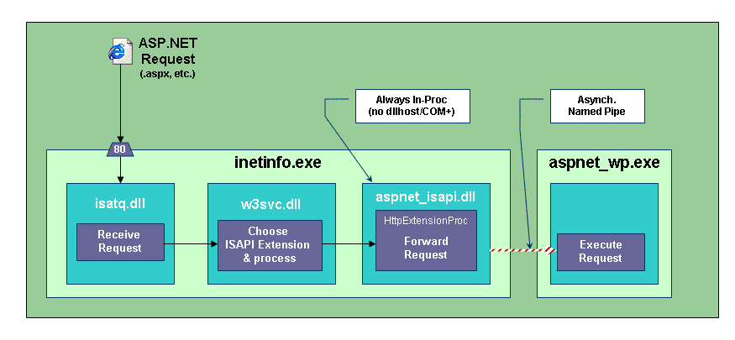
ASP.NET Architecture / Threading
IIS5 / ISAPI

Slide 10
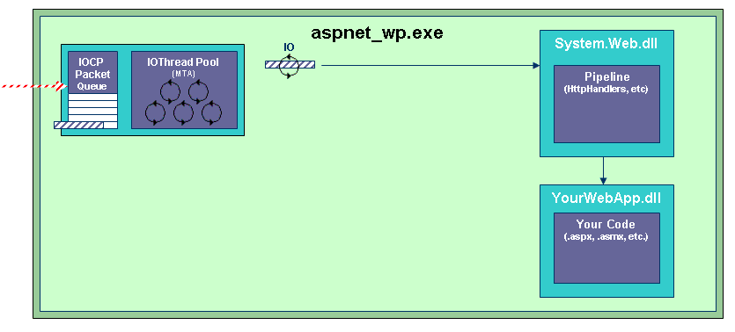
ASP.NET Architecture / Threading
Low Load

Slide 11
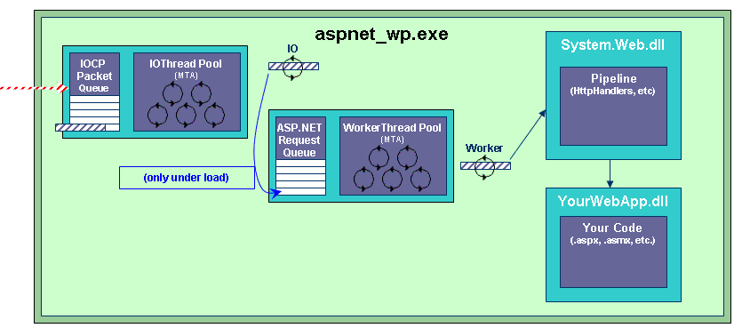
ASP.NET Architecture / Threading
High Load

Slide 12
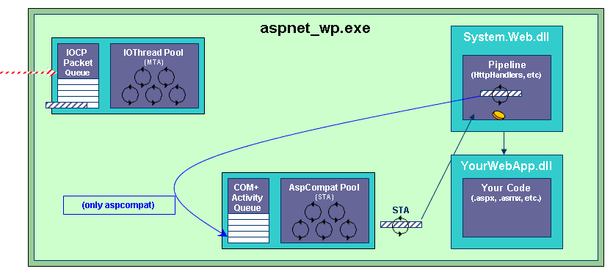
ASP.NET Architecture / Threading
AspCompat

Slide 13
ASP .NET Request Processing
Module Per Request Events:
  BeginRequest
  AuthenticateRequest
  AuthorizeRequest
  ResolveRequestCache
  AcquireRequestState
  PreRequestHandlerExecute
  <handler executes here>
  PostRequestHandlerExecute
  ReleaseRequestState
  UpdateRequestCache
  EndRequest
ASP.NET
Page
ASP.NET
Service
HTTP
Handler
Application
HTTP Module
HTTP Module
HttpContext
Global.asax
.NET Code
ASP.NET Runtime
Host (IIS)
Native Code

Slide 14
Agenda
Handling a request
  IIS5 and IIS6.0
  Threads and ThreadPools
Page processing
  Compilation
  Handlers and Modules
Performance
  Caching
  Server GC
  Session State
Configuration

Slide 15
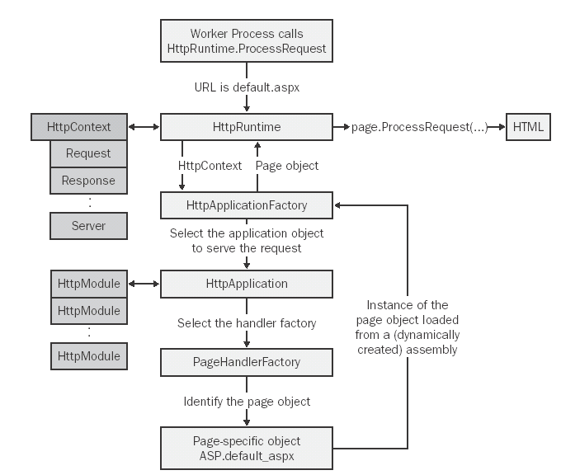
HTTP
Pipeline

Slide 16


Web Forms
Part Declarative, Part Code
Combines declarative tags
  HTML, XML, WML, ASP directives, server controls and static text with code
Clean separation between code and tags
Visual Studio .NET
single file
separate files
<tags>
<tags>
code
code
Form1.aspx
Form1.aspx
Form1.vb

Slide 17
How Does ASP.NET Work?
Review
ASP provided a linear execution model, executing script in the stream
ASP.NET parses and generates a
Page class with an event-based execution model
Rendering the output stream is one phase of the Page execution

Slide 18
How Does ASP.NET Work?
Review
The parsed file is represented
as a tree of controls
The Page is the root of the tree
Web form is declared by the runat=“server” attribute
  Ensures that the form is executed at the server
  <form runat="server">
  </form>
Static text (eg HTML without runat=“server” ) is represented as a “LiteralControl” in the hierarchy

Slide 19
.asmx Deconstructed
3 Mandatory additions, 1 optional addition
<%@ WebService class=“[class]" %>
  Names the class and/or language used
Imports System.Web.Services
  Required namespace
[WebMethod] or <WebMethod()>
  Method is ‘web callable’
WebService base class
  Access ASP.NET intrinsics

Slide 20
Runtime Compilation
Code-
behind
class
Parse
ASPX
Engine
Generate
ASPX
File
Gen’d
Page
Class
Request
Instantiate
Request
Compile
Response
Page
DLL
Response
Instantiate, Process and Render

Slide 21
ASP.NET Modular Architecture
ASPNET_WP
HttpHandlers
Pages
Services
ASPNET_STATE
Session
State
Caching
HTTP Runtime
Authent
Sessions
HttpModules
INETINFO
ASPNET_ISAPI

Slide 22
ASP.NET Request Processing
Pluggable, modular architecture
URL Request Handlers (Http Handlers)
  Page Handler (.aspx)
  Web Service Handler (.asmx)
Request Interceptors (Http Modules)
  Caching
  Authentication/Authorization
  Session State

Slide 23
Method | PostBack | Controls
Constructor | Always | All
AddParsedSubObject | Always | All
DeterminePostBackMode | Always | Page
OnInit | Always | All
LoadPageStateFromPersistenceMedium | PostBack | Page
LoadViewState | PostBack | All
ProcessPostData1 | PostBack | Page
OnLoad | Always | All
ProcessPostData2 | PostBack | Page
RaiseChangedEvents | PostBack | Page
RaisePostBackEvent | PostBack | Page
OnPreRender | Always | All
SaveViewState | Always | All
SavePageStateToPersistenceMedium | Always | Page
Render | Always | All
OnUnload | Always | All

Slide 24
HTTPHandlers
<httpHandlers>
<add verb="*" path="trace.axd“ type="S.W.Handlers.TraceHandler"/>
<add verb="*" path="*.aspx" type="S.W.UI.PageHandlerFactory"/>
<add verb="*" path="*.asmx" type="S.W.Services.Protocols.WebServiceHandlerFactory” />
<add verb="*" path="*.rem" type="System.Runtime.Remoting.Channels.Http.HttpRemotingHandlerFactory, System.Runtime.Remoting, Version=1.0.5000.0, Culture=neutral, PublicKeyToken=b77a5c561934e089" validate="false"/>
<add verb="GET,HEAD" path="*.exe.config" type="S.W.StaticFileHandler"/>
<add verb="*" path="*.config" type="S.W.HttpForbiddenHandler"/>
<add verb="*" path="*.cs" type="S.W.HttpForbiddenHandler"/>
<add verb="GET,HEAD" path="*" type="S.W.StaticFileHandler"/>
<add verb="*" path="*" type="S.W.HttpMethodNotAllowedHandler"/>
</httpHandlers>
ASP.NET
Page
ASP.NET
Service
HTTP
Handler
Handle a request for a resource
Implementation of IHttp(Async)Handler
Can be an assembly or .ashx file
Application
HTTP Module
HTTP Module
HttpContext
Global.asax
.NET Code
ASP.NET Runtime
Host (IIS)

Slide 25
HTTPModules
Used for request pre- and post- handler processing
Implements IHttpModule
Can be an assembly or in global.asax
ASP.NET
Page
ASP.NET
Service
HTTP
Handler
<httpModules>
<add name="OutputCache" type="..."/>
<add name="Session" type="..."/>
<add name="WindowsAuthentication" type="..."/>
<add name="FormsAuthentication" type="..."/>
<add name="PassportAuthentication" type="..."/>
<add name="UrlAuthorization" type="..."/>
<add name="FileAuthorization" type="..."/>
</httpModules>
Application
HTTP Module
HTTP Module
HttpContext
Global.asax
.NET Code
ASP.NET Runtime
Host (IIS)

Slide 26

ASPX Module events highlighted
Control_EnsureChildControls
Control_CreateChildControls
Control_OnPreRender
Page_SaveViewState
Control_SaveViewState
Page_Render
Page_RenderChildren
Control_Render
Control_RenderChildren
Control_OnUnload
Page_OnUnload
Global_PostRequestHandlerExecute
Global_ReleaseRequestState
Global_UpdateRequestCache
Global_EndRequest
Global_PreSendRequestHeaders
Global_PreSendRequestContent
Application_End
Application_Start
Global_BeginRequest
Global_AuthenticateRequest
Global_AuthorizeRequest
Global_ResolveRequestCache
Global_Session_Start
Global_AcquireRequestState
Global_PreRequestHandlerExecute
Page_DeterminePostBackMode
Control_OnInit
Control_TrackViewState
Page_Init
Page_TrackViewState
Page_OnLoad
Control_OnLoad
Page_EnsureChildControls
Page_CreateChildControls
Page_OnPreRender

Slide 27
Simple HTTPModule

Slide 28
Agenda
Handling a request
  IIS5 and IIS6.0
  Threads and ThreadPools
Page processing
  Compilation
  Handlers and Modules
Performance
  Caching
  Server GC
  Session State
Configuration

Slide 29
Caching Support
Full page output caching
  Vary by params, language, user-agent
Fragment “Partial Page” Caching
  Enables portions of pages to be cached
Extensible Cache API
  Developers can cache arbitrary objects eg results from database query
  Multiple expiration policies, file change invalidation

Slide 30
Output Caching
Caches the static result of an ASP.NET page
  Declarative <%@ OutputCache %> directive
  Optional Output Cache APIs can also be called
Caching Options:
  Duration
    Time item exists in the cache
  VaryByParam
    Varies cache entries by Get/Post params
    Name param, separate by semi-colons, supports *
  VaryByHeader
    Varies cache entries by Http header
  VaryByCustom
    Override method within Global.asax to custom vary by whatever you want (you control the cache key)

Slide 31
Partial Page Caching
Caching the entire page isn’t always possible
  Partial page personalization, etc.
Fragment Caching allows caching regions of a page by using user controls (.ascx)
  User controls define <%@ OutputCache %> directive
Additional Features
  VaryByControl – Varies cached items by controls
  VaryByCustom – Allows user cache key method

Slide 32
Cache API
Caching output isn’t always possible
  Cache API allows objects to be cached
In memory Hashtable
  System.Web.Caching.Cache class
  Page intrinsic property (Cache)
Features:
  Dependencies (key, file, time)
  Unused items automatically expire
  Supports Callbacks (CacheItemRemovedCallback)
http://msdn.microsoft.com/library/default.asp?url=/library/en-us/dnaspp/html/aspnet-cachingtechniquesbestpract.asp

Slide 33
Fast And Scalable
Kernel-mode caching
Worker
process
ASP.NET
Worker
process
Kernel-mode cache
  No transition to user mode if in cache
  Static anonymous content
HTTP.SYS
Request
queue
Request
queue
Response
Cache

Slide 34
Kernel Caching in IIS6
ASP.NET leverages kernel cache on IIS6
  As fast as static html in these cases
Requirements for kernel cache promotion:
  HTTP GET Request (no posted pages)
  No VaryByParam
  No VaryByHeader
  No security restrictions to page
Note: ASP.NET Request/Cache counters will not update when kernel hit occurs
  Monitor “Web Service Cache” counter group

Slide 35
Controlling the Cache

Slide 36
Sever GC heaps on MP machines
mscorsvr.dll (not mscorwks.dll) has one heap with affinity per cpu
CLR view: one heap
Inter heap references possible
CPUs
0
1
2
3
GC Threads

Slide 37
Session State
in-process, State Server, and SQL Server
Session State can be external from ASP.NET process
  ASPState: Windows Service
  SQL Server™ temp database (InstallPersistSqlState.sql)
Big reliability wins
  Session state survives crashes/restarts
Enables Web farm deployment
  Session State can be shared across
  a Web farm of ASP.NET Servers
  Applications no longer tied to one machine

Slide 38
Session State
Run the State Server service: systemroot\Microsoft.NET\Framework\versionNumber\aspnet_state.exe
<configuration> <System.Web>
<sessionState mode="StateServer"
stateConnectionString="tcpip=dataserver:42424"
cookieless="false“ timeout="20"/> </sessionState>
</System.Web> </configuration>
ASPNET_WP
HttpHandlers
Pages
Services
ASPNET_STATE
Session
State
HTTP Runtime
Authent
Sessions
INETINFO
ASPNET_ISAPI

Slide 39
Session State Performance
Remote session state incurs a performance hit over in-proc state
  Need to be more careful about usage
  Disable it pages that don’t use it by setting:
  <%@ EnableSessionState=“false” %>
  Set “readonly” access if no updates are made to state:
  <%@ EnableSessionState=“readonly” %>
Test Scenario:
  Store some simple scalar data within session intrinsic
Three techniques measured:
  ASP.NET Session State InProc
  ASP.NET Session State State Server
  ASP.NET Session State SQL Server

Slide 40
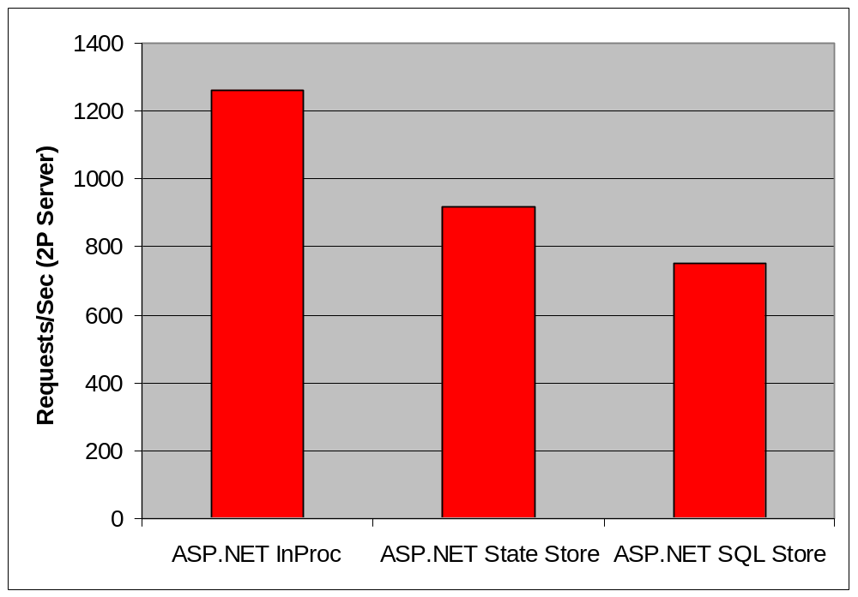
Session State Performance

Slide 41
Agenda
Handling a request
  IIS5 and IIS6.0
  Threads and ThreadPools
Page and service processing
  Compilation
  Handlers and Modules
Performance
  Caching
  Server GC
  Session State
Configuration

Slide 42
Configuration
Stored in XML file in directory with pages
  web.config
Contains all ASP.NET settings
  Authentication, compile options,
  custom error pages, etc.
Allows adding Application settings
  DSN, etc.
Extensible
  Can extend with custom application configuration data
Hierarchical and starts with machine.config

Slide 43
<configuration> <S.W.> #1
</S.W.> </configuration>
Section | Description
<appSettings> | Configures custom settings for an application. The settings in this section can be compared to application variables.
<authentication> | Configures the authentication mode to determine which type of authentication to use.
<authorization> | Configures authorization support and controls client access to URL resources.
<browserCaps> | Configures the settings of the browser capabilities component.
<compilation> | Configures all the compilation settings that ASP.NET uses.
<customErrors> | Provides information about custom error messages for an ASP.NET application.
<globalization> | Configures the globalization settings for the application.
<httpHandlers> | Maps incoming URL requests to the IHttpHandler classes.
<httpModules> | Adds, removes, or clears HTTP modules within an application.
<httpRuntime> | Configures ASP.NET HTTP run-time settings.

Slide 44
<configuration> <S.W.> #2
</S.W.> </configuration>
Section | Description
<identity> | Controls the application identity of the Web application.
<machineKey> | Configures keys to use for encryption and decryption of Forms authentication cookie data. This section allows you to configure a validation key that performs message authentication checks on view state data and forms authentication tickets.
<pages> | Identifies page-specific configuration settings.
<processModel> | Configures the ASP.NET process model settings on IIS Web server systems. Note that you can only use this tag in the Machine.config file.
<securityPolicy> | Defines valid mappings of named security levels to policy files.
<sessionState> | Configures the session state module.
<trace> | Configures the ASP.NET trace service.
<trust> | Configures the set of code access security permissions that is used to run a particular application.
<webServices> | Controls the settings of ASP.NET Web Services.

Slide 45
<processModel/> in machine.config
<processModel enable="true"
timeout="Infinite" idleTimeout="Infinite" shutdownTimeout="0:00:05" requestLimit="Infinite" requestQueueLimit="5000" restartQueueLimit="10" memoryLimit="60" webGarden="false" cpuMask="0xffffffff"
userName="machine" password="AutoGenerate"
logLevel="Errors" clientConnectedCheck="0:00:05"
comAuthenticationLevel="Connect" comImpersonationLevel="Impersonate"
responseDeadlockInterval="00:03:00"
maxWorkerThreads="20" maxIoThreads="20"/>

Slide 46
Misc Perf Config Gotchas
Make sure debug is turned off
  Web.config : <compilation debug=“false”/>
  VS.NET leaves in debug by default
Make sure tracing is turned off
  Web.config and page directive
IIS 6.0 Process Model Restarts
  Default restart is every 29 hours – turn off
IIS 6.0 Maximum Used Memory
  Set to 60% of physical memory (keep < 800mb)
  Important to set if output cache used aggressively

Slide 47
Key Performance Counters
Processor, CPU % Utilization
  Low numbers = blocking or lock contention
ASP.NET, Requests Queued
  Linear growth here indicates server maxed
ASP.NET Applications, Requests/Sec
  Dynamic throughput (should be consistent)
ASP.NET Application, Errors Total
  Indicates functional problems (should be 0)
ASP.NET App/Worker Process Restarts
  Indicates serious functional problems

Slide 48
Summary
ASP.NET Architecture provides a flexible, extensible and configurable Dynamic Web Application Server
ASP.NET runs best on Windows Server 2003
  Scalability: Shared session, output Caching, Thread pooling, HTTP.SYS
  Reliability: Process recycling, managed code
  Secure: configurable trust, IIS Authentication
  Flexibility: Dynamic compilation and configuration

Slide 49


© 2004 Microsoft Corporation. All rights reserved.
This presentation is for informational purposes only. Microsoft makes no warranties, express or implied, in this summary.

